Slide 1
Assessment of droughts at different study sites of grasslands in Germany in 2018.
Franziska Frankenfeld, Andre Fischer,
Jakub Dvorak, Lara Deppermann
EO 2022 – Earth Observation Symposium

Slide 2
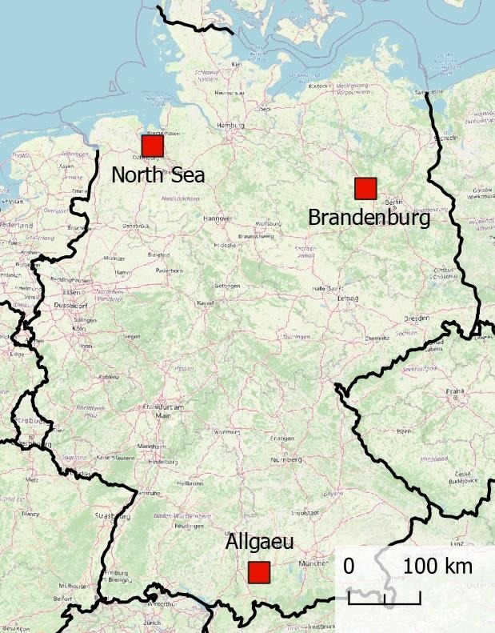
Aim
Study Sites
Assess whether climatic conditions and different landscape types in Germany have an impact on how severely grasslands in these locations were affected by the drought event in 2018
Do different management practices influence the severity of upcoming drought events or is it predominantly influenced by environmental conditions ?

Slide 3
Research Questions & Methodology
How were the grasslands in the 3 different study sites affected by drought events in the year 2018?
approach from Kowalski et al. and derive Normalized Difference Fraction Index (NDFI) time series contrasting NPV and soil cover relative to PV for each study site (training data, model, apply model, validation)
How do environmental variables affect drought severity across the three different study sites? (management, soil type, …)
general linear model ?
group results from part 1 by study site, soil type and management and calculate mean NDFI and compare (descriptive) + visual comparison (map)

Slide 4
Data used
Sentinel-2 surface reflectance time series from 2018
Pure endmember spectra of
PV (green, photosynthetically active grass cover)
NPV (standing dead vegetation and litter)
soil types (26 soil types overall)
Reference pixel-level fractional cover from 2018
Auxiliary data for assessment of underlying drivers:
soil type map (BUEK200)
soil moisture index (SMI)
topographic wetness index based on 30m DEM
number of annual mowing events

