Slide 1


CitiusTech has prepared the content contained in this document based on information and knowledge that it reasonably believes to be reliable. Any recipient may rely on the contents of this document at its own risk and CitiusTech shall not be responsible for any error and/or omission in the preparation of this document. The use of any third party reference should not be regarded as an indication of an endorsement, an affiliation or the existence of any other kind of relationship between CitiusTech and such third party

Slide 2
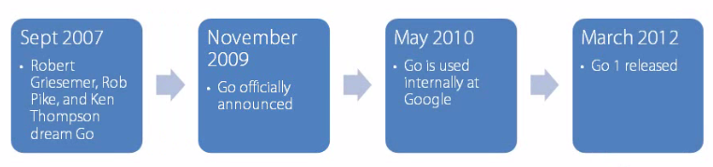
Introduction
Go (often referred to as golang) is an open source programming language created at Google in 2007 by Robert Griesemer, Rob Pike, and Ken Thompson.
It is a compiled, statically typed language with garbage collection, memory safety features and concurrent programming features .
The language was announced in November 2009; it is used in some of Google's production systems.
Was started to create a language that address many challenges that google was facing with their existing system languages, in a single language.
Notes:
1) Go was born out of frustration with existing languages and environments for systems programming.
2) Programming language available for system programming were not able to fully utilize the power of Morden hardware's and smart network infrastructure
3) Go proposes an approach for the construction of system software on multicore machines with in-built support for concurrent execution ,garbage-collection and fast compilation.

Slide 3
Introduction…
Go is a general-purpose language designed with systems programming in mind.
Compilation time is fast.
In Built concurrency support: light-weight processes (via go routines) channels, select statement.
Conciseness, Simplicity, and Safety
Support for Interfaces and Type embedding.
Garbage Collected.
Features excluded intentionally :
No support for type inheritance.
No support for method or operator overloading.
No support for circular dependencies among packages.
No support for pointer arithmetic
No support for assertions
No support for generic programming

Slide 4
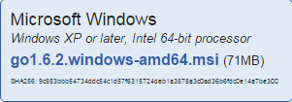
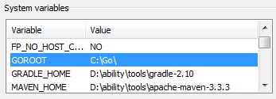
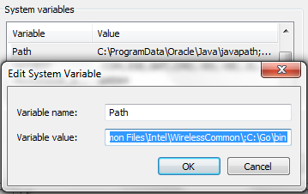

SetUp
Download :
https://golang.org/dl/“
Run the installer and walk through the steps.
After finishing the installation a folder named “go” inside c directory will be created.
It automatically add some system environment variable.
Verifying Go :

Slide 5
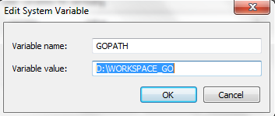
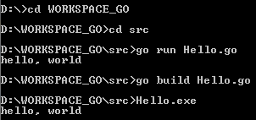
Creating workspace(go convention)
Step1 : Create a folder for workspace(Eg: D:\WORKSPACE_GO)
Step 2: Create a “src” ,’’pkg’’ and “bin” folder under workspace
Step 3 : Set the path of workspace as “GOPATH”
Notes:
For enabling autocomplete in eclipse first install git and set the path till bin if c:\Programe File\git\bin
Then
Windows –>preference ->go->tools->download for gocode.exe
Once gocode.exe is downloaded provide the path in eclipse go-tools

Slide 6
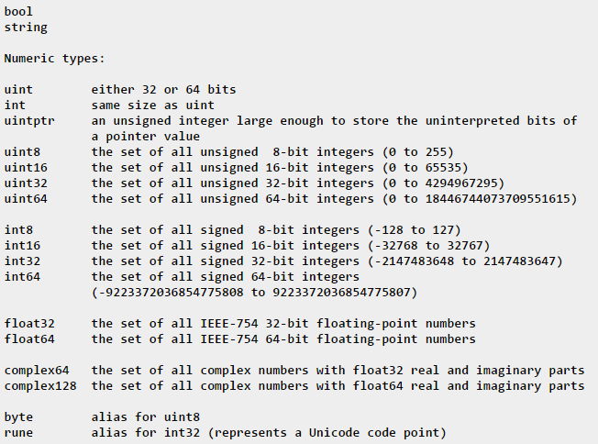
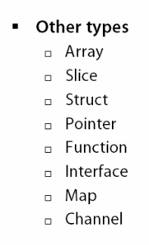
Types

Slide 7


Variable
Syntax:
Here, data_type is a valid Go data type including byte, int, float32
Variables can be initialize with their declaration.
We can skip the type . The type of variable is automatically judged by the compiler based on the value passed to it.
The := syntax is shorthand for declaring and initializing a variable

Slide 8
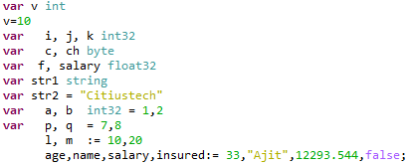
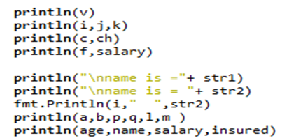
Example :

Slide 9
Exported names
In Go, a name is exported if it begins with a capital letter. For example, Pizza is an exported name, as is Pi, which is exported from the math package.
pizza and pi do not start with a capital letter, so they are not exported.
When importing a package, you can refer only to its exported names. Any "unexported" names are not accessible from outside the package.
package main
import (
"fmt"
"math"
)
func main() {
fmt.Println(math.pi)
}

Slide 10
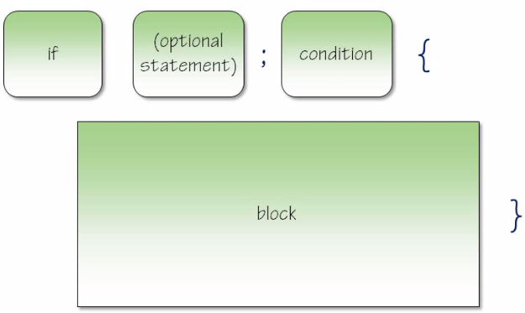
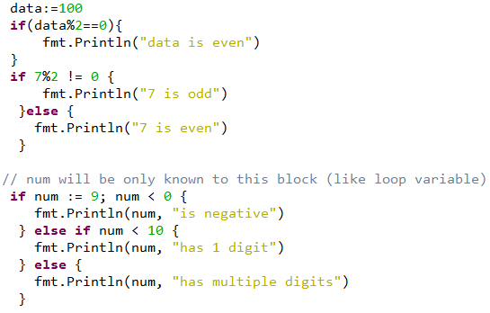
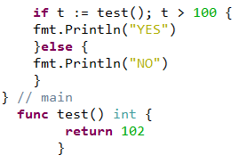
IF - ELSE

Slide 11
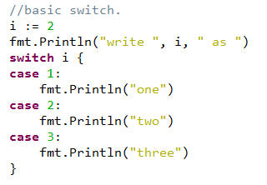
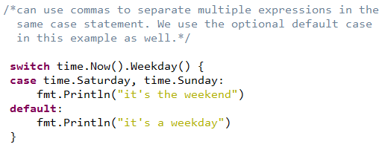
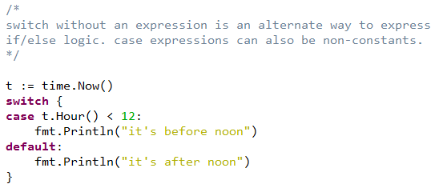
Switch case

Slide 12
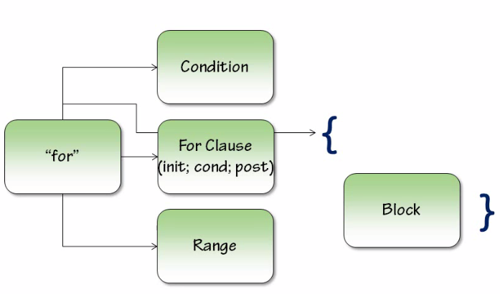
Loops
‘for’ is Go’s only looping construct.

Slide 13
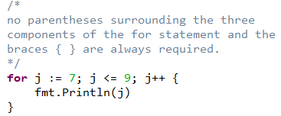
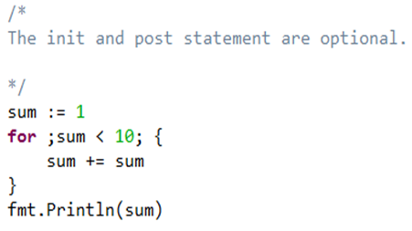
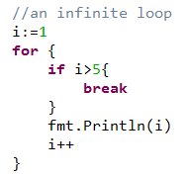
for

Slide 14
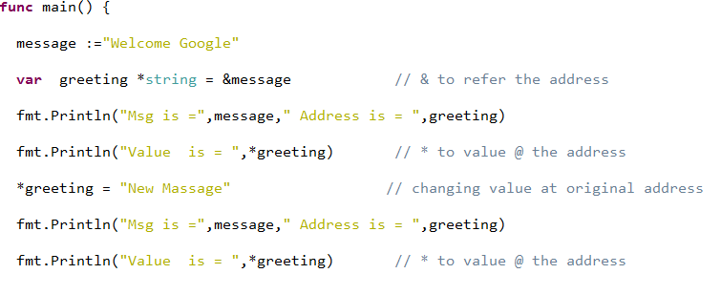

Pointers:
Pointer is a type that can hold the address of another variable.

Slide 15



User Type:
Go’s structs are typed collections of fields. They’re useful for grouping data together to form records.
Initialization & accessing (access struct fields with a dot.)
An & prefix yields a pointer to the struct.

Slide 16
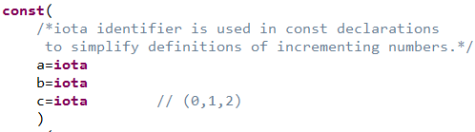
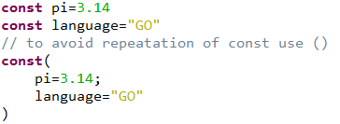
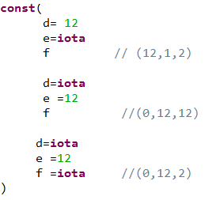
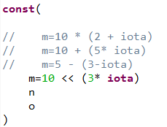
Constant

Slide 17
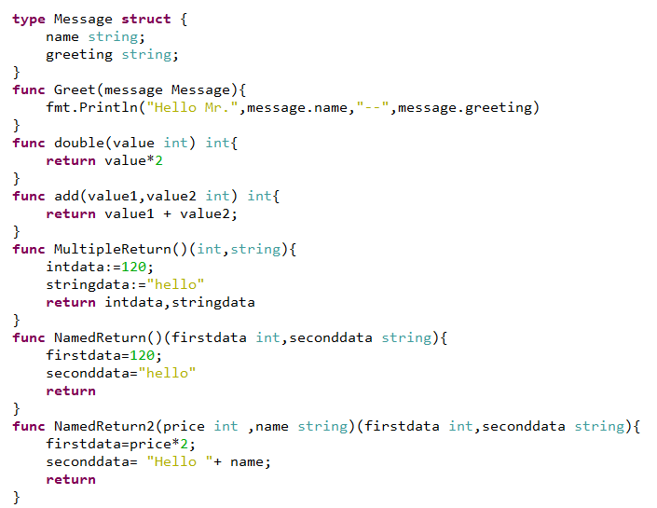
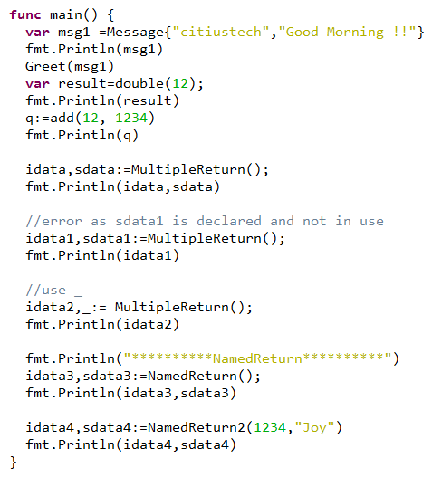
Function
Go has built-in support for multiple return values.

Slide 18
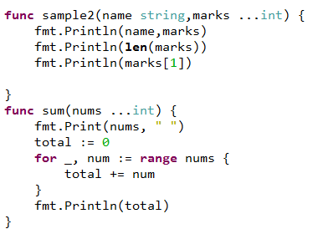
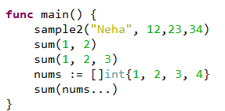
Variadic Functions
Variadic functions can be called with any number of trailing arguments. For example, fmt.Println is a common variadic function.

Slide 19
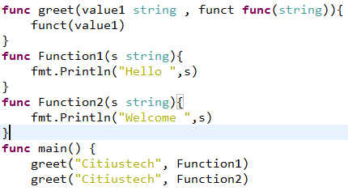
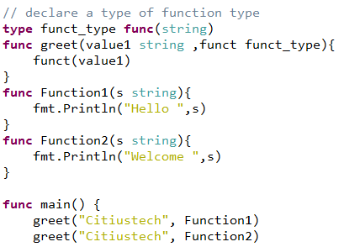
Function Types
All functions in go are types.
We can pass a function to a function as a type.

Slide 20
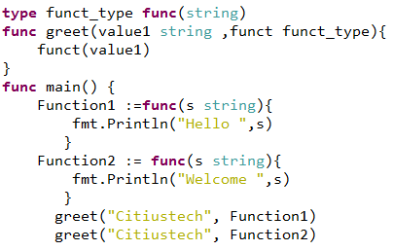
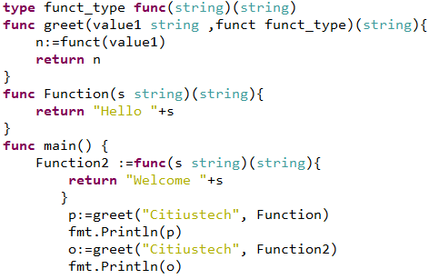
Function Types…
A variable of function type with a anonymous function

Slide 21
Define methods on types.
Go does not have classes.
We can define function with a special receiver argument.
The receiver appears in its own argument list between the func keyword and the method name.
In below example, the Abs method has a receiver of type Vertex named v.
You can declare methods with pointer receivers. Methods with pointer receivers can modify the value to which the receiver points
methods without pointer receivers(getting a copy of type(Vertex))
type Vertex struct {
X, Y float64
}
func (v Vertex) Abs() float64 {
return math.Sqrt(v.X + v.Y)
}
func main() {
v := Vertex{3, 4}
fmt.Println(v.Abs())
}
type Vertex struct {
X, Y float64
}
func (v *Vertex) Abs() float64 {
return math.Sqrt(v.X + v.Y)
}
func main() {
v := Vertex{3, 4}
fmt.Println(v.Abs())
}

Slide 22
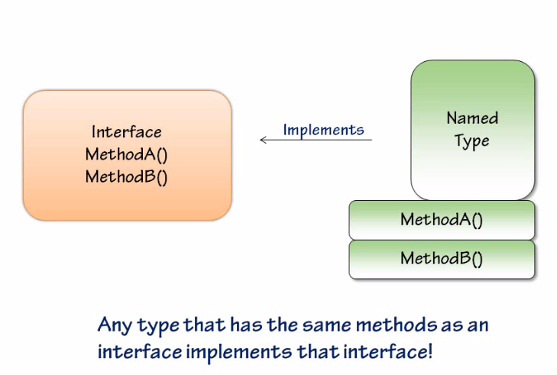
Interfaces
Interfaces are named collections of method signatures
A value of interface type can hold any value that implements those methods.

Slide 23
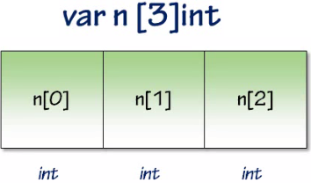
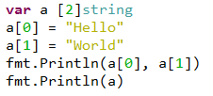

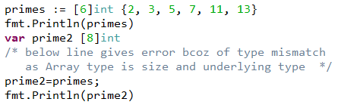
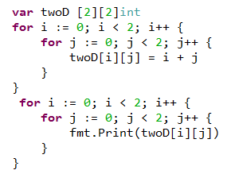
Arrays
An array is a numbered sequence of elements of a specific length.
The built in ‘len’ returns the length of an array.
Array type is size and underlying type.

Slide 24
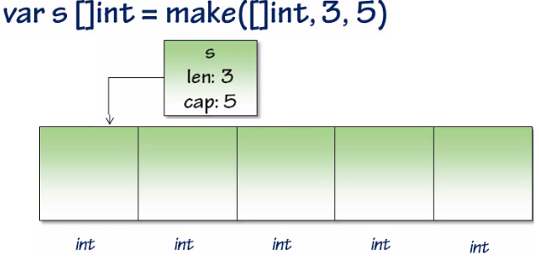
slices
The slice type is an abstraction built on top of Go's array type.
Unlike arrays, slices are typed only by the elements they contain (not the number of elements).
Size of array is fix and different arrays of different size are different types and it can be a problem when if we want to use an array as parameter in function.
To create an empty slice with non-zero length, use the built-in ‘make’’.
Size of slice is also fixed but can be reallocate with append.
Points to an array.
Arrays are value type and slices are reference type.

Slide 25


A slice can be created with the built-in function called make.
Syntax: func make([]T, length, optional_capacity)
When the capacity argument is omitted, it defaults to the specified length.
When called, make allocates an array and returns a slice that refers to that array.
A slice literal is declared just like an array literal, except you leave out the element count:
A slice can also be formed by "slicing" an existing slice or array.

Slide 26

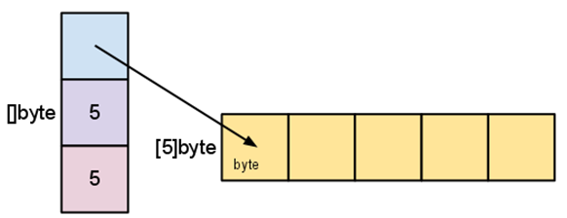
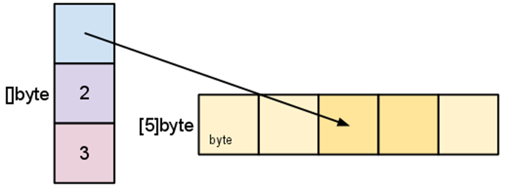
Slice internals
A slice is a descriptor of an array segment. It consists of a pointer to the array, the length of the segment, and its capacity (the maximum length of the segment).
variable s, created
s := make([]byte, 5) is structured like this
When we slice s, observe the changes in the slice data structure and their relation to the underlying array:
s = s[2:4]
NOTE :
Slicing does not copy the slice's data. It creates a new slice value that points to the original array

Slide 27



Growing slices (the copy and append functions)
We create a slice of three elements. Its cap is 3. We then add a fourth element, its capacity doubles to 6.

Slide 28
Maps
Maps are Go’s built-in associative data type
To create an empty map Syntax : make(map[key-type]val-type).
Set key/value pairs using typical name[key] = val syntax
Key have to have equality operator defined
Maps are reference type

Slide 29

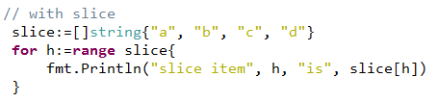




Ranges
range iterates over elements in a variety of data structures.

Slide 30

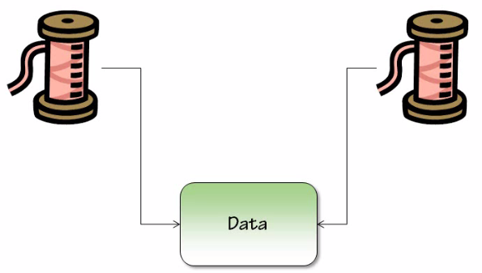

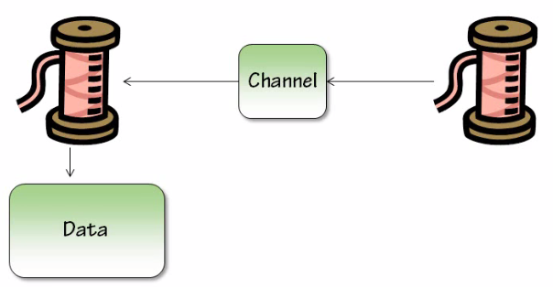
Concurrency
Go comes with built in concurrency into language itself.(not with additional library )
Multiple thread can access the same data.
Traditionally by using lock we can synchronise the access of data.
In Go, instead of sharing data its share communication channel
Channels are the pipes that connect concurrent goroutines

Slide 31
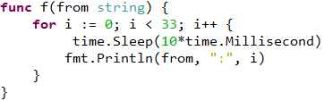

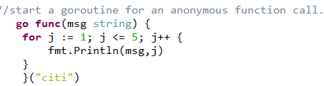
Goroutines
A goroutine is a lightweight thread of execution.
Manage by Go runtime.
Just use the keyword “go” with a function call.
Goroutine will execute concurrently with the calling one
Goroutines allow you to run a piece of code in parallel to others. But to employ it usefully, there are a few additional requirements - we should be able to pass data into the running process and we should be able to get data out of the running process when it is done creating it. Channels provide the way to do that, and they work alongside goroutines.

Slide 32


Channel
Channels are the pipes that connect concurrent goroutines.
We can send values into channels from one goroutine and receive those values into another goroutine.
Can create a new channel with make(chan val-type). Channels are typed by the values they convey.
Can Send a value into a channel using the channel <- syntax. Here we send "ping" to the messages channel we made above, from a new goroutine
The <-channel syntax receives a value from the channel. Here we’ll receive the "ping" message we sent above from a new goroutine.
(The data flows in the direction of the arrow.)
By default, sends and receives block until the other side is ready. This allows goroutines to synchronize without explicit locks or condition variables.
Notes:
Range and Close
A sender can close a channel to indicate that no more values will be sent. Receivers can test whether a channel has been closed by assigning a second parameter to the receive expression: after
v, ok := <-ch ok is false if there are no more values to receive and the channel is closed.
The loop for i := range c receives values from the channel repeatedly until it is closed.
Note: Only the sender should close a channel, never the receiver. Sending on a closed channel will cause a panic.
Another note: Channels aren't like files; you don't usually need to close them. Closing is only necessary when the receiver must be told there are no more values coming, such as to terminate a range loop.

Slide 33
Select
Like a switch but on communications.
The select keyword when used in conjunction with many channels works like a are-you-ready polling mechanism across different channels.
The case blocks within it can be for sending or receiving
Rules :
check each of the case blocks
if any one of them is sending or receiving, execute the code block corresponding to it
if more than one is sending or receiving, randomly pick any of them and execute its code block
if none of them are ready, wait
if there is a default block, and none of the other case blocks are ready, then execute the default block
Notes:
http://golangtutorials.blogspot.in/2011/06/channels-in-go-range-and-select.html

Slide 34
web
Processing HTTP requests with Go is primarily about two things:
ServeMuxes
A ServerMux is essentially a HTTP request router (or multiplexor).
It compares incoming requests against a list of predefined URL paths, and calls the associated handler for the path whenever a match is found.
Handlers
Handlers are responsible for writing response headers and bodies.
Almost any object can be a handler, so long as it satisfies the http.Handler interface .
Simply means it must have a ServeHTTP method with the following signature: ServeHTTP( http.ResponseWriter, *http.Request)

Slide 35
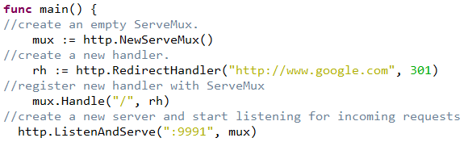
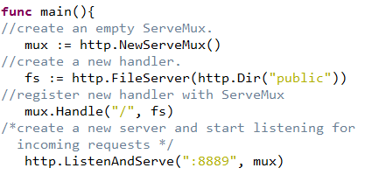
We can think of a ServeMux as just being a special kind of handler, which instead of providing a response itself passes the request on to a second handler
Go's HTTP package ships with a few functions to generate common handlers, such FileServer, NotFoundHandler and RedirectHandler.
Notes:
// fs := http.FileServer(http.Dir("public"))
// http.Handle("/static/", http.StripPrefix("/static/", fs))
// http.ListenAndServe(":8001", nil)

Slide 36
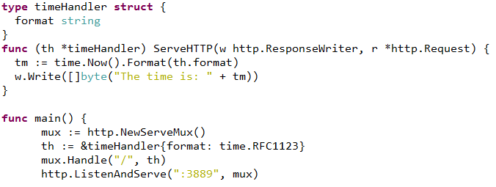
Custom Handlers
To make a handler and we've to implement a method with the signature
ServeHTTP(http.ResponseWriter, *http.Request) on any type

Slide 37
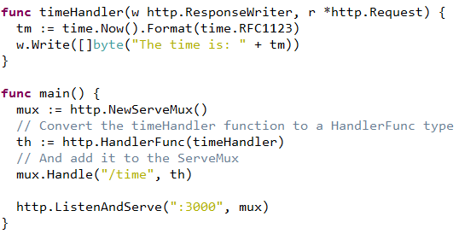
Functions as Handlers
Any function which has the signature func(http.ResponseWriter, *http.Request) can be converted into a HandlerFunc type.
The HandlerFunc type is an adapter to allow the use of ordinary functions as HTTP handlers.
If f is a function with the appropriate signature, HandlerFunc(f) is a Handler that calls f.

Slide 38

Database with GO
sql.DB is use to access database in go. You use this type to create statements and transactions, execute queries, and fetch results.
sql.DB opens and closes connections to the actual underlying database, via the driver.
To use database/sql you’ll need the package itself, as well as a driver for the specific database you want to use.

Slide 39
Retrieving Result Sets
There are several idiomatic operations to retrieve results from the datastore.
Execute a query that returns rows.
Prepare a statement for repeated use, execute it multiple times, and destroy it.
Execute a query that returns a single row. There is a shortcut for this special case.

