Slide 1
SECURE DATA HIDING IN IMAGE USING STEGANOGRAPHY
CAPSTONE PROJECT
Presented By: Edunet IBM Skill Build (AICTE)
Student Name : Yesaswi Madabattula
College Name & Department : MVGR College (CSM)

Slide 2
OUTLINE
Problem Statement
Technology used
Wow factor
End users
Result
Conclusion
Git-hub Link
Future scope

Slide 3
PROBLEM STATEMENT
With the rise of cyber threats, securing sensitive information is crucial. Traditional encryption methods can attract attackers' attention. Steganography offers a way to conceal data within images, making it nearly undetectable. This project implements secure data hiding techniques to enhance information security.

Slide 4
TECHNOLOGY USED
Programming Language: Python
Libraries: OpenCV, NumPy, PIL (Pillow)
Concepts: LSB (Least Significant Bit) Steganography

Slide 5
WOW FACTORS
Invisible data hiding without altering the image quality significantly.
Efficient extraction of hidden data using minimal computational resources.
Enhanced security by applying additional encryption techniques before hiding data.

Slide 6
END USERS
Government agencies for secure communication.
Journalists and whistleblowers for confidential information transfer.
Corporate sectors for data protection

Slide 7
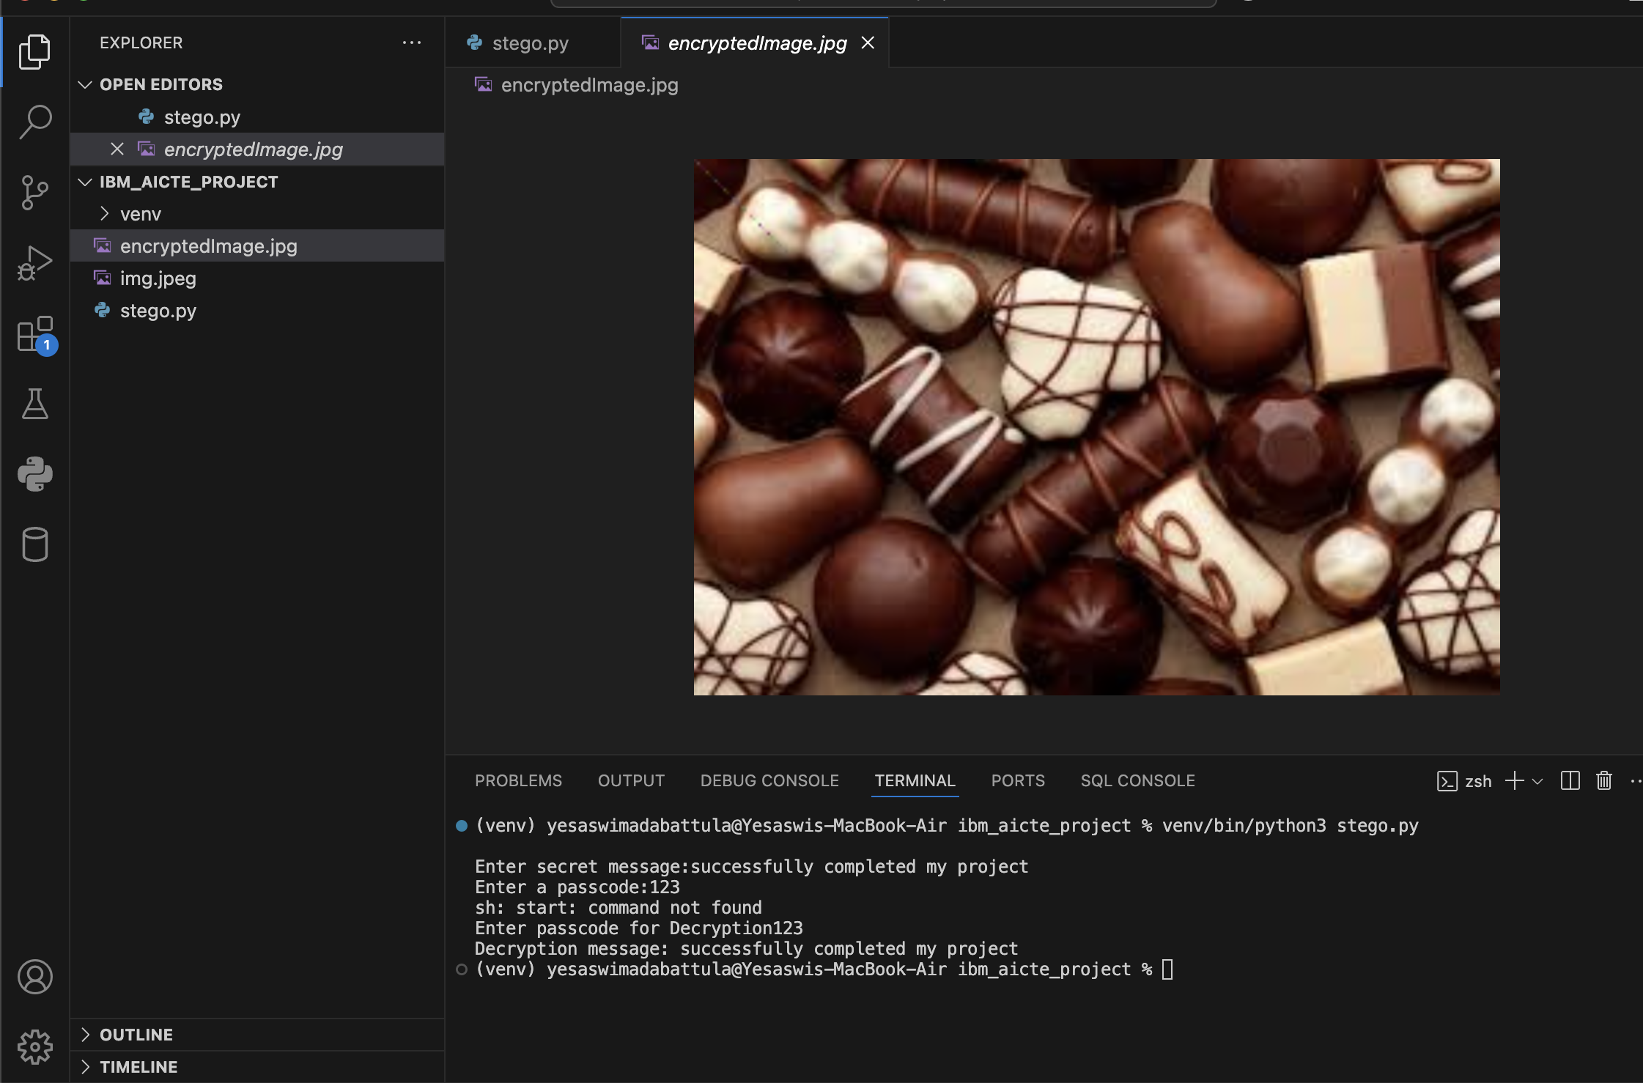
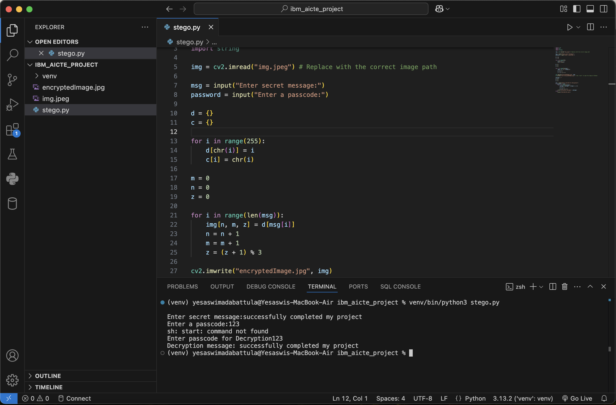
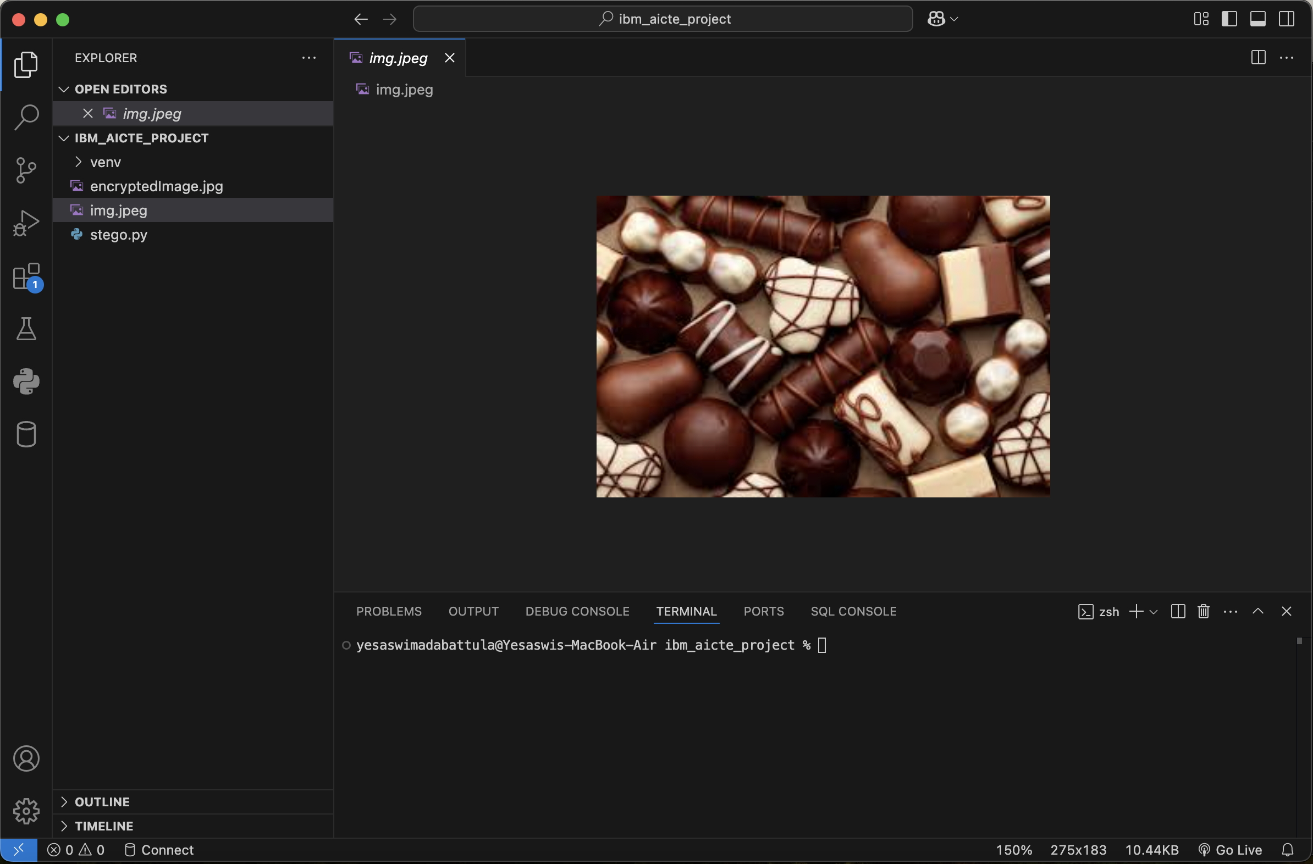
RESULTS

Slide 8
CONCLUSION
This project successfully demonstrates the application of steganography for secure data transmission. By embedding sensitive information into images, it provides an additional security layer without raising suspicion.

Slide 9
GITHUB LINK
https://github.com/Yesaswi33/IBM_AICTE_CS_Project.git

Slide 10
FUTURE SCOPE(OPTIONAL)
Implementing AI-driven steganography for dynamic data embedding.
Extending to video steganography for larger data concealment.
Enhancing security with advanced cryptographic techniques before hiding data.

Slide 11
THANK YOU

