Slide 1

Index Contract
YESBIT
Presentation by Blues Qin
Notes:
交易量才是最终要的指标，具体怎么实现交易并不重要，要考虑如何设计优厚的规则去鼓励大家进行交易

Slide 2
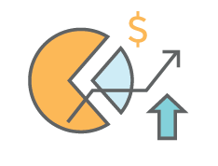
What is YESBIT
29
Contract
Stock Index
Commodity Future
NASDAQ, S&P500, Dow Jones 30 DAX (German 30) Stock market indeces
Apple, Alibaba stock contract
Gold, Silver and metal futures
Oil, Gas and energy futures
Soybean, corn and foodstuff future
Contract
Users can use their cryptocurrency to
purchase financial contract
buy long or sell short index, future, foreign exchange
Invest cryptocurrency contract.
Foreign exchange
Cryptocurrency
USD/JPY, USD/CAD, EUR/HKD
Other foreign exchange
BTC/USD, ETH/USD
BTC/ETH, EOS/ETH
Other Altcoin price contract
Notes:
手里的比特币买了就闲置了

Slide 3
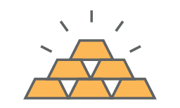
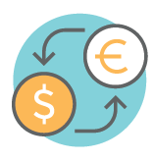


Invest with your Crypto investment.
No Fiat Currency
Gold Contract
Julia bought long the gold contract for 1BTC, because she thought gold was underestimated.
Crypto Coin Only
No Fiat Currency
Gold fell by 20%
Julia lost 0.2BTC，her balance would be 0.8BTC
Foreign Exchange
Jack put a contract for USD/JPY with 100 ETH and a leverage of 2 with long position.
He thought US will cut interest rates
USD/JPY fell by 1%
Jack earned 2ETH, because he used leverage of 2.
NASDAQ Index Contract
Sam paid 10BTC for NASDAQ Contract with long position, as he wanted to share bonus on both US stock and BTC
NASDAQ went up by 5%
Sam got 0.5 BTC
Apple Future Contract
Lin is an Android fan, he used 100 ETH to short Apple Stock contract.
Apple went up by 3%
I lost 3 ETH
Notes:
不用担心踏空币市行情

Slide 4
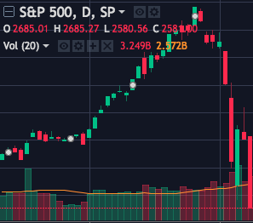
Market Maker
Yesbit Index Contract
Long position user A
has successfully gained a new contract via Yesbit
2,695
Long position user B
Waiting to match
2,690
S&P500
Market Price
2,695
2,695
Yesbit partner, Market Maker.
Waiting to match
Long position user C
Waiting to match
2,590
Our partner, Market maker can list its Contract on the platform. Market maker will take the risk from the users’ profit and lost.
Notes:
人数比较少的时候

Slide 5
Bid/Ask Match
Yesbit Index Contract
Long position user A
have successfully gained new contract via Yesbit
2,695
2,700
Short position user D
Waiting to match
Long position user B
Waiting to match
2,690
2,699
Short position user E
Waiting to match
S&P 500
Market Price
2,685
Long position user C
Waiting to match
2,680
2,695
Short position user F
has successfully gained new contract via Yesbit
Match engine can match each long/short order with the same bid/ask price. Once the contract is closed, the profit/lost are between long and short position users.

Slide 6
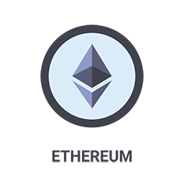

Decentralized Platform
08
Fully control your asset
Long position deposit
Smartcontract
Short position deposit
All the information are in the blockchain. No one can change the record.

Slide 7
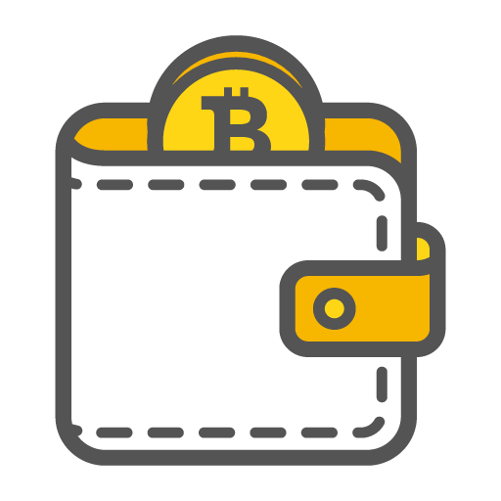


Crypto Wallet System
Safe
Multi-Signature Wallet
Keep your coin safty

Slide 8
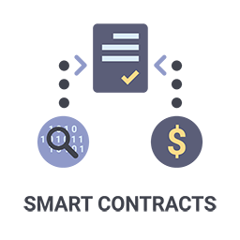
YIC Token
Yesbit Index Contract
YIC Token on Ethereum public chain, total volume is 200 million.
Fund Raising
80 million YIC token
Derivatives Foundation
40 million YIC token
40%
20%
YIC Token
Community Contributors
20 million YIC token
30%
Team
60 million YIC token
10%
Notes:
How

