Slide 1

SENTIMENTAL analysis of MULTILINGUAL DRAVIDIAN LANGUAGES
I. B. S. S. Narayana
A. S. V. Amar Vara Prasad
B. Sohil Goud
Yesha Shah
16H51A0581
16H51A05C2
16H51A05C6
16H51A05Q0
Guide- Dr. Madhavi Latha

Slide 2
Introduction
identify the orientation of opinion in a piece of text.
been carried out in English only.
Social media is a popular platform for sharing of opinions
Performing analysis on languages such as Hindi and Telugu

Slide 3
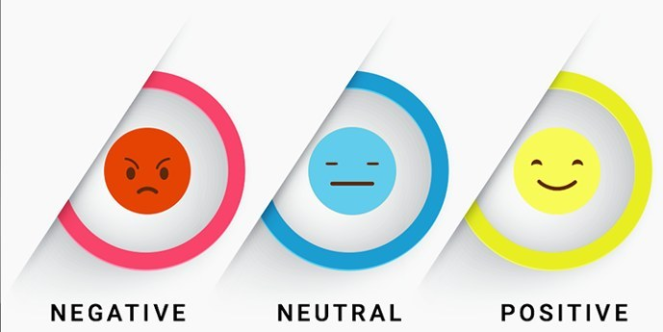
Why sentimental analysis?
Nearly 80% of the world’s digital data is unstructured
difficult to sort and analyze
sort large sets of tweets and detect the polarity of each statement automatically

Slide 4
Advantages of Sentimental Analysis
Revising marketing strategy
Measuring ROI of marketing campaigns
Improve the quality of your products
Give better customer service
Better crisis management
Boost sales revenue
Tracking overall customer satisfaction
Consistent and accurate results
Get valuable insights

Slide 5
Proposed system
Let user enter a query
Fetch related tweets
Tokenize and apply POS tagging
Classify using Naïve Bayes’ Classifier – Original language dataset
Translate words missing in dataset
Classify using English word polarity
Add translated word to respective dataset

Slide 6
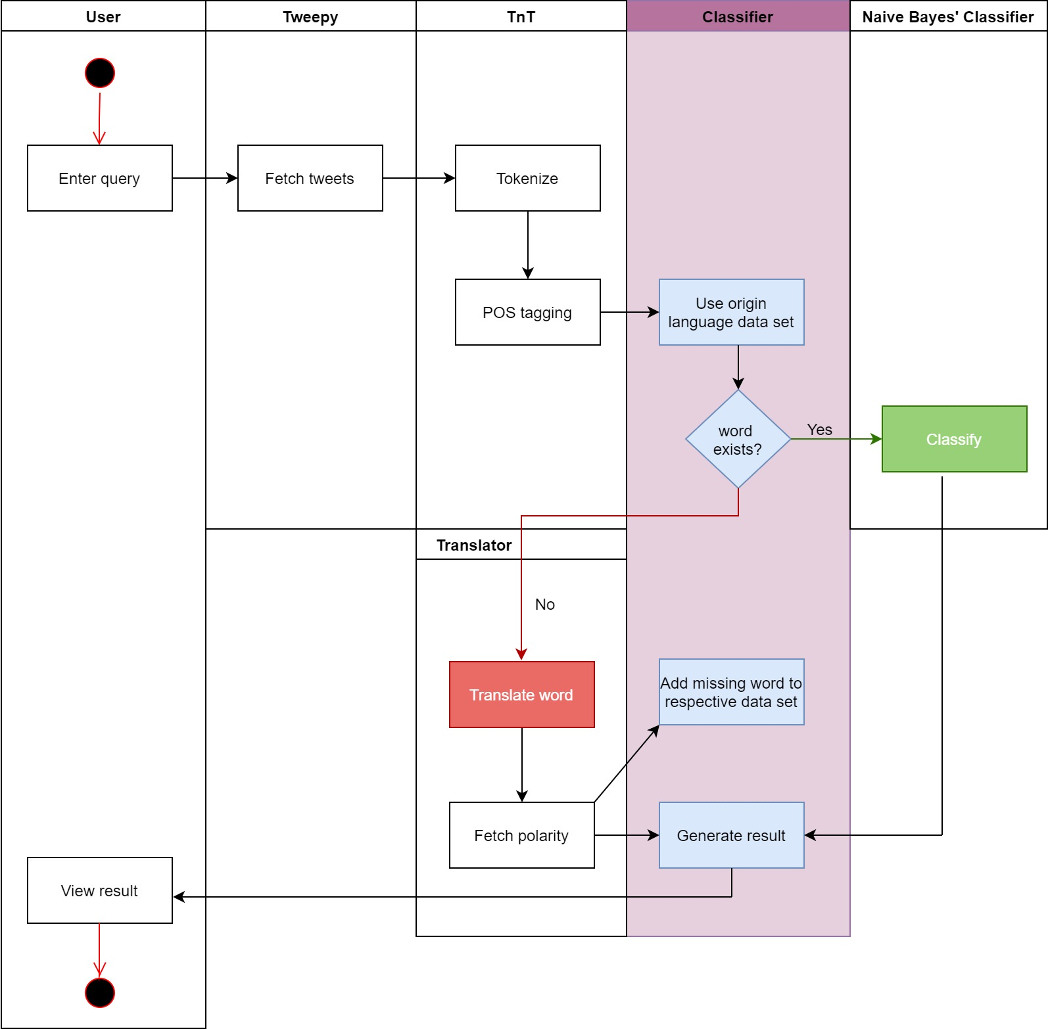

Slide 7
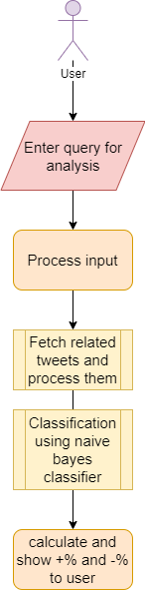
How? Twitter Sentimental Analysis
Data gathering- gathering tweets
Data preparing- preprocessing and cleaning tweets
sentiment analysis model- Naïve Bayes classifier
Results -formatting and showing the result

Slide 8
Data gathering
Three possibilities-
For non-developers (zapier, IFTTT, etc)
For developers (twitter API, powerTrack API, etc)
Open source libraries (Tweepy, python-twitter, etc)

Slide 9

Tweepy
easy-to-use library for accessing the Twitter API
interaction with Twitter’s API using Python
Existing and growing over 8 years
Searching over vast parameters

Slide 10
Data processing
Using various data manipulation techniques to convert data from tweet into clean text format
Example-
Neha Dubey‏ @nehadubey414 4 hours ago
पत्ते सूख गए थे उस पेड़ के लेकिन ... छाँव वो वही पहले जैसी दे रहा था ...#mbaria
पत्ते सूख गए थे उस पेड़ के लेकिन छाँव वो वही पहले जैसी दे रहा था
mbaria

Slide 11
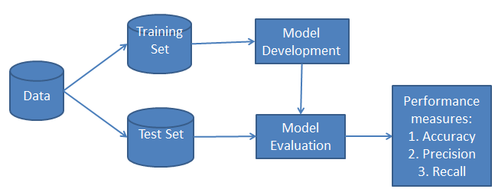
Analysis- Naïve bayes classifier

Slide 12
What is Naïve Bayes?
Classification Algorithm
Works on bag of words – positive and negative dataset
Probabilistic Classifier
Requires small training set
Computationally fast
Scales linearly with training examples

Slide 13
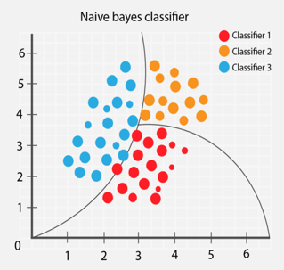
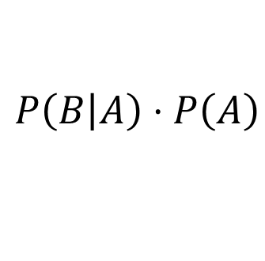
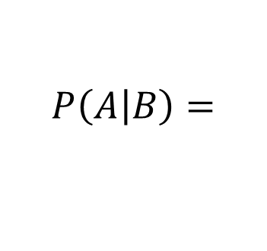

Naïve Bayes Algorithm
Family of simple probabilistic classifiers
Based on Bayes’ theorem
Strong independence assumptions between features
$$P\left(\left.B\right|A\right)⋅P\left(A\right)$$
prior x likelihood
$$P\left(\left.A\right|B\right)=$$
Posterior =
$$P\left(B\right)$$
evidence

Slide 14
Tokenization
splitting up a larger body of text into smaller lines, words or even creating words for a non-English language.
isolates word like units from a text.
Building blocks of other text processing
Python’s NLTK library features a robust sentence tokenizer and POS tagger.

Slide 15
For example, the text
“నరేంద్రమోదీ ప్రసంగం ఎంత జనరంజకంగా ఉందంటే, ఆయన ఈ దేశానికి దాదాపు రెండేళ్ళుగా ప్రధానిగా కొనసాగుతున్న వ్యక్తి అని ప్రజలూ, పార్లమెంటు సభ్యులూ మరచిపోయేట్టు చేసింది.“
Will be tokenized as
['నరేంద్రమోదీ', 'ప్రసంగం', 'ఎంత', 'జనరంజకంగా', 'ఉందంటే', ',', 'ఆయన', 'ఈ', 'దేశానికి', 'దాదాపు', 'రెండేళ్ళుగా', 'ప్రధానిగా', 'కొనసాగుతున్న', 'వ్యక్తి', 'అని', 'ప్రజలూ', ',', 'పార్లమెంటు', 'సభ్యులూ', 'మరచిపోయేట్టు', 'చేసింది', '.']

Slide 16
POS and TnT Tagging
short form of Trigrams-and-Tags
assigning parts of speech to individual words in a sentence
parts of speech tagging is performed at the token level.
very efficient part-of-speech tagger
can be trained on different languages and on any tag set
It incorporates different methods of smoothing and handling unknown words.

Slide 17
Example code:
from nltk.corpus import Indian from nltk.tag import tnt train_data = indian.tagged_sents('telugu.pos') tnt_pos_tagger = tnt.TnT() tnt_pos_tagger.train(train_data)
POSList = tnt_pos_tagger.tag(nltk.word_tokenize(line))
TnT tagging applied to the given example after training it with a data set.
('నరేంద్రమోదీ', 'Unk’) ('ప్రసంగం', 'Unk’) ('ఎంత', 'QW’) ('జనరంజకంగా', 'Unk’)
('ఉందంటే', 'Unk’) (',', 'SYM’) ('ఆయన', 'PRP’) ('ఈ', 'JJ’) ('దేశానికి', 'NN’) ('దాదాపు', 'Unk’) ('రెండేళ్ళుగా', 'Unk’) ('ప్రధానిగా', 'Unk’) ('కొనసాగుతున్న', 'Unk’) ('వ్యక్తి', 'NN’) ('అని', 'CC')
('ప్రజలూ', 'Unk’) (',', 'SYM’) ('పార్లమెంటు', 'Unk’) ('సభ్యులూ', 'Unk’) ('మరచిపోయేట్టు', 'Unk’) ('చేసింది', 'VFM’) ('.', 'SYM')

Slide 18
Results
From classifier:
To user:
positive- x %
negative- y %
(where x+y = 100)
Enhanced formats-
Bar graph
Pie chart
Other visualization formats
tweet1
tweet2
tweet3
.
.
.
tweet n
positive
negative
negative
.
.
.
positive

Slide 19

Challenges
Free word order
Absence of benchmark
Decrease in accuracy or results
Scarcity of tools and resources
Short informal text
Multilingual subjectivity detection

Slide 20
Social Media Monitoring
Customer Service
Market Research
Brand Monitoring
Political Campaigns
Decision Making
Innovative Product design
Product Analysis
User Modelling
use cases of SA

Slide 21
Conclusion
Sentimental analysis offers a deeper understanding of people’s feelings and opinions. Text analysis with machine learning is simple, fast, and can provide consistent results with a high level of accuracy.
Future enhancements:
User login
Database for storing history
Customization
Caching

Slide 22
THANK YOU
any questions or suggestions?

