Slide 1
Supervised machine learning models for dementia prediction
Manpreet Kaur, Yesha Shah
DSCI-6612: Intro to AI
Spring-21’
Notes:
Hi, this is Manpreet and Yesha!
We are here to present our AI Term project focused on building supervised machine learning models for dementia prediction.

Slide 2
Contents
Motivation & objectives
Data set description
Data preparation
Feature selection
Model complexity comparison
Model evaluation and metrics
Prediction
Links and references
Notes:
This is our Agenda for the presentation followed by a demo of the implementation.

Slide 3
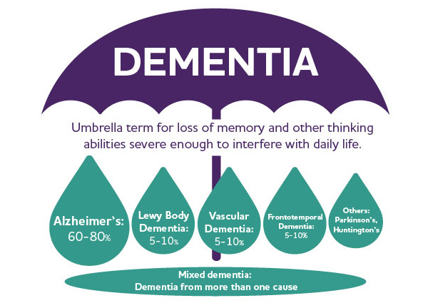
Motivation
Dementia is a collective term associated with cognitive decline or other thinking skills severe enough to reduce a person’s ability to perform everyday activities
World wide - 50 million cases
~10 million new cases / year
Estimations:
2030 - 82 million cases
2050 - 152 million
Early detection is highly important, which is difficult to perform manually on such a large scale. Thus, automated models can truly help boost the process.
Notes:
Speak about dementia
Worldwide, around 50 million people have dementia, with nearly 60% living in low- and middle-income countries.Every year, there are nearly 10 million new cases. The estimated proportion of the general population aged 60 and over with dementia at a given time is between 5-8%. The total number of people with dementia is projected to reach 82 million in 2030 and 152 in 2050.
Hence, early detection is highly important, which is difficult to perform manually on such a large scale. Thus, automated models can truly help boost the process.

Slide 4
Objectives
Creating different supervised machine learning models
Comparison of the above models to find the best among them
Notes:
Our primary objectives with this project were to - Create different supervised machine learning models for dementia classification and to evaluate as well as compare them.

Slide 5
Data set description
Data source : https://www.oasis-brains.org/ Data set : OASIS 2
Longitudinal data
150 subjects spanning 373 records for MRI scans over multiple visits- aged 60 to 96
MRI scans for 2 or more visits - at least one year apart
Subjects - right-handed, gender - M&F
Records classification - 190 nondemented and 146 demented
37 records - converted from nondemented to demented
Notes:
The Open Access Series of Imaging Studies (OASIS) is a project aimed at making neuroimaging data sets of the brain freely available to the scientific community. Talk about data from above.

Slide 6
Data set description
Data set features: ID, Gender, category, #visits, age, Years of Education, Socioeconomic Status(SES), Mini Mental State Examination(MMSE), Clinical Dementia Rating (CDR), Estimated Total Intracranial Volume (eTIV), Normalize Whole Brain Volume (nWBV), Atlas Scaling Factor (ASF)
Features planned to use initially: Age
Gender SES affects the diet and livelihood of subject MMSE 30 point questionnaire used to test subjects CDR 5-point scale to characterize domains of cognitive and functional performance eTIV provides a approximation of maximum morbid brain volume nWBV normalized volume of the entire brain
Notes:
The original data set has 12 columns. Out of these, we initially suspected that 7 of them would be relevant for building the model, while the category/group remains the target.
The 7 features being- bla bla ba

Slide 7
Data preparation
Removing non-essential / redundant features:
Hand all subjects are right handed
MR Delay time taken for the scan
Visit visit number for the patient
Subject ID patient ID - irrelevant
MRI ID scan ID number - irrelevant
Handling null values:
MMSE 2 records: dropped
SES 17 records: replace using mean
Mean - maintains original data distribution
Notes:
First step to build a model was to prepare the data set. To do so, we performed some preprocessing such as

Slide 8
Data preparation
Correcting group label:
Records classified as nondemented at initial visit, converted to demented at a later visit
Modifying ‘converted’ to ‘demented’
Data transformation:
Converting categorical data to numerical data
Modify M/F M - 0 ; F - 1 Add GroupNum Nondemented- 0 ; Demented - 1
Setting column type for above from ‘object’ to ‘int’

Slide 9
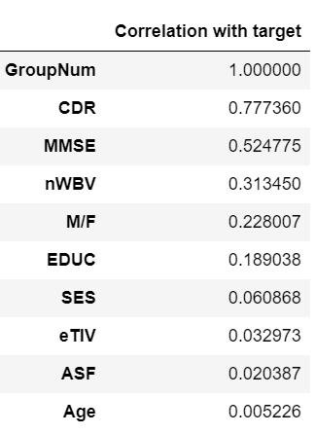
Feature selection
The correlation of various features with the target feature (GroupNum) looks as below:
Decreasing correlation
Notes:
Once the preprocessing was done, we wanted to identify the highly correlated features with respect to the target. Upon calculating the correlation factor, the features from most to least correlated are as shown in the table. These numbers are basically the contribution of each feature towards determining the final target.

Slide 10
Model complexity comparison
Models under consideration:
Logistic Regression
Random Forest
Support Vector Machine
KNeighbors
Decision Tree
XGBoost
Number of features compared:
All
Top 5
Top 4
Top 3
Order of priority:
CDR > MMSE > nWBV > M/F > EDUC > SES > eTIV > ASF > Age
Model comparison using 5-fold cross validation - for a combination of 24 different models
Notes:
Of the many many models available, we chose to go ahead with these 6, namely …
In addition to that, we were curious as to how different features affect the accuracy of the model under consideration. This comparison was done in 4 categories, with all features, top5, top4, and top3 highly correlated features wrt the target.
In short, for 6 models and 4 different feature categories, we ended up comparing 24 models in total. This was done through the process of 5-fold cross validation for each model.

Slide 11
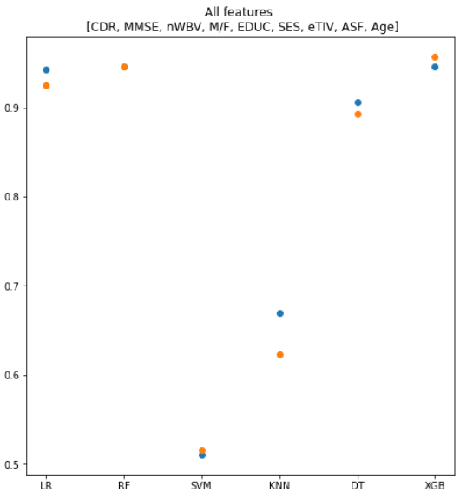
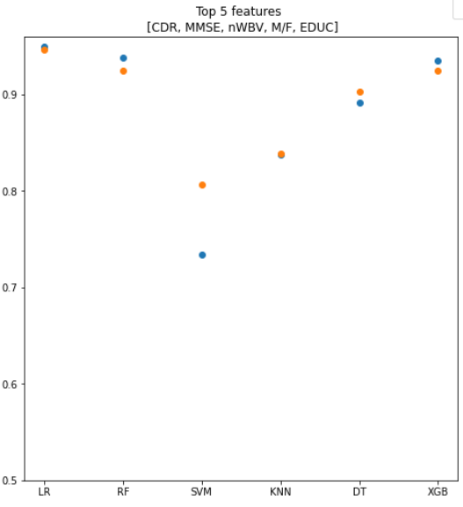
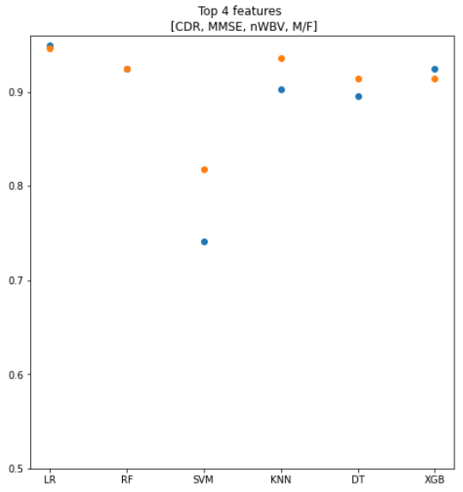
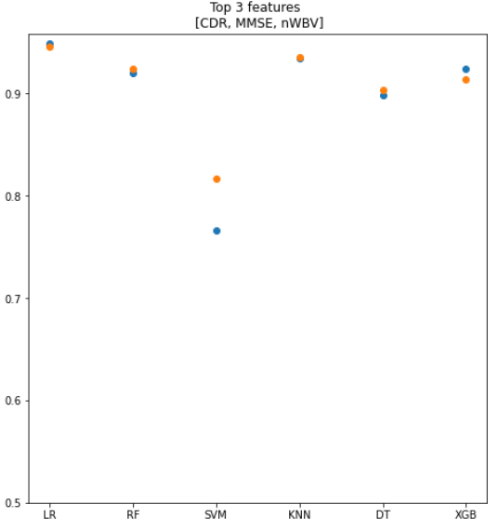

Model selection on most accuracy-
Top 4 features [CDR, MMSE, nWBV, M/F]
LR Logistic Regression RF Random Forest SVM Support Vector Machine KNN K- Nearest Neighbors DT Decision Tree XGB XGBoost
Model accuracy comparison based on number of features
Notes:
From the 5-fold cross validation, we acquire the average accuracy scores of train and test sets for each model, as represented by these plots.
It is noticeable that as the number of features decrease, the accuracy is increasing for all models except for Random Forest and XGB. Additionally, we wanted to make sure that the models weren’t overfitted. Thus, we looked for models with a better test accuracy as compared to its train accuracy.
Comparatively, models constructed using the top 4 features fit the requirements as closely as possible.

Slide 12
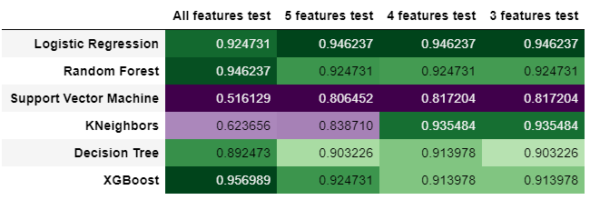
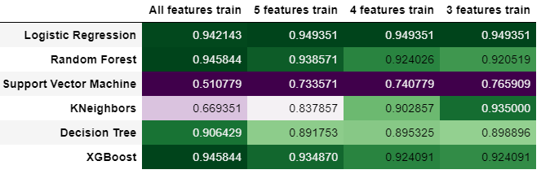
Test accuracy comparison
Train accuracy comparison
Notes:
These are the actual test and train accuracies for the 24 models, which are shown in the plots previously

Slide 13
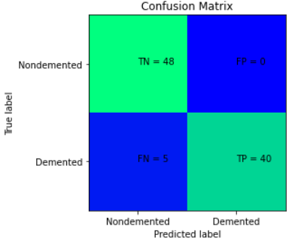
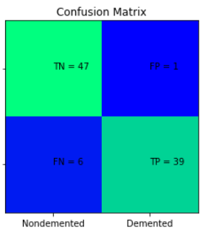
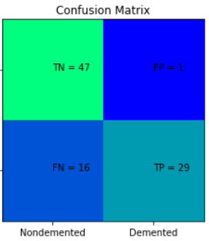
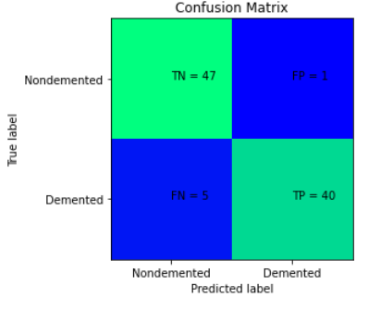
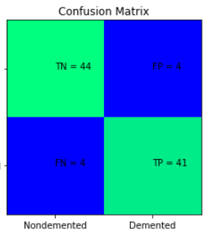
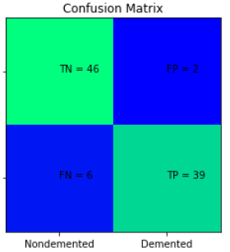
LR
RF
SVM
TN - True Negative
TP - True Positive
FN - False Negative
FP - False Positive
KNN
DT
XGB
Notes:
Once the best combination of features were selected, we moved on to evaluate each of the models individually. These are the confusion matrices of the six models, which is often used to describe the performance of a classification model on a set of test data for which the true values are known. These were further used to calculate the metrics for assessing the efficiency of classification by the models.

Slide 14
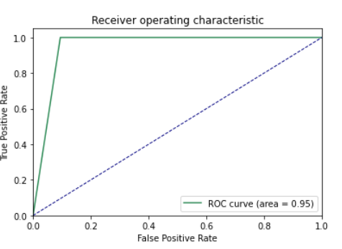
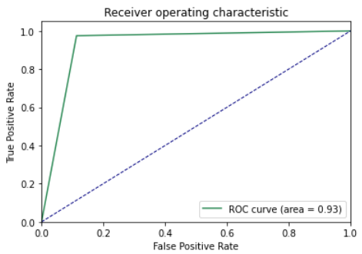
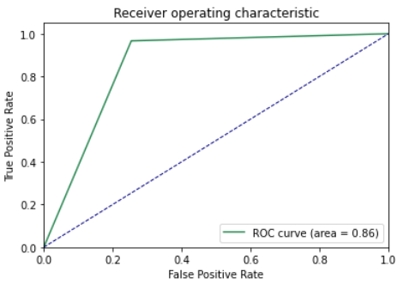
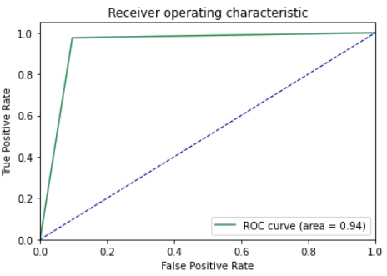
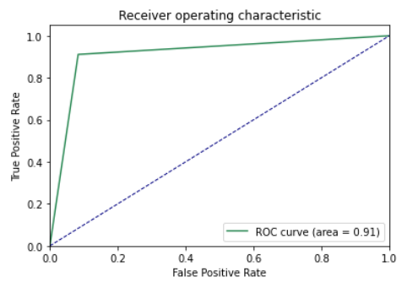
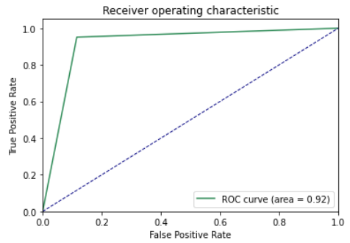
LR
RF
SVM
KNN
DT
XGB
Notes:
These are the ROC curves for the six models which resembles their performance at different classification thresholds. The area under the curve or AUC is the probability of correctly classifying a record by that model. Higher the AUC, better the accuracy of the model.

Slide 15
Model evaluation- metrics*
 | LR | RFC | SVM | KNN | DT | XGB
Accuracy | 0.9462 | 0.9247 | 0.8171 | 0.9357 | 0.914 | 0.914
Precision | 1 | 0.975 | 0.9667 | 0.9756 | 0.9111 | 0.9512
Recall | 0.8889 | 0.8667 | 0.6444 | 0.8889 | 0.9111 | 0.8667
F1-score | 0.9412 | 0.9176 | 0.7733 | 0.9302 | 0.9111 | 0.907
AUC | 0.95 | 0.93 | 0.86 | 0.94 | 0.91 | 0.92
Model with best metrics- Logistic Regression
*metrics are calculated mathematically from the scores in the confusion matrix
Notes:
These are the different metrics of model efficiency and are calculated using the confusion matrices. The maximum and minimum scores of each metric have been highlighted. From this, it was evident that Logistic Regression model performed the best among all models under consideration. Thus, it can further be used to predict dementia classification for a given set of records.

Slide 16
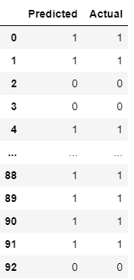
Prediction
Using the best model among all - Logistic Regression with top 4 features
Total number of wrongly predicted = 5 (out of 93 ~ 5.3%)
Final model equation :
Y = 11.408 + 5.5268(x1) - 0.437(x2) - 0.309(x3) - 0.235(x4) where, Y = GroupNum x1 = CDR x2 = MMSE x3 = nWBV x4 = M/F
If,
positive Y => demented
negative Y => non-demented
Notes:
These are the predictions of the test data set. We found that out of 93 records, 5 were wrongly predicted. This basically means that around 95% of the records were identified and classified correctly by our model.
This is the final logistic regression equation, showing the weights of each feature along with the intercept value.

Slide 17
Thank you!
Special thanks – Prof. Vahid Behzadan
Notes:
Thank you to everyone for listening and a special thanks to Prof.Vahid Behzadan for his constant guidance and support throughout the course.

Slide 18
References
https://www.oasis-brains.org/#oasis2
https://www.who.int/news-room/fact-sheets/detail/dementia
https://developers.google.com/machine-learning/crash-course/classification/roc-and-auc
https://scikit-learn.org/0.18/auto_examples/model_selection/plot_confusion_matrix.html

