Slide 1

CSE 541 : Computer Vision
DRIVER DROWZINESS DETECTION SYSTEM
Mentor : Prof. Mehul Raval
Group 4 : Good Pointsss
Yesha Dhivar | AU2040215
Kenil Shah | AU2040111
Rajan Nandha | AU2040101

Slide 2
INTRODUCTION
The project aims to develop a drowsiness detection system that uses a non-interfering method to continuously capture images of a driver's eyes and assess their condition in real-time. The system alerts the driver when their eye closure exceeds a predetermined threshold, helping prevent accidents caused by drowsy driving.
PROBLEM STATEMENT
To develop a non-invasive and real-time drowsiness detection system that can continuously capture images and analyze eye closure values, and alert the driver when drowsiness is detected, aiming to prevent accidents caused by driver fatigue on the road.

Slide 3
LITERATURE REVIEW
REVIEW 1
REVIEW 2
This paper proposes a hybrid algorithm for facial expression recognition using Principal Component Analysis (PCA), K-Means Clustering, and Artificial Neural Networks (ANN). The proposed algorithm achieves an accuracy rate of 96.67% on the CK+ dataset, outperforming other existing methods.
This paper proposes a driver drowsiness detection system using OpenCV and Support Vector Machine (SVM) classifier. The system achieves an accuracy rate of 95.2% in detecting drowsiness based on eye closure and head movement, providing a potential solution for preventing accidents caused by driver fatigue on the road.

Slide 4
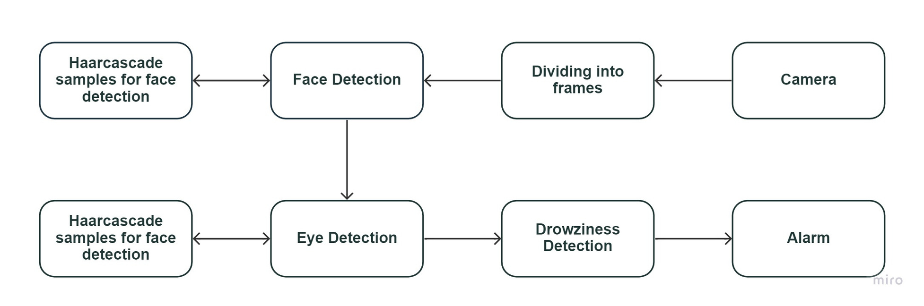
APPROACH

Slide 5
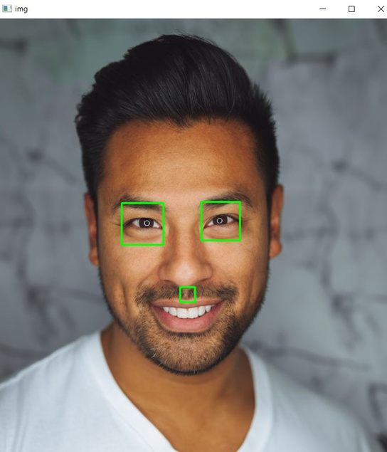
The mrlEyes_2018_01 dataset has been divided into two categories based on the status of the eyes in each image: open eyes data and close eyes data. A binary indicator is included with each image to indicate whether it is an open eyes image or a close eyes image.
INITIAL RESULTS
A code has been developed to detect faces and subsequently identify eyes within the detected faces. This was achieved by utilizing the files:
haarcascade_frontalface_default.xml
haarcascade_eye.xml

Slide 6
We have enabled the video capture using the webcam of our laptop using library like OpenCV.
INITIAL RESULTS
We have also started working on model training. As of now, we have imported the data set and segregated it into the training set, validation set, and test set.

Slide 7
ROLES AND FUTURE WORK
KENIL SHAH
YESHA DHIVAR
RAJAN NANDHA
LIterature Review
Camera Capture
Literature Review
Data Exploration
Face and Eye Detection
Data Exploration
Data Preprocessing

Slide 8
REFERENCES
[1] Mahek Jain, Bhavya Bhagerathi, Sowmyarani C N “Real- Time Driver Drowsiness Detection using Computer Vision,” October, 2021
[2] V. B. Navya Kiran, Raksha R., A. Rahman, Varsha K. N., Dr. Nagamani N. P., “Driver Drowsiness Detection,” September 21, 2020

Slide 9



QUESTIONS

Slide 10

THANK YOU

