Slide 1





CSE519: Human Computer Interaction
Mentor : Prof. Anurag Lakhlani
The Educators
"Empowering Minds, Shaping Future"
Group 3: Good Pointsss

Slide 2



“An investment in knowledge pays the best interest.”
– Benjamin Franklin

Slide 3


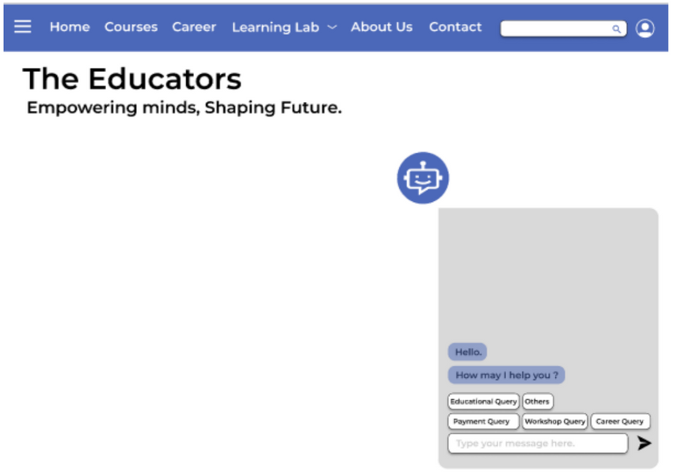


Best Feature - 1
ChatBot
Rules/Principles
Design Dialogue to yield closure – The user has an active dialogue to clear any queries and reach to a conclusion.
Interaction Style:
Natural Language – Here, the user chats to understand any specific feature and resolve any query.

Slide 4
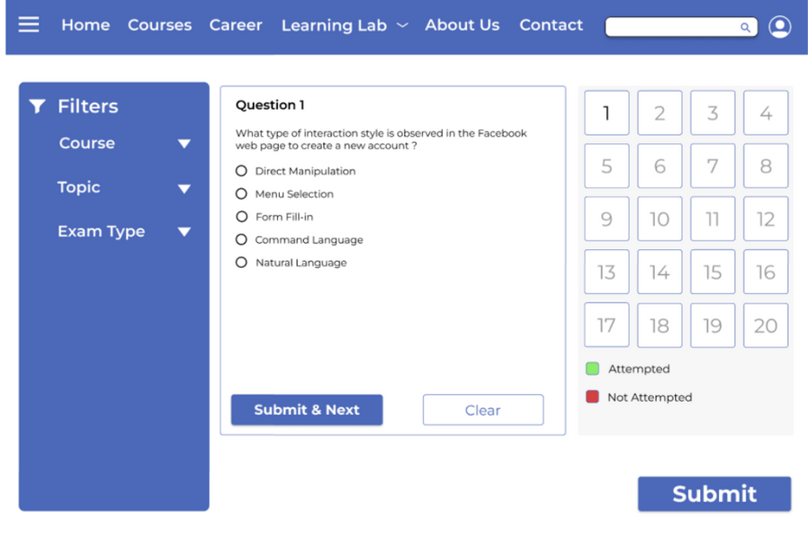
Best Feature - 2
Practice Tests
Rules/Principles
Offer Informative feedback: The green symbol and red symbol.
Interaction Style:
Menu selection: The filters give the option to the user to directly go to the exam they want to apply for.

Slide 5
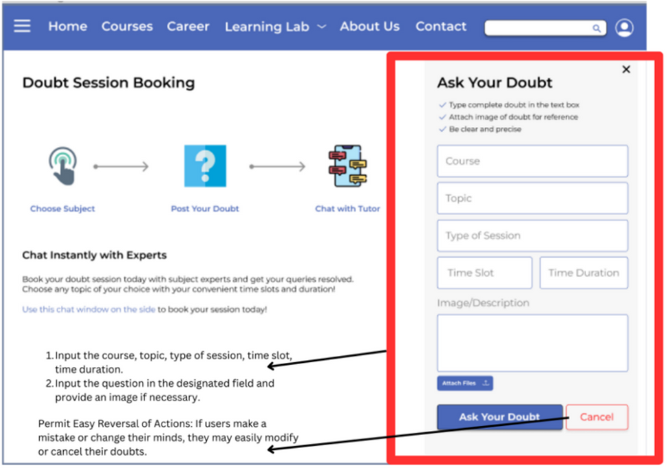
Best Feature - 3
Doubt-Session Booking
Rules/Principles
Design Principle:
Permit Easy Reversal of Actions - If users make a mistake or change their minds, they may easily modify or cancel their doubts.
Interaction Style:
Form Fill-in: Users will be asked to fill in a form with details about their doubt, such as the topic and their specific question.

Slide 6
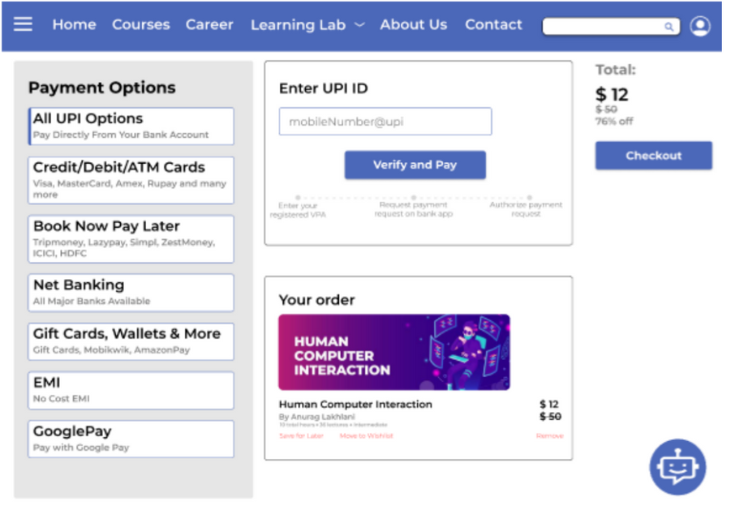
Best Feature - 4
Payment
Rules/Principles
Design Principle:
Offer Informative Feedback: Here, the original price, discounted price as well as the discount is clearly mentioned.
Interaction Style:
Direct Manipulation: User can click any option available for payment as per his/her convenience.

Slide 7


The Difficulty
The Solution
Services which are to be provided by our website.
Short listing from the list of our ideas by considering the pros and cons.
Looking at the current colour palette for various similar website.
Colour Palette for the website .
Researched about the software and saw various tutorial tp gain knowlegdde
Working and Prototyping in Figma
According to the relatability of various pages and the user opinion for the flow of the page.
Flow of the webpages

Slide 8

Getting Certificates: The website will provide users with certificates upon completion of courses, as well as offer letter of recommendation and other services for job seekers.
Recommendation Services: The website will use machine learning to provide course recommendations to users, making it easier for them to find the courses they are interested in and also help in job searches.
Real-Life Implementation
( Good Factors )

Slide 9
Scalability : It requires periodic modifications to both application code and hardware resources, and cloud services can help in expanding the platform further.
Security: Protection against data leaks and hacking attempts. Careful attention needs to be paid to DevOps, server interfaces, and regular updates to ensure efficient workflow and effective communication between the application and server.
Real-Life Implementation
( Challenges Involved )

Slide 10


Video
https://drive.google.com/file/d/1JWikM1mU6xlbYYar5gs0IKeOQ7WttRzR/view
Project Demo
Figma
https://www.figma.com/proto/8fEgh7akvCksvLwSrl7v4Q/The-Educators_HCI?node-id=90-246&scaling=scale-down&page-id=0%3A1&starting-point-node-id=90%3A246

Slide 11


Working with Figma:
This was the first time we all were trying our hands in Figma.
There were some challenges such as connections and working.
But it was fun learning a new software.
Learnings
Understanding User Perspective:
From this course and while doing the project, the main thing we learned was to stand in the place of the user and then implement the design.

Slide 12


Team Members
Kenil Shah
AU2040111
Neel Buddhdev
AU2040176
Yesha Dhivar
AU2040215
Freya Modi
AU2040222

Slide 13
Questions?
"The art of asking questions is the source of all knowledge."
– Thomas Berger

Slide 14

Thank You!

