Slide 1
Project
PATTERN: ITERATOR
TEAM
1. YESHRAJ MAGANTI (1144105)
2. SUBASH CHANDRA BOSE KONDRU (1140025)
3. VENKATA SAI TEJA SAGI (1140301)

Slide 2
Design Pattern
A technique to accessing the elements of an object sequentially and define the relationship and interactions among multiple classes and objects.
To improve the performance of communication among the objects the code should be reusable, well maintained and flexible in adding of components.
The common problem that arises while developing a project and the common solution will be provided so that there is a necessity of patterns.

Slide 3

Iterator Design Pattern
Iterator is a behavioral design pattern that allows sequential traversal through a complex data structure without exposing its internal details.
Iterator is easy to recognize by the navigation methods (such as next, previous and others). The specific code that uses iterators might not have direct access to the collection being traversed

Slide 4
Intent
Provide a way to access the elements of an aggregate object sequentially without exposing its underlying representation.
The C++ and Java standard library abstraction that makes it possible to decouple collection classes and algorithms.
Promote to "full object status" the traversal of a collection.
Polymorphic traversal

Slide 5
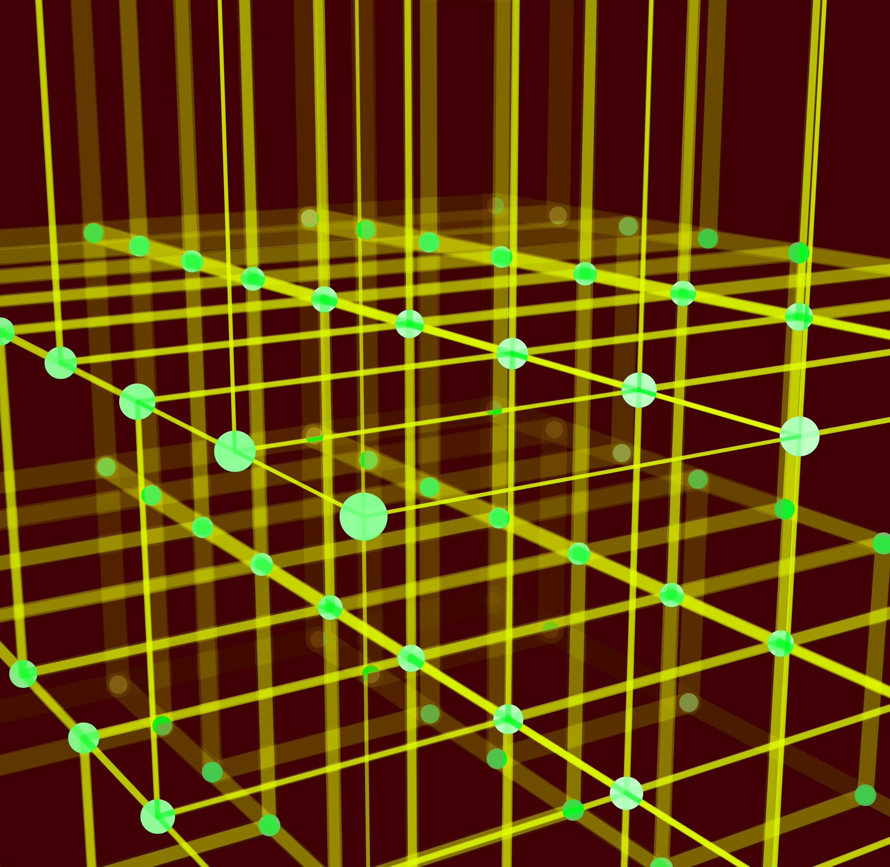
Problem
Need to "abstract" the traversal of wildly different data structures so that algorithms can be defined that are capable of interfacing with each transparently.

Slide 6
Relations with Other Patterns
Use
You can use Iterators to traverse Composite trees.
Use
You can use Factory Method along with Iterator to let collection subclasses return different types of iterators that are compatible with the collections.
Use
You can use Memento along with Iterator to capture the current iteration state and roll it back if necessary.
Use
You can use Visitor along with Iterator to traverse a complex data structure and execute some operation over its elements, even if they all have different classes.

Slide 7



Applicability
Use the Iterator pattern when your collection has a complex data structure under the hood, but you want to hide its complexity from clients (either for convenience or security reasons).
Use the pattern to reduce duplication of the traversal code across your app.
Use the Iterator when you want your code to be able to traverse different data structures or when types of these structures are unknown beforehand.

Slide 8

Pros
Single Responsibility Principle. You can clean up the client code and the collections by extracting bulky traversal algorithms into separate classes.
Open/Closed Principle. You can implement new types of collections and iterators and pass them to existing code without breaking anything.
You can iterate over the same collection in parallel because each iterator object contains its own iteration state.
For the same reason, you can delay an iteration and continue it when needed.

Slide 9
CONs
Applying the pattern can be an overkill if your app only works with simple collections.
1
Using an iterator may be less efficient than going through elements of some specialized collections directly.
2

Slide 10
Template
What classes are used in the class
Iterator
First()
Next()
isDone()
iter_type_Current()
Container
Add()
CreateIterator()
Data
Data()
setData()
ClientCode
Calling of Iterator,Container and Data

Slide 11
COde
#include <iostream>
#include <string>
#include <vector>
template <typename T, typename U>
class Iterator {
public:
typedef typename std::vector<T>::iterator iter_type;
Iterator(U *p_data, bool reverse = false) : m_p_data_(p_data) {
m_it_ = m_p_data_->m_data_.begin();
}
void First() {
m_it_ = m_p_data_->m_data_.begin();
}
void Next() {
m_it_++;
}
bool IsDone() {
return (m_it_ == m_p_data_->m_data_.end());
}
iter_type Current() {
return m_it_;
}
private:
U *m_p_data_;
iter_type m_it_;
};

Slide 12
template <class T>
class Container {
friend class Iterator<T, Container>;
public:
void Add(T a) {
m_data_.push_back(a);
}
Iterator<T, Container> *CreateIterator() {
return new Iterator<T, Container>(this);
}
private:
std::vector<T> m_data_;
};
class Data {
public:
Data(int a = 0) : m_data_(a) {}
void set_data(int a) {
m_data_ = a;
}
int data() {
return m_data_;
}
private:
int m_data_;
};

Slide 13
void ClientCode() {
std::cout << "_____Iterator with int_____________" << std::endl;
Container<int> cont;
for (int i = 0; i < 10; i++) {
cont.Add(i);
}
Iterator<int, Container<int>> *it = cont.CreateIterator();
for (it->First(); !it->IsDone(); it->Next()) {
std::cout << *it->Current() << std::endl;
}
Container<Data> cont2;
Data a(100), b(1000), c(10000);
cont2.Add(a);
cont2.Add(b);
cont2.Add(c);
std::cout << "_____Iterator with custom Class___________" << std::endl;
Iterator<Data, Container<Data>> *it2 = cont2.CreateIterator();
for (it2->First(); !it2->IsDone(); it2->Next()) {
std::cout << it2->Current()->data() << std::endl;
}
delete it;
delete it2;
}

Slide 14
int main() {
ClientCode();
return 0;
}

Slide 15
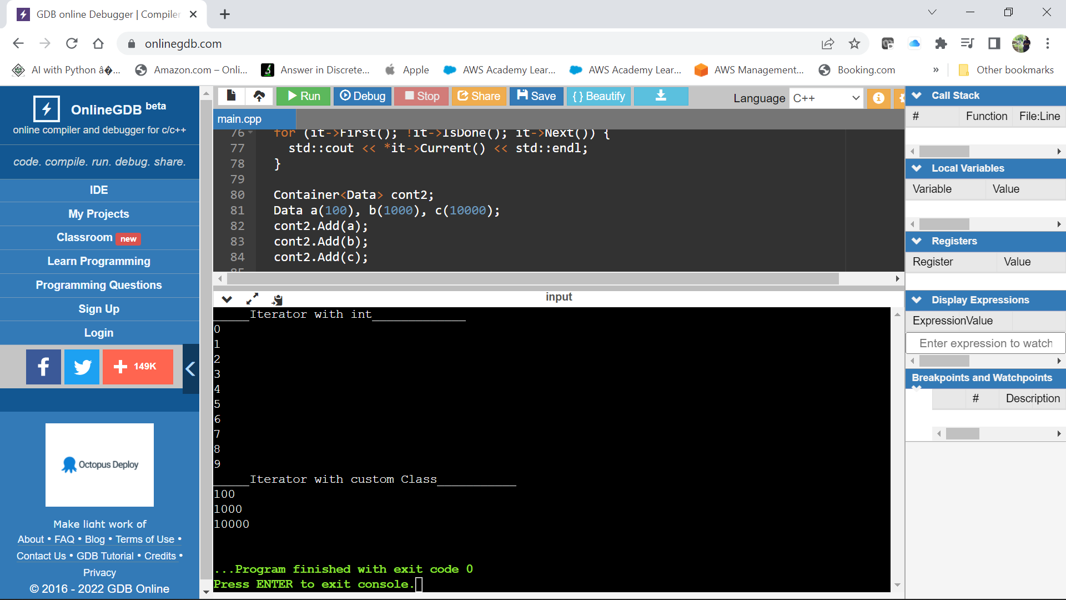

Slide 16
THANK YOU

