Slide 1
Creating Smart Contractors Using NFT in Block Chain Yeshraj Maganti Subash Chandra Bose Kondru Under Professor Dr. Wafa Elmannai & Dr. Ausif Mahmood

Slide 2
Block Chain
A blockchain allows a person to safely send money to another person without going through a bank or financial services provider.
The block chain is changing the shape of the business chain by eliminating the middleman.
The middleman is creating their own model to bring any businesses into their control.

Slide 3
The smart contracts itself works with non-fungible tokens to make the process with almost standards.
The blockchain creates the process to identify someone in a unique way.
The block chain gives the value to the assets digitally where the flow of transactions can be carried out without any interference.

Slide 4
We are creating a contract application binary interface that provides the gas value which is the total tokens that are being transferred over the network.
Smart contracts will make the process in a more easy and beneficial manner.

Slide 5
Blockchain technology has gained significant attention in industries, including finance, healthcare, and supply chain management.
The technology allows for the secure and transparent storage of information.
The use of blockchain technology is not limited to cryptocurrency but has many potential applications such as digital identity verification, smart contracts, and secure data sharing.

Slide 6
ERC 721A
ERC 721A is an improvement standard for ERC721 tokens
It is used for developing their NFT collection.
Compared with ERC721, ERC721A is a more gas-efficient standard to mint thousands of NFTs simultaneously.
It allows developers to mint multiple NFTs at the same gas price.

Slide 7
Minting
Minting is the process of generating new coins by authenticating data, creating new blocks, and recording the information onto the blockchain through a “proof of stake” protocol. Both new units of a cryptocurrency and Non-Fungible Tokens (NFTs) can be minted this way.

Slide 8
ERC 721 Enumerable
1. The ERC721Enumerable interface is an optional interface for adding more features to the ERC721 NFT.

Slide 9
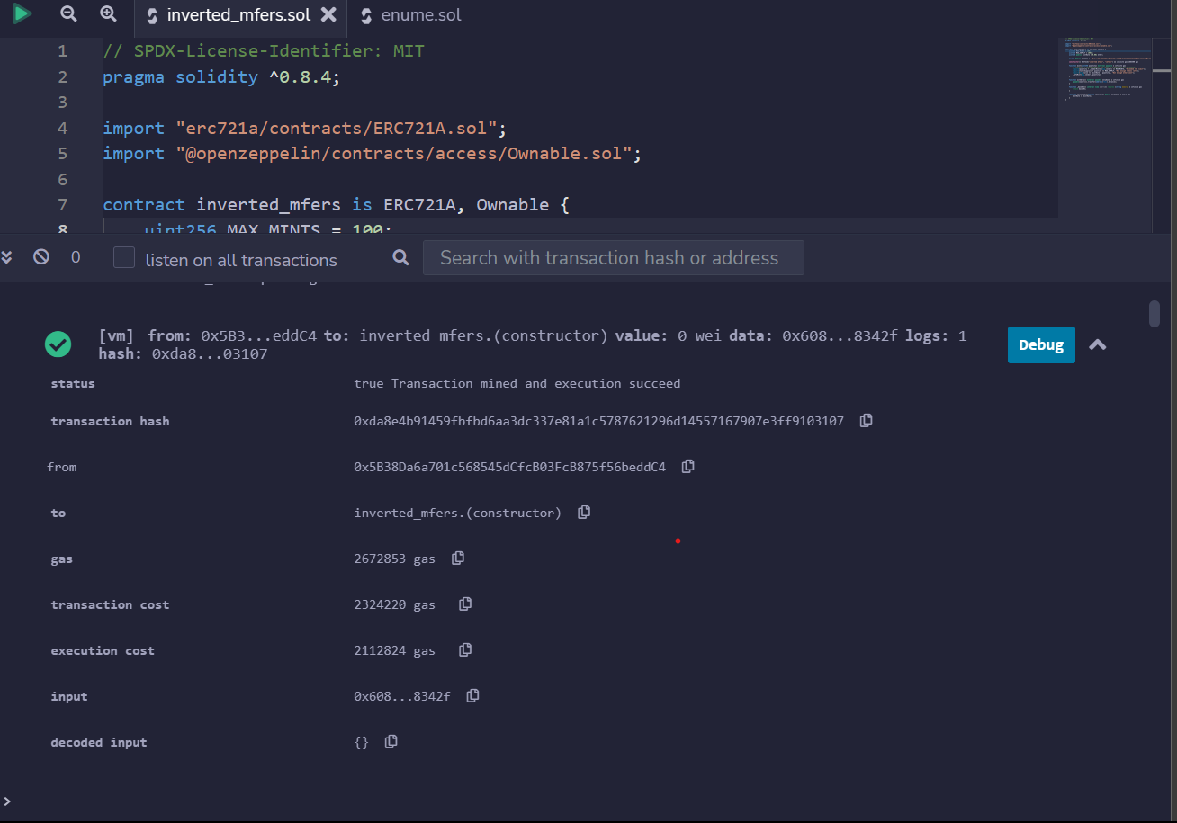

Slide 10
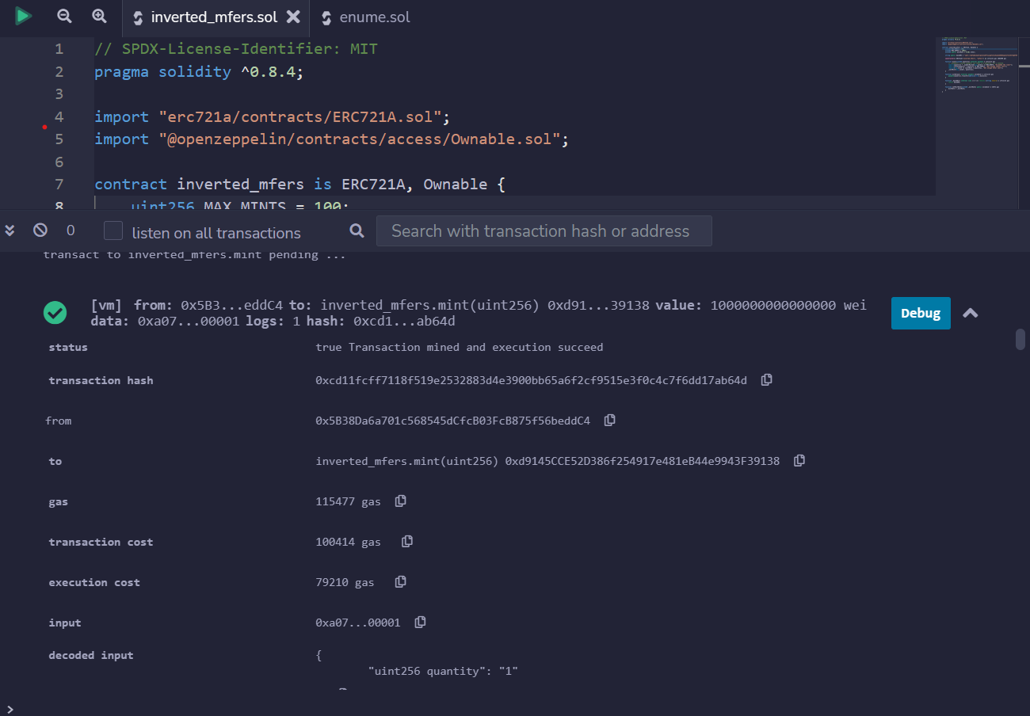

Slide 11
Thankyou

