Slide 1
SENSITIVITY OF WORDS
By Yeshvanth N and
Nishanth Senthilvasagam T

Slide 2
What is sentiment analysis?

Slide 3
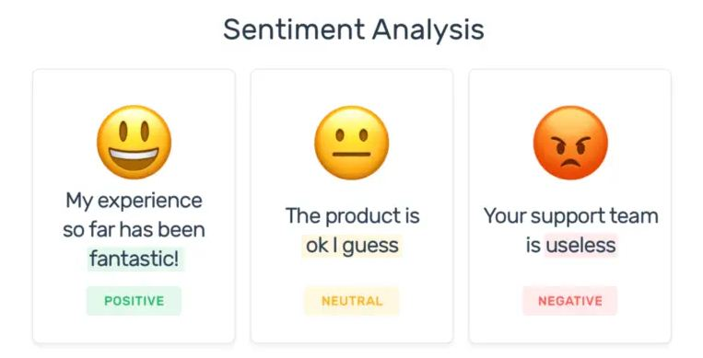

Slide 4
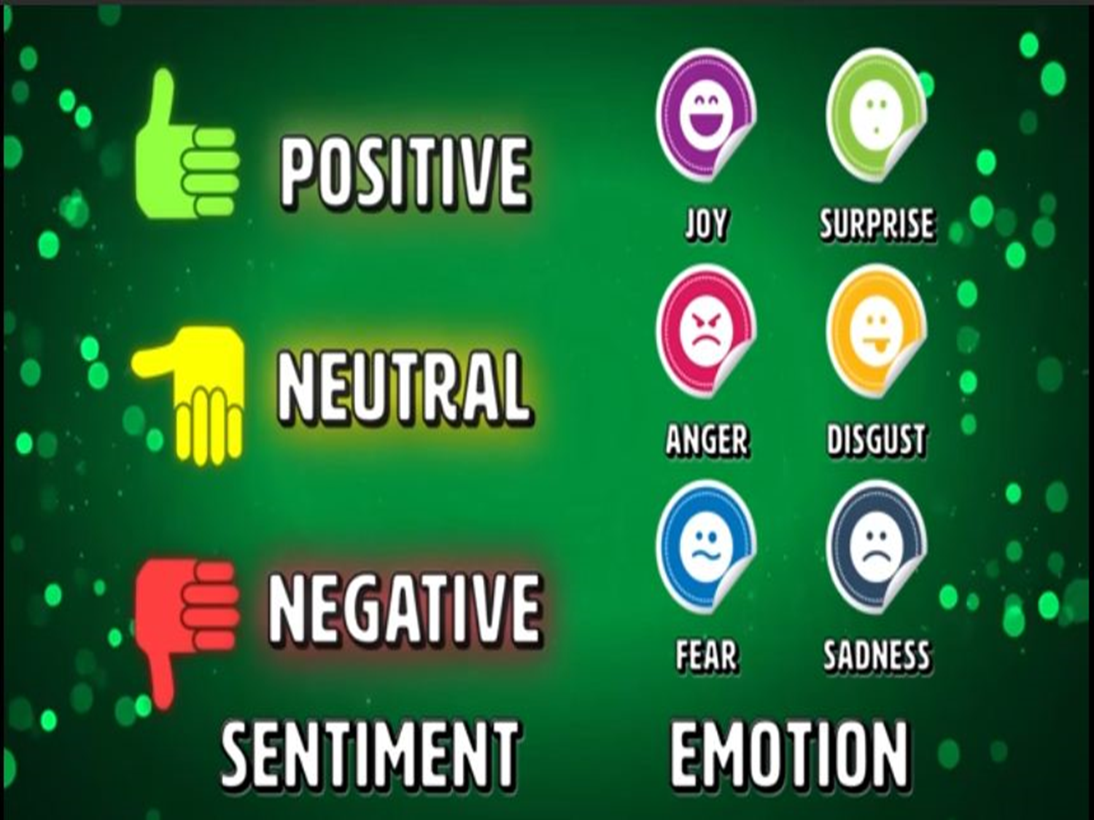
Polarity
Subjectivity
Opinion holder

Slide 5
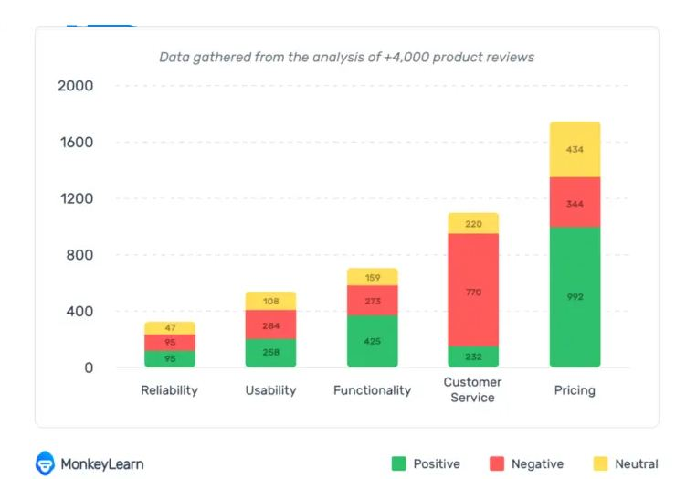
Sentiment analysis example

Slide 6
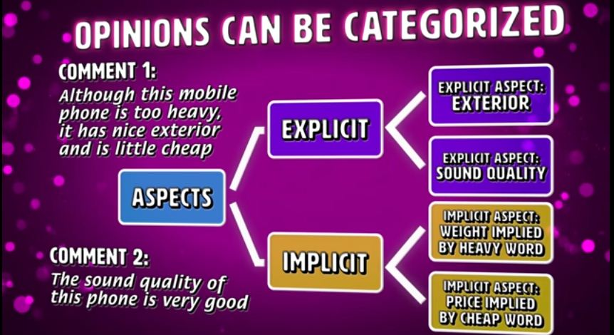
What is an Opinion?

Slide 7
Scope
Document level
In a text file which has a description of an event.
Sentence level
In a text file which has movie reviews.
Sub sentence level
Words with stress.

Slide 8
Types of sentiment analysis
Fine-grained sentiment analysis
Emotion detection
Aspect based sentiment analysis
Intent analysis
Multilingual sentiment analysis

Slide 9
Why is sentiment analysis important?
Scalability
Real time analysis
Consistent criteria

Slide 10
How does it actually work?
Two types:
Rule based approach
Automatic (via Machine learning)

Slide 11
Rule based approach
The rules may use a variety of inputs, such as the following:
Classic NLP techniques like stemming, tokenization, part of speech tagging and parsing.
Other resources, such as lexicons (i.e. lists of words and expressions).
Eg : TextBlob

Slide 12
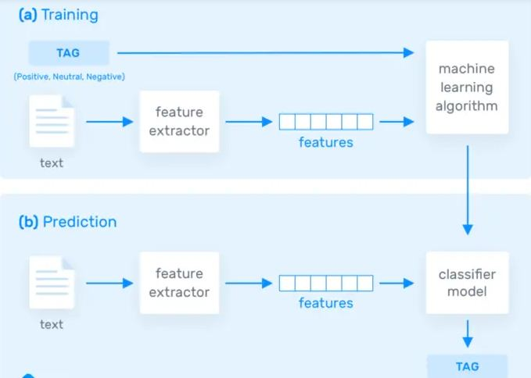
Automatic approach

Slide 13
Challenges to Sentiment analysis
Subjectivity and tone
Context and polarity
Irony and sarcasm
Comarisons
Emojis
“Neutral”

Slide 14
Some applications(can be added after the code)
Social media monitoring
Brand monitoring
Voice of customer (VoC)
Customer service
Workforce analytics and voice of employee
Product analytics
Market research and analysis

Slide 15
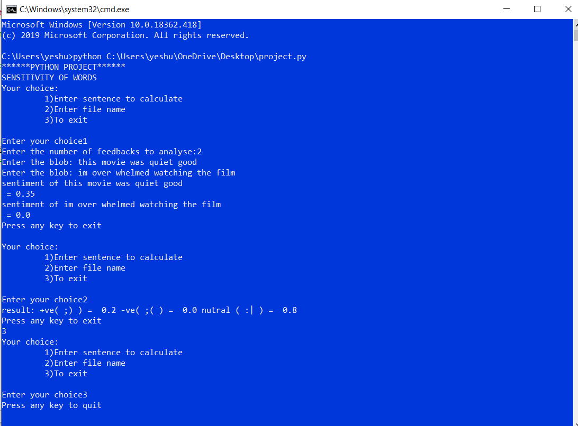
(OUTPUT)

Slide 16
