Slide 1

SAGE
Secure AI Governance Engine
LLM-Powered Enterprise Compliance Assistant
Name: Yeshwanth Balaji
Email: Yeshwanthbalaji.dev@gmail.com
Github: https://github.com/YeshwanthBalaji0412
LinkedIn: https://www.linkedin.com/in/yeshwanthbalaji/
Portfolio: https://yeshwanthbalaji.com/

Slide 2
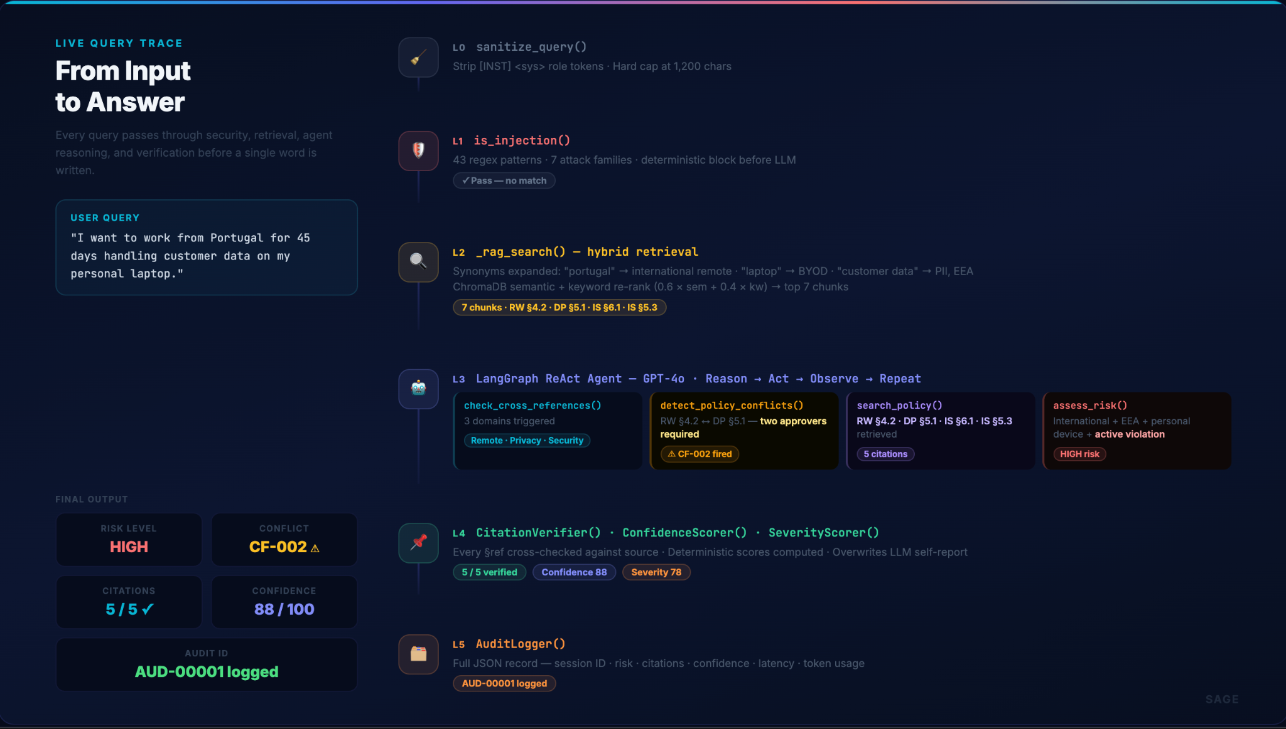

Slide 3
