Slide 1
Question 1

Slide 2
Locate the following VM programs in the nand2teris folder SimpleAdd StackTest BasicTest PointerTest StaticTest a.Check the correctness of the programs using the VM emulator and supplied test script.

Slide 3
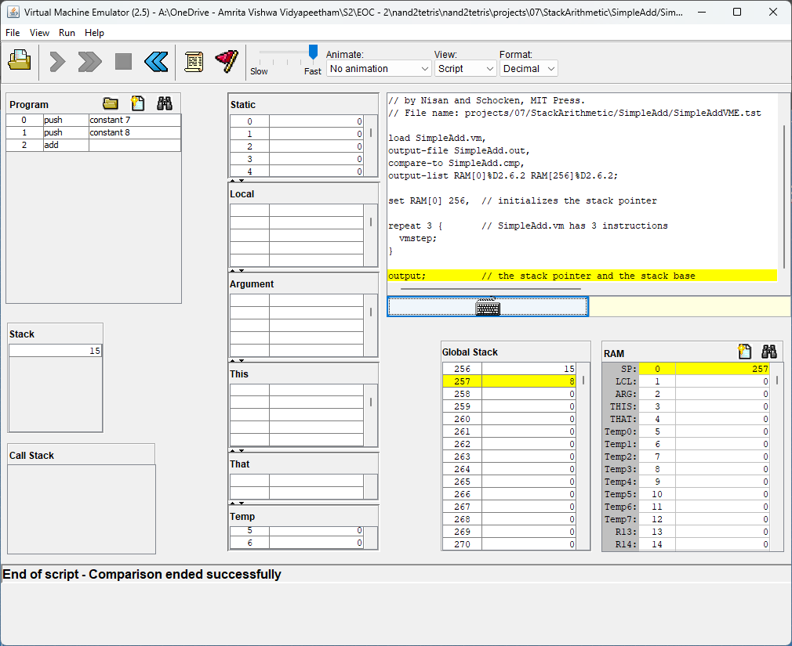
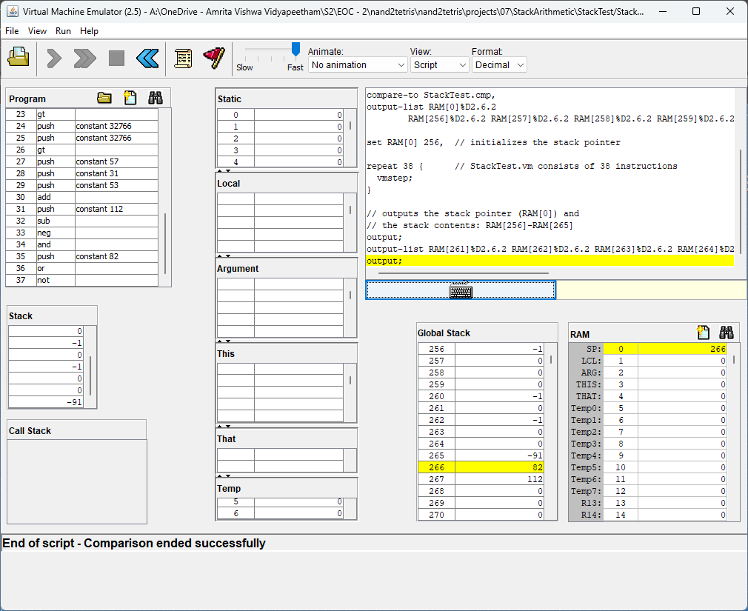
SimpleAdd
StackTest

Slide 4
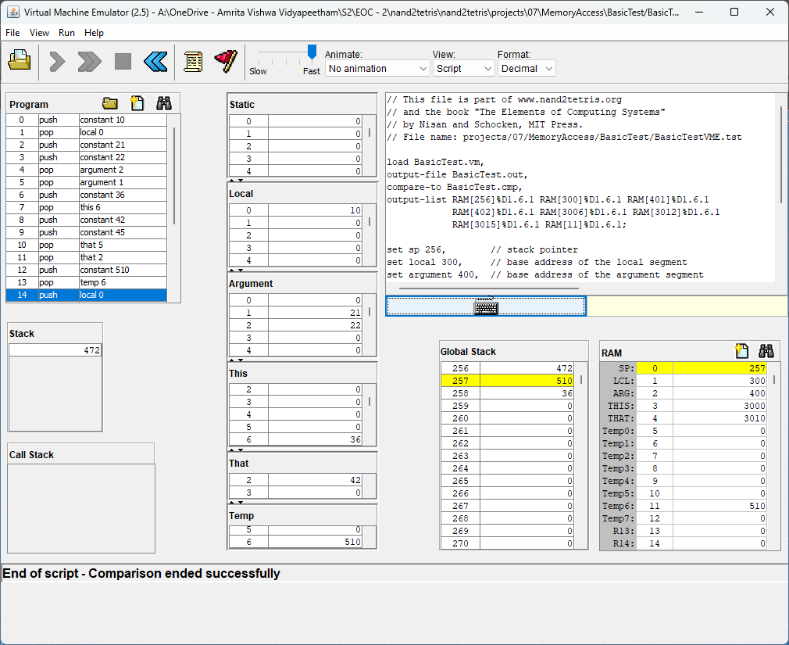
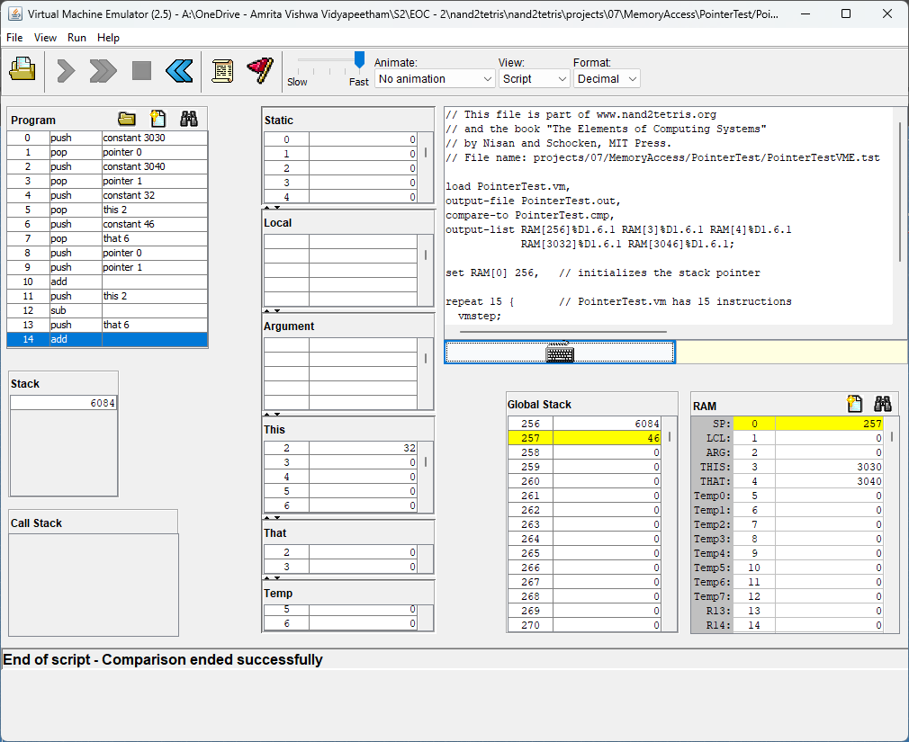
BasicTest
PointerTest

Slide 5
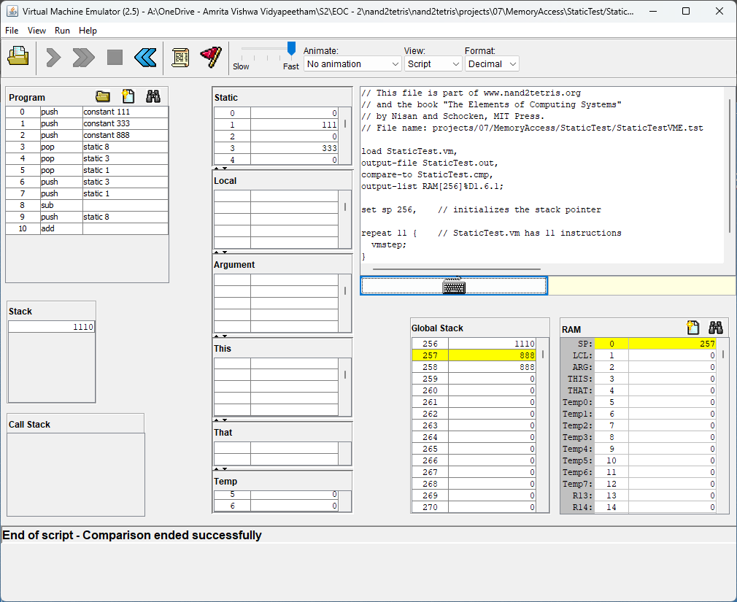
StaticTest

Slide 6

b.Comprehend the lines of codes. (You may be asked to explain the lines of codes). SimpleAdd.vm
This is a simple code where two constants are pushed into the stack and are added using the add command

Slide 7
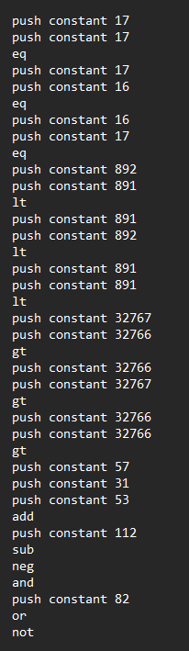
StackTest.vm
In this code constants are pushed into the stack and eq,gt,lt operations are performed.
If the operation performed and is true then in the stack it pushes “-1” else it pushes “0”

Slide 8
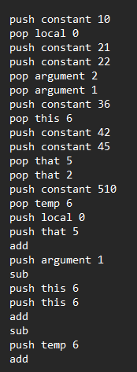
BasicTest.vm
Firstly we push constant 10 into the stack and pop it to local 0 then 21,22 into the stack and pop it to argument 1 and 2 respectively, then we push a constant 36 into the stack and pop it to this 6, then 42 and 45 in that 2 and that 5 respectively. Then 510 to temp 6.
Now we access the loaded memory segments where we push local 0 that is constant 10 and we push that 5 and add and then we push argument 5 and subtract it then we push this 6 two times and add it then we subtract it with the previously stored values in the stack then finally we push temp 6 and add

Slide 9
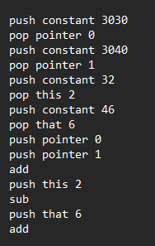
PointerTest.vm
Here basically pointer means this and that memory segments access.
Pointer 0: this
Pointer 1: that
In the first two lines, we basically set the base address of this memory segment as 3030 by pushing into the stack and popping the value to pointer 0
Then in the 5th to 8th lines, we basically do pointer manipulation and store the value in the this and that memory segment.
In the 9th to 11th lines, we access the base address of this and that and then add it to the global stack.
Now with the same pointer manipulation we just access the values and do some operations

Slide 10
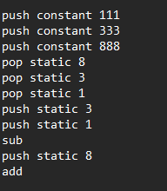
StaticTest.vm
In this code, we basically push few constants into the stack and pop it to static.
Then we do few operations
Here the point of using static is it can be accessed not only by functions but also the stack, whereas local can only be accessed by functions

Slide 11
c.Write a VM-to-Hack translator in python or Java, conforming to the ‘Standard VM-on-Hack Mapping’
For building the code we’ve used 3 classes namely Code, Translator, and LabelGenerator.
You can refer to the report for the detailed explanation of the code.

Slide 12
Class: LabelGenerator

Slide 13
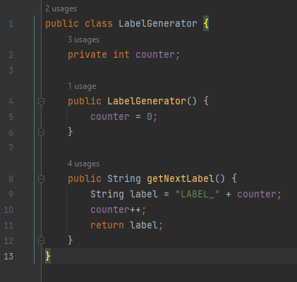

Slide 14
Class: Translator

Slide 15
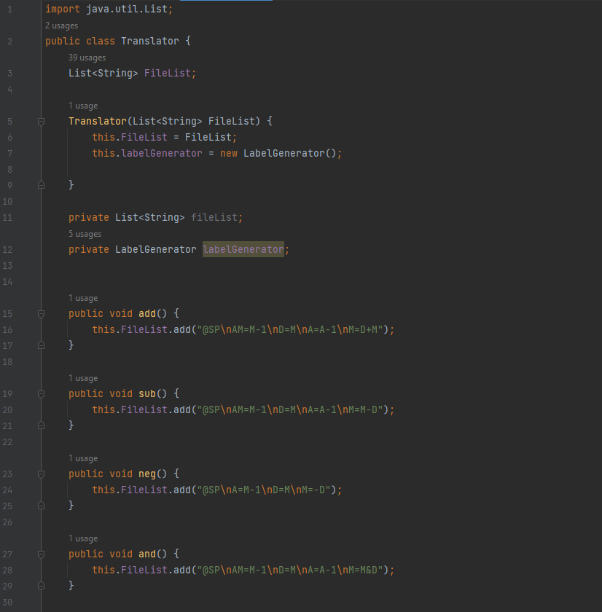
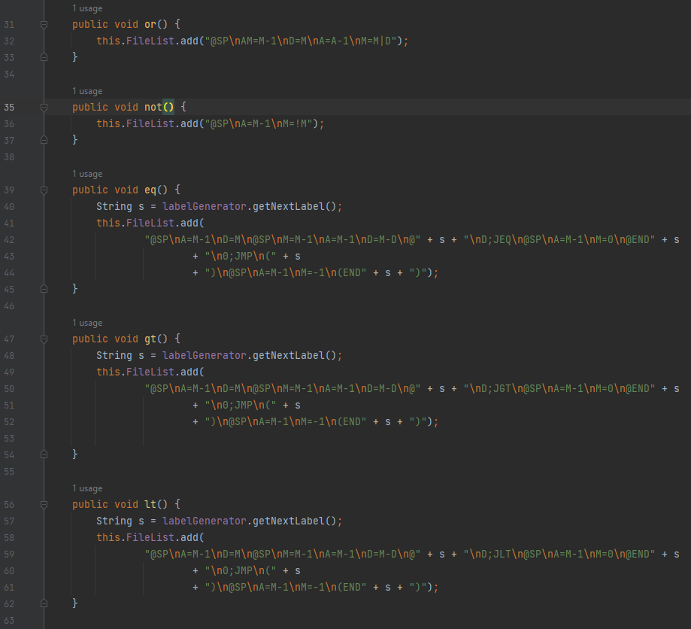

Slide 16
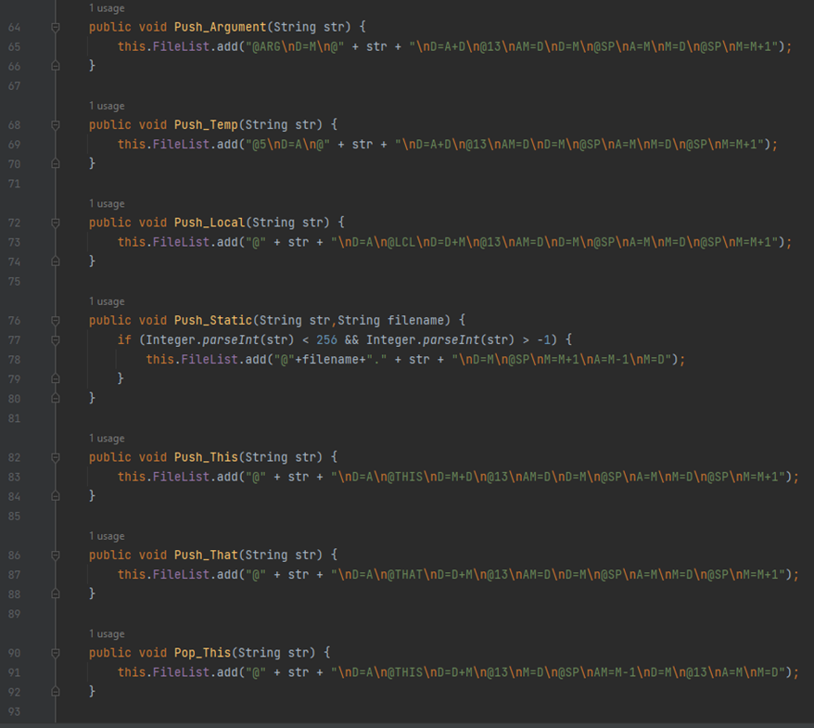
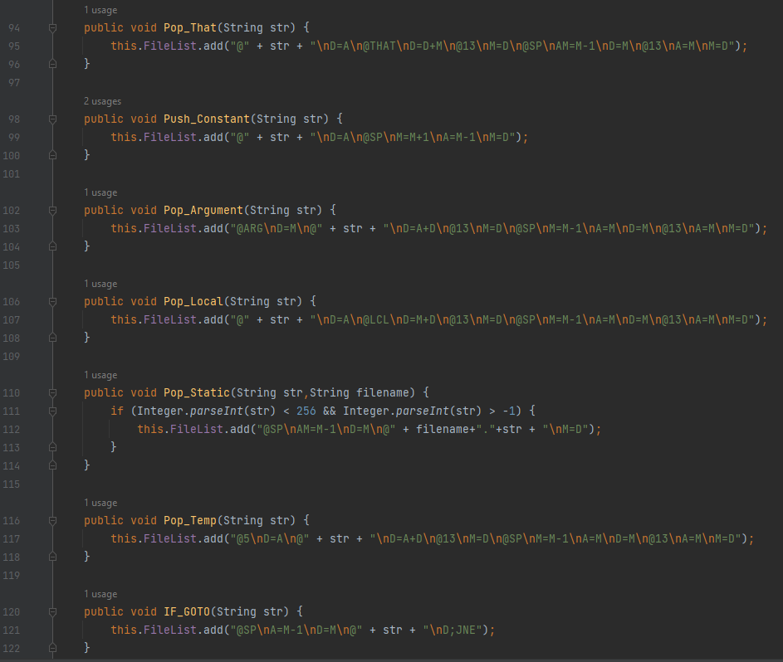

Slide 17
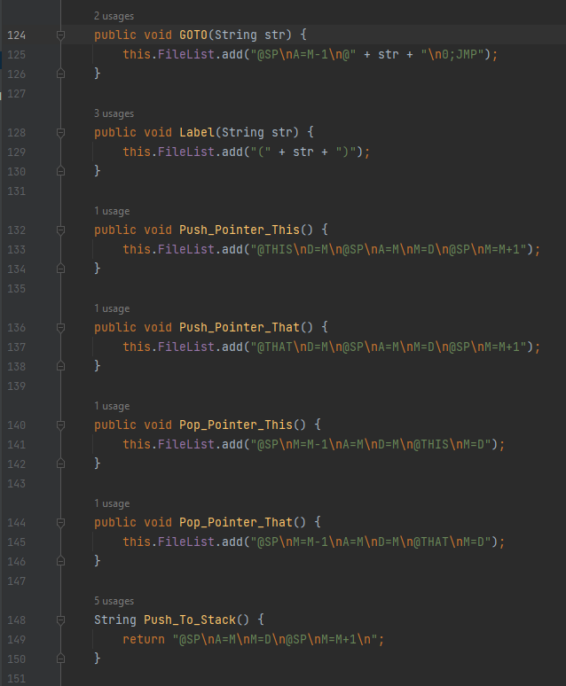
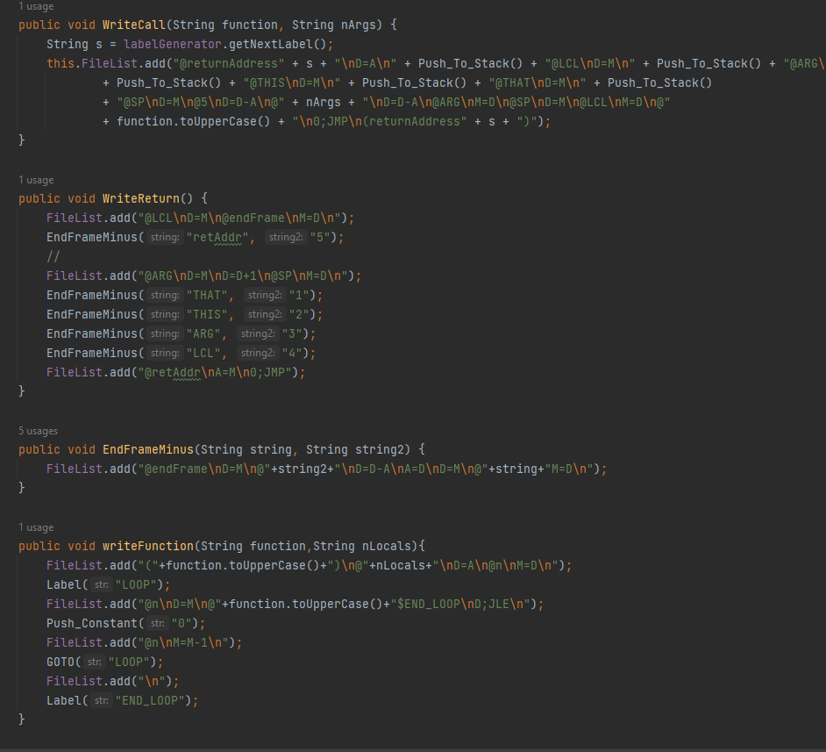

Slide 18
Class: Code

Slide 19
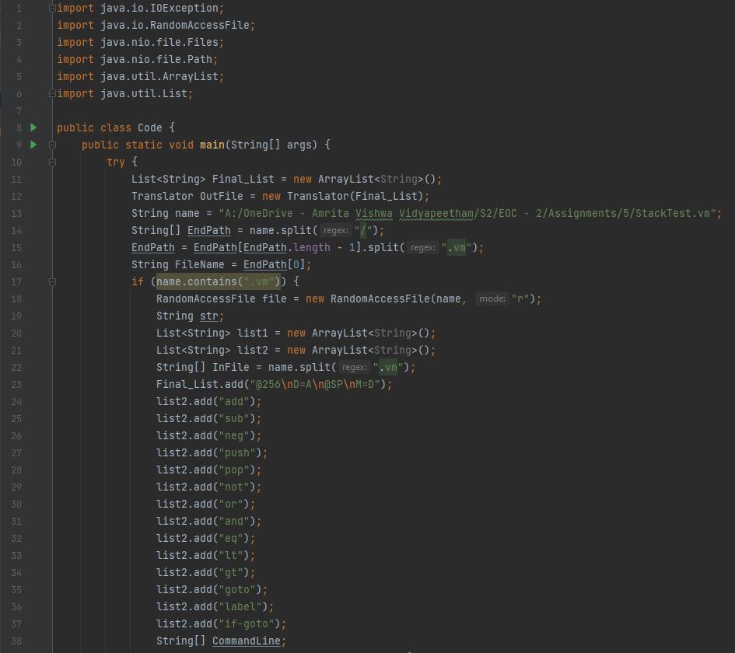
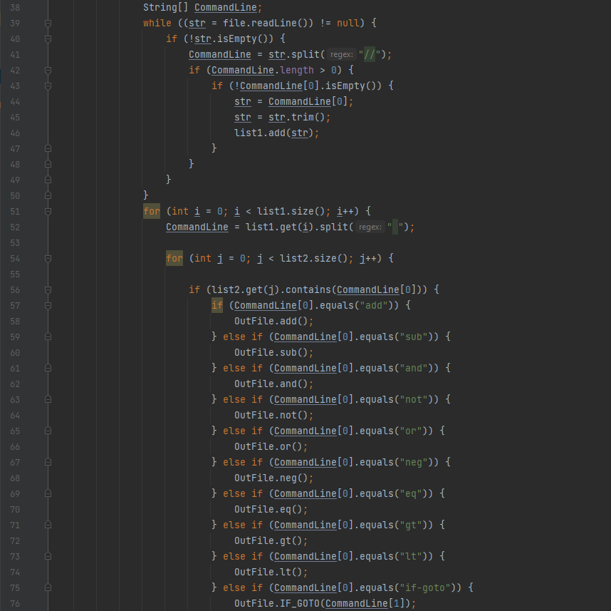

Slide 20
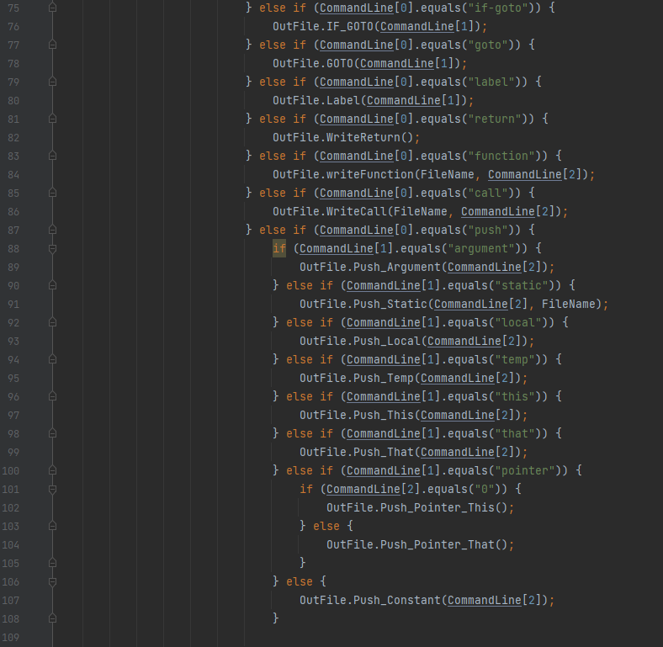
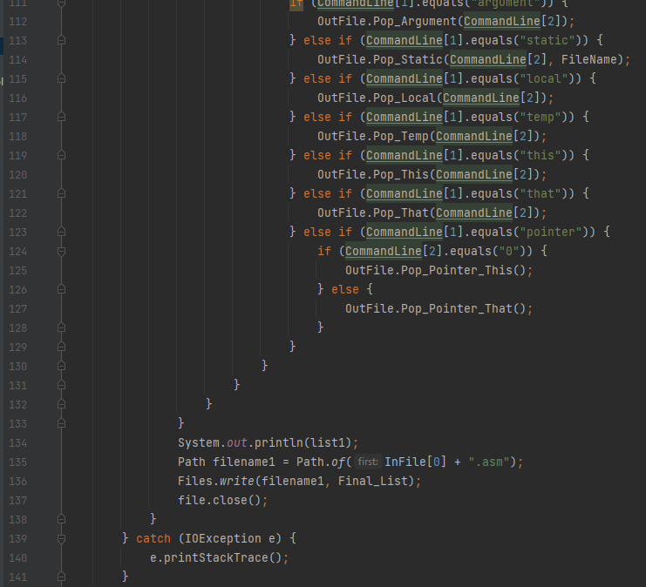

Slide 21
d. Use your VM translator to translate the above .vm programs to .asm programs Successfully we have translated the above mentioned .vm files to .asm files.

Slide 22
e.Execute the generated .asm programs on the CPU emulator using the supplied testscript.

Slide 23
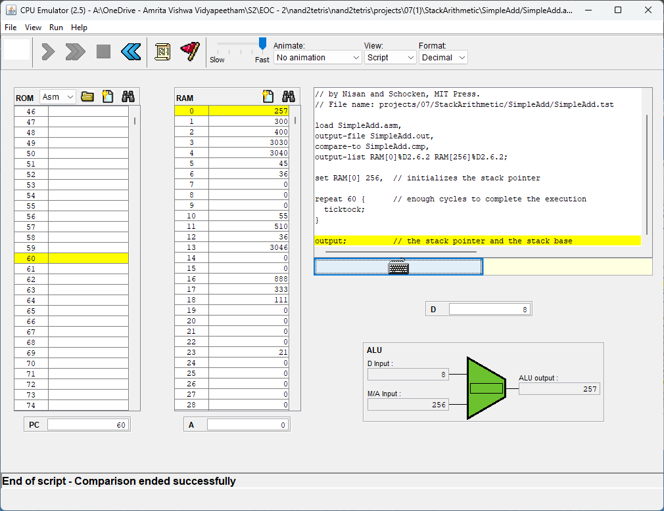
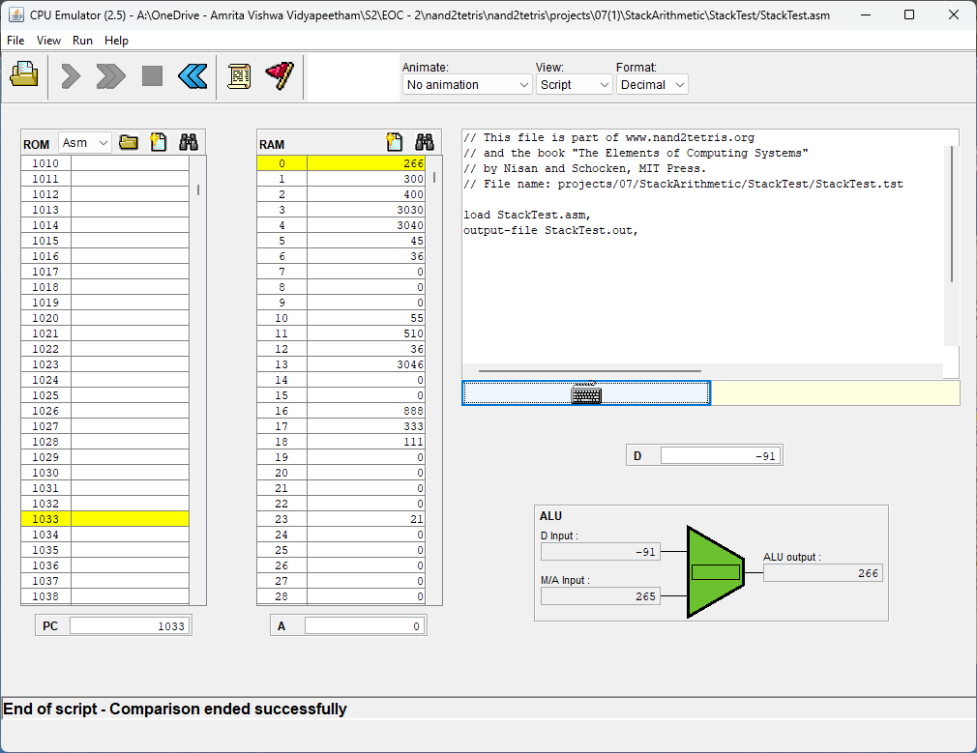
SimpleAdd
StackTest

Slide 24
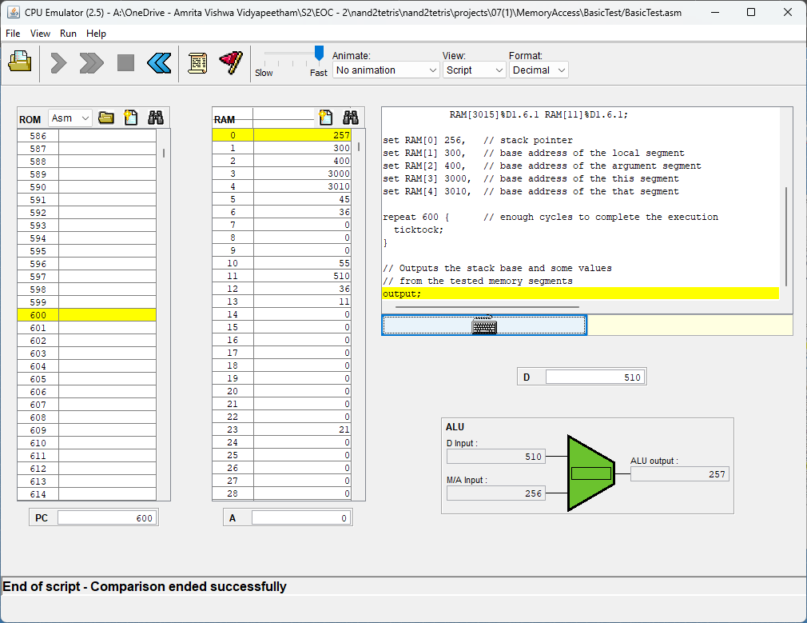
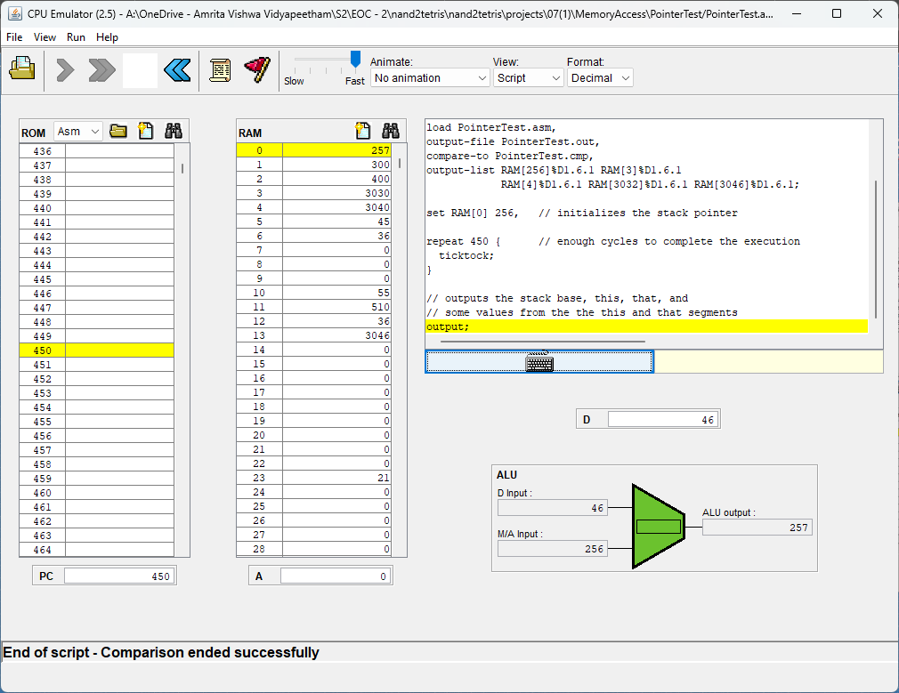
BasicTest
PointerTest

Slide 25
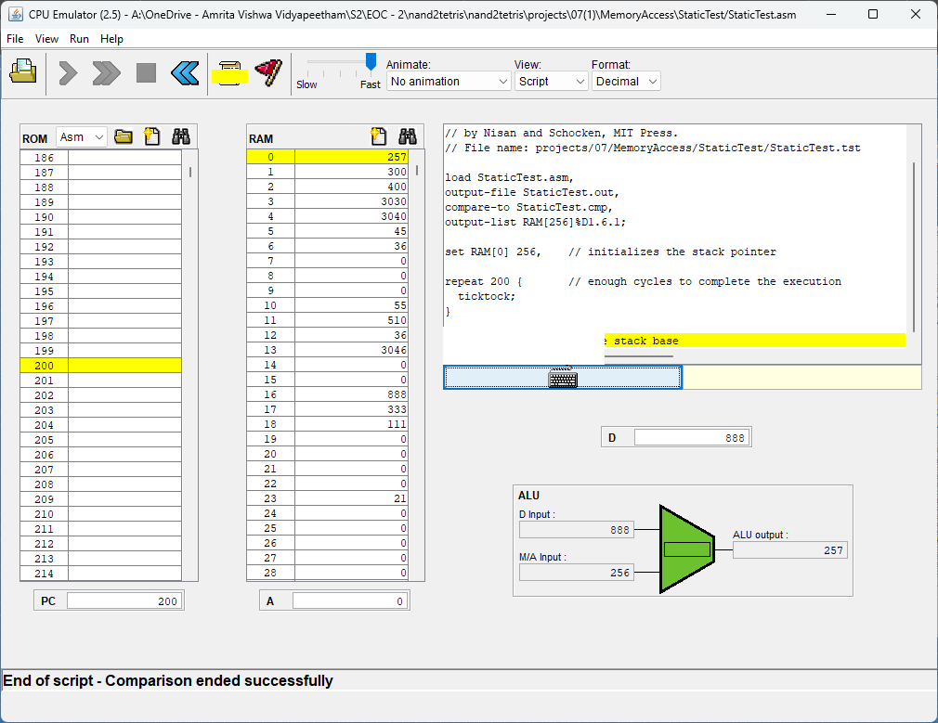
StaticTest

Slide 26
Question 2 Explain with the help of a stack diagram, argument how the following snippet of code works.

Slide 27
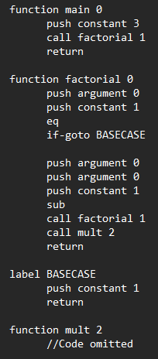
Answer
This is a function in VM language that calculates the factorial of the top value of the stack. When the function is called, the value is taken as argument in the function. The ‘0’ in the function definition implies that this function requires zero local variables to work. The logic here is that we first push the argument two times onto the stack, then subtract one from the top value and then using recursion, call the function again. This goes on until argument value becomes 1, in which case a constant 1 is returned. The values are multiplied and the factorial is calculatd and returned to the main function.

Slide 28
Answer
Function Call:
When the function gets called, the number of values we specify in the function call, get pushed onto the argument stack in the order they were pushed onto the global stack. Also, the location of the return address, LCL, ARG, THIS, THAT or collectively called stack, gets saved.
Handling Function:
When the function runs, a new temporary local segment gets created with the number of local memory variables equal to the number we specify in the function definition.

Slide 29
Answer
Handling Return:
After the function finishes, we need to go back to our main function. We use the ‘return’ command for this. When ‘return’ is used, the answer we obtained from our function is pushed onto ‘argument 0’.Then the temporary stack we used is cleared. Finally, the frame of the main function is restored using the values we saved earlier during the function call. This effectively transfers control of our program back to the main function with our answer as the top value in the global stack.

Slide 30

Explanation
In the main function, first a constant 3 is pushed onto the stack.
After this, the function is called and the control is transferred to the factorial function.
3
push constant 3
STACK
STACK

Slide 31
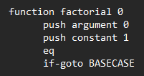
Explanation
In the function, first the ‘argument 0’ is pushed onto the stack and a ‘constant 1’ is also pushed onto the stack.
If ‘eq’ returns true, program jumps to label ‘BASECASE’, else it continues as usual.
3
T/F
push argument 0
push constant 1
1
eq
STACK
STACK
STACK

Slide 32
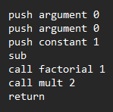
Explanation
3
3
push argument 0
push argument 0
push constant 1
3
2
sub
1
STACK
STACK
STACK
The argument is pushed 2 times and then ‘constant 1’.
Then ‘sub’ is used and the final stack is obtained.

Slide 33
Explanation
Then the factorial function is called again. So now, we will take factorial of 2. Again the same first few steps are followed.
3
3
2
2
1
STACK
STACK

Slide 34
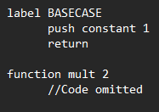
Explanation
Now, the factorial function again gets called but this time for ‘1’.
So, this time, the initial ‘eq’ condition is True. This makes the program jump to the label ‘BASECASE’ and return 1.
3
3
3
3
2
2
2
If-goto BASECASE
push constant 1
2
push constant 1
eq
1
1
T
1
1
STACK
STACK
STACK
STACK

Slide 35
Explanation
Now, the ‘mult’ function gets called which multiplies the top 2 values. As we saw, with recursion, the factorial function got called two times. So the ‘mult’ function also gets called two times.
3
3
6
2
2
mult
mult
1
STACK
STACK
STACK

Slide 36
Explanation
This is the final stack we obtained. As we can see, we obtained the value ‘6’ which is equal to 3 factorial.
After this, the ‘return’ command transfers control of the program back to the main function.
6
This value is returned
STACK

Slide 37
Question 3

Slide 38
Write a VM function that pushes the value of the input arg onto the stack N times, where N is the value of the second input arg.

Slide 39
CODE

Slide 40
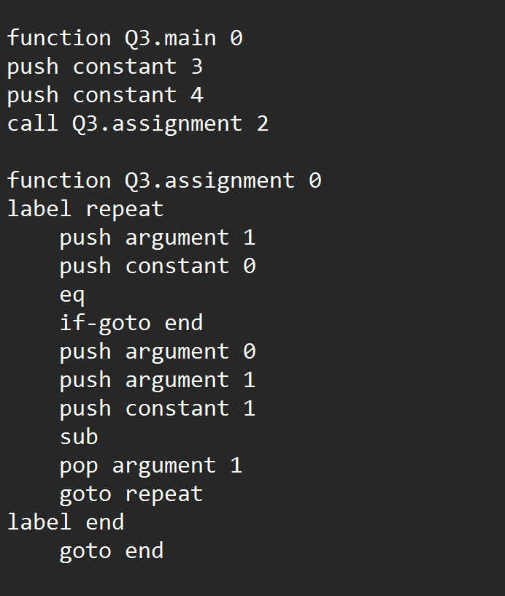

Slide 41
RESULT

Slide 42
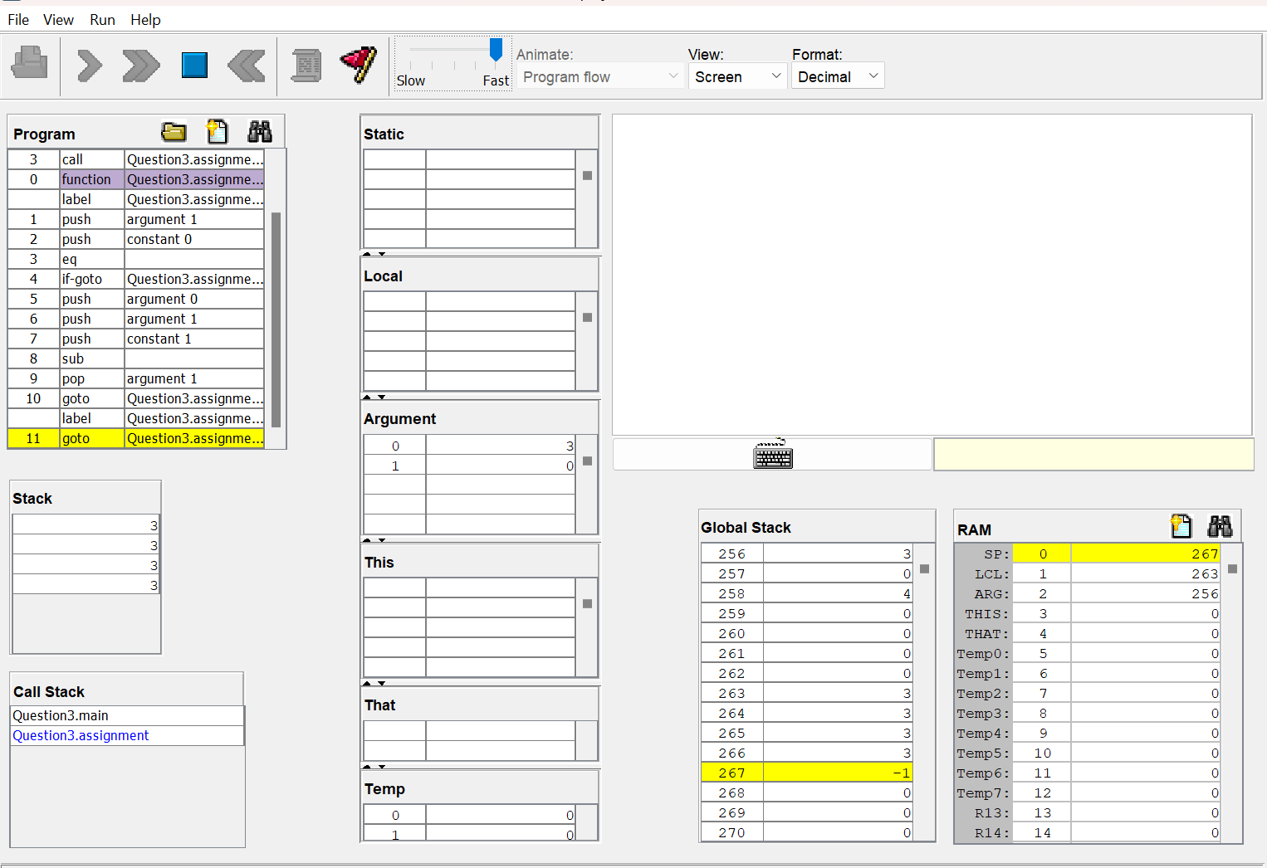

Slide 43
Question 4

Slide 44
Explain in detail ‘THIS’, ‘THAT’and ‘POINTERS’

Slide 45
THIS
The "this" memory segment refers to the memory block reserved for the current object instance being called on.
When a method on an object is called, the Hack VM reserves a block of memory for that object and initialises it with its data members. The "this" section points to the beginning of that block of memory, allowing the method to access or edit the object's data.
The "this" memory segment is used for instance variable access, which means that whenever a method wants to access or alter a data member of the current object instance, it will do so via the "this" segment. Assume we have a "Person" class with two data members "name" and "age". We could utilise the "this" segment within a Person class method to get the current Person object's "name" data component.

Slide 46
THAT
The "that" memory segment is used to store the base address of the memory segment containing the current object on which a method is being called.
An object is an instance of a class in object-oriented programming, and each object has its own set of data and behaviour. When a method on an object is called, the method must know where the object's data is stored in memory in order to access or modify the data.
To access or modify data within the current object, use the "that" segment in conjunction with the "this" keyword. The keyword "this" refers to the current object instance, whereas the "that" segment stores the base address of the memory segment containing the current object.

Slide 47
POINTER
The "pointers" memory segment in Hack VM is a region of memory used to store references to objects in the heap.
A variable that contains the memory address of another variable or object is known as a pointer. Pointers allow programmes to indirectly access and manipulate data by referring to the data's memory location rather than the data itself. Pointers are frequently used in object-oriented programming to refer to objects in memory, which are typically allocated dynamically on the heap.

Slide 48
In Hack VM, the "pointers" memory segment provides a way to store references to these objects. When a new object is created on the heap using the "push constant" and "call Memory.alloc" commands, the address of the object is returned, and this address can be stored in a pointer variable in the "pointers" memory segment using the "pop pointer" command. Once the pointer is set to the address of the object, it can be used to access and manipulate the object's data using other commands such as "push this" and "pop that".
The memory segment "pointers" is made up of two pointer variables called "pointer 0" and "pointer 1," which are used by the VM implementation to access the "this" and "that" pointers, respectively. Using the "push pointer" and "pop pointer" commands in a VM programme, the programmer can use these pointers to store and retrieve references to objects on the heap. VM programmes can dynamically allocate and manipulate objects by using pointers, which is a key feature of many object-oriented programming languages.

Slide 49
Question 5

Slide 50
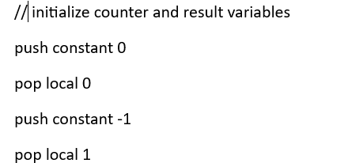
CODE EXPLANATION
Here, the code initializes two local variables: counter (local variable 0) is set to 0, and result (local variable 1) is set to -1. These variables will be used to keep track of the loop counter and the index of the found target value, respectively.

Slide 51

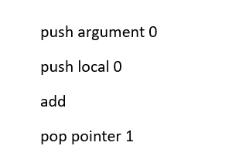
This line declares a label named "loopStart". It marks the starting point of a loop.
These instructions calculate the memory address of the current array element based on the array pointer and the counter. It pushes argument 0 (the array pointer) onto the stack, then pushes local 0 (the counter) onto the stack. The two values are added together, and the result is stored in pointer 1 (a pointer to the current array element).

Slide 52

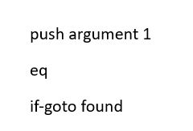
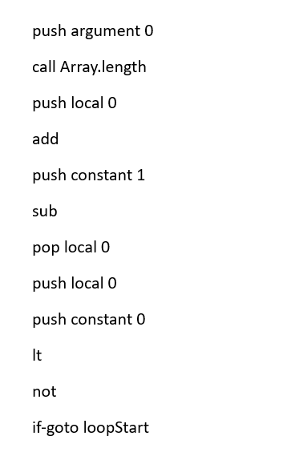
Here, the code compares the value at the current array element (obtained by dereferencing pointer 1) with the target value (argument 1). If the values are equal, it jumps to the label "found". Otherwise, it continues to the next instructions.
These lines update the counter variable (local 0) to prepare for the next iteration. First, it calls the Array.length function, passing argument 0 (the array pointer) to determine the remaining length of the array. Then, it adds the length to the counter (local 0) and subtracts 1. The updated counter value is stored back in local 0. Finally, the code checks if the counter is less than 0 (indicating there are still elements to search), and if so, it jumps back to the label "loopStart" to continue the loop.

Slide 53

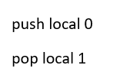
This line declares a label named "found". It marks the position in the code where the loop exits when a match is found.
Here, the code stores the current value of the counter (local 0) in the result variable (local 1). This indicates that the index of the first occurrence of the target value in the array has been found.

Slide 54
CONTRIBUTIONS
Aswin Ravidev(08) – Question 2
Sarvesh () – Question 5
Kishor(28) – Question 3,4
Yeshwanth Balaji – Question 1

