Slide 1

Machine Learning Hackathon CG 2022
Team Name-Yesh Group
Team Leader Name- Yeshwanth Sai Melpati
Team Leader Email Address- yeshuthecool@gmail.com

Slide 2
Brief description of the problem at hand:
Problem statement: The problem is all about finding whether a website is prone to phishing attach or not. In this present day, data privacy plays a major role. It is responsibility of the individuals and developers to make sure the data stays safe with relevant parties.
We as a team of Data Scientist came to rescue this. We have to build a ML algorithm that can predict whether the website with its attributes and features, is prone to phishing attack or not.
In this way, website make their arrangements for a better protection and safe gaurd the information.

Slide 3
Solution proposed and description:
For this phising attack dataset, We have analyzed the entire data set for all the features.
Among 30 features, We first find out which features are responsible for almost all of the phishing attacks.
We build a base line model with train test split data, In order to get the predictability of the ML models. We are fortunate that our base line model of Random forest perform good.
Now with help of feature engineering, we subset the high important features responsible for the accurate predictions.
Now with iterate our models for fine turing the parameters.
And finally we build Random Forest Classifier with optimum parameters and hence were able to achieve 97% accurate results.

Slide 4
Technology/Tool Stack Used:
We used pandas for data loading and analysis.
We used matplotlib, seaborn for plotting graphs and charts
We used sklearn for all the Machine Learning models
especially: DecisionTreeClassifier, RandomForestClassifier
We used accuracy, f1 scores for validating the predictions

Slide 5
Approach:
Our approach:
1. We first loaded the dataset with help of pandas
2. We analyzed with describe functions
3. We plotting distribution of variables / features with matplotlib
4. We split the train dataset to train and validation sets
5. We build a base line models DecisionTreeClassifier, RandomForestClassifier
6. We then perform Feature importance and Hyperparameter turning
7. Finally we conclude with our final best model.

Slide 6
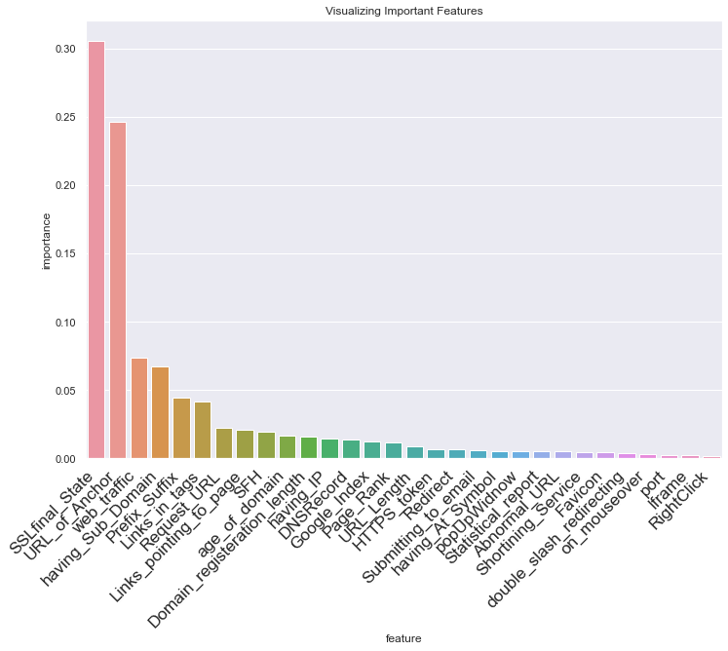
Execution Demo(Video/Screenshots) of the solution:

Slide 7
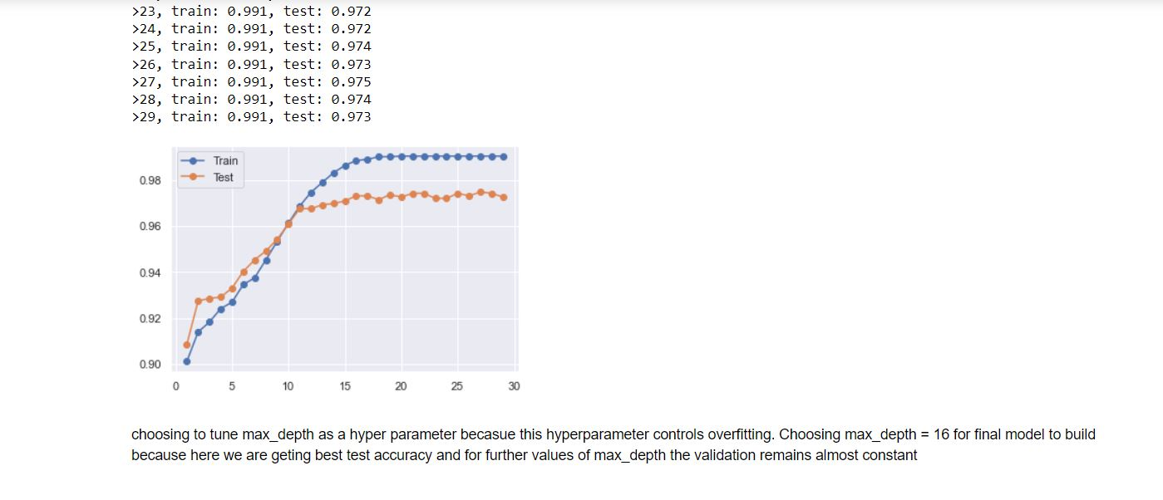
Screen shots of the solution
Execution Demo(Video/Screenshots) of the solution:

Slide 8
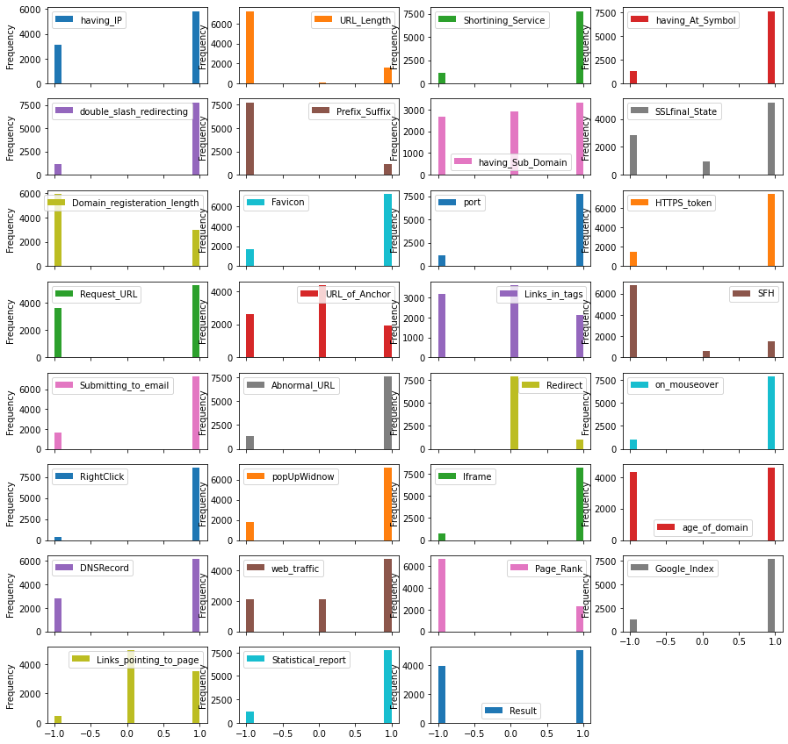
Screen shots of the solution

Slide 9
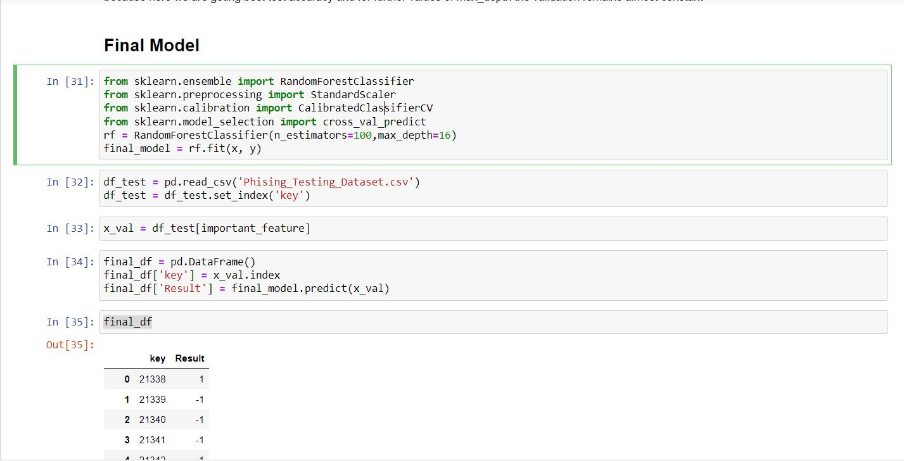
Screen shots of the solution

Slide 10
Source code as ZIP or Github URL:
https://github.com/YeshwanthSaiM/HPE-ChallengeTechGig

Slide 11
Additional comments (optional):
This is an interesting problem. For further accuracy and performance we can
dive deep in feature engineering techniques and methods.

Slide 12
THANK YOU

