Slide 1
callPay
~Voice experience-as-a-service
Team Name: YeshwanthsAI
Members:
Yeshwanth Sai Melpati :: ML engineer
Sanchita Khare :: Business Analyst
Praveen :: Backend engineer
Siva :: UI developer

Slide 2
CONTENTS
Overview
Goals
Specifications
Features in Detail
Impact of callPay
Use cases
User Flows- Onboarding
User Flows- Payment
Technology Specifications

Slide 3
Overview
With 6 billion smartphone users and 51 %of the world's population being internet users, the impact of digital technologies on customers has increased significantly.
Digitalization of financial services has become an integral part of the economy in developing countries especially in India. Hence successful financial inclusion has to be made at the customer level.
Highlights of callPay:
By using “callPay” the reach and digital financial traffic will increase at least by 20 percent.
Our service can cover up to 75 - 80 % of the existing financial transactions.

Slide 4
Goals
Voice based assistant for making UPI based payments.
Impact: This feature offers users natural voice experiences, and zero-touch experiences, while communicating with the enterprise systems.
Voice assistant for making these payments more fun and interactive.
Impact: Soon you won’t be able to spot a difference between a human and a machine. Would increase the engagement of the users therein resulting in the increase of the acquisition rate
Toll free number enabling users to perform UPI transactions offline.
Impact: Even when there is no internet connection to the mobile or internet is fluctuating. They can make a call and then the payment or transaction completes
Quizzes and other services to educate the user about the services.
Impact:By this feature we increase app usage, user engagement and eventually awareness about the app feature

Slide 5
SPECIFICATIONS
Chat-bot
Which listen and understands the user intention and tries to full-fill the need in terms of making payments.
We make chat-bot using aws lex nlp, which has the required skills to understand and perform UPI based transactions.
Name : callPay bot
Toll-free number
a tool-free number which enables users to perform all UPI based transactions even offline.
We make a toll-free number with chat-bot as an end point to address all the issues and even make UPI based transactions offline.
Number : +1 866-803-6498

Slide 6
FEATURES IN DEATIL
Voice assistant
Chat-bot has the ability to respond to user voice. Hence almost all transactions can be made through voice commands. Bot constantly listens and converts the speech to text and performs necessary transactions. Once the transaction completes the acknowledgement is also provided in the form of voice.
Offline UPI transactions
Offline UPI transactions are possible with the toll-free number. As this is done solely on phone network, they don’t require the internet.
Voice notification
User receives a voice notification every time he receives a payment. We can extend it to notify with voice for any transaction done. But currently we implemented voice notification features similar to “Paytm sound box”.
Note : We made voice notifications translated from english to hindi.
Quiz
UPI and app based quiz, where the questions are based on app features, details, limits, working procedure and offers. There are levels based on usage and difficulty. User clears the questions and receives rewards in the form of cashbacks and directly prize money. A small survey done with random 10 different people using UPI based payments app. We found 80 percent of them interesting and curious about this quiz feature.

Slide 7
Personalization
We add soothing and relevant music to make it more fun and realistic.
Use case 1:
For Quiz: User would be asked to answer couple of questions
For Correct Answer
Sound : “Claps and celebrations”
In Correct Answer
Sounds : No noise .Encourage the user to never mind and take up the next question.
Use case 2:
For notification :
Voice : Congratulations Eric one thousand rupees was transferred to your account from Varun. .
Any more help required Eric ?
User : No
Voice : That’s cool I guess you are driving the vehicle . Am I right?
User - Yes
Voice : Oh okay just to remind you. Please fasten your seat belt. Have a safe trip Eric. Cya.!!

Slide 8
Multi-language support
We can support almost all main regional languages including Hindi. By using relevant translators we can easily shift and lend support or service in any other language.
Rapid re- prompts
Even when user response was not captured correctly, bot remains in the same state and prompts again till it gets the required information to complete the task and then completes the transaction. Typical conversation to show that they didn’t really understand the speaker like
“What was that?”
“Say it again?”
“I’m sorry?”
Additional security features
Voice recognition: We authenticate users with some voice tokens. To make it a bit fun and interactive, We ask him to repeat a tongue twister or ask him to sing a song.
Face recognition: We use face recognition. We recognize him with his smile.

Slide 9
IMPACT
Impact on existing users
Existing users can use callPay and can be able to make an UPI transactions even without the internet and while driving in addition to existing ways using the internet. This increases the total number of transactions by at least 25%. The Quiz feature even engages the users with more usage and awareness of the features. By rewards and tasks in the quiz there is an increase in app usage many folds. With reference to google pay sticker collection feature introduced in October 2019 increased the usage of it by 27%. Hence, we claim an
increase in usage of app by around 25 %.
Impact on new users
Adding new users is made with an ease with callPay that assists the users in regional languages. Hence, we target 35 % of total population in rural india using smartphones to use our paySa app with callPay in it. The ability of making transactions even at fluctuating internet is Unique Selling Point for users. Hence we claim an
increase of 25 to 35 %of total upi based transactions with callPay
Impact on merchants
On the total of 672 million upi transactions in the month of January 2019. Not more than 14 percent i.e around 100 million transactions are of merchant transactions. According to Sajal Bhatnagar, vice-president, business at Paytm, There is a need to solve merchant use-cases and needs that has potential for improvement in total upi digital print. So paytm has launched a sim-card enabled sound box for a one-time deposit of Rs: 700 and then Rs: 50 every month. We at callPay provide the same feature without any additional cost in regional language. Hence, we can claim
an improvement of 14 to 20 percent of upi digital print from realme Paysa app with callPay enabled.

Slide 10
Impact on metro cities
Among the total upi transactions around 64 percent of transactions happened in metro cities as of august 2019. Though there are many situations where a user was unable to make a upi transaction for example while driving , without proper internet. We solve the problem with toll-free numbers and featuring users to make transactions handsfree.
Hence there can be increase of additional 5 % of upi transactions and eventually reflect the digital usage of the paySa app with callPay
Impact on rural
35 percent of total population in rural india using smartphones are more likely to use our paySa app with callPay due to the handsfree regional language upi payments feature and with toll-free numbers facility. The ability of making transactions even at fluctuating internet is Unique Selling Point for users. Hence, we claim an
increase of 25 to 35 % of total upi based transactions with callPay.
Overall Impact:
Hence on a whole, considering previous upi transactions and realme mobile usage. There would be at least a 20 to 25 % increase in usage of paySa app in terms of both registered users and in usage hours.

Slide 11
USE CASES
Use case 1 :: Making UPI based transactions while driving.
Use case 2 :: For farmers to make an UPI payment in their own language.
Use case 3 :: Making a voice notification in regional language once after the payment.
Use case 4 :: Making UPI based transactions offline.
Use case 5 :: Making UPI based transactions through a phone call.
Use case 6 :: Making UPI based transactions in different currency(Dollars/Euros)
Use case 7 :: Adding money to existing e-wallets like ola, uber zomato and big basket apps.
Use case 8 :: Block/Unblock the card if lost associated with the account.
Use case 9 :: Information about last transaction was successful if yes to whom it was done with what amount
Use case 9 :: Recharge your phone number
Use case 10 :: Reminder for mobile recharge on next month(financial decisions by analysing habits)
Use case 11 :: To enquire and get to know the bank savings/current account balance with the associated card.

Slide 12
Demo User FLOW-Onboarding
Onboarding flow (Registration Flow)
A new user can be registered to the UPI gateway by calling the toll-free number as stated above. If he already had an UPI registration done. He can directly use the services by calling the number.
User :: User calls the toll-free number
Bot :: Welcome to callPay! This app is made by team YeshwanthsAI. You can send money or play a quiz here with your voice. Isn’t it fascinating!
User :: “I want to send money but before that I want to register for callpay.”
Bot:: Hi suraj. You have registered for the following banks SBI with 1023 account last four digits and HDFC 1204 account last four digits.
User :: Register with HDFC bank account.
Bot:: Sure. A otp is sent to your mobile. Please say it.
User :: otp is * * * * * *
Bot:: Please say or enter a four digit number to set it as your pin
User :: * * * *
Bot::Congrats. You have successfully registered. Do you want to check me for other features like sending money or even you can play quiz with me.

Slide 13
Demo User FLOWS-Payment
Payment flow:
When a user calls the toll-free number from his registered number, the chat-bot addresses with relevant prompts for getting required details for making a payment. Then back-end system powered by aws makes a secured API call to complete the payment and acknowledgment is given to the user
Steps for payment:
Step1: User calling to toll-free number.
Step2: User says “I want to send money to phone number 9874563210
Step3: User gets the prompt to say his pin number.
Step4: For another stage of authentication, User is asked to say his last four digits of registered aadhar card number. (Important)
Step5: Once all the required details are collected the back-end engine makes the payment
Step6: User is given the acknowledgement of the payment.

Slide 14
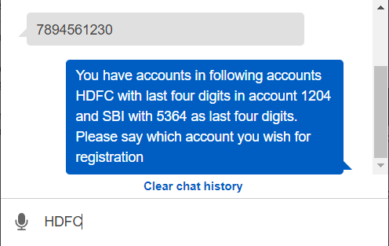
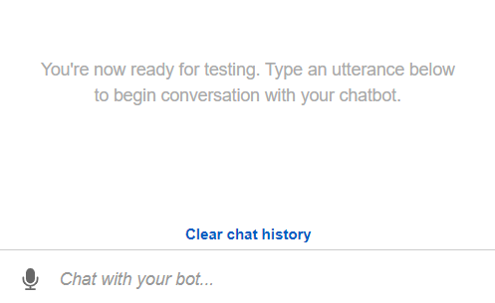
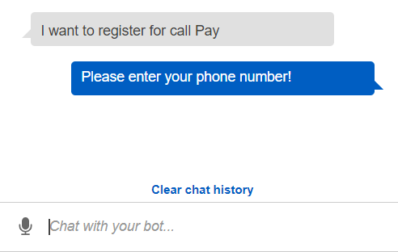
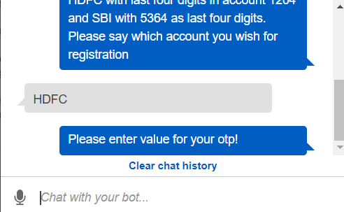
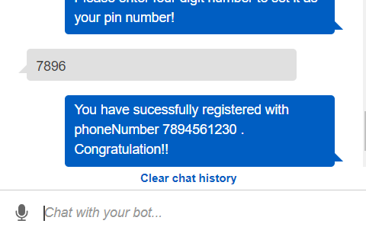
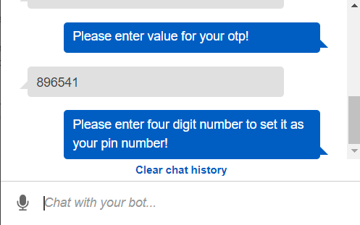
Fig: The snapshot of the payment flow

Slide 15
Technology specifications
MOBILE APP INTEGRATION:
This service can be integrated with any of the existing UPI based payments apps like GooglePay, PhonePe, BHIM etc. When a user clicks on the button, a phone call will be placed to the toll-free number. This way is more secure, As the relevant api keys are extracted from the mobile encrypted storage from the app.
Additional Details:
Toll-free number :: +1 866-803-6498
Chat-bot :: callPay
Security :: Aws authentication
IVR system :: Aws connect
Chat-bot engine :: Aws lex
Note:
Presently for the demo purpose, we use US region toll-free number. Once the project goes live, we use the local region toll-free number.
The present paytm speaker feature is implemented with additional speakers. We will be implementing the feature with no additional speaker.
These features can easily be applied to Iot devices like smart watches, smart tvs etc.

Slide 16
THANK YOU

