Slide 1

Department of Computer Science and Engineering TEXT CLASSIFICATION USING LSTM (RNN)
171FA04512 - Yeshwanth Zagabathuni
171FA04546 – Gokul Krishna Sesank

Slide 2
Topics to be covered
Abstract
Architecture
Hardware and Software Requirements
Technical Requirements
Introduction to RNN
Need for LSTM
About LSTM
Evaluating the model
Pros and Cons
Applications
References

Slide 3
ABSTRACT
Text Classification is an on-demand research project used by many NLP systems, Character Recognition, Music Composition, Handwriting Recognition and what not.
The project is based on classifying a set of text organized in 2-3 lines each, into one of the two categories: spam or ham.
The first step is to eliminate useless features. Except for the class label and text column, the other features are of no use and hence will be dropped.

Slide 4
ABSTRACT
After a bit of data visualization and analysis, we proceed by splitting the dataset into train and test.
After tokenizing the data we create the required LSTM function and create an instance of it.
Our final step is to fit the model to the dataset and train the model for a fixed number of iterations or epochs.
We can further evaluate the model with metrics from the confusion matrix such as accuracy.

Slide 5
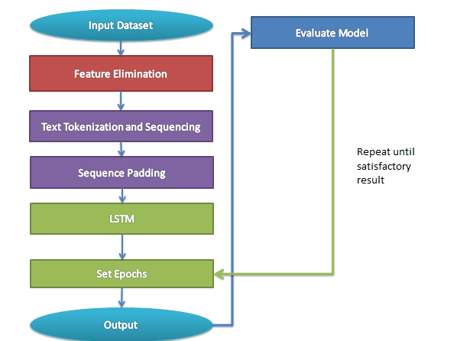
Architecture

Slide 6
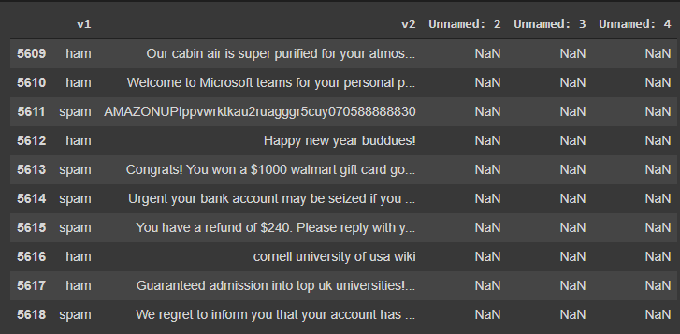
Initial Dataset

Slide 7
Eliminating useless Features
As you can see, features like username, screenname, location are not useful to the LSTM model in any way.
However, the text and assigned class label are the features that are actually useful to the model.
Hence, the useless features are dropped. This can be visualized in the following slide.

Slide 8
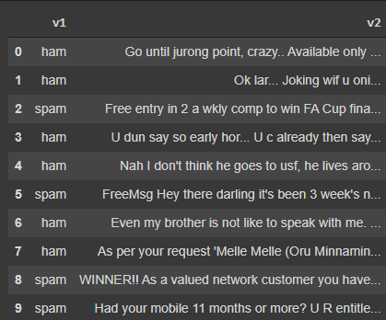
Eliminating Useless Features

Slide 9
Hardware and Software Requirements
HARDWARE:
RAM: 8GB or higher.
Intel Core: i5 or higher
Minimum memory required: 8GB
Min Graphic Card: NVIDIA GeForce GTX 970
SOFTWARE:
Windows OS (8 or higher) or any Linux OS.
Python (3.6 or higher).
CSV file support.
High speed internet connectivity.
MS-Office support.

Slide 10
Technologies to be used
Google co-laboratory
Anaconda Navigator or Jupyter Notebook
Python
Keras modules for NLP
Sci-kit-learn functions
Visualization libraries such as Matplotlib, Seaborn
Pandas and Numpy for numerical computations, visualizations and database style operations.

Slide 11
Introduction to RNN
We might have definitely heard of convolutional neural networks capable of replicating humanoid neurons.
These kind of neural networks comprise of a summation function which sums up the weights with additional bias and an activation function which decides the output.
And of course it consists of 3 major layers: input layer, hidden layer and output layer. The visualization is as follows:

Slide 12
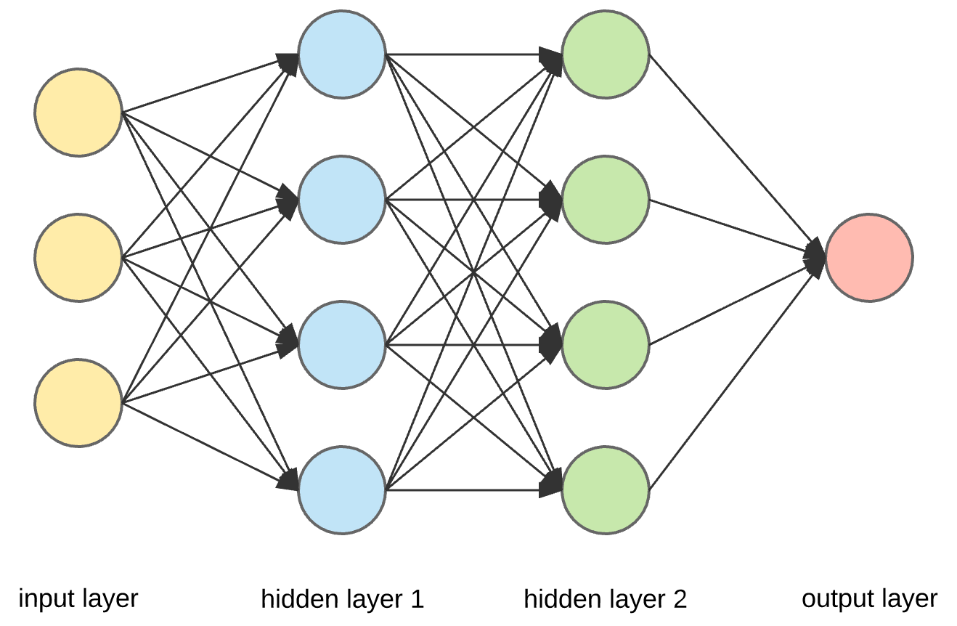
Introduction to RNN

Slide 13
Introduction to RNN
Now let us understand the need to introduce RNN.
Humans don’t start their thinking from scratch every second. We also keep the past in view on multiple occasions. Simple examples can be drawing money from an ATM, paying bills, driving to a certain location etc.
In all the above cases we use our past experience. This is where RNN succeeds and CNN fails.

Slide 14
Introduction to RNN
RNNs are capable of taking decisions based on past knowledge something the CNNs lack.
While CNNs may help classify an image based on similar images they may not be helpful to classify sequential data.
This may include determining the category of a sentence consisting of a large sequence of words or a speech.

Slide 15
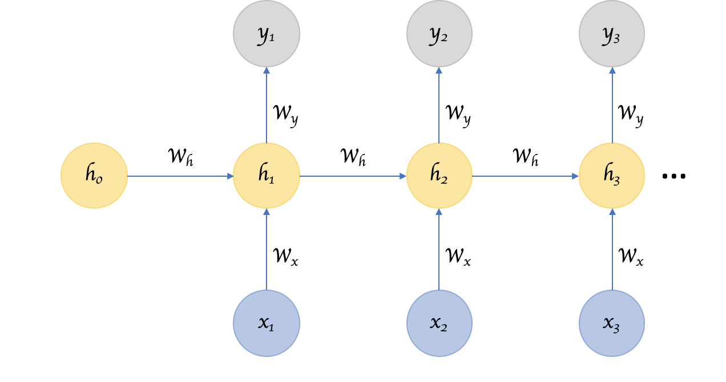
Visualization of RNN

Slide 16
Need for LSTM
Let’s consider a text like “My name is Ash and I’ve been to Tamil Nadu…..I can speak Tamil.”
We obviously know that the last word in the sequence is going to be a certain language but the question is which language? Until we trace back to the first sentence we don’t know the answer.
Although RNNs may consider the last few sentences they still can’t identify what language it is without keeping the entire essay in mind. This is because the gap has become really large and that created the need for LSTM.

Slide 17

Visualization of LSTM

Slide 18
About LSTM
The rectangular box is called as an LSTM cell. It comprises of three gates. The LSTM does have the ability to remove or add information to the cell state, carefully regulated by structures called gates.
The gates are different neural networks that decide which information is allowed on the cell state. The gates can learn what information is relevant to keep or forget during training.

Slide 19
About LSTM
Input Gate: It controls whether a value must be updated or not.
C_{t} = C_{t} + (I_{t} * C`_{t})
Forget Gate: It controls whether memory is set to zero or should lstm remember previous state.
C_{t} = C_{t-1} * f_{t}
Output Gate: It determines whether the output of the current cell state is made visible.
All of these gates have a sigmoid activation function. In addition we also have a cell state vector Ct.
H_{t} = tanh(C_{t})

Slide 20
About LSTM
The sigmoid layer outputs numbers between zero and one, describing how much of each component should be let through. A value of zero means “let nothing through,” while a value of one means “let everything through!”
The core concept of LSTM’s are the cell state, and it’s various gates. The cell state act as a transport highway that transfers relative information all the way down the sequence chain.

Slide 21
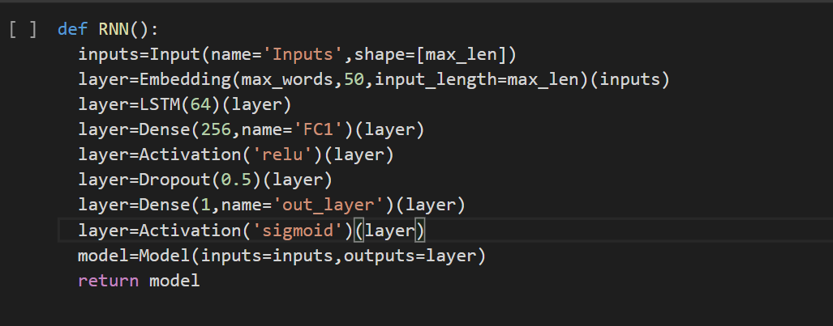
About LSTM

Slide 22
About LSTM
First, in order to pass the inputs we create an Input class object.
Next we create a “layer” object to which an complex embedding of the input is passed. Now, this object is passed to LSTM as input.
Next, we have the Dense function which does the weighted summation of inputs followed by addition of bias.
The summation passes through the relu activation function.

Slide 23
About LSTM
Next, in order to eliminate certain information that may not be useful for decision making, the Dropout function is introduced at a rate of 0.5.
After filtering out unnecessary information, yet again the Dense function is called which does the weighted summation of inputs followed by addition of bias.
This time, the summation passes through the sigmoid activation function.
Finally, we have the model object, which groups all the given layers into a single object model.

Slide 24
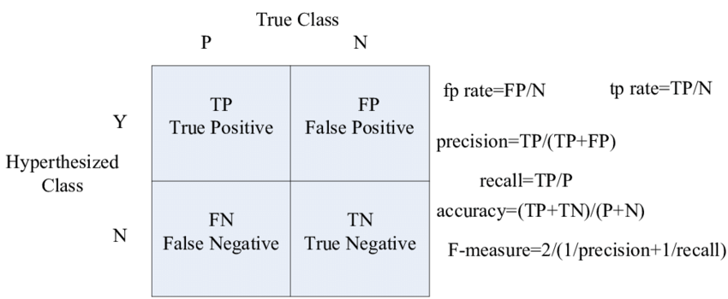
Evaluating the Model

Slide 25
Evaluating the Model
We vary the number of epochs and evaluate our model at each iteration until we achieve our required classification.
We use metrics from the confusion matrix to evaluate our model.
We can also use similarity measures such as Jaccard Similarity, Cosine Similarity etc.
Furthermore, we may also use distance measures such as L1-norm, L2-norm….L∞-norm.

Slide 26
Pros and Cons
Pros:
Overcomes Vanishing Gradient problem.
Useful for time series data with lags.
Less sensitivity to gaps compared to RNNs.
Cons:
A very complex structure not that easy to understand.
Requires more memory and time to train.
Prone to overfitting.
Sensitive to random weight initializations.

Slide 27
Applications of LSTM
Time series prediction
Speech Recognition
Handwriting Recognition
Grammar Learning
Music Composition
Rhythm Learning

Slide 28
References
https://colah.github.io/posts/2015-08-Understanding-LSTMs/
https://www.analyticsvidhya.com/blog/2017/12/fundamentals-of-deep-learning-introduction-to-lstm/
https://arxiv.org/abs/1801.07883
https://www.geeksforgeeks.org/understanding-of-lstm-networks/
https://youtu.be/QciIcRxJvsM
https://youtu.be/UNmqTiOnRfg

Slide 29
THANK YOU!

