Slide 1

TRACE
The AI memory lab
DataForge 2026
Team Cyber Leek
Pathway track: Explain the Frontier
Notes:
Opening, about 20 seconds: We are Cyber Leek. TRACE is an interactive AI memory lab built for DataForge’s Explain the Frontier challenge. Our goal is to help a learner understand why an AI memory can retain an outdated answer and what changes when we use a different update rule.
Source: DataForge 2026 Pathway track brief, docs/problem-1.pdf, pages 1–3. Organizer link: https://drive.google.com/file/d/1GKEOMLngVNvOa9Kiybj8yhX0946-7z52/view
Cover artwork: generated conceptual illustration using the built-in image generation tool. It is not an image of an actual neural network. Prompt: sparse cyan threads and warm gold synaptic points across translucent dark glass planes, portrait composition on black.

Slide 2
The problem: AI memory is hard to explain
The hackathon challenge
Turn one advanced AI concept into an interactive explainer. Learners must change inputs and observe meaningful behavior. Connect the explanation to Dragon Hatchling (BDH) or BDH-CQ.
Our focus: associative memory
How can changing connections store an association, retrieve it later, and mix it up with another? For students and developers learning how AI memory works.
Learning goal: explain a recall failure using the memory state.
Notes:
Problem, about 40 seconds: The track addresses the gap between frontier research and reusable teaching material. It requires meaningful interaction and a substantial, technically accurate BDH or BDH-CQ connection. We selected the approved topic Associative Memory and Fast Weights. The learner should be able to explain why competing information changes recall. A simple practical analogy is an assistant remembering an old preference after a new one arrives. TRACE demonstrates the underlying association mechanism with a controlled vocabulary. It does not understand arbitrary preferences or natural-language input.
Source: DataForge 2026 Pathway track brief, docs/problem-1.pdf, pages 1–3. Organizer link: https://drive.google.com/file/d/1GKEOMLngVNvOa9Kiybj8yhX0946-7z52/view

Slide 3
Technology stack
React + TypeScript
Interactive experiments, matrix replay, guided lessons and notebook UI.
Python FastAPI + NumPy
Validated APIs, live memory updates and a locally trained symbol decoder.
SQLite + secure sessions
Saved experiments and lesson progress. Scrypt password hashes and HttpOnly cookies.
Docker Compose + Nginx
Two containers, a persistent database volume and one startup command.
docker compose up --build
Notes:
Stack, about 35 seconds: The frontend sends real API requests through Nginx to FastAPI. NumPy computes the memory states and decoder output. SQLite stores user data and experiments. Passwords use salted scrypt hashes rather than reversible encryption. Session cookies are HttpOnly. Docker builds the frontend and trains the small decoder, then starts both services. No paid AI key or GPU is required. First builds need network access for dependencies.
Sources: compose.yaml; backend/Dockerfile; backend/app/main.py; backend/app/model.py; frontend/package.json; frontend/nginx.conf.

Slide 4
Our solution: a memory experiment you control
TRACE lets a learner cause a recall failure and test a correction.
01 Write
02 Compare
03 Explain
Create a conflict
Write Atlas with Amber twice, then write Atlas with Violet.
Change the rule
Hebbian recalls Amber. Delta recalls Violet in this controlled example.
Inspect the evidence
Replay actual matrix updates. Compare output with the latest value.
The memory still uses 72 cells. More writes can introduce interference.
Notes:
Solution and live demo, about 60 seconds: Select Memory collision. The sequence is Atlas–Amber, Atlas–Amber, Atlas–Violet. The desired latest value is Violet. With the preset’s additive Hebbian update, Amber dominates. Replay the writes and inspect a matrix cell. Change the write rule to Delta. The prediction becomes Violet in this example. The matrix remains 9 by 8, which is 72 float64 cells or 576 bytes for the recurrent state alone. This does not imply unlimited memory capacity. Delta corrects a prediction error during a write, while Hebbian accumulates an association. Overlap and retention controls reveal additional tradeoffs. Predictions and matrices come from Python computation.
Implementation: backend/app/model.py; backend/artifacts/metrics.json; docs/MODEL_CARD.md. All paths relative to D:/hackathon1.

Slide 5
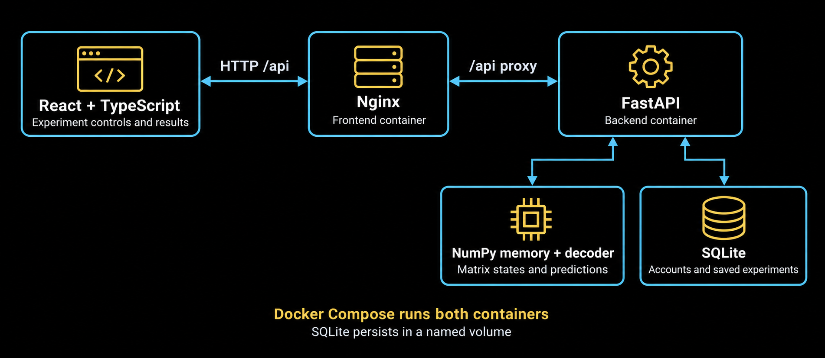
System architecture
Notes:
Architecture, about 35 seconds: React runs in the browser using static files served by the frontend Nginx container. Nginx forwards /api calls to the backend FastAPI container. FastAPI calls NumPy in the same backend process for inference and writes user records to SQLite. State snapshots and predictions return as JSON for the frontend to render. The SQLite database resides on a Docker named volume and survives normal container restarts. The diagram shows logical components, not five independently deployed services.
Sources: compose.yaml; frontend/nginx.conf; backend/app/main.py; backend/app/model.py. Architecture graphic generated with the built-in image generation tool from these verified component relationships. Prompt: black engineering diagram with cyan bidirectional connectors from React to Nginx to FastAPI, FastAPI branches to NumPy and SQLite, two-container Docker Compose caption.

Slide 6
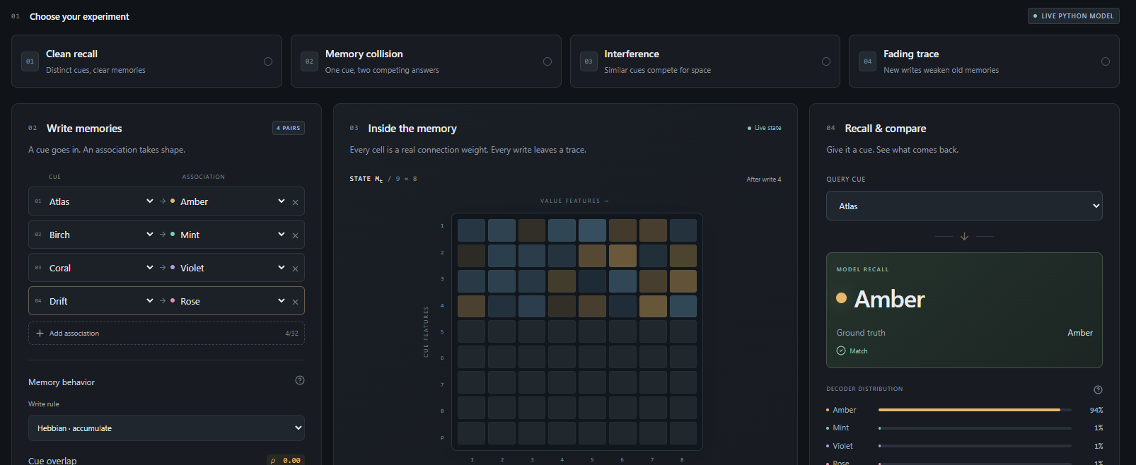
Working prototype
Editable inputs
Computed memory state
Prediction and expected value
Notes:
Prototype, about 30 seconds: This is an actual screenshot of TRACE, supplied by the user. The slide crops the browser and navigation so the experiment itself is easier to see. On the left, users edit associations and controls. The center shows the computed matrix. The right shows the decoder prediction alongside the expected latest answer. Names and presets are fixed teaching labels, while the memory matrix and results are calculated from the input. The current app also offers secure accounts, saved notebooks, lessons and a Model & evidence page. Open http://localhost:8080 for the live demonstration if the containers are running.
Screenshot source: C:/Users/PC/AppData/Local/Temp/codex-clipboard-40ad674c-e7e9-4769-9b95-52088deab901.png. Original preserved in output/pitch-assets/prototype.png.

Slide 7
Novelty: learning through visible memory failures
A reproducible learning experience that connects research
to behavior the learner can test.
Inspectable computation
Each write runs the memory update. Replay exposes how a wrong answer emerges.
Controlled comparisons
Change the update rule or cue overlap while keeping the experiment comparable.
Evidence and research
A trained decoder, exported metrics and guided BDH explanations support the lesson.
Eight-symbol educational model. Full BDH architecture remains outside the prototype.
Notes:
Novelty and close, about 45 seconds: Our contribution is the learning experience and integration, not an invented memory algorithm. We combine controllable failure cases, inspectable Python state, fair comparisons and a reproducible local application. The BDH section connects temporary synaptic association to the research and explains where the teaching model differs. We trained a small decoder on 6,000 generated noisy symbol samples and tested it on a separate 1,500. It classified 1,499 correctly. This is a controlled symbol-decoding metric, not language, reasoning, memory-retrieval or BDH accuracy. The implementation record reports 11 tests passing in the built Linux image on 8 September 2026. We have not yet measured learning gains in a user study. Proposed next validation: a short pre/post lesson assessment with student participants. Close: TRACE helps learners explain a memory failure by experimenting with the mechanism that caused it.
Implementation: backend/app/model.py; backend/artifacts/metrics.json; docs/MODEL_CARD.md. All paths relative to D:/hackathon1.
Research context: https://arxiv.org/abs/2509.26507 and https://arxiv.org/abs/2608.09888. TRACE teaches an associative-memory mechanism. It does not implement the complete sparse BDH architecture, language model, or BDH-CQ latent reasoning system.
Verification source: docs/VALIDATION.md.

