Slide 1

RAP N°2
BASTIEN, CLEMENT et HUGO
CÉDRIC LEFEBVRE et YESID BELLO
MAI 2021
Notes:
(20s)

Slide 2
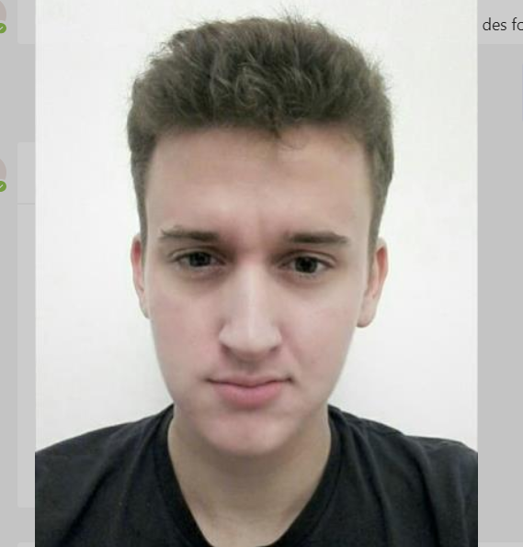






NAVeco system.
NAVeco presentation
Segmentation
Optimization
(Electrical)
Optimization(thermal)
Feedback
Destination
Arrival time
Nav. parameters
Constraints
parameters
Speed reference
Segmentation
Optimization
$$\left[\begin{matrix}d \\ v \\ e\end{matrix}\right]$$
Vehicle
(ACC, …)
Environment
(Traffic, Topography, …)
Dynamic model
(x, v, e)
or
$$τ$$
Phone, …
Vehicle
(Mass, SCx, …)
Position reference (itinerary)
Notes:
(1min30)

Slide 3
Clément ALEXANDRE
Itinerary segmentation strategy development
Internship : 01/02/2021 – 31/07/2021
RAP #2
3

Slide 4
Summary of the RAP 1 and the tasks carried out since
NAVeco presentation
HMI Simulink
HMI Python
Dynamic vehicle model
Dynamic vehicle model
Analysis of the variation of each parameter
Analysis of arithmetic uncertainties
Quadratic uncertainty analysis
Conclusion on the weight of each parameter
RAP 1
RAP 2

Slide 5
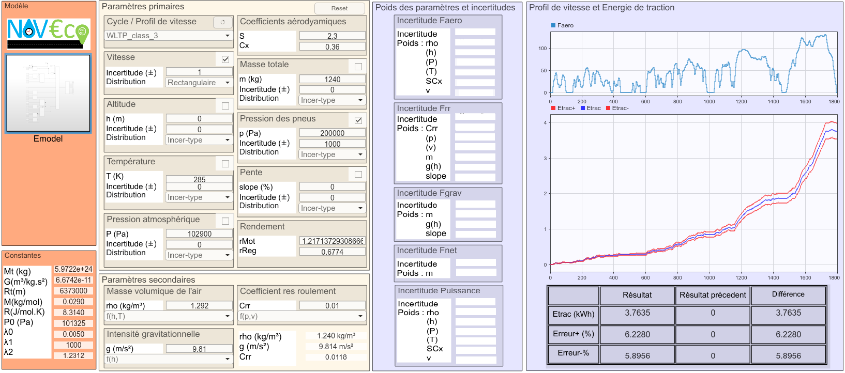
First approach of uncertainty estimation
NAVeco presentation
Calculation method
Calculation with the extremes of the uncertainty interval for each parameter
Example :
Parameter a ± Δa
y1 = ƒ(a-Δa)
y2 = ƒ(a+Δa)
[y1; y2] new uncertainty interval
Simulink GUI

Slide 6
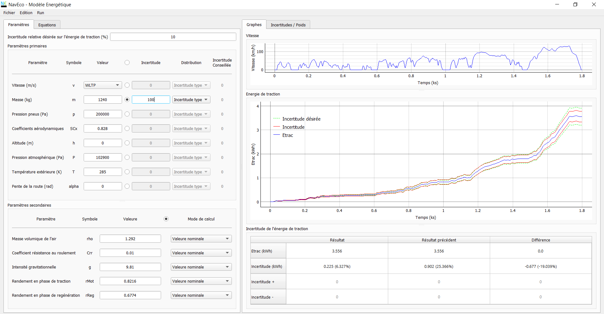

Second approach of uncertainty estimation
NAVeco presentation
Calculation method
Calculation with the derivative
Quadratic uncertainty
$$u_{E_{trac}}=\int_{0}^{T}{u_{P_{trac}}=\int_{0}^{T}{\sqrt{\sum_{x_{i}}{{\left(\frac{∂P_{trac}}{∂x_{i}}u_{x_{i}}\right)}^{2}}}}}$$
Python GUI with PyQt5
Parameters
Results

Slide 7
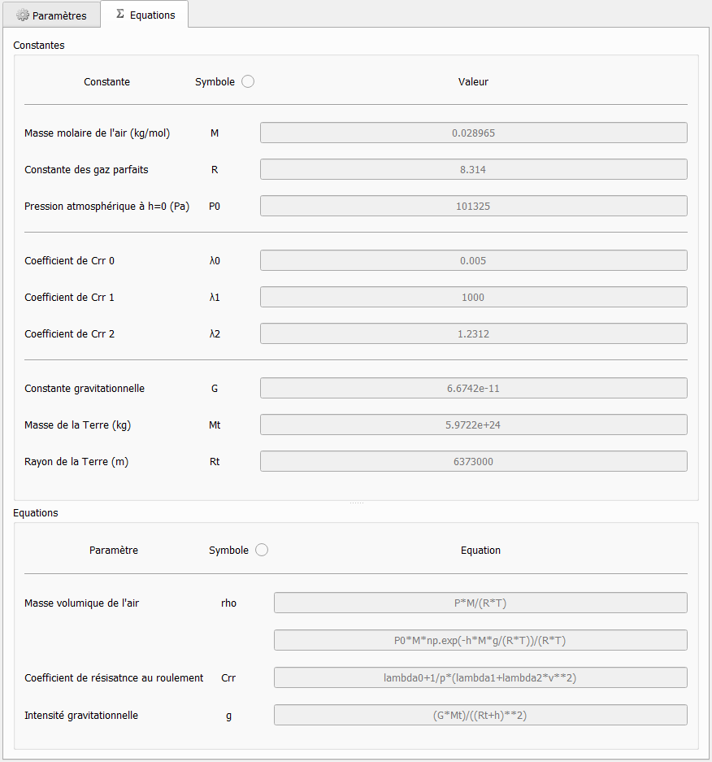
Software description : Model Tab
NAVeco presentation
Constants of the dynamic vehicle model
To modify the model
Constants of the dynamic vehicle model
Equation of calculated parameters

Slide 8
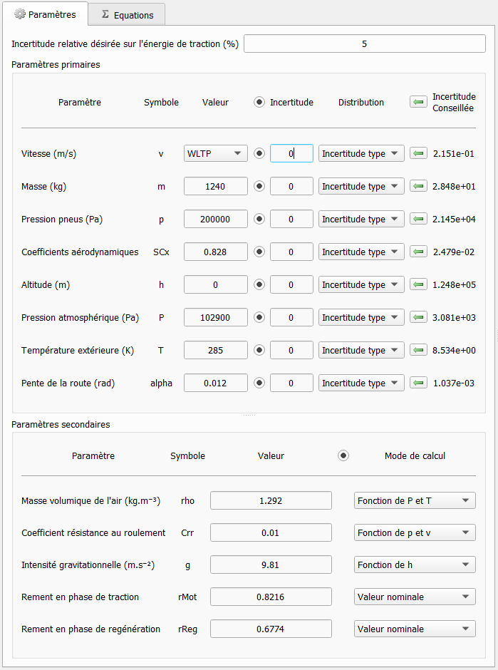
Software description : Parameters Tab
NAVeco presentation
Optimization program which makes it possible to advise an uncertainty as a function of the desired relative uncertainty
Optimization program: advise an uncertainty as a function of the desired relative uncertainty
Parameters with their uncertainty
Calculated parameters with their calculation methods

Slide 9
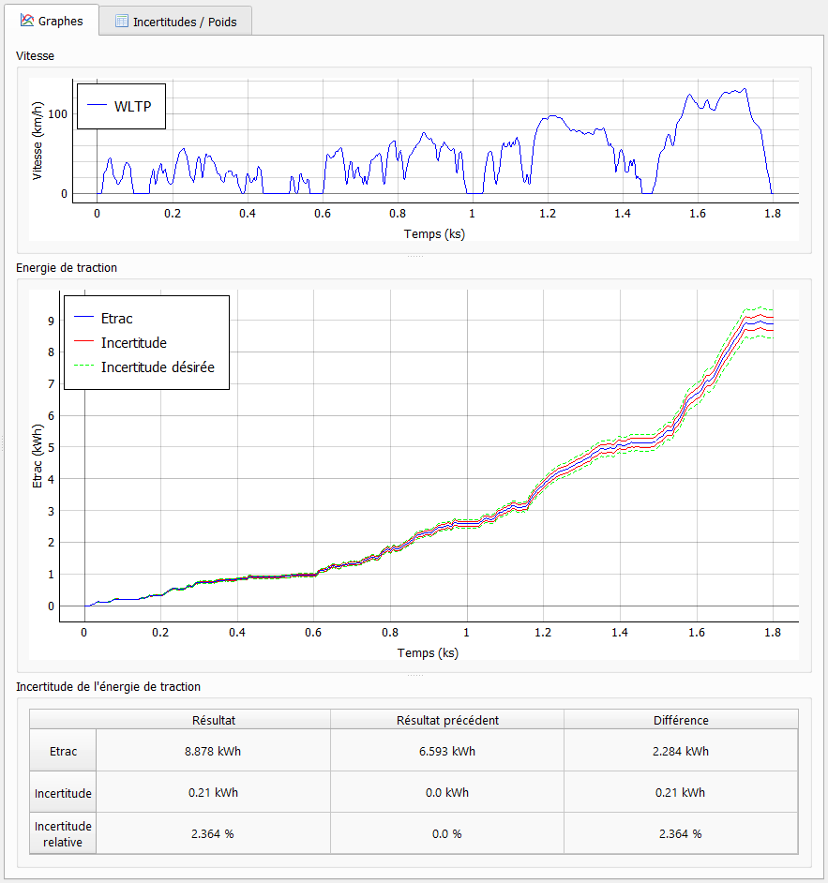
Software description : Graph Tab
NAVeco presentation
Optimization program which makes it possible to advise an uncertainty as a function of the desired relative uncertainty
Speed profil
Graph of traction energy, its uncertainty and the desired uncertainty
Numerical results and previous results

Slide 10
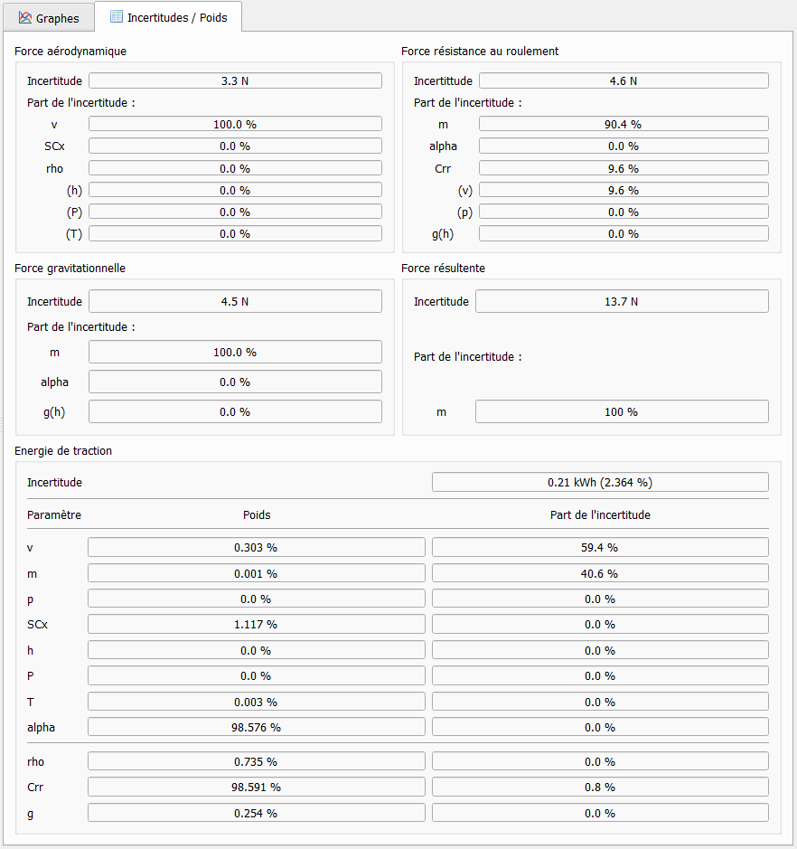
Software description : Uncertainty Tab
NAVeco presentation
Optimization program which makes it possible to advise an uncertainty as a function of the desired relative uncertainty
Uncertainty of the forces and detail of the part of the uncertainty of each parameter
Uncertainty of the traction energy and detail of the part of the uncertainty of each parameter and their weight

Slide 11
Interest of the software and conclusions on the study
NAVeco presentation
Interest of the software
From which parameters does the uncertainty arise and in which proportion ?
Applicable to any project
How to choose the uncertainty of my sensor ?
Which parameters are most important for route segmentation ?
Conclusion : Weight of each parameter on the uncertainty of the traction energy

Slide 12
State of progress
NAVeco presentation
Processed
In progress
Upcoming tasks
Goal
Intermediate objectives
Application
Means
Study the influence of the parameters on the model
Adapt the vehicle's energy model
Integrate the calculation of uncertainties
Identify important parameters
Develop a route segmentation strategy for the NavEco solution
Route segmentation strategy
Retrieve environmental data on the route
Identify the means to recover the data
Time and distance allocation strategy
Retrieve data
Develop a GPS with alternative routes
Adapt the operation of existing GPS
Study of route algorithms
Develop an algorithm

Slide 13

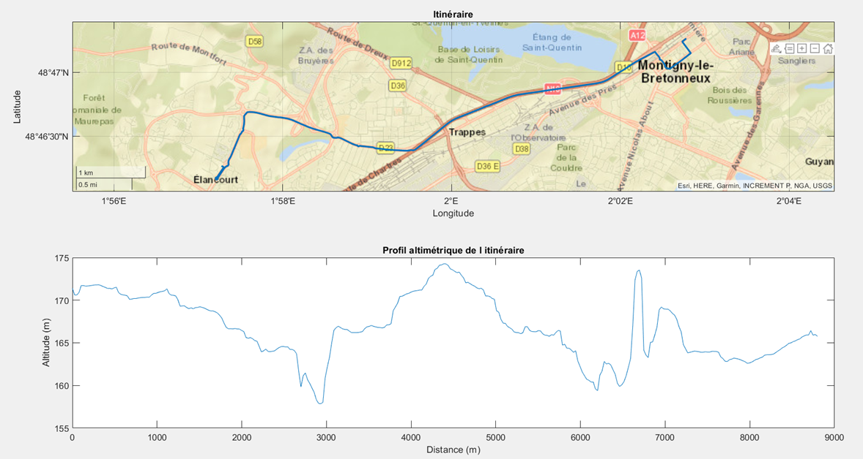
Real data recovery
NAVeco presentation
Altimetric profile

Slide 14
Bastien VENOT
Incorporation of electric vehicle specifics in the development of NAVeco
Internship : 01/02/2021 – 31/07/2021
RAP #2

Slide 15
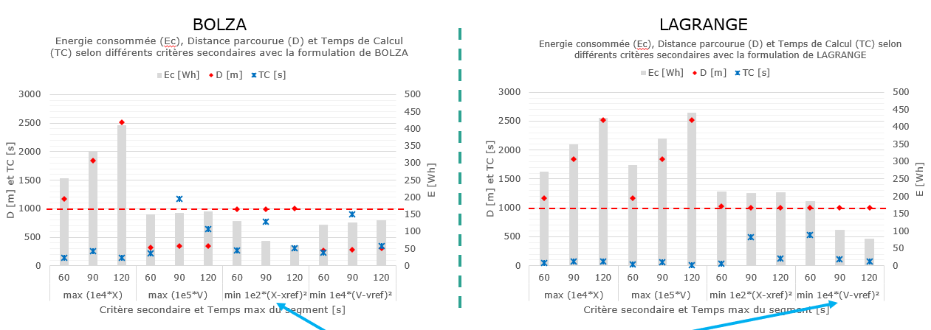
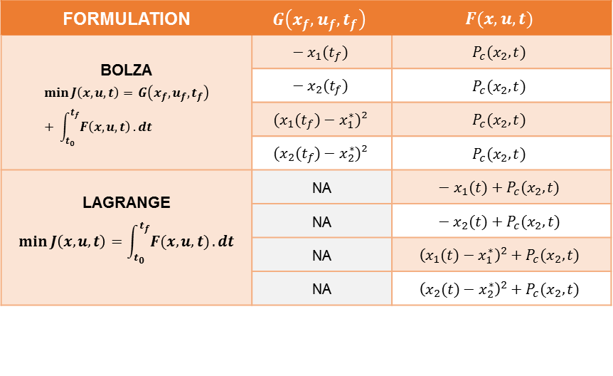
Search for strategies : Study of optimization problem formulation
FORMULATION | $$G\left(x_{f},u_{f},t_{f}\right)$$ | $$F(x,u,t)$$
BOLZA $$\min{J\left(x,u,t\right)= }G\left(x_{f},u_{f},t_{f}\right)+ \int_{t_{0}}^{t_{f}}{F\left(x,u,t\right)}.dt$$ | $$− x_{1}(t_{f})$$ | $$P_{c}(x_{2},t)$$
 | $$− x_{2}(t_{f})$$ | $$P_{c}(x_{2},t)$$
 | $$(x_{1}(t_{f})−x_{1}^{∗})²$$ | $$P_{c}(x_{2},t)$$
 | $$(x_{2}(t_{f})−x_{2}^{∗})²$$ | $$P_{c}(x_{2},t)$$
LAGRANGE $$\min{J\left(x,u,t\right)}=\int_{t_{0}}^{t_{f}}{F(x,u,t)}.dt$$ | NA | $$− x_{1}(t)+P_{c}(x_{2},t)$$
 | NA | $$− x_{2}(t)+P_{c}(x_{2},t)$$
 | NA | $${\left(x_{1}(t)−x_{1}^{∗}\right)}^{2}+P_{c}(x_{2},t)$$
 | NA | $${\left(x_{2}(t)−x_{2}^{∗}\right)}^{2}+P_{c}(x_{2},t)$$
Variables ➔ $x_{1}$ : Distance / $x_{2}$ : Speed / $P_{c} :$ Power consumption
1st optimization criterion ➔ Power consumption
1
2nd optimization criterion ➔ Distance OR Speed
2
1
2

Slide 16
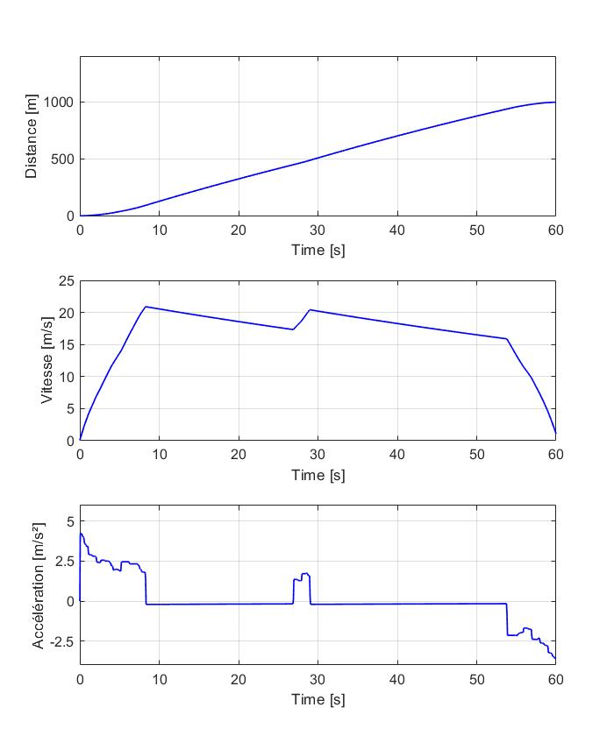
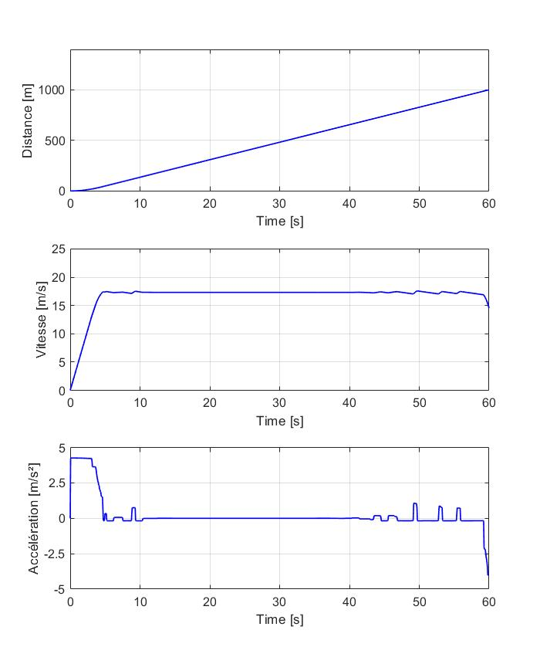
Search for strategies : Study of optimization problem formulation
FORMULATION | $$G\left(x_{f},u_{f},t_{f}\right)$$ | $$F(x,u,t)$$
BOLZA $$\min{J\left(x,u,t\right)= }G\left(x_{f},u_{f},t_{f}\right)+ \int_{t_{0}}^{t_{f}}{F\left(x,u,t\right)}.dt$$ | $$− x_{1}(t_{f})$$ | $$P_{c}(x_{2},t)$$
 | $$− x_{2}(t_{f})$$ | $$P_{c}(x_{2},t)$$
 | $$(x_{1}(t_{f})−x_{1}^{∗})²$$ | $$P_{c}(x_{2},t)$$
 | $$(x_{2}(t_{f})−x_{2}^{∗})²$$ | $$P_{c}(x_{2},t)$$
LAGRANGE $$\min{J\left(x,u,t\right)}=\int_{t_{0}}^{t_{f}}{F(x,u,t)}.dt$$ | NA | $$− x_{1}(t)+P_{c}(x_{2},t)$$
 | NA | $$− x_{2}(t)+P_{c}(x_{2},t)$$
 | NA | $${\left(x_{1}(t)−x_{1}^{∗}\right)}^{2}+P_{c}(x_{2},t)$$
 | NA | $${\left(x_{2}(t)−x_{2}^{∗}\right)}^{2}+P_{c}(x_{2},t)$$
Variables ➔ $x_{1}$ : Distance / $x_{2}$ : Speed / $P_{c} :$ Power consumption
1st optimization criterion ➔ Power consumption
1
2nd optimization criterion ➔ Distance OR Speed
1
2
2
Discomfort
1
2

Slide 17
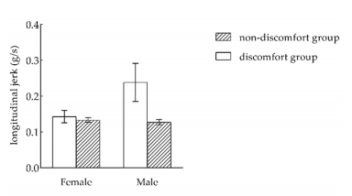



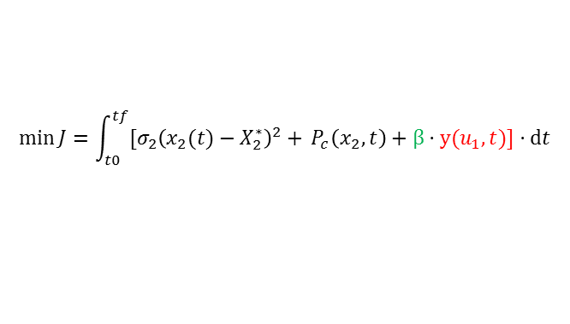
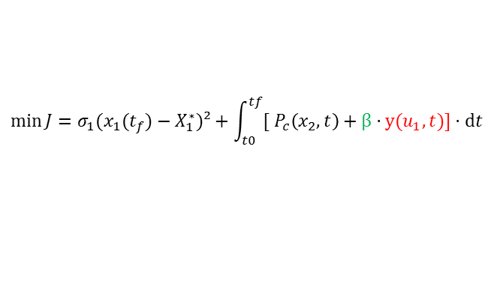
Search for strategies : Test for control criteria
Input variable
Criteria : Distance, Power, Torque
Motor torque (u1)
Criteria : Speed, Power, Torque
$$\min{J}=σ_{1}(x_{1}(t_{f})−X_{1}^{∗})²+\int_{t0}^{tf}{{[ P}_{c}\left(x_{2},t\right)+β⋅y(u_{1},t)]⋅ⅆt}$$
$$\min{J}=\int_{t0}^{tf}{[σ_{2}{\left(x_{2}(t)−X_{2}^{∗}\right)}^{2}+{ P}_{c}\left(x_{2},t\right)+β⋅y(u_{1},t)]⋅ⅆt}$$
CF 1 (Bolza)
CF 2 (Lagrange)
Cost function formulation
Torque squared
$$u_{1}²$$
Torque squared
$$u_{1}²$$
$$y(u_{1},t)$$
Control criterion expression
Study the sensitivity of factor $β$
Objective
Research on the Comfort of Vehicle Passengers Considering the Vehicle Motion State and Passenger Physiological Characteristics
Chang Wang, Xia Zhao, Rui Fu, Zhen Li
Observation of acceleration profile
Performance indicator

Slide 18
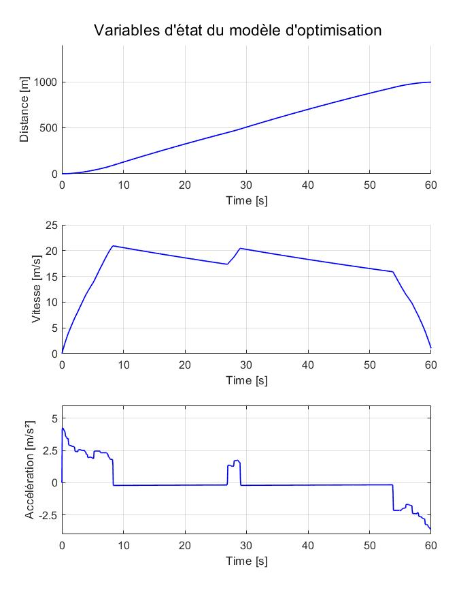
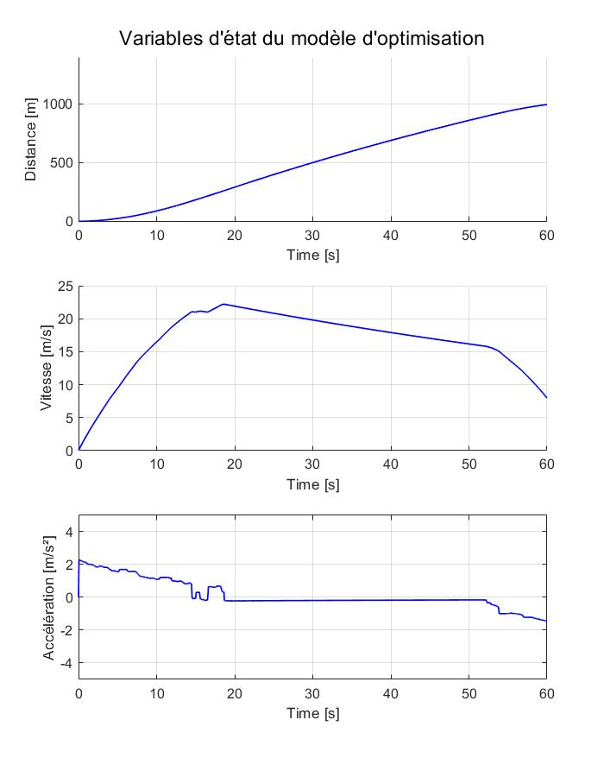
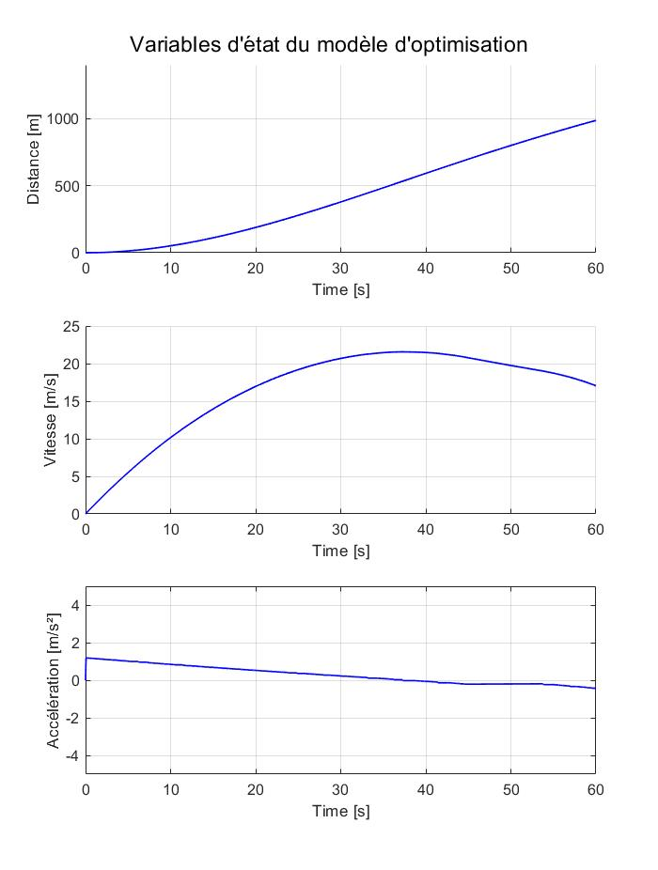
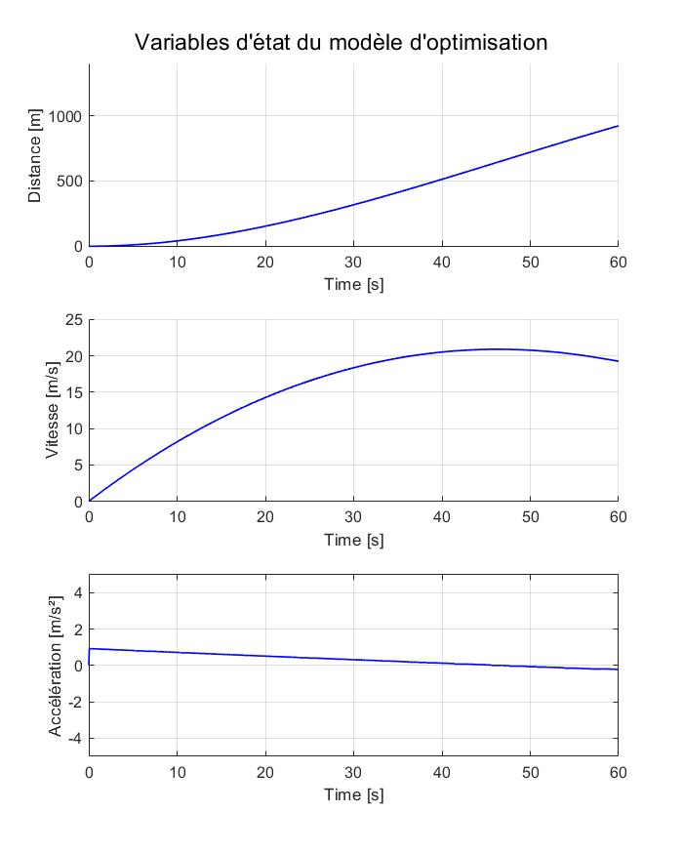
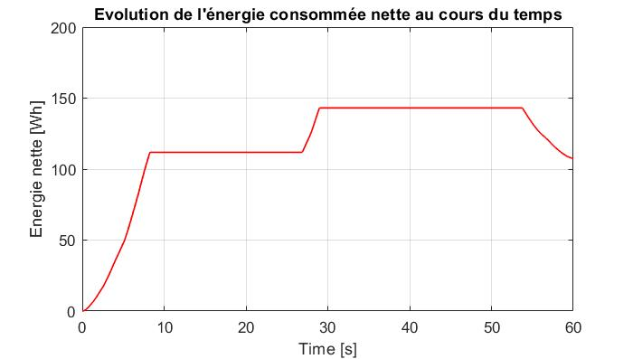
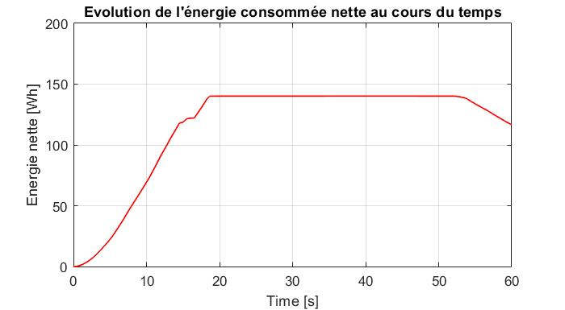
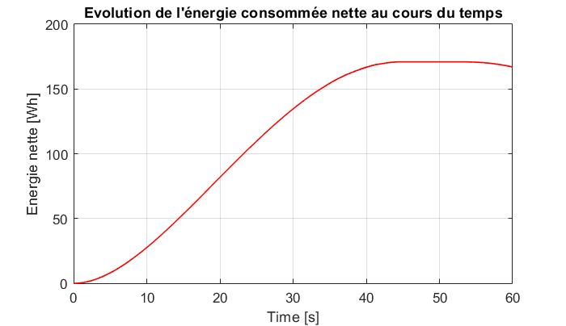
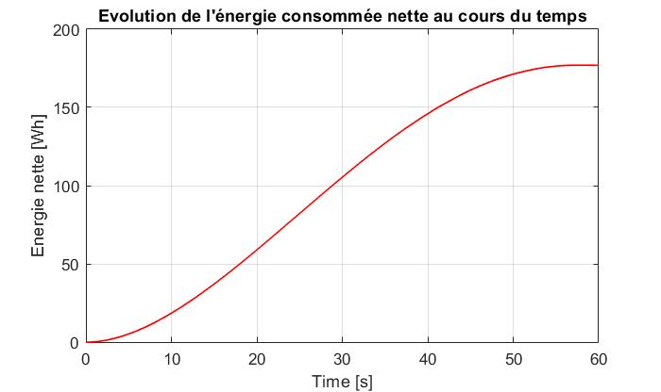





Evolution of the acceleration profile according to the torque penalty factor
Exemple of results with quadratic distance error criterion
$$\min{J}=σ_{1}.(x_{1}(t_{f})−X_{1}^{∗})²+\int_{t0}^{tf}{{[ P}_{c}\left(x_{2},t\right)+β⋅u_{1}²]⋅ⅆt}$$
$β :$ Normalization of the criterion in relation to energy AND weigth of importance in the cost function
$$β=0$$
$$β=1$$
$$β=10$$
$$β=100$$
Distance
Speed
Acceleration
Energy

Slide 19
Influence of torque penalty on other optimization criteria
2
1
1
EQV : Cost function with quadratic speed error (Lagrange formulation)
EQX : Cost function with quadratic distance error (Bolza formulation)

Slide 20
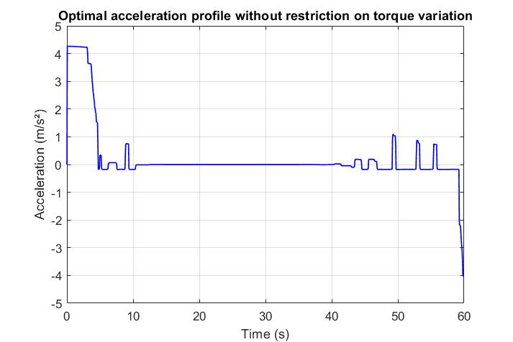
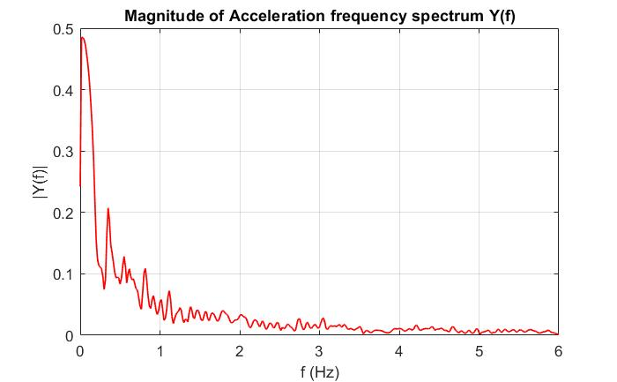
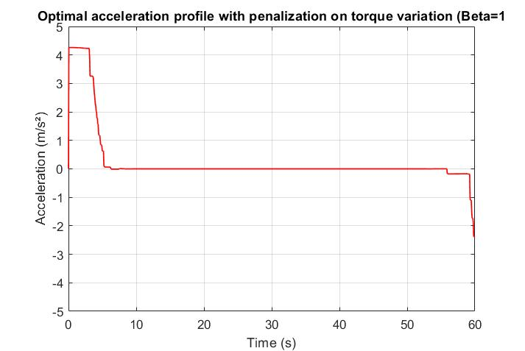


Determination of torque penalty factor according to customer requirements
Objective : Determine the link between the torque penalty factor and the acceleration frequencies and amplitudes in order to predict the optimal value of Beta according to customer comfort requirements
Solution Diagram
Test methodology
Customer requirements (for comfort) :
acceptable acceleration gradient
permissible frequencies in the acceleration profile
$$β=0$$
Observation of frequency spectrum
Calculation of optimal torque penalty factor
Optimal Beta
$$β=1$$
Optimization model
Results comparison with the curve for Beta=1
Several low-pass filters with differents cut-off frequencies
Optimal acceleration profile

Slide 21




Status of progress
Completed
In progress
Futur
Objective
Intermediate objectives
Provisions
Means implemented
Study the benefits of regenerative braking
Adapt the energy model of EV
Integrate the regenerative braking feature
Incorporate expression of traction chain performance
Integrate the specifics of an electric motor in the development of NAVeco
Study the optimization problem formulation
Adapt de optimization model
Incorporate the energy model of EV
Tests for energy and distance optimization
Tests with distance and speed criteria
Tests for comfort optimization
Define the torque criterion
Determination of torque penalty factor according to customer requirements
Study the interest of freewheel strategy and compare with regenerative braking
Adapt the optimization model
Define the slowdown without braking as a criterion to be optimised

Slide 22
Hugo DUCHEMANN
Incorporation of thermal engines in the NAVeco development
Internship : 08/02/2021 – 06/08/2021
RAP #2

Slide 23
Last RAP : Optimization methods
Présentation NAVeco
Synoptic
Acceleration
Iterative algorithm
Constant acceleration
(limited for each segment)
One-dimensional optimization
Speed limit
Minimum final energy
Deceleration
Dynamic optimization (MPC or Dynamic programming)
Dynamic acceleration
Multidimensional optimization
Minimization of the cost function
Taking into accounts the constraints of the dynamic model

Slide 24
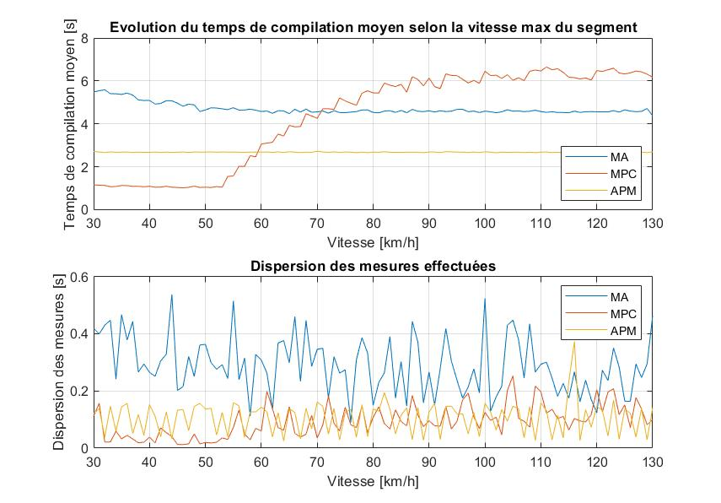
Optimization methods : Study the impact of different parameters on the compute time
Présentation NAVeco
Objective
Determine which algorithm respond best to important varying parameters of the segment
List of parameters
Maximum authorized speed on the segment
Maximum authorized speed on the segment
Initial speed on the segment
The percentage of the slope
The mass of the vehicule
The rolling resistance coefficient
The time to travel the segment
The distance to travel
Measures and dispersion
For each value of parameters, 10 measures are made.
Represent the average of the compute time
The dispersion is calculated excluding the extremums
Iterative algorithm : Affected
MPC : Affected
Dynamic Programming : Not affected

Slide 25
Optimization methods : Study the impact of different parameters on the compute time
Présentation NAVeco
Objective
Determine which algorithm respond best to important varying parameters of the segment
Method / Parameter | Maximum authorized speed | Initial speed | Percentage of the slope | Mass of the vehicle | Rolling resistant coefficient | Time to travel | Distance to travel
Iterative algorithm | The vehicle arrives or not at his destination -> Increase the compute time | A higher initial speed than the maximum authorized speed decreases the compute time | No effect on compute time | No effect on compute time | No effect on compute time | Increase the computational load | No effect on compute time
Dynamic Programming | No effect on compute time | No effect on compute time | No effect on compute time | No effect on compute time | No effect on compute time | No effect on compute time | No effect on compute time
MPC | The presence of the braking step increase the compute time | No effect on compute time | The percentage of the slope affect the accceleration of the vehicle and the final position -> try to get the vehicle to the final position | The mass affects the acceleration of the vehicle and the final position -> try to get the vehicle to the final position | The coefficient affects the acceleration of the vehicle and the final position -> try to get the vehicle to the final position | Part of an another study | Part of an another study
25

Slide 26
Prediction Horizon and Time sample pair study
Présentation NAVeco
Last RAP : Optimization time and final energy of retained binomial
Distance errors of (6,2) binomial
The position error does not exceed 9 meters.
Optimization time and final energy of retained binomial
D =7000m
T = 500s
RESULT : For a distance of 1 000 meters and a duration of 60 seconds, we have chosen the pair (6, 2).
26

Slide 27


Prediction Horizon and Time sample pair study
Présentation NAVeco
Test Protocol
Distance : 1 000m to 100 000m (logarithmic scale)
Number of tries : 19
For each distance :
$$T_{min}=\frac{D}{V_{max}}$$
to
$$T_{max}=\frac{D}{V_{min}}$$
(logarithmic scale)
Number of tries : 17
For each time : Test and save every combination of Prediction Horizon and Time sample
Number of tries : 600
Advantages :
Create a database of every binomial and extract the optimal according to permissible position error
Combine 3 tests in a single simulation
Disadvantages :
Very high compute time (193 800 tries)
Example : The duration of the test with a distance of 1 000m, which represent 10 200 tries, was 1 week.
27

Slide 28
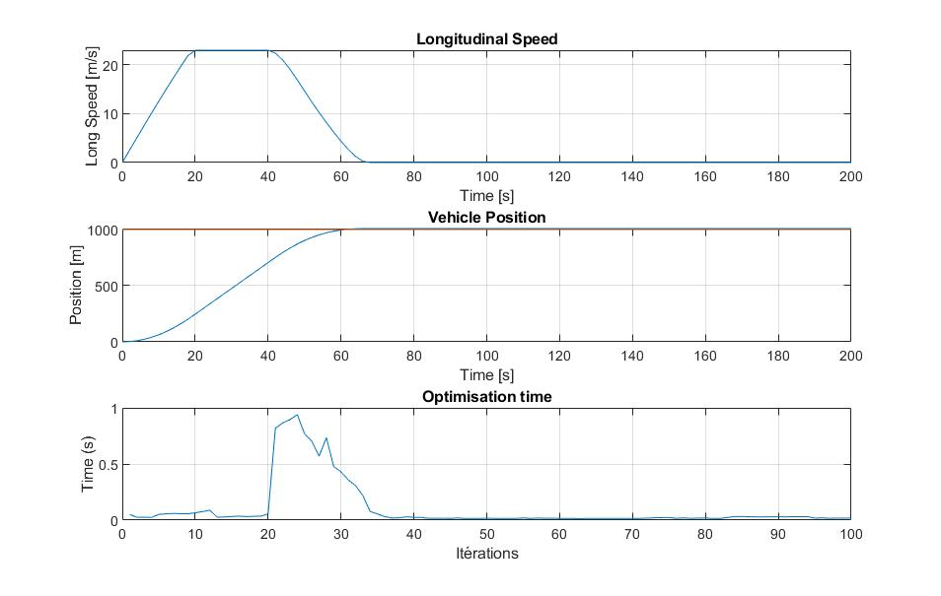
Prediction Horizon and Time sample pair study
Présentation NAVeco
Observation : Time’s impact on energy
Observation : Optimization’s time during optimization
Objective : Reduce the compute time
Complete the vector of speed, position and energy when the vehicle exceeds the desired final position and when the 3 values in the vector are constant
Parameters :
Distance : 1 000m
Time : 60 s
Prediction Horizon : 6*Ts
Time sample : 2s
28

Slide 29
State of progress
Présentation NAVeco
Traité
En cours
A venir
Notes:
(1min30)

