Slide 1
Batch-Constrained Q-Learning (BCQ)
Optimal Decision-Making: BCQ enhances decision-making in varying sensor modes, particularly for color and distance.
Targeted Learning: Ideal for datasets from specific policies, even when not all states and actions are covered.
Ease of Implementation: BCQ integrates easily into existing Q-learning frameworks with minimal modifications.
Effective Use: Best suited for discrete action spaces with limited data availability.

Slide 2
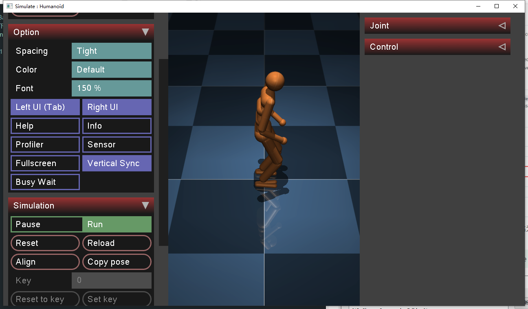
Implement:D4RL
Simple API Interface: D4RL offers an easy-to-use API, facilitating direct access to datasets for training agents.
Rich Baselines: D4RL provides a comprehensive set of baselines, including common offline algorithms like BCQ, BEAR, BRAC, and others.
Maybe Simulation？mujoco210

