Slide 1

CMR COLLEGE OF ENGINEERING & TECHNOLOGY
Kandlakoya, Medchal, Hyderabad - 501401
Department of Computer Science and Engineering
Analysis of Women Safety In Indian Cities
Batch No:77
Name of the student:
M. VAISHNAVI 21H55A0514
N. YESUMANI 21H55A0515
Under esteemed guidance of
Dr. G. Ravi Kumar,
Associate professor
Dept. of CSE.
Batch: 2020-2024

Slide 2
Outline
Abstract
Introduction
Literature survey
Existing system
- Problems in existing system
Research Objective of Presentation
Problem Definition
Research work
- Proposed system architecture
- Methods
- Comparison of Proposed system with an existing system
Results
Conclusion
Future Work
References
Notes:
2

Slide 3
Abstract
Notes:
3

Slide 4
Abstract
Women and girls have been experiencing a lot of violence and harassment in public places in various cities starting from stalking and leading to abuse harassment or abuse assault. This basically focuses on the role of social media in promoting the safety of women in Indian cities with special reference to the role of social media websites and applications including Twitter platform Facebook and Instagram. This also focuses on how a sense of responsibility on part of Indian society can be developed the common Indian people so that we should focus on the safety of women surrounding them. Tweets on Twitter which usually contains images and text and also written messages and quotes which focus on the safety of women in Indian cities can be used to read a message amongst the Indian Youth Culture and educate people to take strict action and punish those who harass the women

Slide 5
Introduction
Notes:
5

Slide 6
Introduction
Twitter in this modern era has emerged as a ultimate microblogging social network consisting over hundred million users and generate over five hundred million messages known as ‘Tweets’ every day. On the twitter, users will share their opinions and perspective in the tweets section.
A Twitter text collection analysis of women who stand up against sexual harassment and unethical behavior in Indian cities was used to analyze the status of women's safety in Indian society. From the tweet, the sentiment behind the message is extracted. This extraction is done by using the sentimental analysis procedure.
Notes:
6

Slide 7
Literature survey

Slide 8
Existing system
Model Interpretability: ML models used for analyzing women's safety may lack interpretability, making it difficult to understand how they arrive at their decisions or recommendations. Lack of transparency in ML algorithms can hinder trust and accountability, particularly in sensitive domains like public safety.
Models Can Be Biased: Machine learning models may not always give accurate results

Slide 9
Research objective
Notes:
9

Slide 10
Research objective
Gather comprehensive data on women's safety incidents in Indian cities.
Clean and preprocess data to improve model accuracy.
Identify relevant features for predicting women's safety perceptions.
Develop XGBoost models to analyze and predict women's safety.
Ensure model interpretability, validation, and ethical considerations in deployment.

Slide 11
Problem Definition
Notes:
11

Slide 12
Problem Definition
Women and girls have been experiencing a lot of violence and harassment in public places in various cities starting from stalking and leading to abuse harassment or abuse assault.
The problem is to use machine learning to understand and improve women's safety in Indian cities. We'll gather data on incidents like harassment and assault, find patterns to predict where they might happen, and suggest ways to make those areas safer. Our goal is to create easy-to-use tools that help authorities and communities take action to protect women. We'll make sure our methods are fair, accurate.

Slide 13
Proposed system architecture
Uploading The Dataset
Reading & viewing Dataset
Feature Extraction
Training set
Run XGBoosting
Testing Set
Trained ML Model
Classified Data

Slide 14
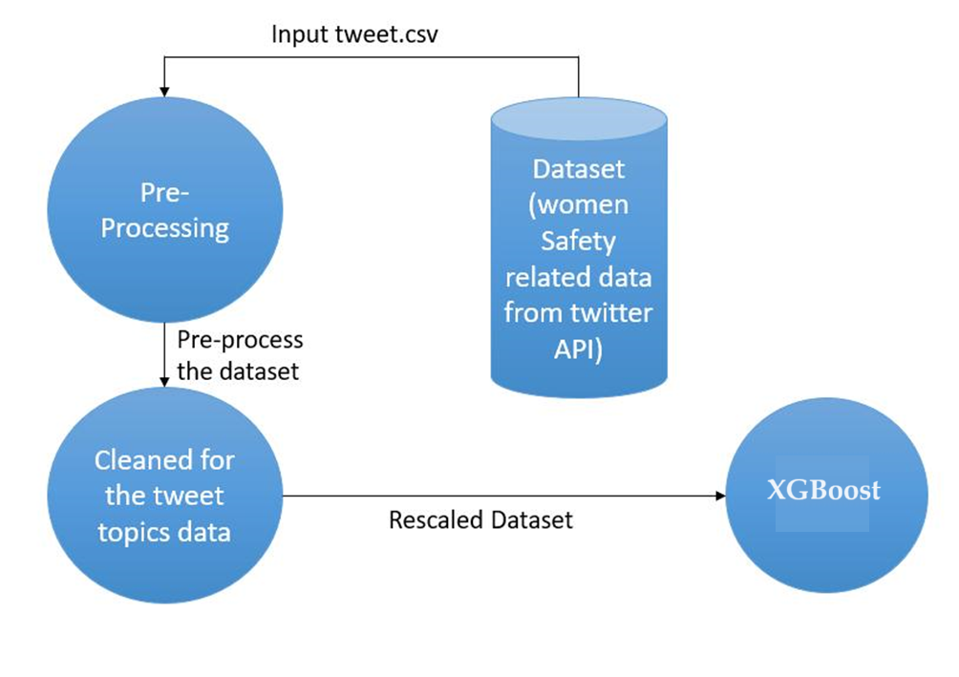

Slide 15
Proposed method
Data Collection and Pre-processing:
Data Collection: Gather a large dataset of tweets relevant to the topic of women's safety in urban India.
Pre-processing: Clean and pre-process the data by removing noise (like URLs, non-alphabetic characters), normalizing text (like converting to lowercase), and handling abbreviations and emoticons.
Feature Extraction: Extract relevant features from the tweets that are significant for sentiment analysis. This could include word embedding's, TF-IDF scores, and other linguistic features.
Training the XGBoost Model:
Dataset Splitting: Split the data into training and testing sets.
Model Training: Train the XGBoost model on the training set. Fine-tune the parameters (like learning rate, depth of trees, etc.) to improve the model's performance.
Cross-Validation: Use cross-validation techniques to ensure the model's robustness and prevent overfitting.

Slide 16
Working
Step1: Pre-processing.
Step2: Features extraction utilizing counting vectorization, word level TF-IDF and n-gram level TF-IDF. Then Converting the Text into Vectors.
(Number of times term t appears in a document)
(Total number of terms in the document)
Total number of docs
IDF(T) = log Number of docs with term t in i
Step3: Fit the training dataset, it learns the model
Step4: XGBoosting classifier is utilized to predict the values as the XGBoosting initializtion is done, the accurate calculation of the model will be done inlcuding all the three vectorization techniques.
TF(t) =

Slide 17
Comparison table for the existing system
S.No | Authors and Journal Name& Year of publication | Problem Statement | Name of the Proposed solution/Method | Solution | Remarks
1 | N Kavitha, N Srinivasa Rao, Srinivasa Rao Madalac. (PACE Institute of Technology and Sciences 2021) | The safety of women in Indian cities remains a critical issue, with rising violence and harassment concerns. | Employing machine learning techniques to analyze women's safety data and enhance urban safety measures. | The project aims to leverage data-driven approaches to improve women's security in city environments. | Privacy and data collection challenges must be addressed for effective implementation.
2 | Bindu M, Chandini J V, Kola Prem Kumar. (Journal of Data Mining and Management 2021) | Women's safety in Indian cities is a growing concern, with instances of harassment, and abuse creating a pressing issue. | NLP and ML to extract insights from social media data for women's safety improvement. | Project focuses on using social media as a source of data for creating safer urban environments for women. | Ethical considerations regarding data usage and fairness of algorithms are vital.
3 | Mohd Naved, Dr.A.Narasima Venkatesh, Vani A.(AIP Conference Proceedings 2022) | Violence against women in Indian cities is a significant problem, leading to a lack of security for women in public spaces. | AI-based system for real-time women's safety evaluation and alerting in urban areas. | The solution aims to empower women by providing them with real-time information about their safety. | Technical challenges in real-time data processing and system reliability are key concerns.
4 | Afrin Jaman Bonny, (Daffodil International University 2022) | The safety of women in Indian cities is a pressing concern, need for practical solutions to address this issue. | Social media sentiment analysis and ML to assess women’s safety perceptions in public spaces. | Project's objective is to gauge public sentiment and generate awareness about the importance of women's safety. | Ethical considerations and model accuracy are central to this research.

Slide 18
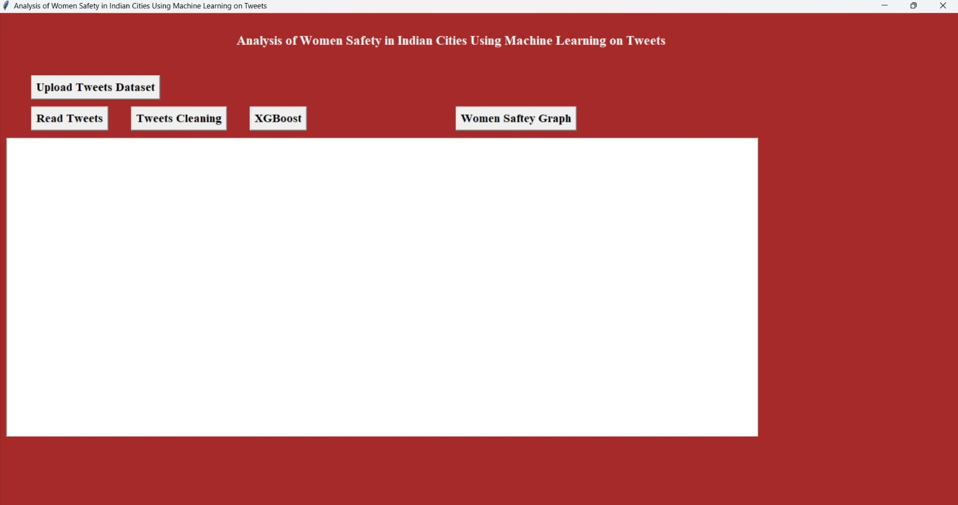
Result
Fig1 : Home Screen

Slide 19
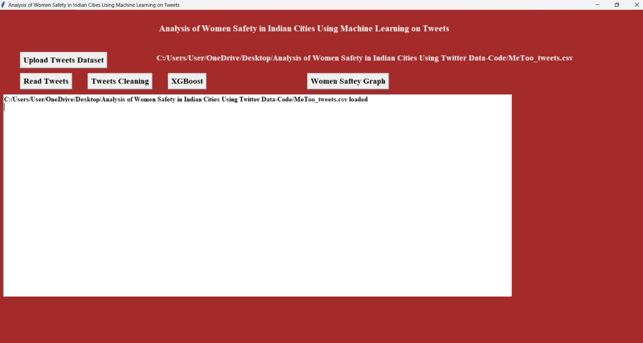
Fig 2: Uploading Tweets Dataset

Slide 20
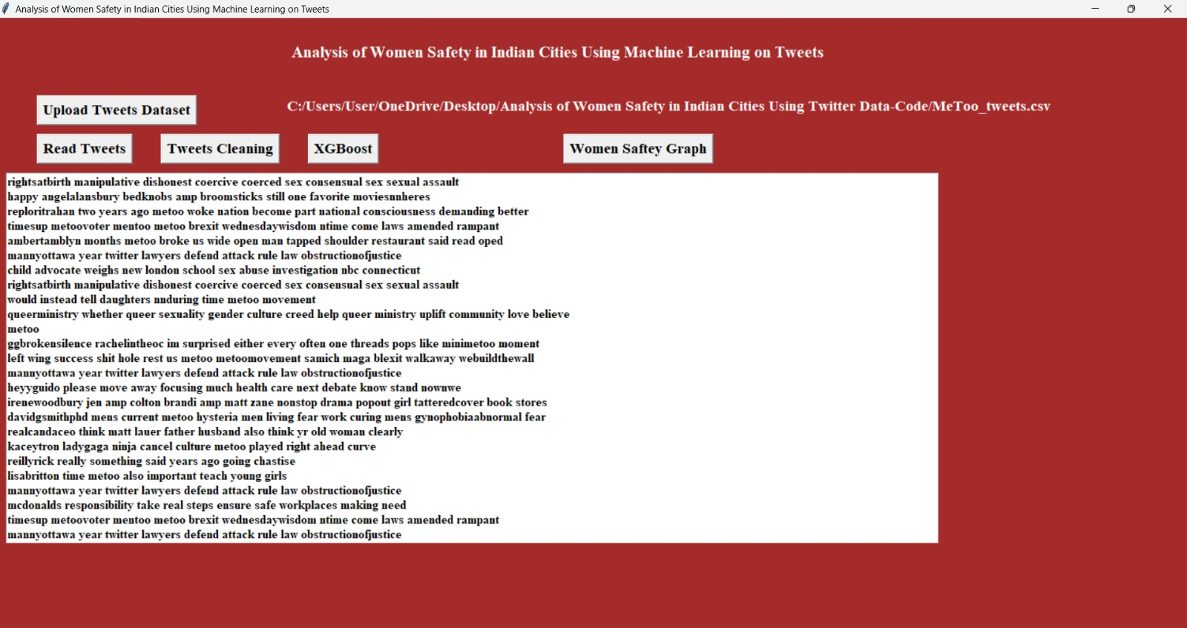
Fig 3 : At the above screen we will view every single doc, includes special texts, halt words and to minimize those texts tap on 'Tweets Cleaning button

Slide 21
Fig 4 : Tweets Cleaning

Slide 22
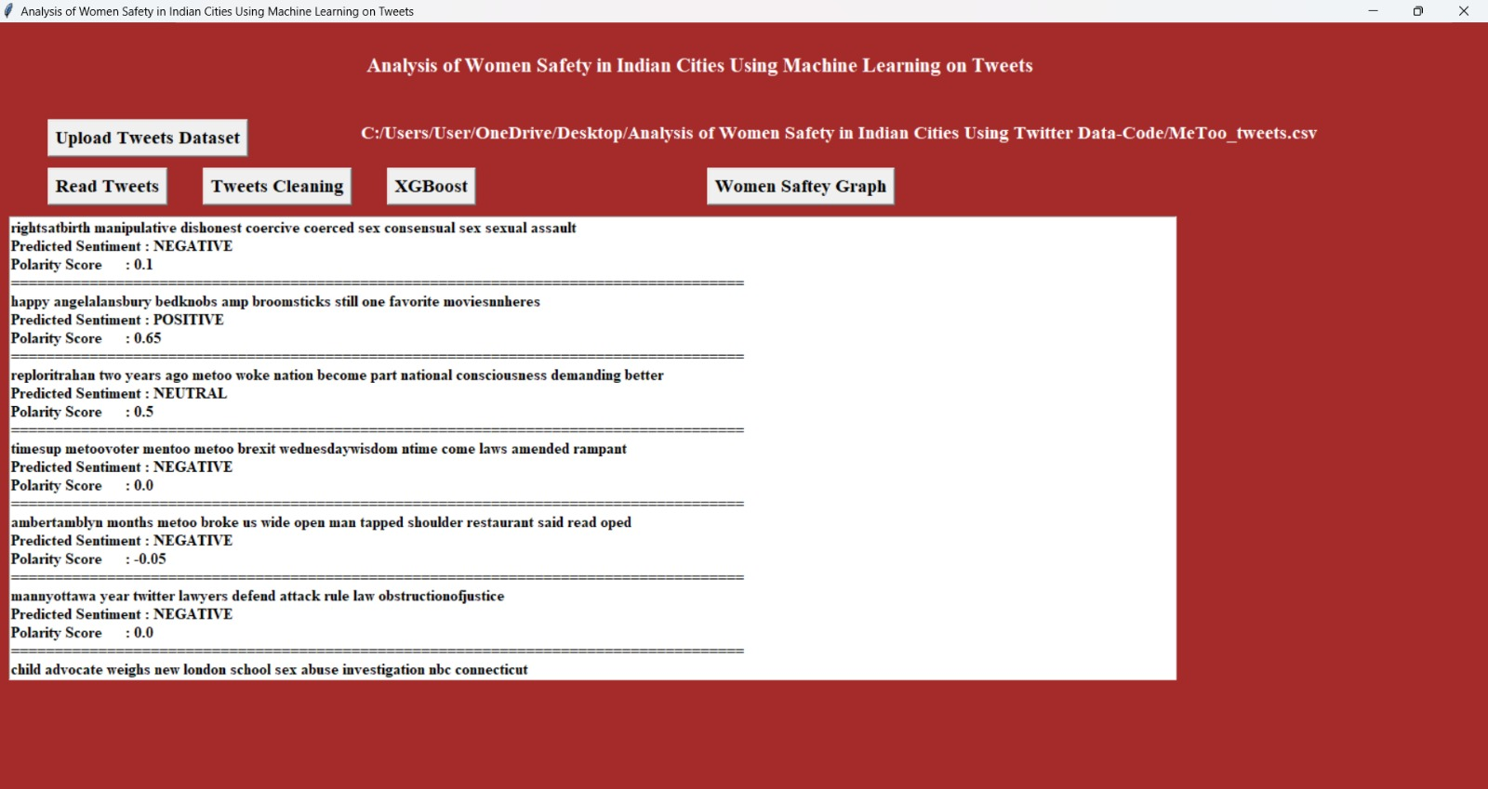
Fig 5: XG Boosting Algorithm

Slide 23
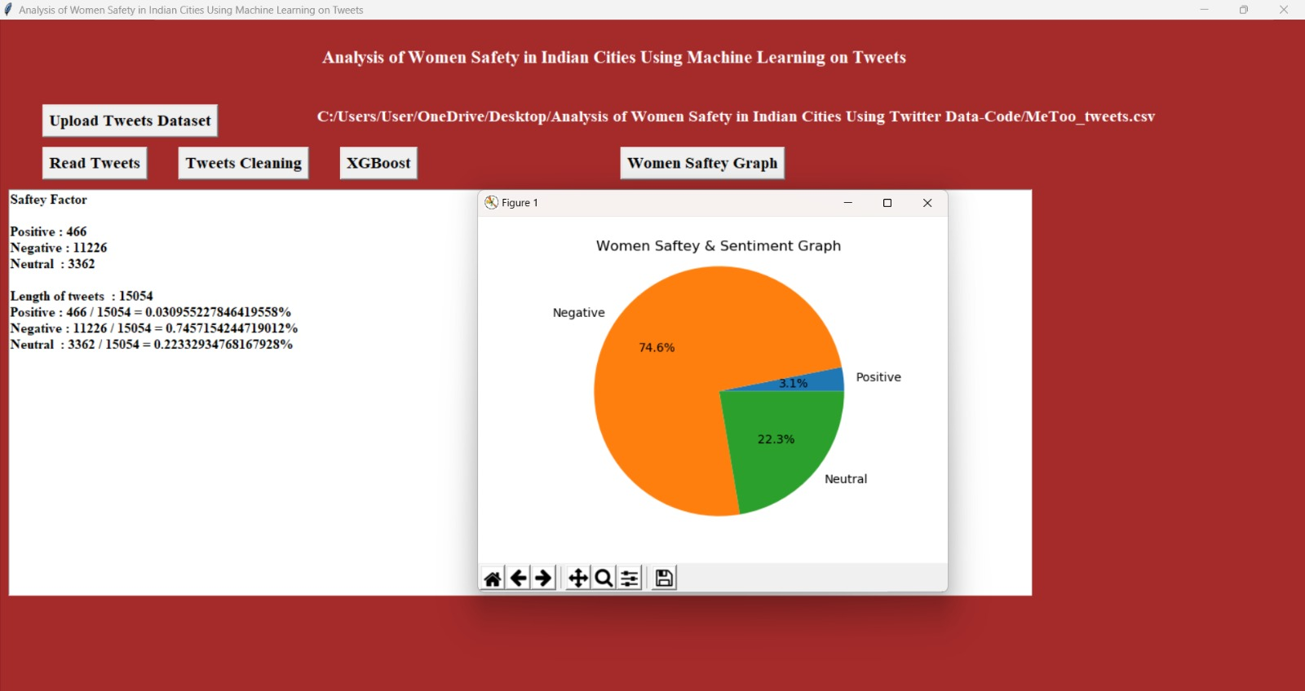
Fig 6:Women Safety Graph

Slide 24
Conclusion
The global picture of various crimes against women and demonstrate how the scenario's goal and motivation are structured. We can identify risky areas in metropolitan cities and increase safety in those areas as a result of our project, allowing women to feel free to go wherever they want. As a result, we present recommendations in order to reduce the possibility of unsecured problems appearing in society, which will undoubtedly aid in lowering the risk of these devious actions affecting society, and by rigorously adhering to the rules, we will be able to reach a greater level of security.

Slide 25
Future work
The project scope is restricted to machine learning algorithms and models. Staring at women and passing comments can be certain types of violence and harassment and these practices, which are unacceptable, are usually normal especially on the part of urban life. Many researches that have been conducted in India shows that women have reported sexual harassment and other practices as stated above. Such studies have also shown that in popular metropolitan cities like Delhi, Pune, Chennai and Mumbai, most women feel they are unsafe when surrounded by unknown people.

Slide 26
References
[1] TEJASHWINI, M., PRASANNA, V. L., PRAVALLIKA, S., AFROZ, S., YADAV, R. R., & DHANUNJAYA, M. Analysis of Women Safety in Indian cities using Machine Learning on Tweets.
[2] Reddy, P. S., Ramasubbaiah, B., & Chandra, G. R. Analysis of Women Safety in Indian Cities Using Machine Learning on Tweets.
[3] Riyazuddin, Y. M., Sriram, G. J., Vaibhav, P. M., & Vikranth, I. (2020). Utilization Of Support Vector Machine For Analyzing Women Safety In Indian States. International Journal of Grid and Distributed Computing, 13(1), 2244-2251.
[4] Kumar, D., & Aggarwal, S. (2019, February). Analysis of women safety in Indian cities using machine learning on tweets. In 2019 Amity International Conference on Artificial Intelligence (AICAI) (pp. 159-162). IEEE
[5] Swapna, D., Ashrita, J., Ashwini, K., & Bhargavi, T. B. Analysis of Women Safety in Indian Cities Using Twitter Data.

Slide 27
Thank You!

