Slide 1

UNIVERSITY EVALUATION · SYSTEM SECURITY
SecureVote
Enterprise electronic voting with database-enforced integrity.
Secure identity · private ballots · auditable results
01 / 10
Notes:
Introduce SecureVote as an enterprise electronic voting platform whose integrity is enforced across the workflow and at the database layer.

Slide 2
Trust is the product
SECUREVOTE
System promise
THE STANDARD
THE WORKFLOW
Digital elections must protect
One controlled path
TRUST
Eligibility
Privacy
One-person-one-vote
Result integrity
Registration, approval, authentication, ballot casting, receipts, and certified results come together in one workflow.
01 · 10
02 / 10
Notes:
Frame trust as the product requirement. SecureVote treats eligibility, privacy, uniqueness, and result integrity as one connected system rather than isolated features.

Slide 3
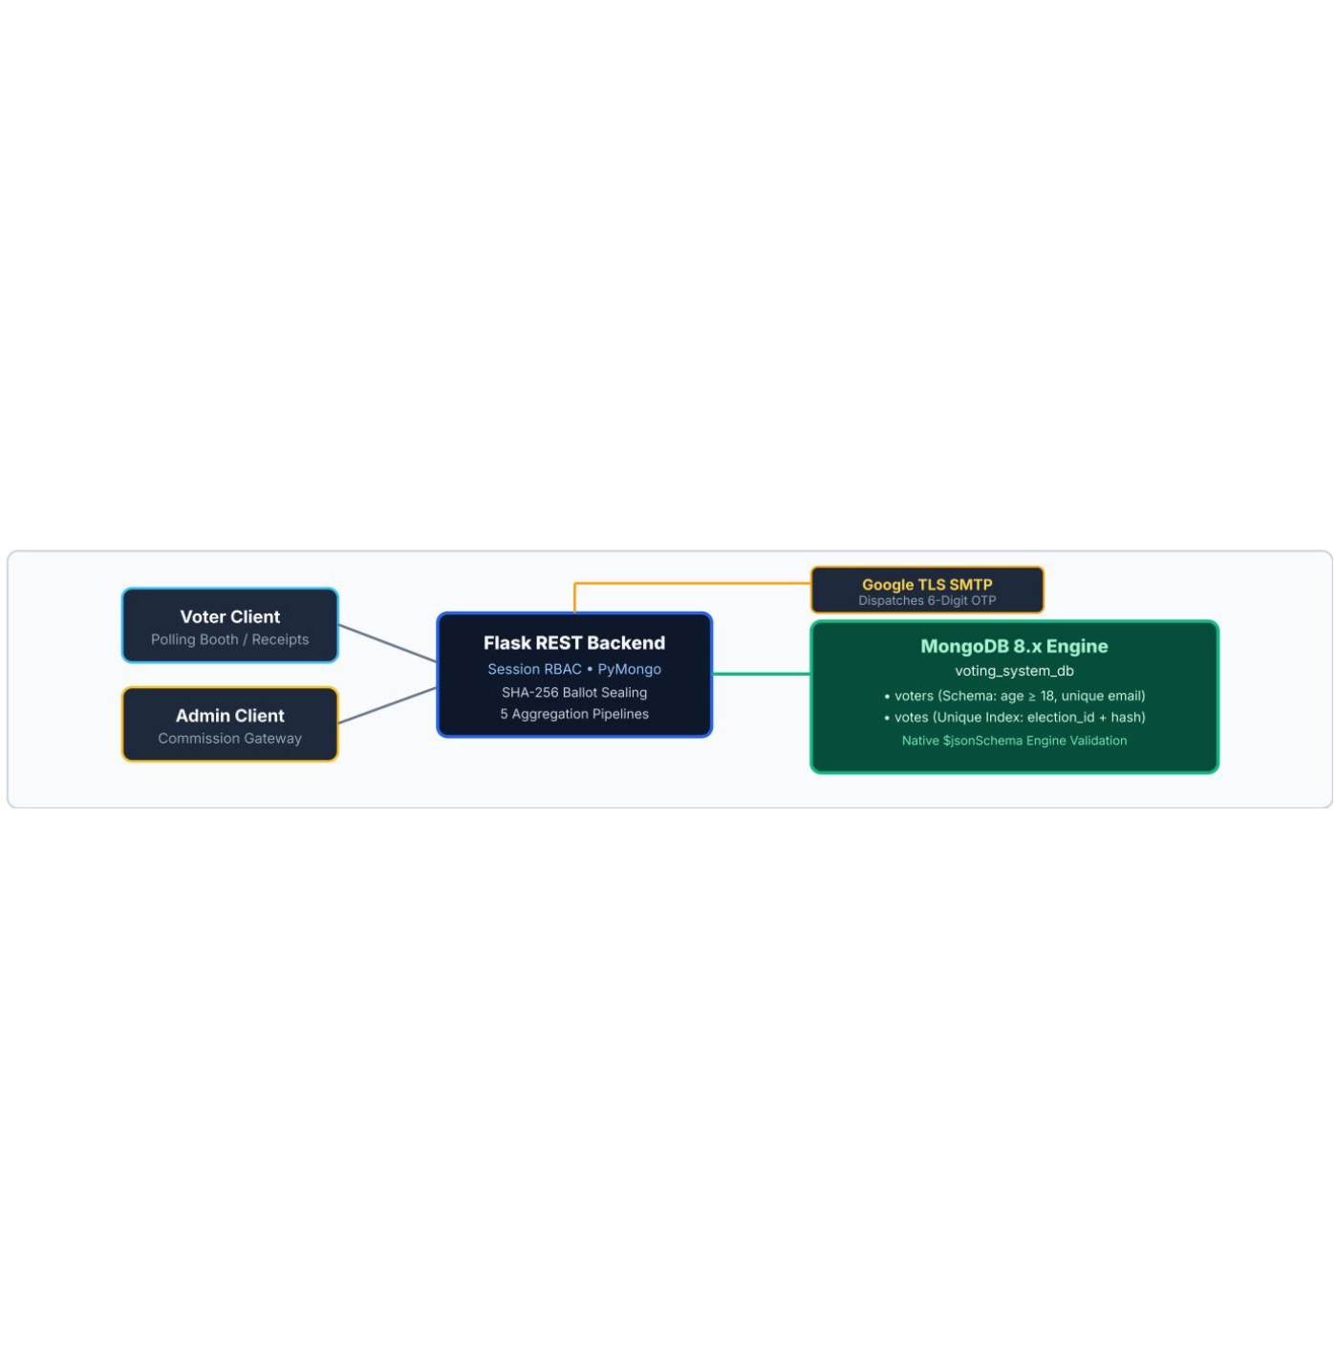
One platform, two controlled experiences
SECUREVOTE
System architecture
TWO CLIENTS
Voter and administrator clients connect through Flask REST services, while MongoDB enforces validation, indexes, and audit-ready storage.
VOTER CLIENT
Registration · approval · ballot · receipt
ADMINISTRATOR CLIENT
Verification · elections · analytics · audit
02 · 10
03 / 10
Notes:
Use the architecture image to show the separation of experiences and the shared enforcement layer. The clients differ, but the controlled path converges through Flask REST services and MongoDB.

Slide 4
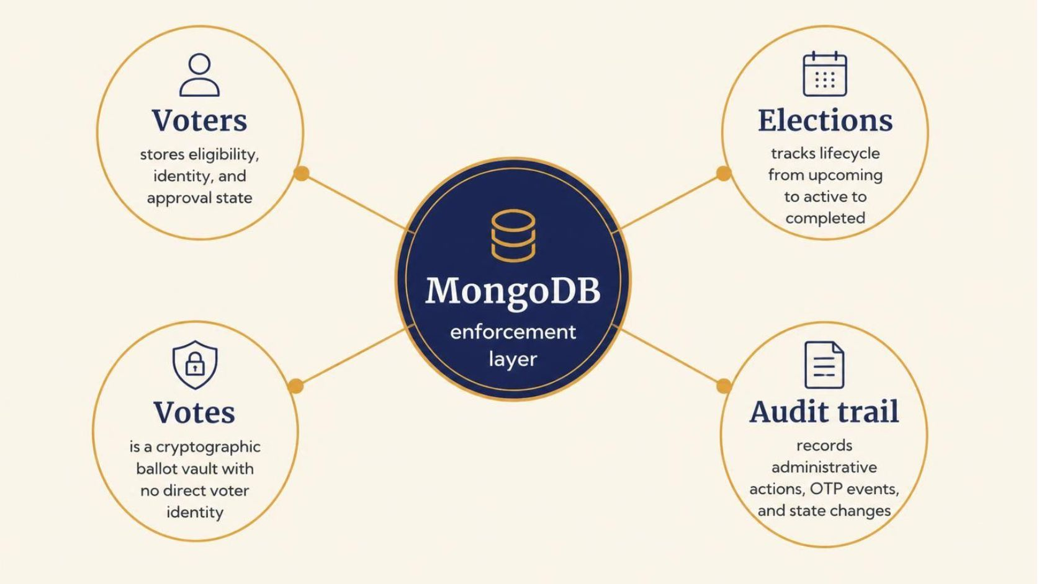
MongoDB is part of the security model
SECUREVOTE
Data model
SECURITY MODEL
The database is an active control boundary, not passive storage.
Each collection carries a distinct security responsibility.
03 · 10
04 / 10
Notes:
Walk through the four collections and emphasize the architectural point: MongoDB participates in validation, uniqueness, lifecycle control, and audit readiness.

Slide 5
Privacy and one-person-one-vote are enforced together
SECUREVOTE
Ballot protocol
01
02
03
04
PRIVACY + UNIQUENESS
Combine
Hash
Index
Reject
Combine voter and election identifiers with a salt.
Store only the SHA-256 hash in the ballot record.
Apply a compound unique index on election_id and voter_id_hash.
Reject a second ballot at the database layer with DuplicateKeyError E11000.
04 · 10
05 / 10
Notes:
Explain the sequence from identifier combination to database rejection. The design preserves ballot privacy while making a second ballot structurally impossible at the database layer.

Slide 6
Invalid data never reaches storage
SECUREVOTE
Write protection
01
02
03
VALIDATION
Schema
Strict rules
WriteError 121
MongoDB $jsonSchema validation rejects malformed records and underage registrations.
Validation covers age, email format, and lifecycle status.
Invalid writes return MongoDB WriteError 121 before persistence.
05 · 10
06 / 10
Notes:
Focus on the boundary: malformed records are rejected before persistence. The database therefore protects data quality independently of the client experience.

Slide 7

Authentication starts with a short-lived OTP
SECUREVOTE
Administrator access
AUTHENTICATION
RECEIVE
PROTECT
Six-digit passcode
Short-lived session
Administrators receive a single-use six-digit passcode through Google TLS SMTP.
Expiry, resend cooldown, session protection, and automatic OTP consumption.
UNLOCK
Electoral controls
Successful verification unlocks electoral controls.
06 · 10
07 / 10
Notes:
Use the screenshot as evidence of the OTP experience, then name the controls around it. Authentication is deliberately short-lived and single-use before administrator actions become available.

Slide 8
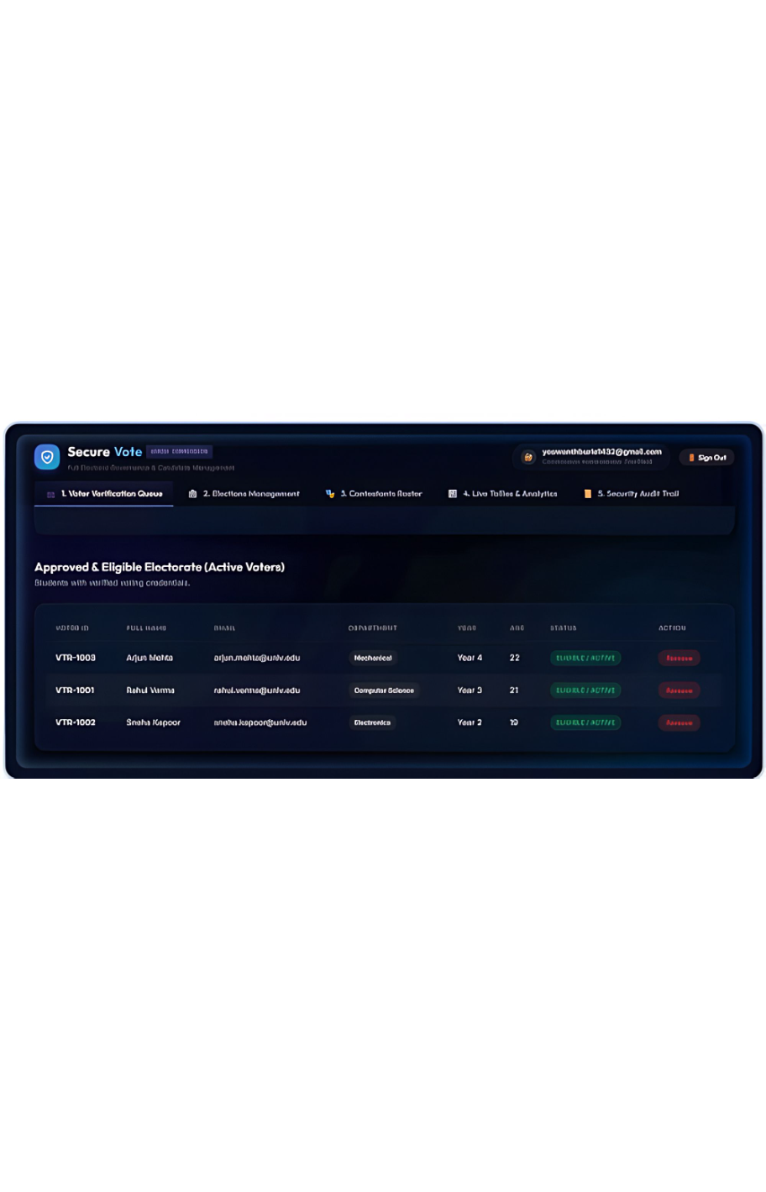
Every role has a defined workflow
SECUREVOTE
Operating model
ROLES
VOTER
ADMINISTRATOR
Participate with proof
Operate with oversight
Register, await approval, cast one ballot, receive a verifiable receipt.
Verify voters, manage elections, manage contestants, monitor analytics, review the audit trail.
07 · 10
08 / 10
Notes:
Contrast the two workflows without treating either as secondary. Voters receive a verifiable path to participation; administrators receive the controls and evidence needed to operate the election.

Slide 9





Analytics turn ballots into operational insight
SECUREVOTE
Operational intelligence
ANALYTICS
Results
Turnout
Leaderboard and winner ranking.
Departmental turnout breakdown.
Velocity
Seniority
Temporal voting velocity.
Student seniority matrix.
Executive view
08 · 10
Executive KPI dashboard using $facet.
09 / 10
Notes:
Analytics serve operations, not decoration. The system supports result ranking, turnout analysis, temporal voting velocity, seniority comparison, and an executive KPI dashboard using $facet.

Slide 10
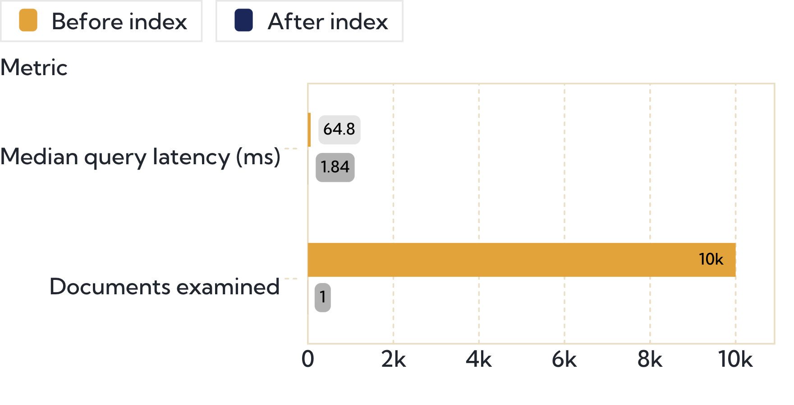
The index changed the query profile
SECUREVOTE
Performance evidence
SYNTHETIC DATASET
64.82 → 1.84 ms
BENCHMARK
On approximately 10,000 documents, the tested query moved from 64.82 ms to 1.84 ms median latency and from 10,000 examined documents to 1.
The compound index sharply reduces latency and documents examined.
09 · 10
10 / 10
Notes:
Close with the benchmark, clearly labeled as synthetic. The compound index changes both sides of the query profile: median latency and the number of documents examined.

