Slide 1
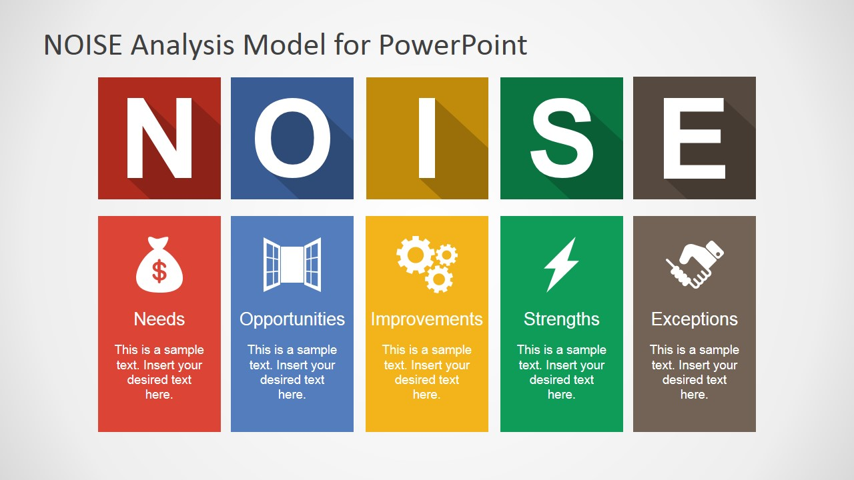
NOISE POLLUTION MONITORING
USING IOT
TEAM MEMBERS:
1.MOHAN KRISHNA
2.YESWANTH
3.VIGNESH KUMAR
4.PAVAN KUMAR
5.SHAIK KAIF
IOT PHASE -05
Pollution

Slide 2
Project Objectives:
The project aims to develop a real-time noise level monitoring system using IoT sensors, a cloud-based platform, and a mobile app.
The system will provide real-time noise level data to the public and relevant authorities, promote public awareness of noise pollution, and contribute to noise pollution mitigation.
Provide real-time data on noise levels in various locations, such as residential areas, commercial areas, and industrial areas.
Identify noise pollution hotspots and sources.
Promote public awareness of noise pollution and its negative impacts.
Contribute to noise pollution mitigation by providing data to policymakers and regulators.

Slide 3
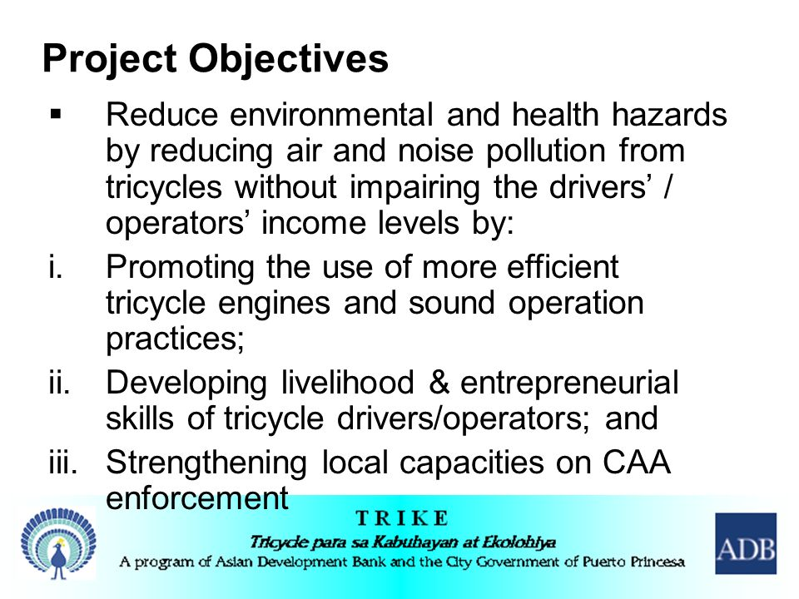
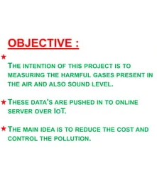

Slide 4
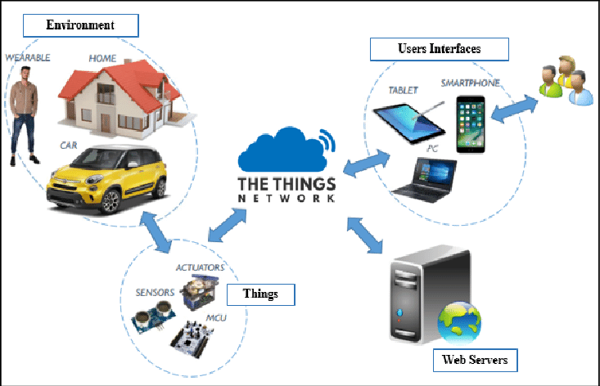
IOT Sensor Deployment:
The IoT sensors will be deployed in strategic locations throughout the city, such as near busy roads, construction sites, and industrial areas.
The sensors will be equipped with microphones and other sensors to measure noise levels in real time.
The data collected by the sensors will be transmitted to the cloud-based platform via a cellular or Wi-Fi network.

Slide 5
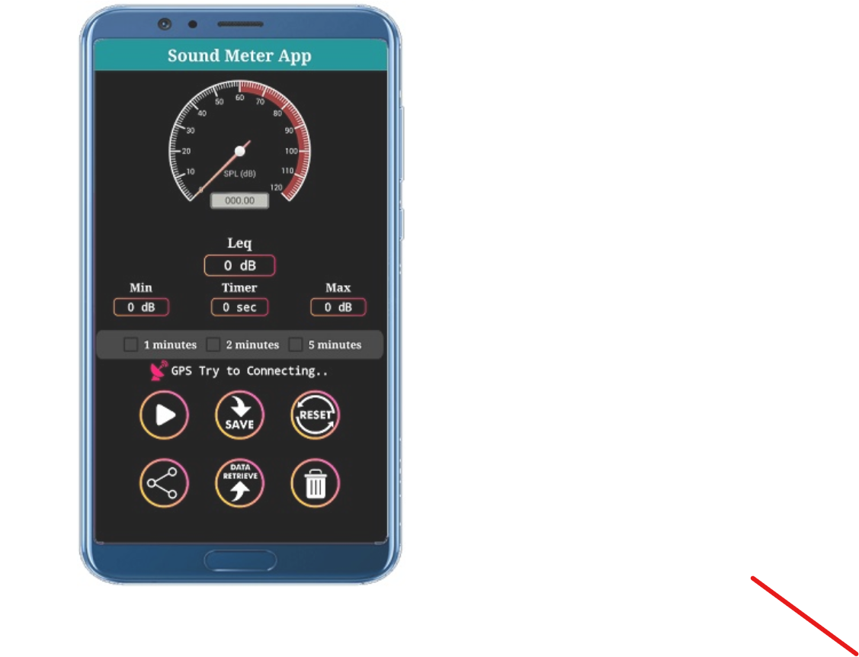
Platform:
Collect and store noise data from mobile devices and other sensors.
Analyze noise data to identify patterns and trends.
Generate reports and visualizations of noise data.
Provide a user interface for accessing and interacting with the data.
Mobile App:
Measure noise levels using the device's microphone.
Record and store noise measurements.
Send noise measurements to the platform.
Display real-time noise levels and other information to the user.
NOISE OR SOUND METER MOBILE APP

Slide 6
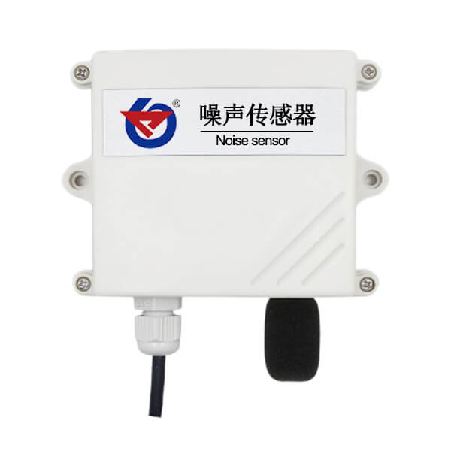
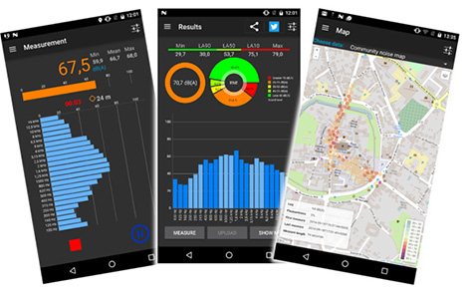
NOISE SENSOR
MOBILE APP FOR NOISE DETECT

Slide 7
Code :
import 'package:flutter/material.dart';
import 'package:noise_pollution_monitor/noise_pollution_monitor.dart';
void main()
{
runApp(MyApp());
}
class MyApp extends StatelessWidget {
@override
Widget build(BuildContext context) {
return MaterialApp(
home: Scaffold(
appBar: AppBar(
title: Text('Noise Pollution Monitor'),
),
body: Center
(
child: NoisePollutionMonitor(),
),
),
);
}
}

Slide 8
class NoisePollutionMonitor extends StatefulWidget
{
@override
_NoisePollutionMonitorState createState() =>
_NoisePollutionMonitorState();
}
class _NoisePollutionMonitorState
extends
State<NoisePollutionMonitor>
{
double noiseLevel = 0.0;
@override
void initState()
{
super.initState();
NoisePollutionMonitor.startMonitoring((noiseLevel)
{
setState(()
{
this.noiseLevel = noiseLevel;
});
});
}

Slide 9
@override
Widget build(BuildContext context)
{
return Text('Noise level: $noiseLevel dB');
}
}
Code Implementation:
The IoT sensors will be programmed to collect noise level data at regular intervals and transmit the data to the cloud-based platform.
The cloud-based platform will be programmed to store and process the noise level data, generate real-time noise maps and reports, and send notifications to users when noise levels exceed certain thresholds.
The mobile app will be programmed to fetch real-time noise level data and noise maps from the cloud-based platform, allow users to report noise pollution incidents, and provide feedback.

Slide 10
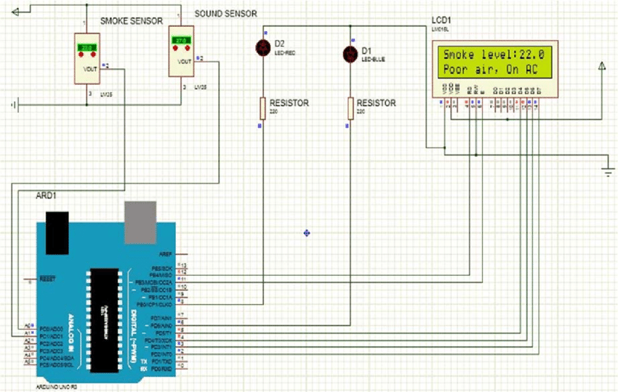
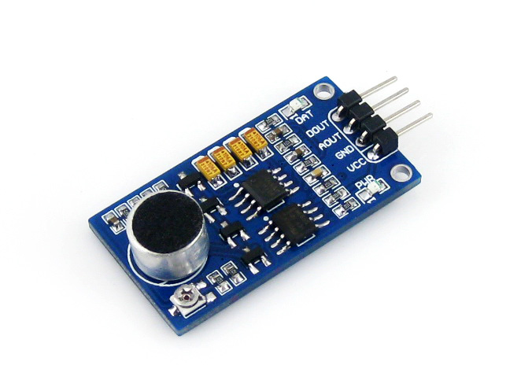
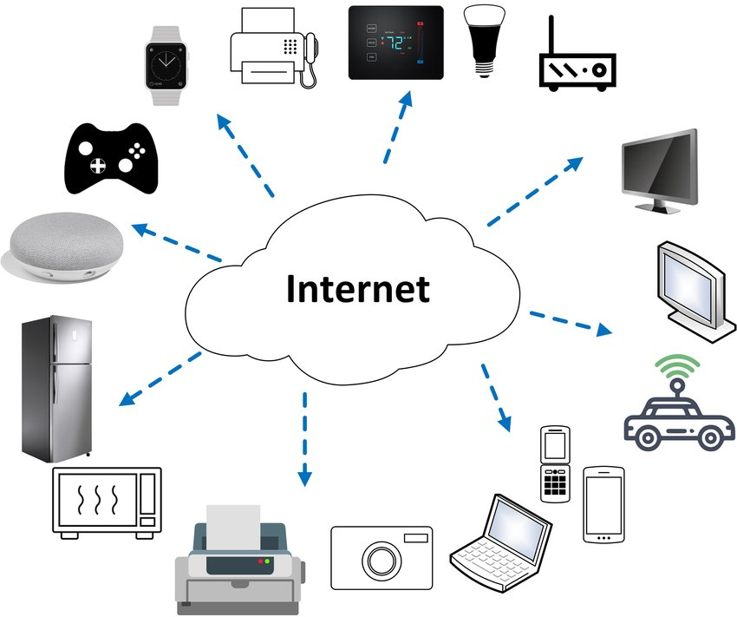
IOT SENSORS USED NOISE POLLUTION IN VARIOUS FIELDS:
sound sensor
Examples of noise pollution in Various fields
Schematic of noise pollution monitoring

Slide 11

Mobile App For Audiobooking:

Slide 12
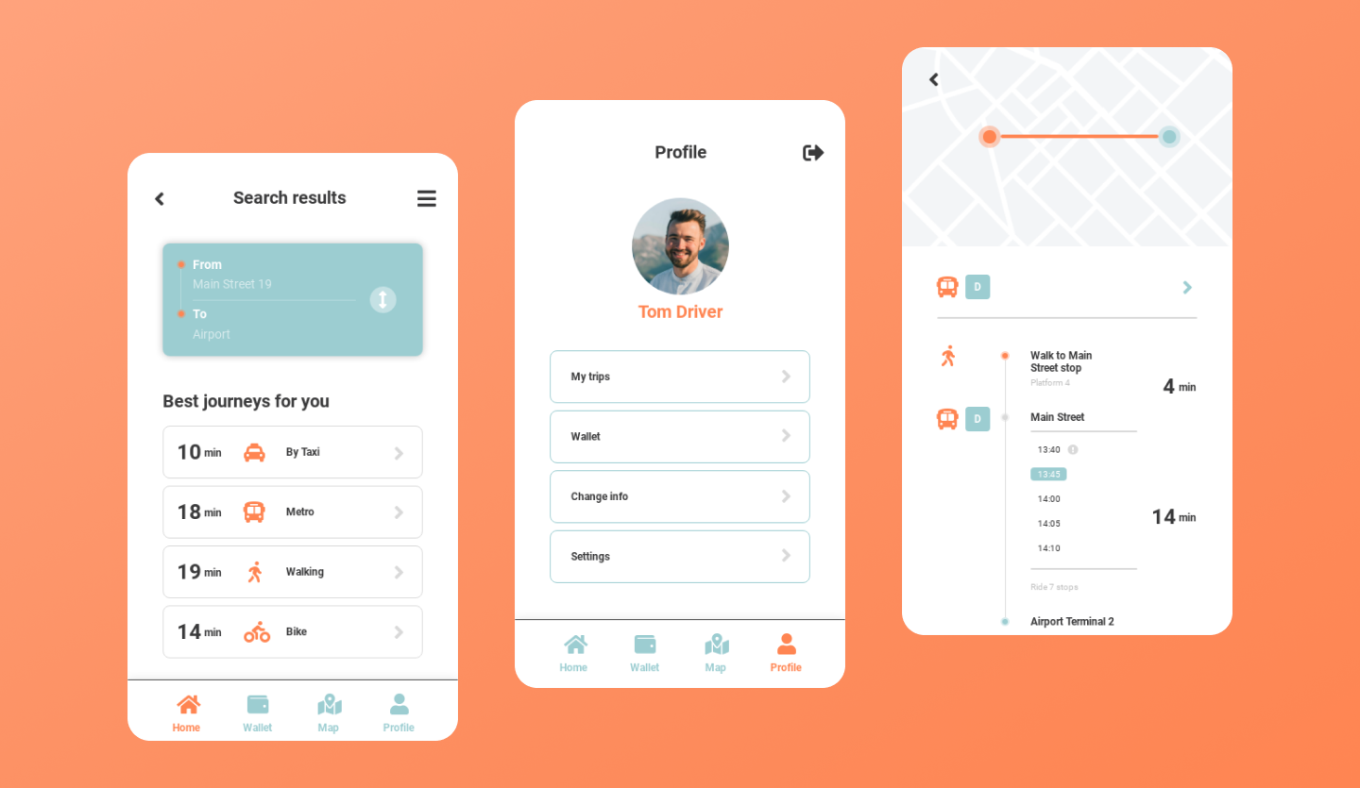
Mobile App For Transportbooking:

Slide 13
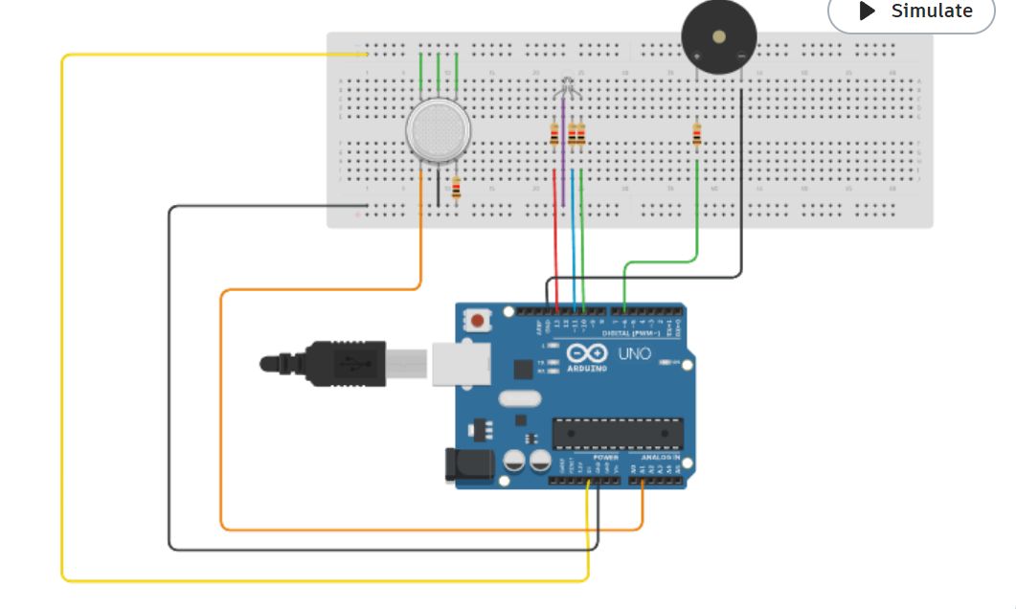
Noise Pollution Model:

Slide 14
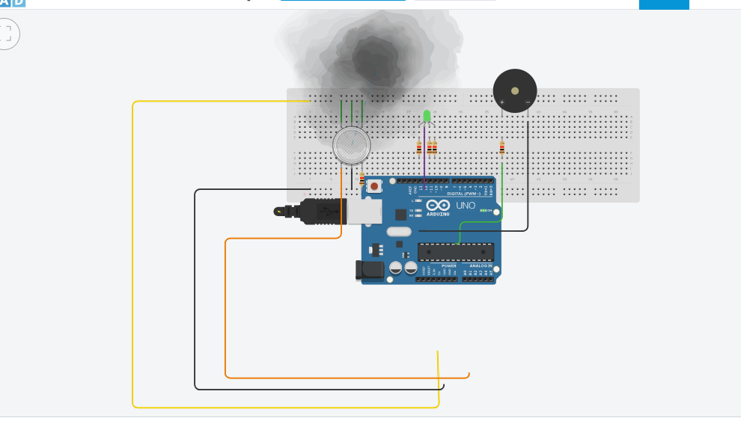
Output For The Noise Pollution Model:

Slide 15
PUBILC AWARENESS FOR NOISE POLLUTION:
Education:
Educating people about the health and environmental impacts of noise pollution is essential for raising awareness and promoting change. This can be done through school programs, public awareness campaigns, and media coverage.
Advocacy:
Advocacy groups and individuals can play an important role in raising awareness of noise pollution and advocating for policies and regulations to reduce noise levels.
Technology:
Technology can also be used to promote public awareness of noise pollution. For example, mobile apps can be used to provide real-time noise level data and noise maps to the public.

Slide 16

NOISE POLLUTION AWARENESS IN SCHOOLS:

Slide 17
Educate the public about the health effects of noise pollution.
Educate the public about the health effects of noise pollution includes raising awareness of the short- and long-term health impacts of noise pollution, such as hearing loss, sleep disturbance, cardiovascular disease, and stress.
Highlight the economic and social costs of noise pollution.
Highlight the economic and social costs of noise pollution includes the costs associated with lost productivity, absenteeism, and healthcare.
Empower people to take action against noise pollution.
Empower people to take action against noise pollution includes providing information on how to reduce noise exposure, report noise pollution incidents, and advocate for noise pollution mitigation measures.
Develop and distribute educational materials.
Develop and distribute educational materials could includes brochures, infographics, videos, and social media posts.

Slide 18
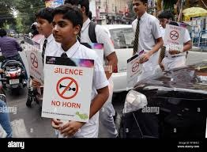
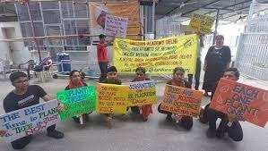
PUBLIC AWARENESS:

Slide 19
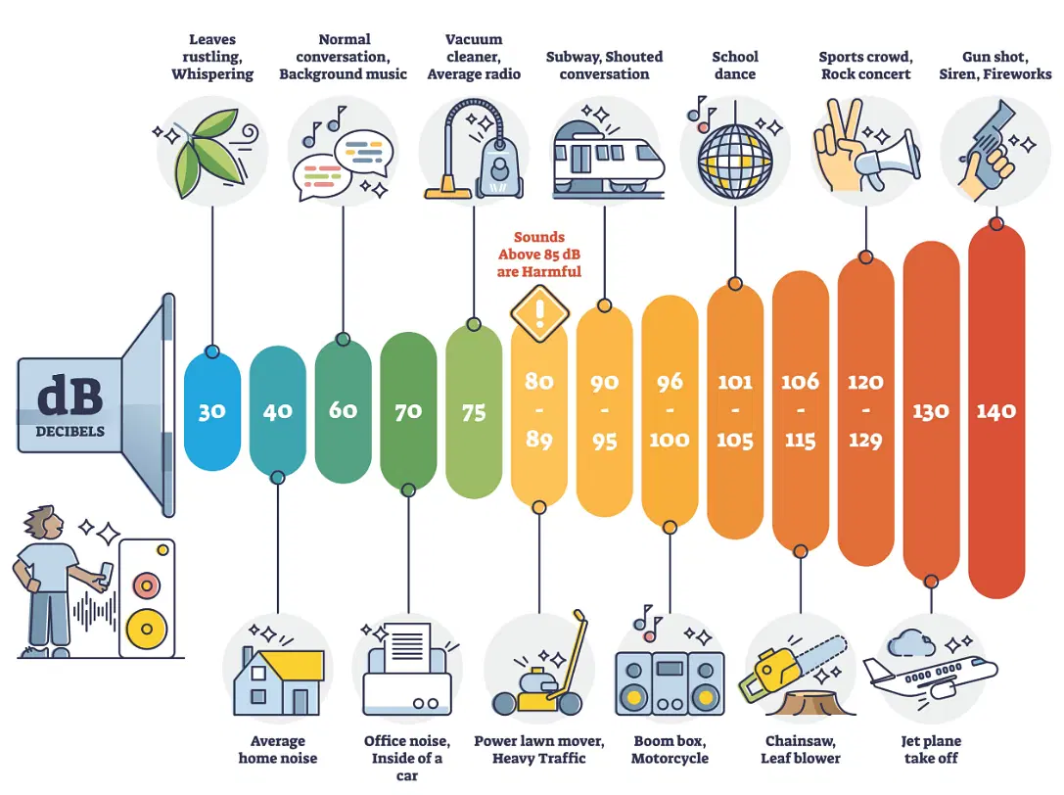
NOISE LEVELS:

Slide 20
The real-time noise level monitoring system can be used to:
1.Identify areas with high noise levels.
2.Monitor the effectiveness of noise pollution mitigation measures.
3.Provide early warning of potential noise pollution problems.
4.Help people to choose quieter places to live and work.
5.Educate people about the dangers of noise pollution.

Slide 21
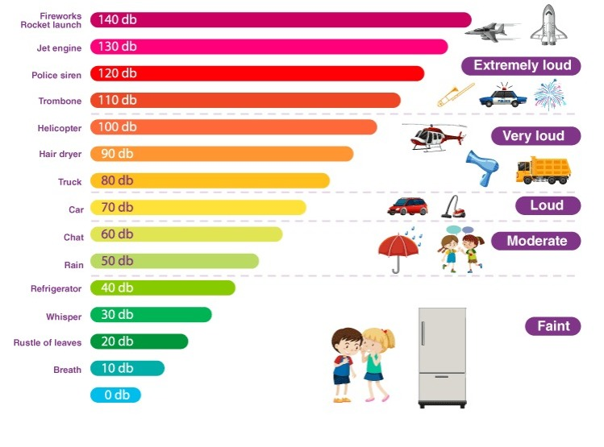
REAL TIME NOISE POLLUTION:

Slide 22
Conclusion:
The real-time noise level monitoring system is a valuable tool for promoting public awareness of noise pollution and contributing to noise pollution mitigation.
By providing real-time data on noise levels, identifying noise pollution hotspots and sources, and educating the public about noise pollution, the RTNLMS can help to create a quieter and more livable environment for everyone.
THANK YOU

