Slide 1
Weather Image Recognition System
Yeswanth Reddy Chereddy (RD76099)
Vishal Balaji Kotrike (EE36010)
Akshay Reddy Gone (AM60898)

Slide 2
Phases in the Project
Data Collection
Data Preprocessing
Model Development
Apache Spark Processing
Reporting

Slide 3
Accomplishments
Data gathered from Kaggle
Completed data collection for training the image recognition model.
Successfully created and trained the initial version of the image recognition algorithm.
Evaluated the dataset accuracy

Slide 4

Changes Since the Defense
Adjustments Made:
Modified the data preprocessing techniques to enhance model accuracy.
Facing issues in storing the data in MongoDB
Implemented CNN model using Tensor flow and Keras

Slide 5
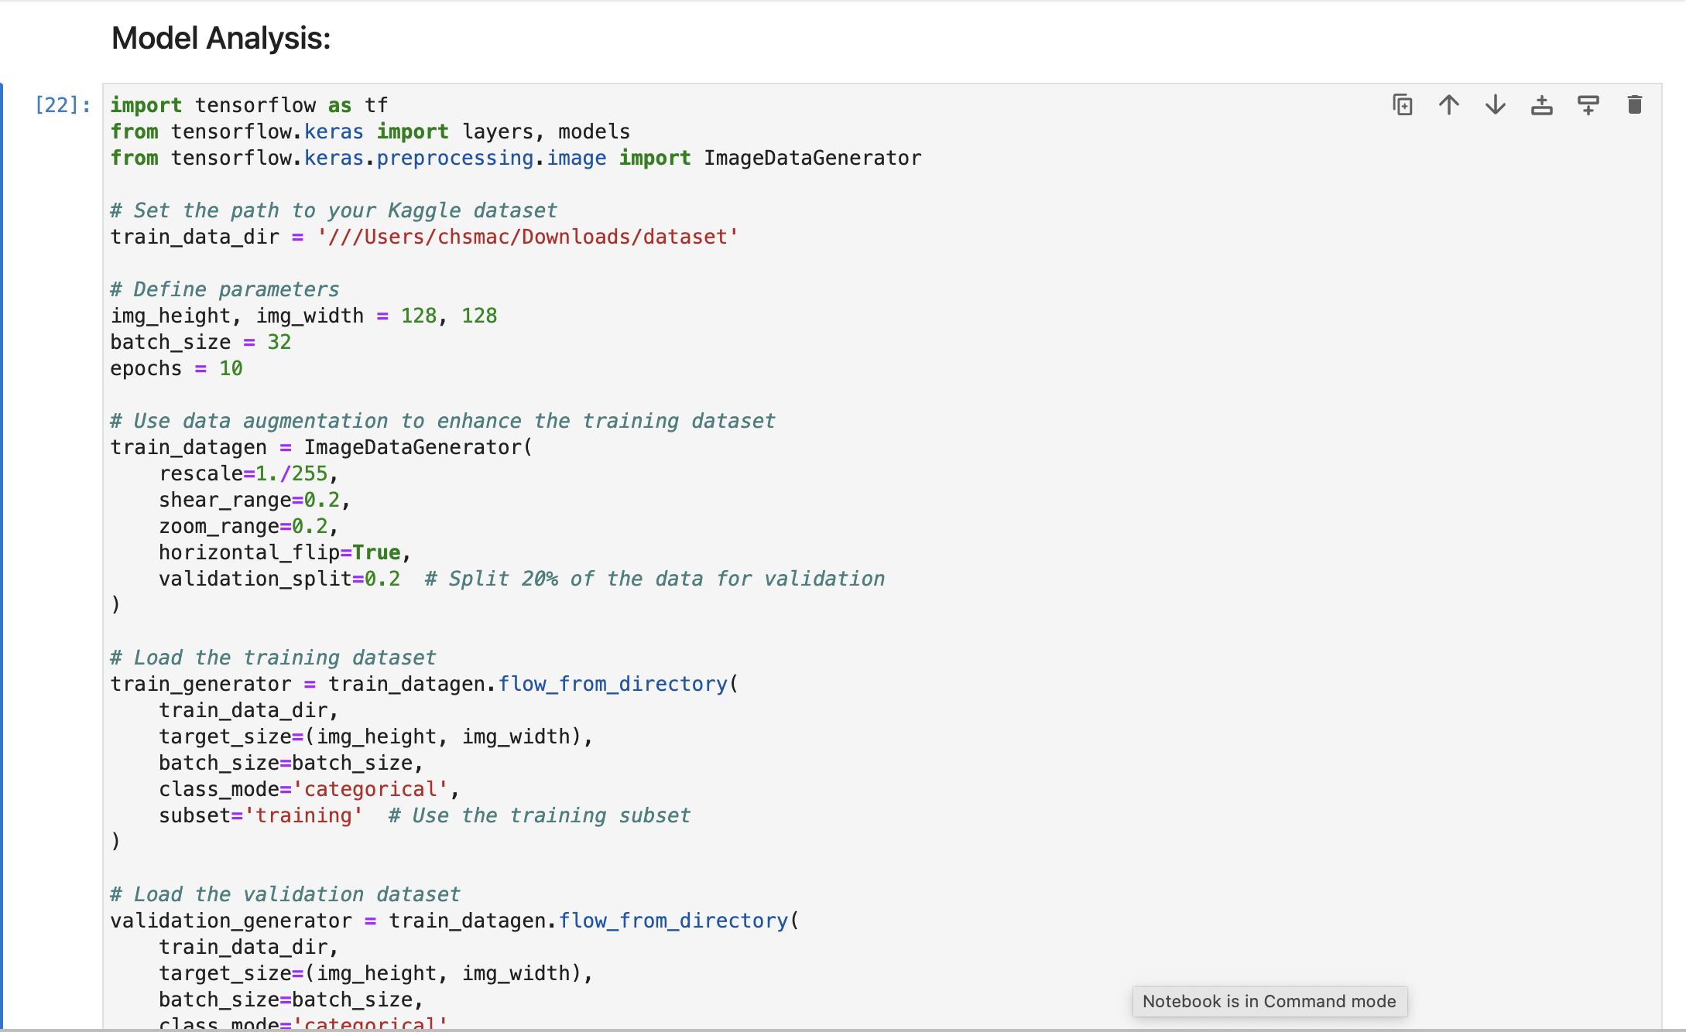
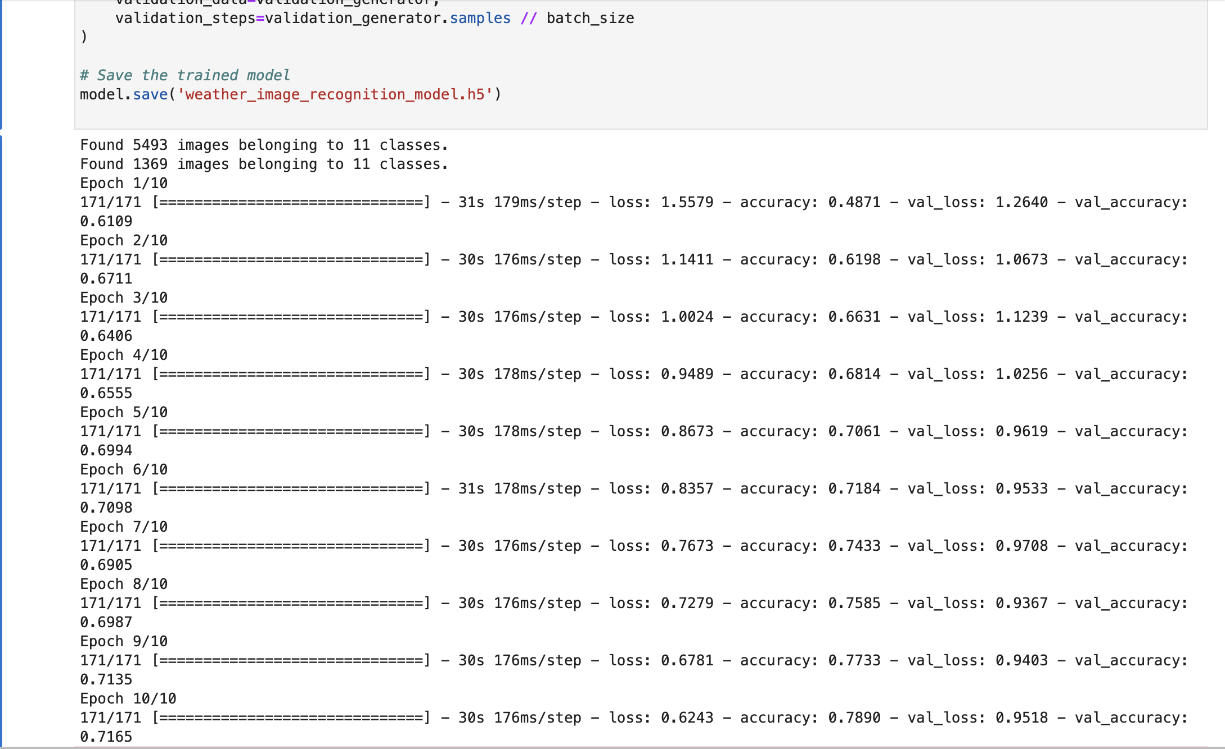
Evidence of Project Progress
Model Training Code:
Model Training Results:

Slide 6
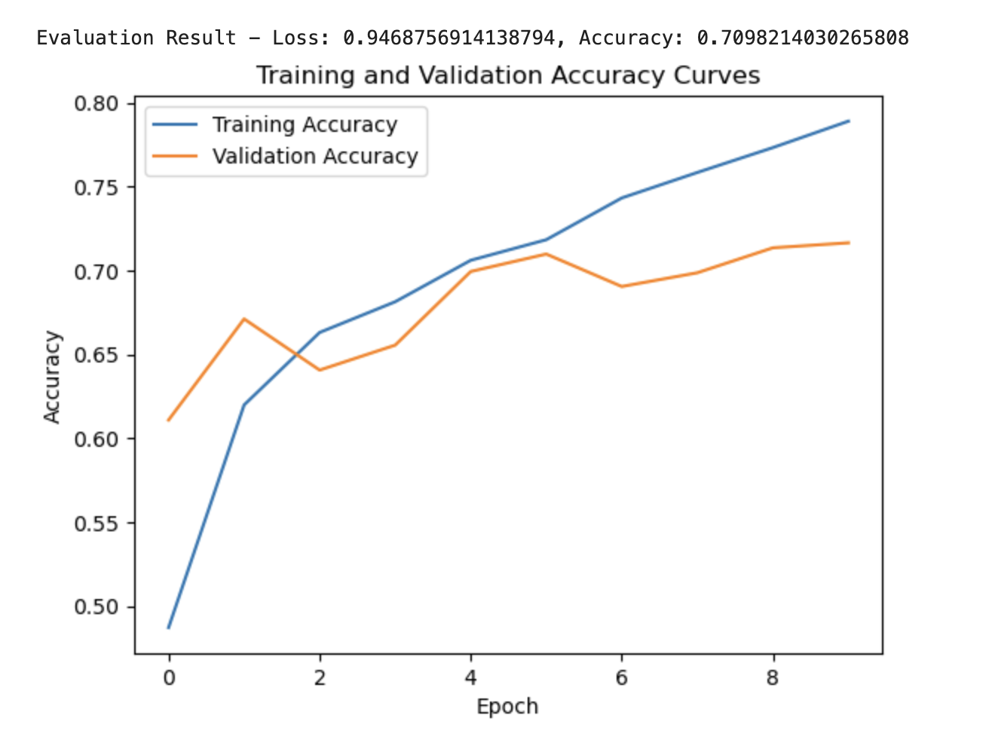
Evidence of Project Progress
Model Evaluation results:

Slide 7
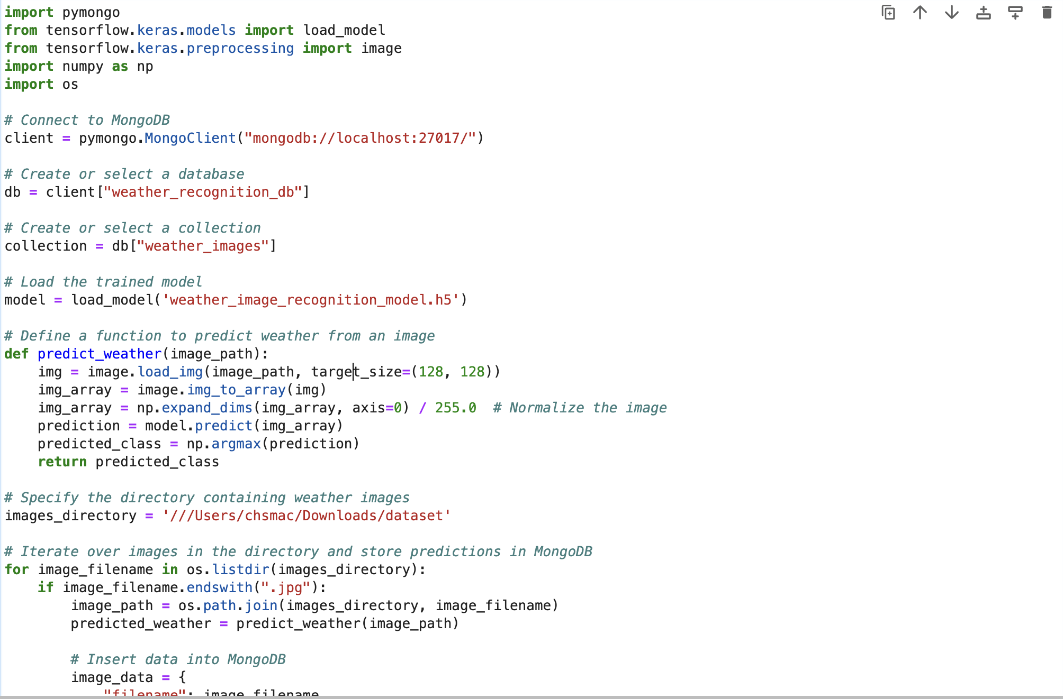
Phases yet to be implemented:
Data Storage (MongoDB)
Data Processing (Apache Spark)
Reporting

Slide 8
Thank you

