Slide 1
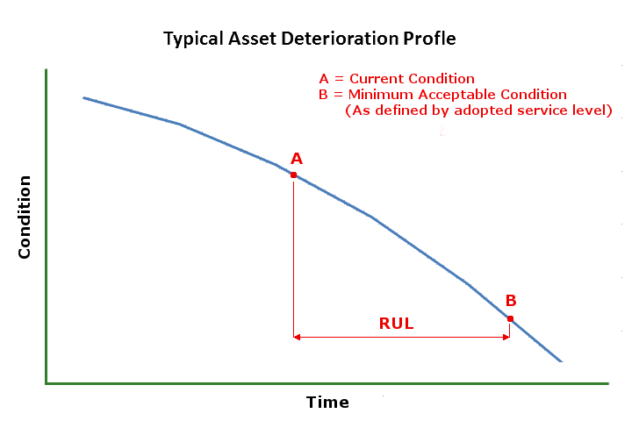
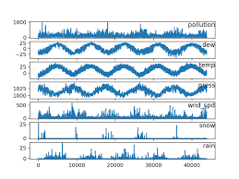
Multi-Sensor Prognostics using an Unsupervised Health Index based on LSTM Encoder-Decoder
P. Malhotra et al – aug. 2016
Remaining Useful Life (RUL) of a machine
Health degradation curve
Time to reach same level of degradation
Construct an Health index
Main idea : reconstruct healthy data thanks to an LSTM – ED at a time point of the time-series
LSTM-ED for multivariate time-series input.
Data : multi-sensor data from time point until the end-life of the system

Slide 2
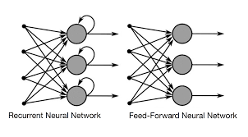
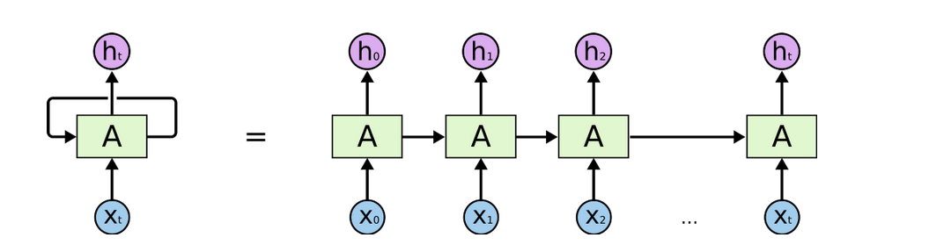
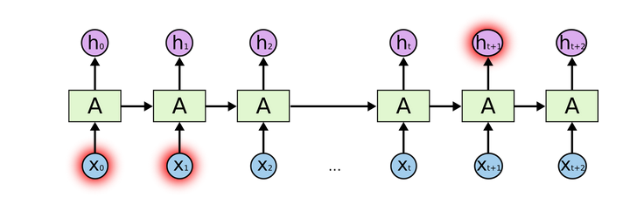
Long Short Term Memory
LSTM unit = Recurrent unit that uses a combination of a memory cell
and 3 gates : input gate ; forget gate ; output gate
(decision : throw information or keep it into memory cell
Memory cell :

Slide 3
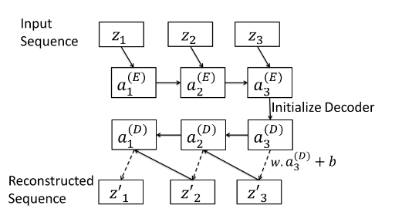
Long Short Term Memory – Encoder Decoder
LSTM-based encoder-decoder for ulti-sensor anomaly detection. P.Malhotra et al. – 2016
A novel approah for automatic acoustic novelty detection using a denoising autoencoder
with bidirectional LSTM neural network. E. Marchi et al. - 2015
The LSTM encoder learns a fixed length vector representation of the input time-series and the LSTM decoder uses this representation to reconstruct the time-series using the current hidden state and the value predicted at the previous time-step.

