Slide 1
Trees

Slide 2
The British Constitution
Crown
Church of
England
House of
Commons
House of
Lords
Supreme
Court
Cabinet
Ministers
County
Council
Metropolitan
police
Rural District
Council
County Borough
Council

Slide 3
More Trees Examples
Unix / Windows file structure

Slide 4
Definition of Tree
A tree is a finite set of one or more nodes such that:
There is a specially designated node called the root.
The remaining nodes are partitioned into n>=0 disjoint sets T1, ..., Tn, where each of these sets is a tree.
We call T1, ..., Tn the subtrees of the root.

Slide 5
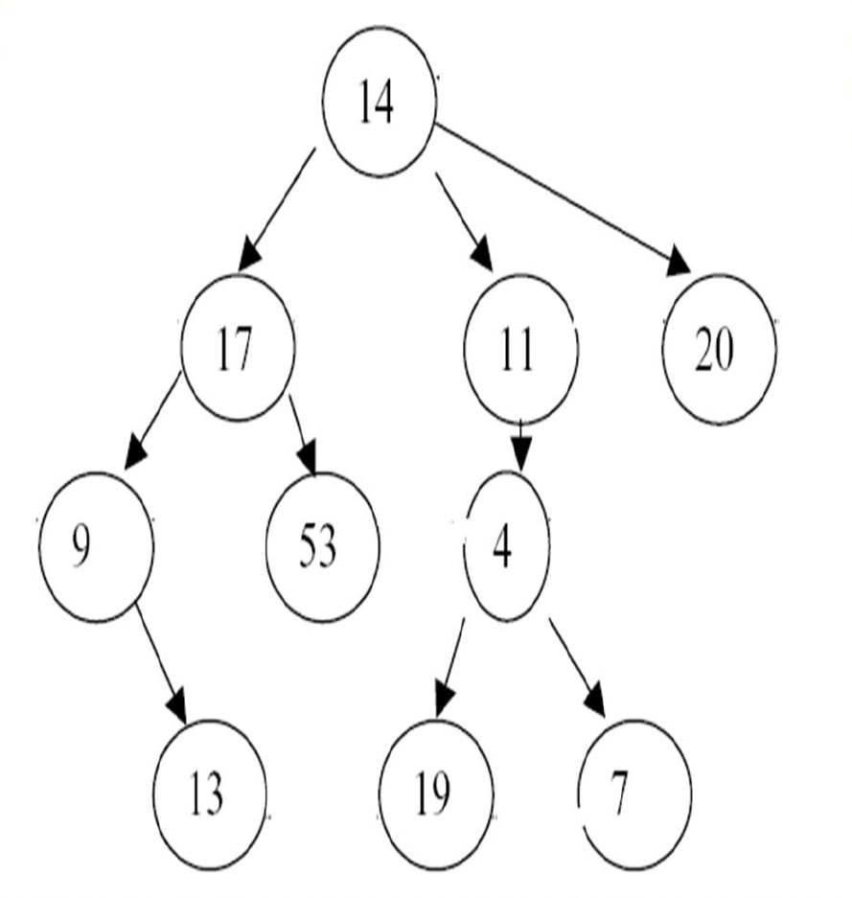
Some Terminologies
Root
– The only node in the tree with no parent
– A tree has only one root
– Root : 14
• Child and parent
– Every node except the root has one parent
– Parent of node n
• The node directly above node n in the tree
• 14 is Parent to 17, 11, 20
– A node can have an arbitrary number of
children
– Child of node n
• A node directly below node n in the tree
• 17, 11, 20 are children of 14

Slide 6

Some Terminologies
Leaves
– Nodes with no children
– 13, 53, 19,7, 20
• Sibling
– nodes with the same parent
– 17, 11, 20 are siblings
– 19 and 7 are siblings
• Subtree of node n
– A tree that consists of a
child (if any) of node n and
the child’s descendants

Slide 7
Some Terminologies
Ancestor of node n
– A node on the path from
the root to n
– Ancesstor 13 : 9,17,14
– Nod 14 is ancestor for all
node in the tree
Descendant of node n
– A node on a path from n
to a leaf
– Descendant 11: 4,19,7
– All nodes in the tree are
descendant to the root.

Slide 8
Some Terminologies
• Path – sequence of nodes in which each
node is adjacent to the next one
. Example: Path from root to 13: 14,17,9,13
Path from root to 19: 14,11,4,19
• Length
– number of edges on the path
– Length of Tree : 3
• Depth of a node
– length of the unique path
from the root to that node
– The depth of a tree is equal
to the depth of the deepest leaf
– Depth of Tree : 3
– Depth of 4 : 2

Slide 9
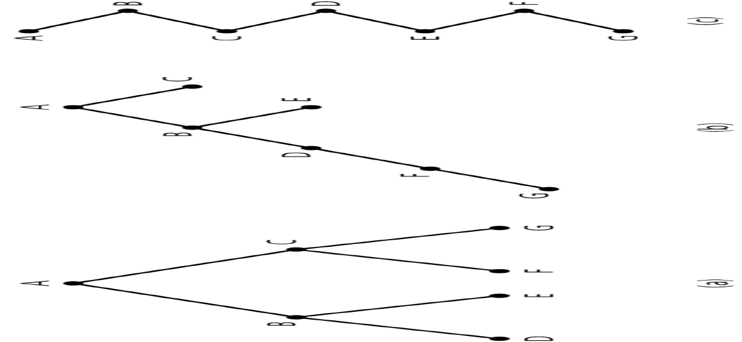
Some Terminologies
Height of a tree
• Number of nodes along the longest path from the root to a leaf. (Carrano,2007)
• If Tree is empty, its height is 0
Heights of these trees?

Slide 10
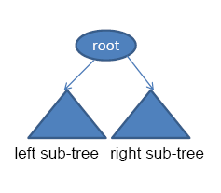
Binary Tree Definition
A tree with restrictions, such that any
given node can have at most two child
nodes.
• A binary tree consists of a set of nodes such
that either :
– Tree is empty, or
– Tree is partitioned into three disjoint subsets:
• The root
• Two possibly empty sets that are binary trees, called the left subtree of the root and the right subtree of the root.

Slide 11
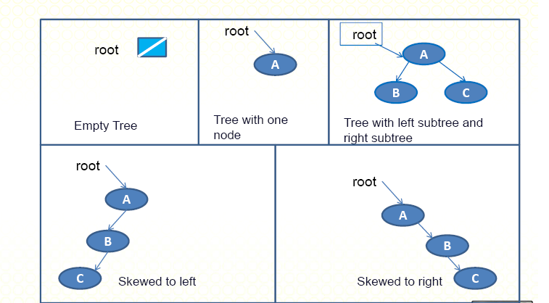
A Collection of Binary Trees

Slide 12
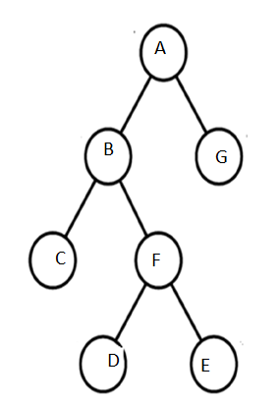
Strictly Binary Tree
If every non-terminal node in a
binary tree consist of non empty
left subtree and right subtree,
then such a tree is called strictly
binary tree.

Slide 13
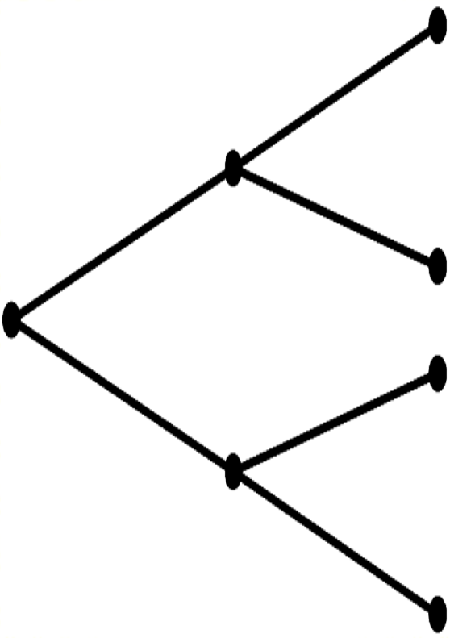
Complete Binary Trees
• A binary tree of height h is full if
– Nodes at levels < h have two
children each
• Recursive definition
– If T is empty, T is a complete
binary tree of height 0
– If T is not empty and has height
h > 0, T is a complete binary tree if its
root’s subtrees are both full
binary trees of height h – 1.
A full binary tree of height 3

Slide 14
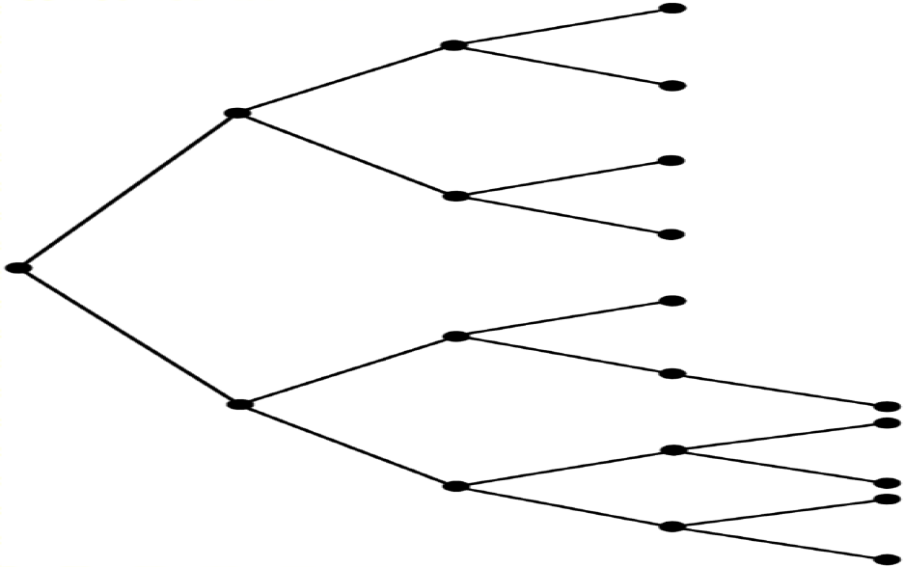
Almost Complete Binary Tree
A binary tree of height
h is complete if
– It is full to level h–1,
and
– Level h is filled from
left to right

Slide 15
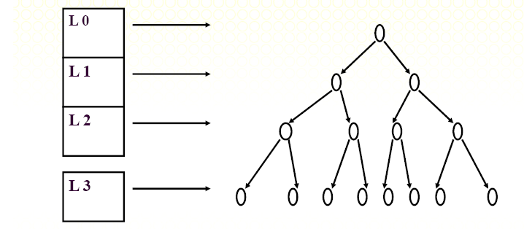
At each level the number of the nodes is doubled.
Total number of nodes: 1 + 2 + 2^2 + 2^3 = 2^4 ‐ 1 = 15

Slide 16
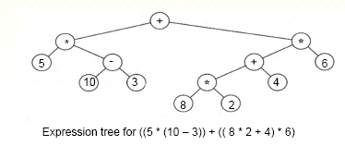
Expression Tree
Expression Tree
• Leaves are operands (constants or variables)
• The other nodes (internal nodes) contain operators

Slide 17
Complete Binary Trees

Slide 18
Tree traversal
Traverse a tree is to visit every node in a tree.
• Some operations can be done with the node during a
visit.
– For example, modify or update the data in the node
– Used to print out the data in a tree in a certain order
• Type of Traversal
– Inorder traversal
– Preorder traversal
– Postorder traversal

Slide 19
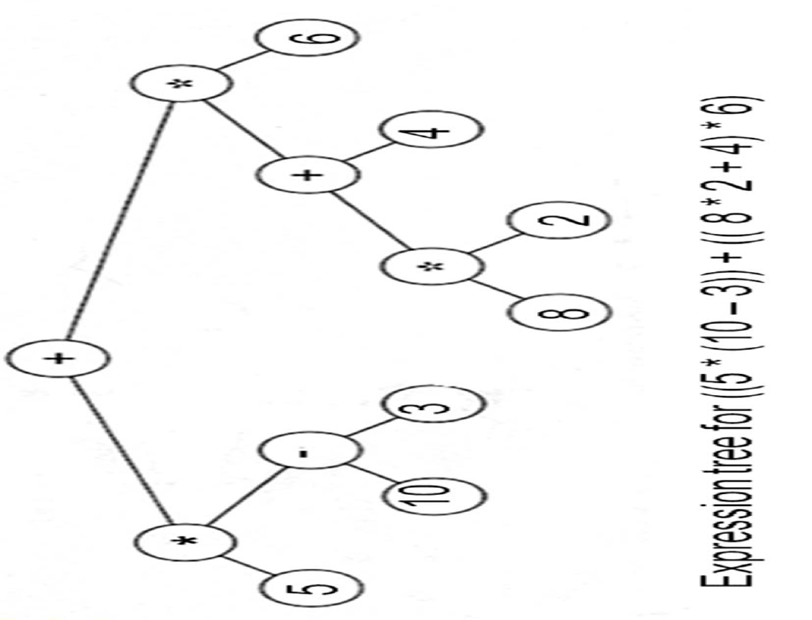
Pre‐order traversal
Visit the root
Traverse the left subtree
in preorder.
Traverse the right
subtree in preorder.
Prefix expression
+*5‐103*+*8246

Slide 20
Postorder traversal
Traverse the left subtree
in postorder.
Traverse the right
subtree in postorder.
Visit the root
POST ORDER:
5103‐*82*4+6*+

Slide 21
Inorder traversal
Traverse the left subtree
in inorder.
Visit the root
Traverse the right
subtree in inorder.
IN ORDER:
5*10‐3+8*2+4*6

Slide 22
Pre‐order traversal :
ABCFDEG
In‐order traversal:
CBDFEAG
Post‐order traversal:
CDEFBGA

