Slide 1



AWash: Handwashing Assistance for the Elderly with Dementia via Wearables
Presenter: Yetong Cao
Yetong Cao∗ Huijie Chen∗ Fan Li∗ Song Yang∗ Yu Wang†
*School of Computer Science and Technology, Beijing Institute of Technology, China †Department of Computer and Information Sciences, Temple University, USA

Slide 2
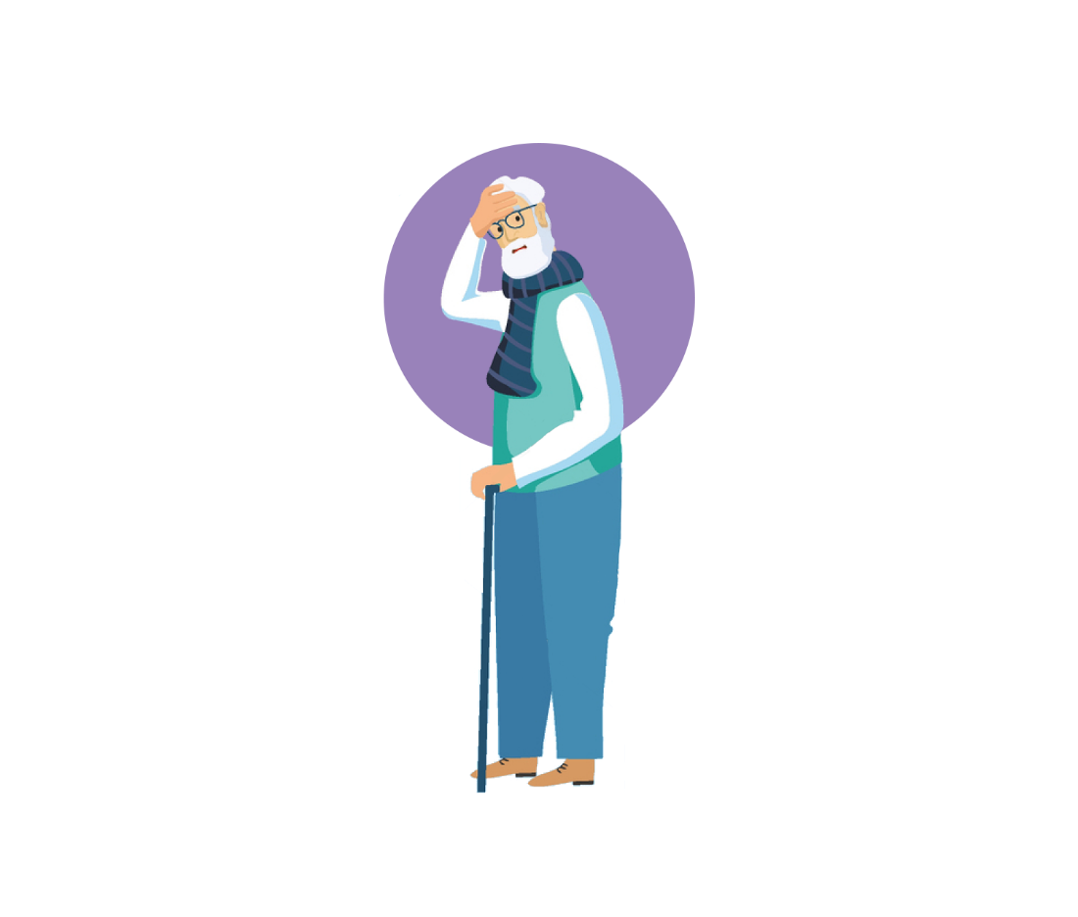



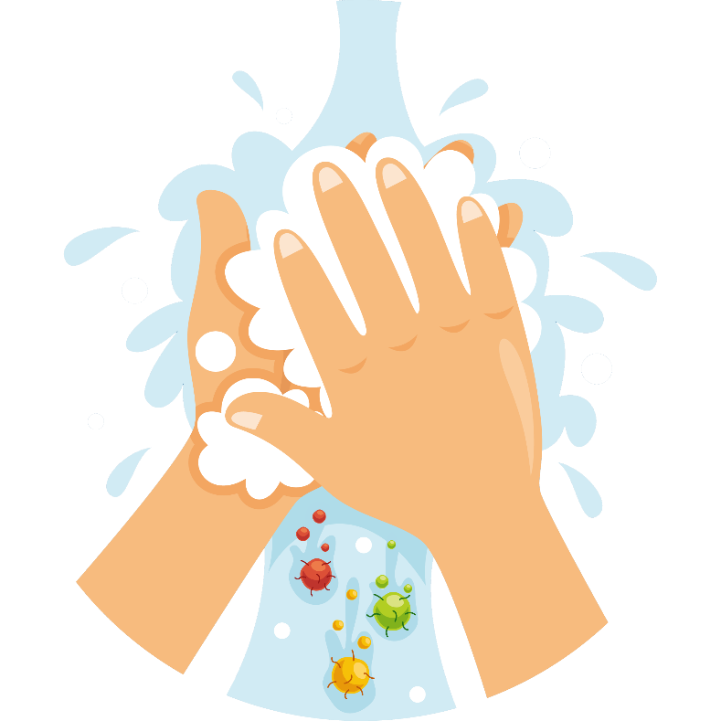


Motivation
？
？
Memory Loss
Difficulty Completing Tasks

Slide 3
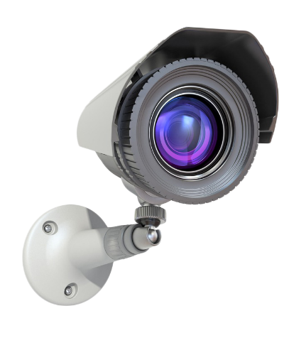
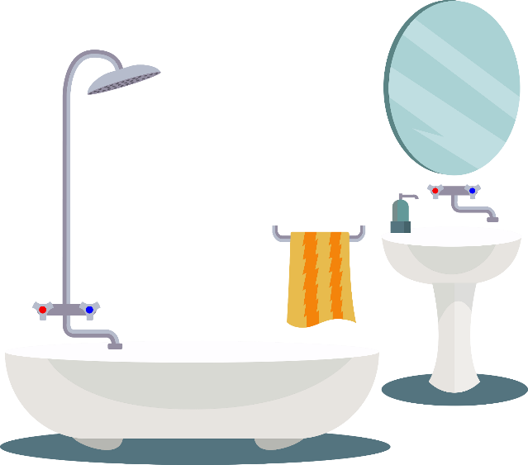
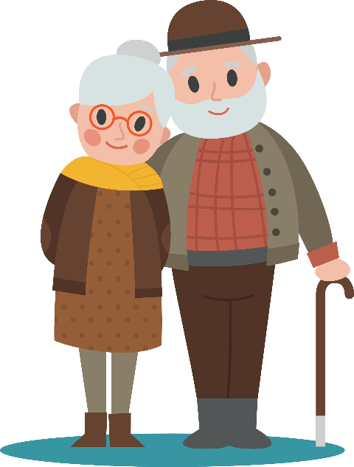
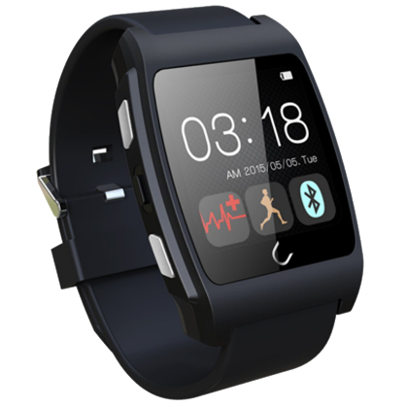
Limitation of Existing Techniques
Privacy
Vision-based Methods
Different behavior patterns
Ineffective
More distinct individual differences in handwashing movement patterns
Wearable-based Methods
Diverse assistance manner

Slide 4
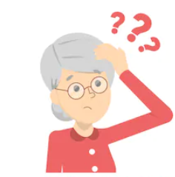
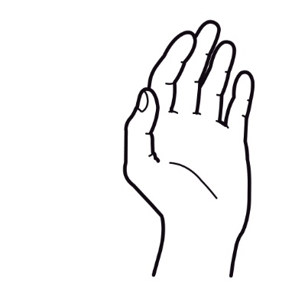
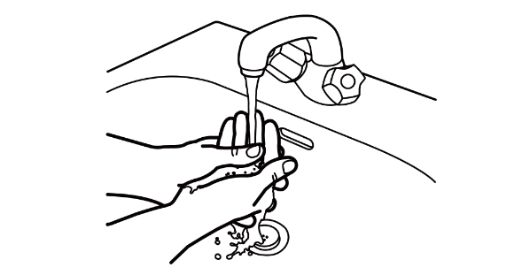
Goals
1
Accurate
2
User-independent
3
Support diverse assistance manner
Collect Data
Recognize
Assist
Handwashing Actions
Wrist Posture
senile dementia patients

Slide 5
Overview
C1:How to obtain each type of handwashing movement fragment from the continuous and noisy IMU sensor data?
C2:How to derive the repre-sentative wrist movement information to distinguish the various handwashing move-
ments of the elderly with dementia?
C3:How to design a user-independent handwashing motion recognition system for senile dementia patients with diverse cognitive impairment?

Slide 6
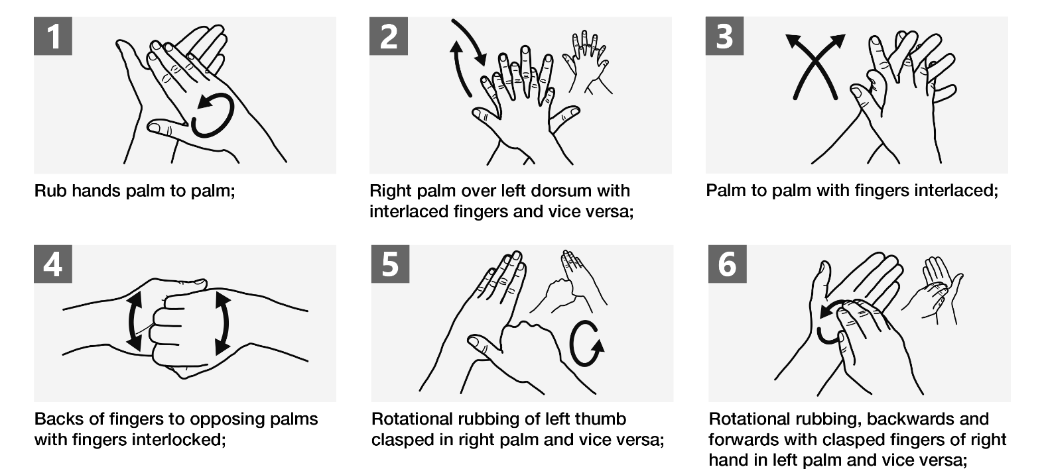

Handwashing Actions Segmentation
？
？
Visuomotor impairment affects eye-hand coordination for the orderly in some dementias during handwashing
1
？
Noise Reduction：
Moving average filter
Interferences

Slide 7

Handwashing Actions Segmentation
Repetitive patterns！
2
Handwashing Action Detection：
Data in window
Data in window
Data in window
Autocorrelation
Autocorrelation
Autocorrelation

Slide 8
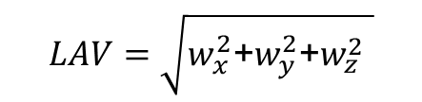
Handwashing Actions Segmentation
3
Start and End Position Detection：
P
$$LAV=\sqrt{w_{x}^{2}\text{+}w_{y}^{2}\text{+}w_{z}^{2} }$$
Data in window
Autocorrelation

Slide 9
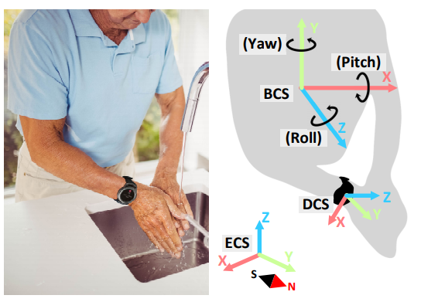
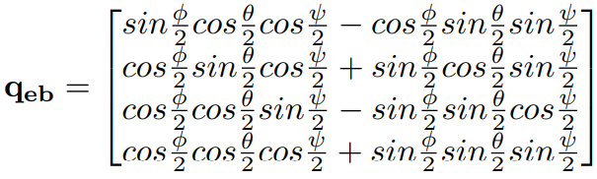
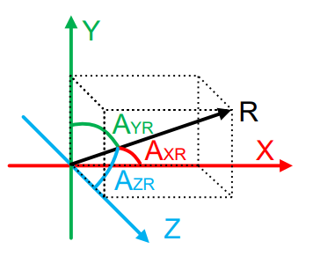
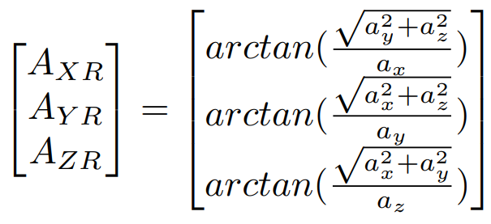





Handwashing Information Derivation
1
Coordinate Transformation:
Device coordinate system
Body coordinate system
$$P_{d}$$
$$P_{b}$$
$$P_{e}=q_{de}P_{d}q_{de}^{−1}$$
$$P_{b}=q_{eb}P_{e}q_{eb}^{−1}$$
$$P_{e}$$
Earth coordinate system
2
Sensor-Body Inclination Angles Calculation:

Slide 10
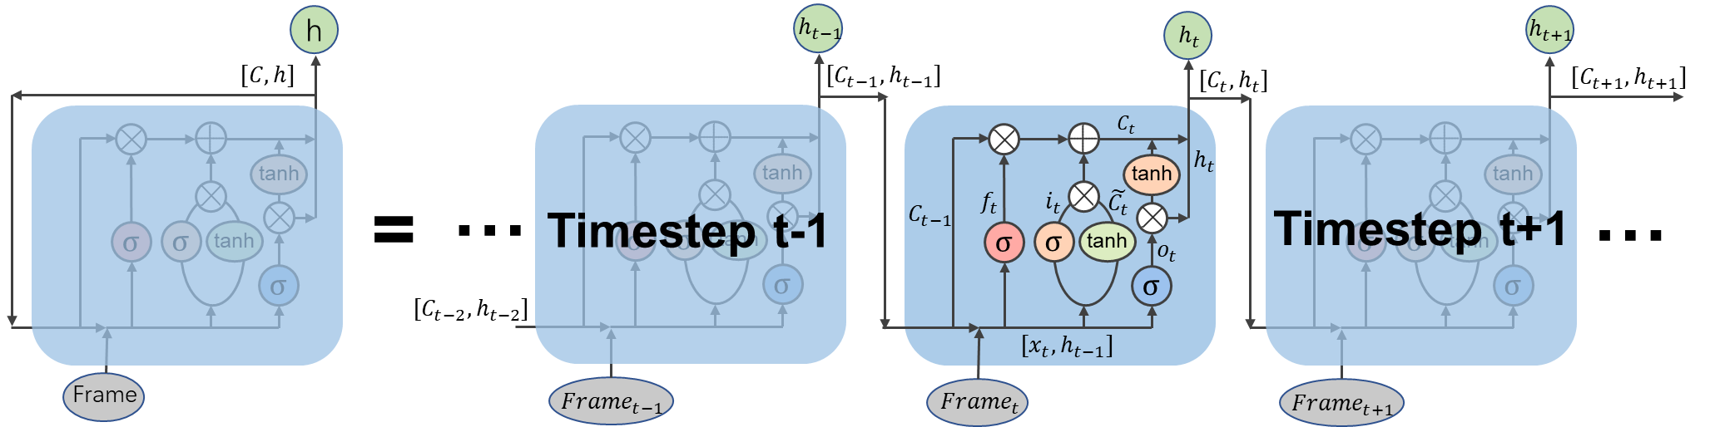
Action Recognition
$$h_{t}=σ\left(W_{0}\left[h_{t−1},x_{t}\right]+b_{0}\right)∙\tanh\left(C_{t}\right)$$
We take prediction with the highest probability as the recognized action

Slide 11

Handwashing Assisting
Type | Issue | Assistance Form
Mild dementia | Forget the handwashing process; Miss a few steps in the overall task | Practice handwashing actions in the same procedure
Moderate dementia | Forget how to perform a specific action; Have obsessive behaviors; Fail to focus on the task | Practice performing specific actions; Stop the wrong action
Severe dementia | More complex issues
？
？
？
1
Handwashing Process Modeling:
Uses tate machine to model hanwashing process.
2
Design of Audio Prompt:
Audio guidance：familiar with audio prompts, provides a more direct augmentation of executive function, do not distract users.
Gentle male voice, more straightforward commands, played loud enough.

Slide 12
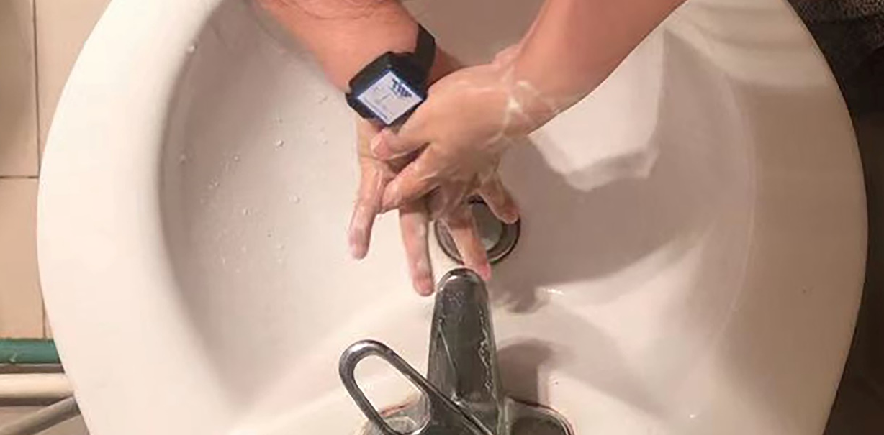
EVALUATION
Setup:
9-axis IMU sensor
100Hz
Ground truth:
camera
Recruitment:
8 participants
20 days
6,000 samples
ID | 1 | 2 | 3 | 4 | 5 | 6 | 7 | 8
Age | 81 | 75 | 74 | 71 | 71 | 68 | 65 | 65
Gender | F | M | M | F | M | M | F | M
MoCA | 21 | 20 | 18 | 21 | 25 | 27 | 23 | 28

Slide 13
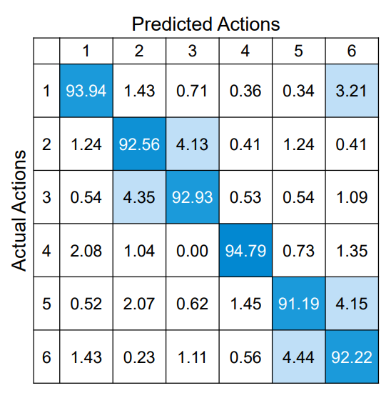
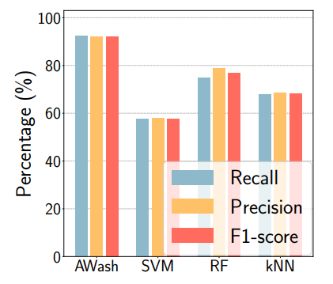
Performance of Handwashing Action Recognition
Recall: 92.94%
Precision: 92.60%
F1-score: 92.76%
delay < 0.9 s: 80.00%

Slide 14
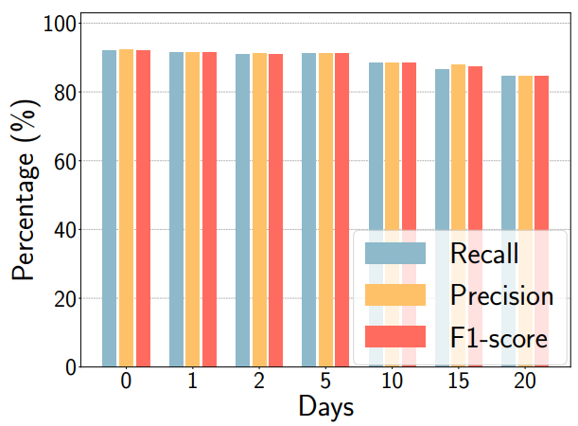
Issue Study
Long-Term Recognition Performance
Impact of Sink Height：
Sink height | recall | precision | F1 score
Children Sink (25 in) | 81.74% | 83.50% | 82.10%
Mixed data | 87.86% | 88.61% | 88.07%
Recall, precision, and F1-score are all above 84%

Slide 15
Effectiveness of Handwashing Assistance
 | Prompt when miss steps in the overall task |  |  |  | Prompt when perform steps in wrong order
ID | 1 | 2 | 3 | 4 | 5 | 6 | 7 | 8
Baseline | 3.67 | 3.67 | 3.00 | 4.00 | 4.67 | 5.00 | 4.67 | 5.33
AWash 1st day | 5.40 | 5.40 | 5.40 | 5.60 | 5.80 | 6.00 | 5.80 | 6.00
Awash 20th day | 6.00 | 5.00 | 5.00 | 6.00 | 6.00 | 6.00 | 6.00 | 6.00

Slide 16
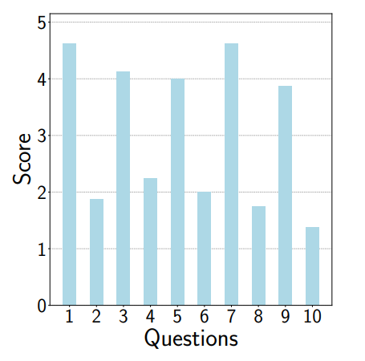
User Experience
System Usability Scale (SUS) Questions:
I think that I would like to use this system frequently.
I find the system unnecessarily complex.
I think the system is easy to use.
I think that I would need the support of a technical person to be able to use this system.
I find the various functions in this system are well integrated.
I think there is too much inconsistency in this system.
I would imagine that most people would learn to use this system very quickly.
I find the system very cumbersome to use.
I feel very confident using the system.
I need to learn a lot of things before I could get going with this system.

Slide 17
Conclusion
We present AWash, a cognitive assistive technology that takes a new step in helping the elderly with dementia washing their hands
Only use commodity IMU sensor integrated on most wrist-worn devices (e.g., smartwatches) to collect handwashing data.
We propose a set of novel algorithms
Autocorrelation-based handwashing movements segmentation method
Quaternion-based coordinate transformation method
A hybrid network model is achieve user-independent handwashing action recognition
State machine-based user-define assistance.
We implement a prototype system and conduct experiments with 8 older participants
Demonstrate the robustness and effectiveness of the system.

Slide 18
Thanks!
Thanks!
Thanks!
&
&
&
Questions
Questions
Questions
Yetong Cao
yetongcao@bit.edu.cn

