Slide 1
Machine Learning Model for Charity Organization
Business Problem
The charity's mail marketing campaigns resulted in a -$1,099.50 loss, emphasizing the need for a smarter, cost-effective strategy to identify likely donors and maximize returns.
:
{}
</>
Zitong(Vicki) Ye
Zhiying(Questa) Quan
//

Slide 2
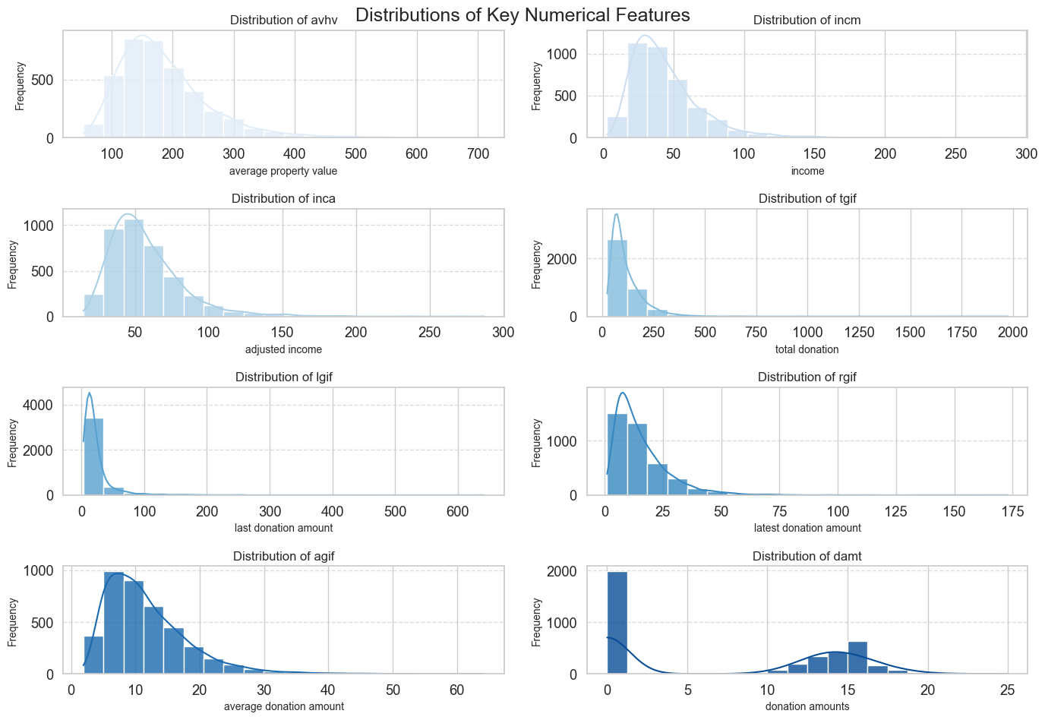
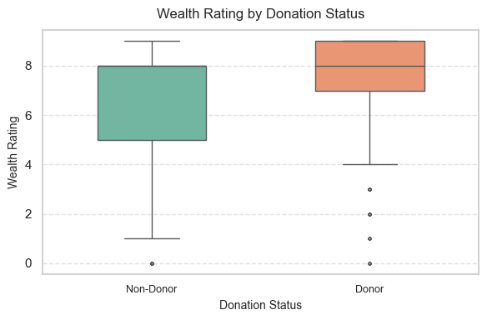
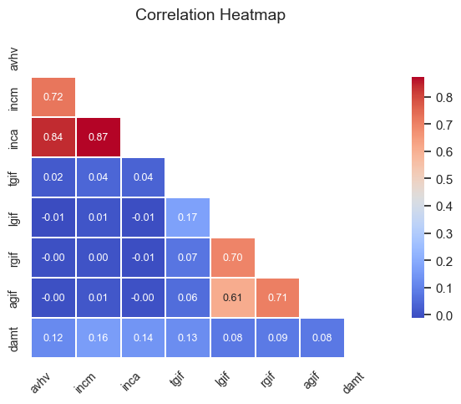
Data and Methods
Correlation Analysis
Wealth Ratings & Donations
Distributional Analysis of Numerical Features
Donation Behavior: Both recent (rgif) and average (agif) donation amounts have a weak relationship with actual donation amounts (damt, ~0.08).
Wealth Features: Income (incm) and adjusted income (inca) also show little connection to actual donation amounts (damt), despite being highly correlated with each other (0.87).
Donation Patterns:Variables are right-skewed, meaning most donations are small, with a few large ones.
Wealth Diversity:Wealth indicators vary widely, but wealthier donors are likelier to contribute more.
Donors have higher median and upper quartile wealth ratings (median ~8 vs. ~6).
Overlap exists near wealth rating 6, making it harder to distinguish donors/non-donors in this range.
Datasets
Key Variables
charitydataset_training& charitydataset_test: Including behavioral and wealth-related features, used for model training.
charitydataset_instructor_scoring: To predict who our potential donors are.
Donation Behavior
Wealth Features
Demographics information
Classification model — predict who is most likely to donate
Regression model — predict the amount of their donation
Most donations are small, but targeting wealthier donors might significantly boost fundraising efficiency.
Wealth ratings influence donation behavior but cannot solely predict donor status.
No single variable is enough; combining factors improves predictions.

Slide 3
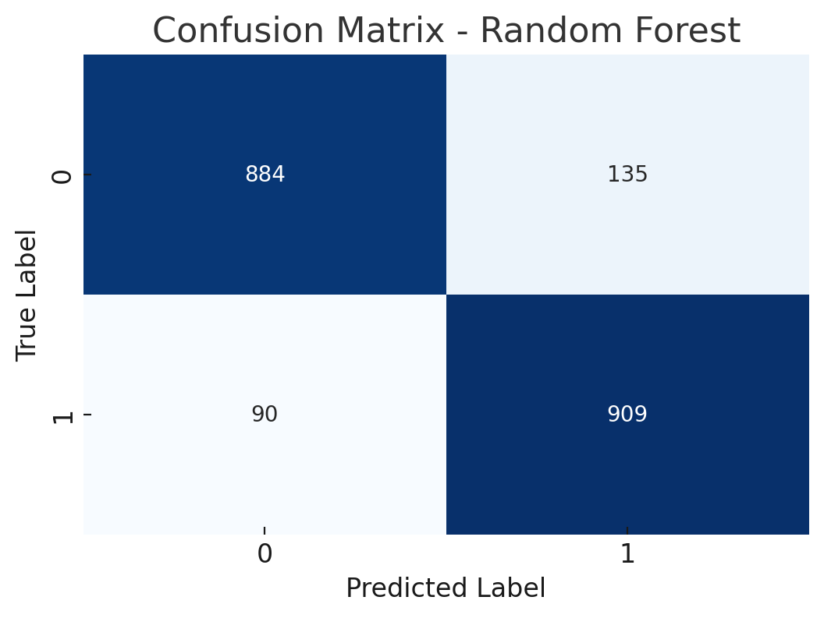
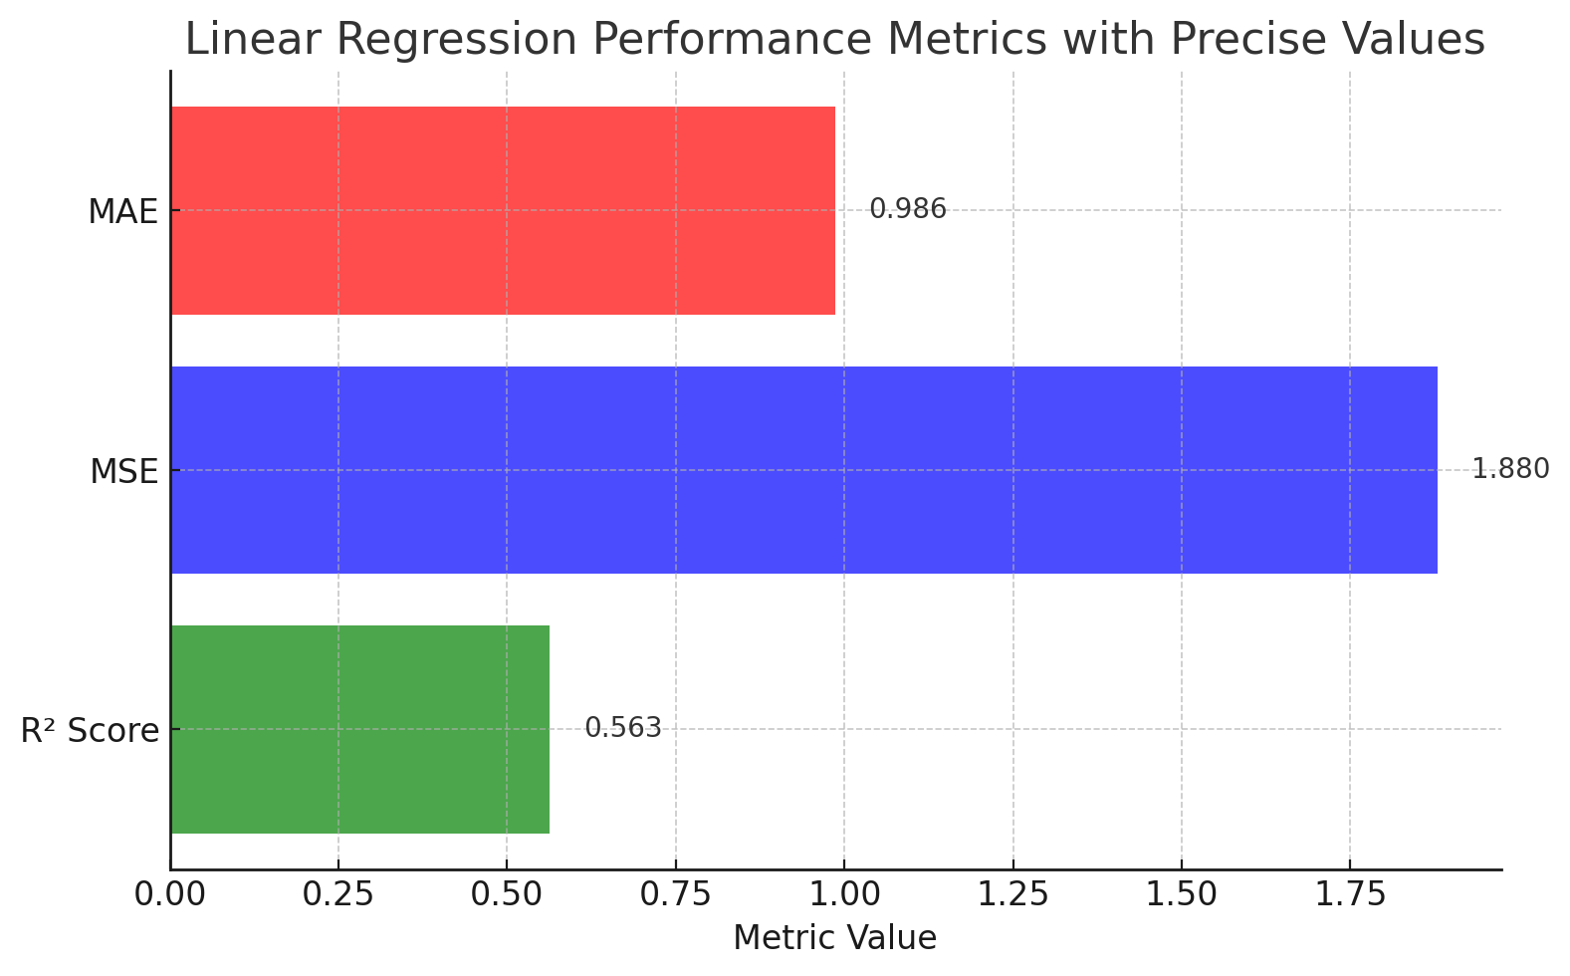
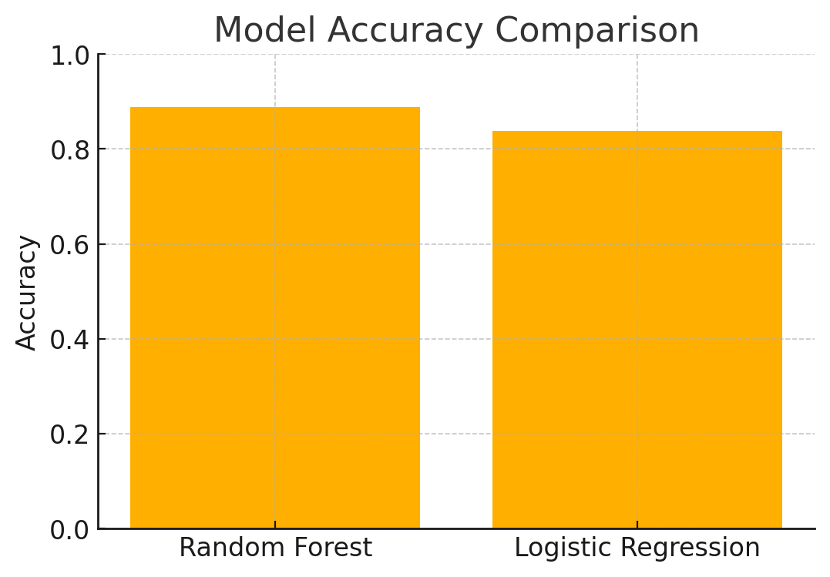
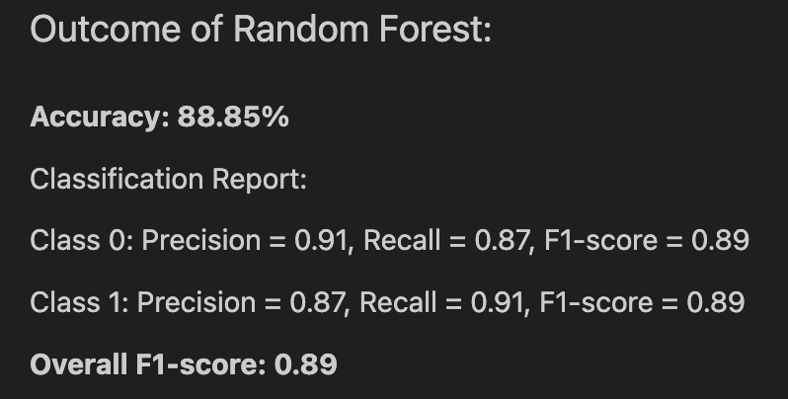
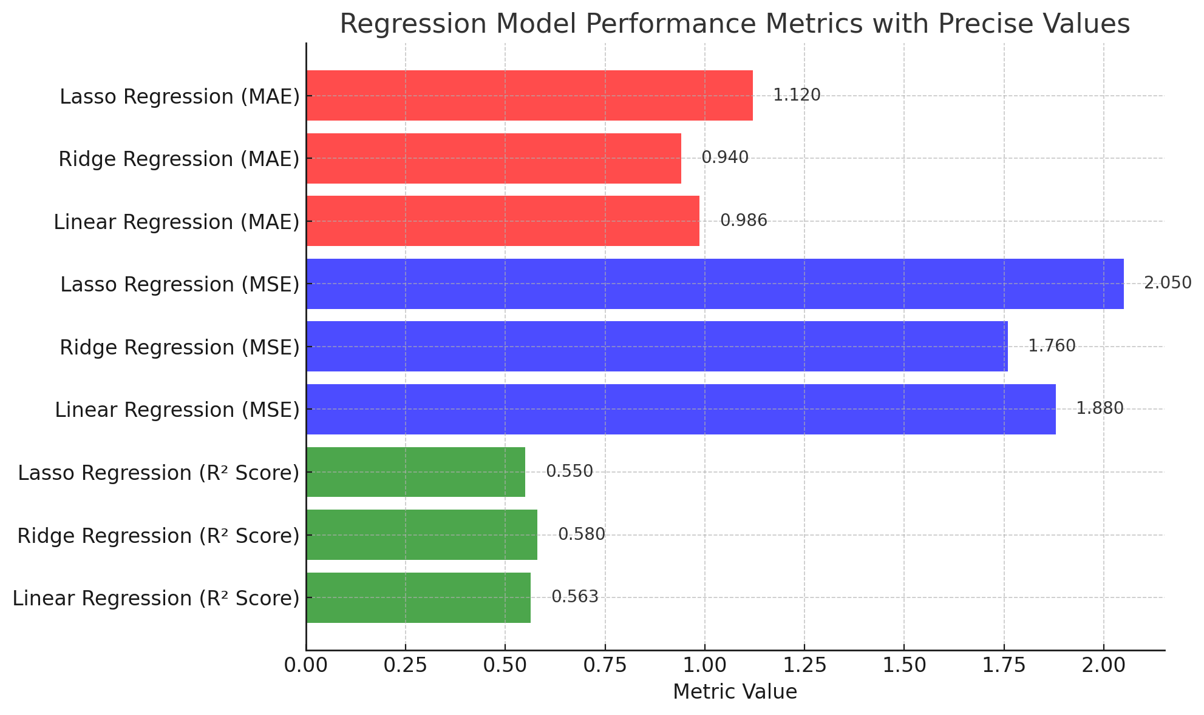
Model Analysis-Model Selection
Classification Model
Prediction Model
Predict whether a potential donor will respond to a marketing campaign (donr variable)
Helping the charity optimize its direct mail efforts by focusing on likely donors, reducing costs while maximizing net profits
Predict the donation amounts (damt) for donors identified through the classification model
Provide accurate predictions of donation amounts to optimize resource allocation and enhance the charity's return on investment
Classification Model: Random forest
Prediction Model: Linear Regression
due to its ability to handle complex feature interactions and better accuracy
simplicity, interpretability, and efficiency in modeling relationships between predictors and the target variable

Slide 4
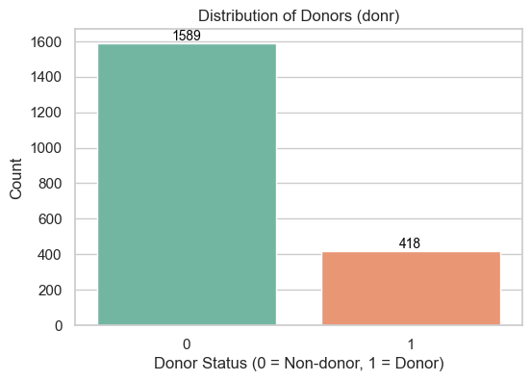
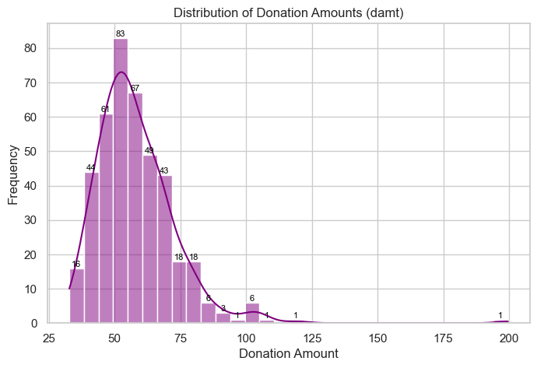
Predict the values for Scoring Data
The proportion of donors in the dataset is low, with the majority of the sample being non-donors (1589) and only a small proportion of donors (418)
Most of the donations are in the lower range ($0-50), with only a few donations in the higher range.
Enable the organization to determine potential donors and their corresponding donation amounts.
Classification Prediction
Regression Prediction
The Random Forest Classifier was used to predict donor status (donr) for the scoring dataset
For rows where donr = 1, the Linear Regression model predicted the donation amounts (damt). For non-donors (donr = 0), the donation amount was set to zero.

Slide 5
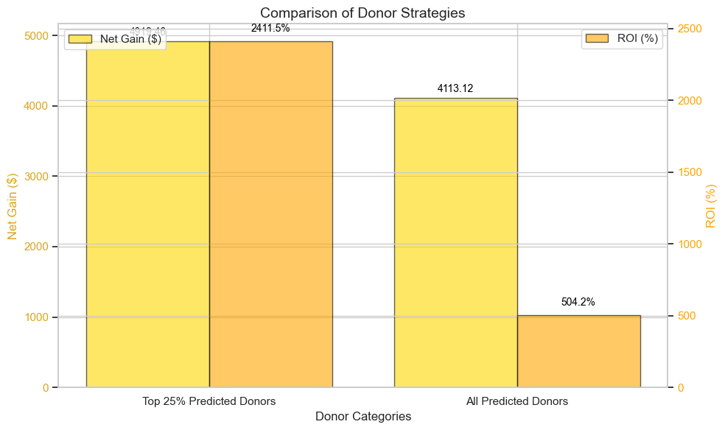
Business Problem Solution
High-Value Donor
All Predicted Donors
Focuses on the top 25% of predicted donors with the highest ROI.
Achieves a net gain of $4,919.46 and an ROI of 2,411.5%.
Avoids wasting resources on low-value targets.
Mailing all predicted donors gives a net gain of $4,113.12, but the ROI is lower at 504.2%.
Less efficient compared to targeting high-value donors.
Targeting high-value donors ensures better returns
increased by $6,018.96

Slide 6
Thank YOu!

