Slide 1
Theory of Computation
Lecture 6:
Determinism vs. Non-determinism Converting NFA to DFA
Mr Alan Herbert

Slide 2
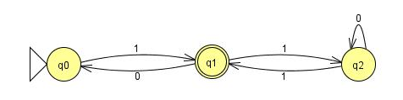
Deterministic FSA
State | Input = 1 | Input = 0
q0 | q1 | error
q1 | q2 | q0
q2 | q1 | q2

Slide 3
Non-determinism
So far, every step of a computation follows in a unique way from the preceding step
Deterministic!
In a non-deterministic machine, several choices exist for next state

Slide 4

Non-Deterministic FSA
State | Input = 1 | Input = 0
q0 | q1 | error
q1 | q2 | q0
q2 | error | q1, q2
Notes:
Start with 1 terminate with 0

Slide 5
Converting an NFA
Every DFA is an NFA
Can convert every NFA into a DFA, that accepts the same language
Use the subset construction
So-called, because there is one state of the DFA for every subset of the set of states of the NFA

Slide 6
Converting an NFA (2)
Either magically guess (oracle)???
Or delay commitment to one state by running all possible states in parallel:
Need to maintain a set of all possible states
As soon as one of the set of states ceases to be a possibility
– it is removed
Thus, new DFA could have an exponential number of states
Notes:
Analogy with a GPS that just says “Turn at the next crossroads!” - Can try both ways or phone a friend to get the correct way.

Slide 7
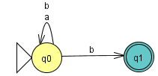
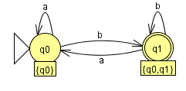
First NFA Conversion
State | Input = a | Input = b
q0 | q0 | q0,q1
q1 | x | x
{q0,q1} | q0 | q0,q1
RE: (a+b)* b
Notes:
Use (a+b)* b as the first example
Then use (a+b)* b a as the next example (do on white board) -- don’t forget to add complex state rules in the rule table
a b
--------------------------------------------
Q0 q0 q1,q0
Q1 x x
Q2 x x -- for second problem only
(q0,q1) q0, x q0,q1,x
Etc

Slide 8
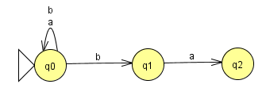
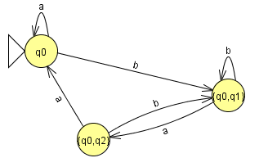
Second NFA Conversion
State | Input = a | Input = b
q0 | q0 | q0,q1
q1 | q2 | x
q2 | x | x
{q0,q1} | q0,q2 | q0,q1
{q0,q2} | q0, x | q0,q1,x
RE: (a+b)* b a
Notes:
Use (a+b)* b as the first example
Then use (a+b)* b a as the next example (do on white board) -- don’t forget to add complex state rules in the rule table
a b
--------------------------------------------
Q0 q0 q1,q0
Q1 x x
Q2 x x -- for second problem only
(q0,q1) q0, x q0,q1,x
Etc

Slide 9
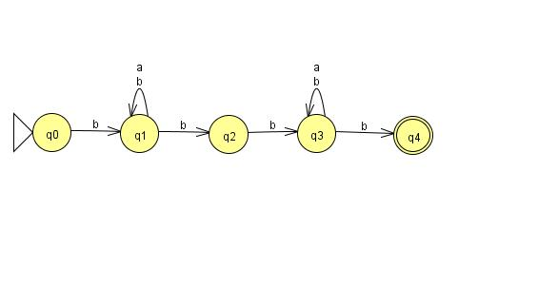
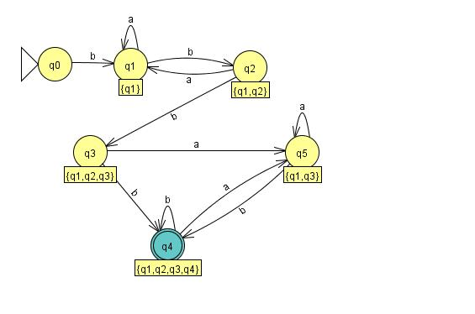
Another NFA Conversion

Slide 10
Numbers in C#/Java
.34f -> float
.34 -> double both start with ‘.’
3.4 -> double
3 -> integer all start with digit
3L -> long

Slide 11
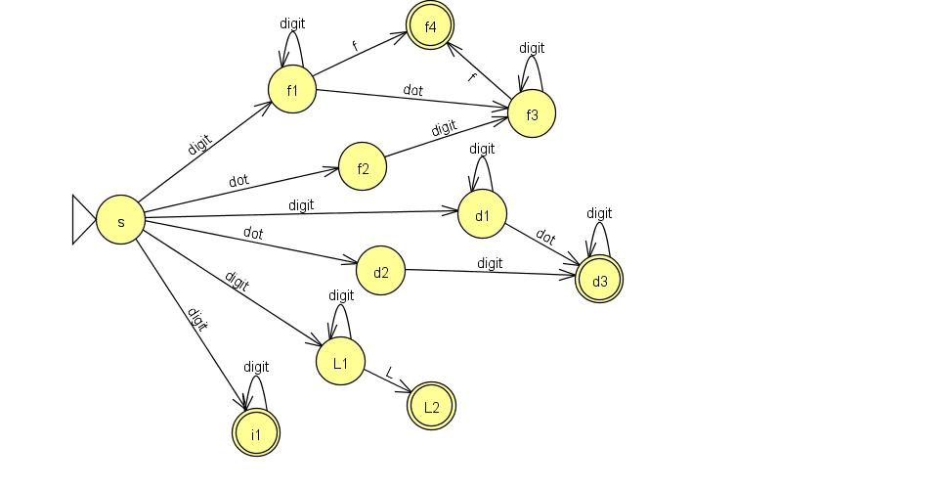
NFA - long,double,int,float

Slide 12
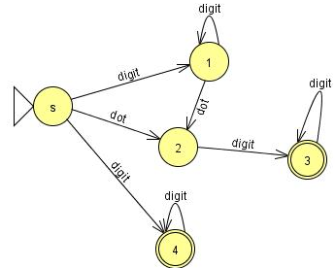
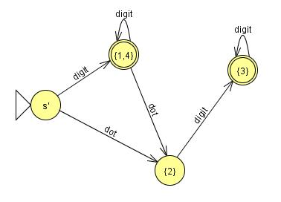
Convert Simplified Floating Point NFA to DFA

Slide 13
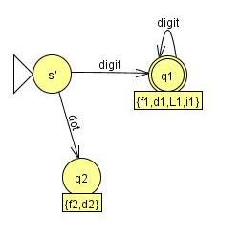
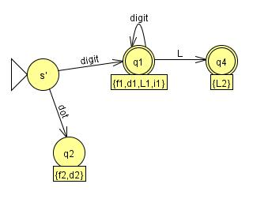
Full FP NFA to DFA (1)

Slide 14
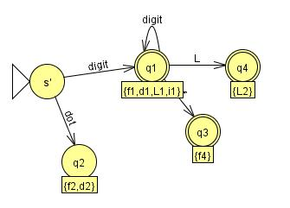
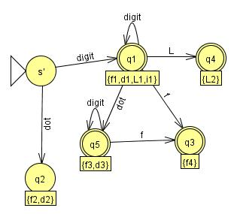
Full FP NFA to DFA (2)

Slide 15
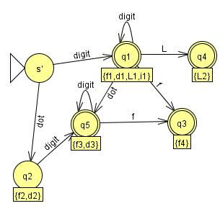
Final DFA from Full FP NFA

Slide 16


Slide 17
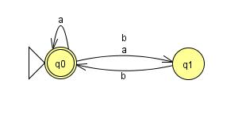
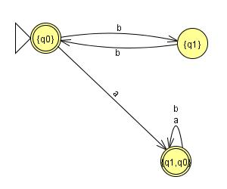
Another NFA conversion

Slide 18
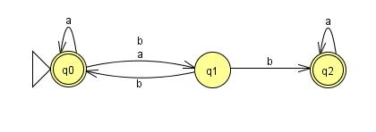
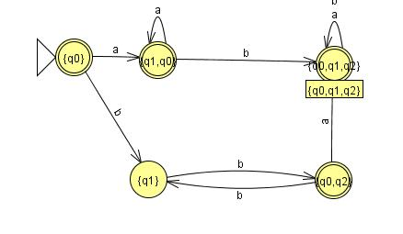
Yet another conversion
Notes:
2016 prac 2 t1a

