Slide 1
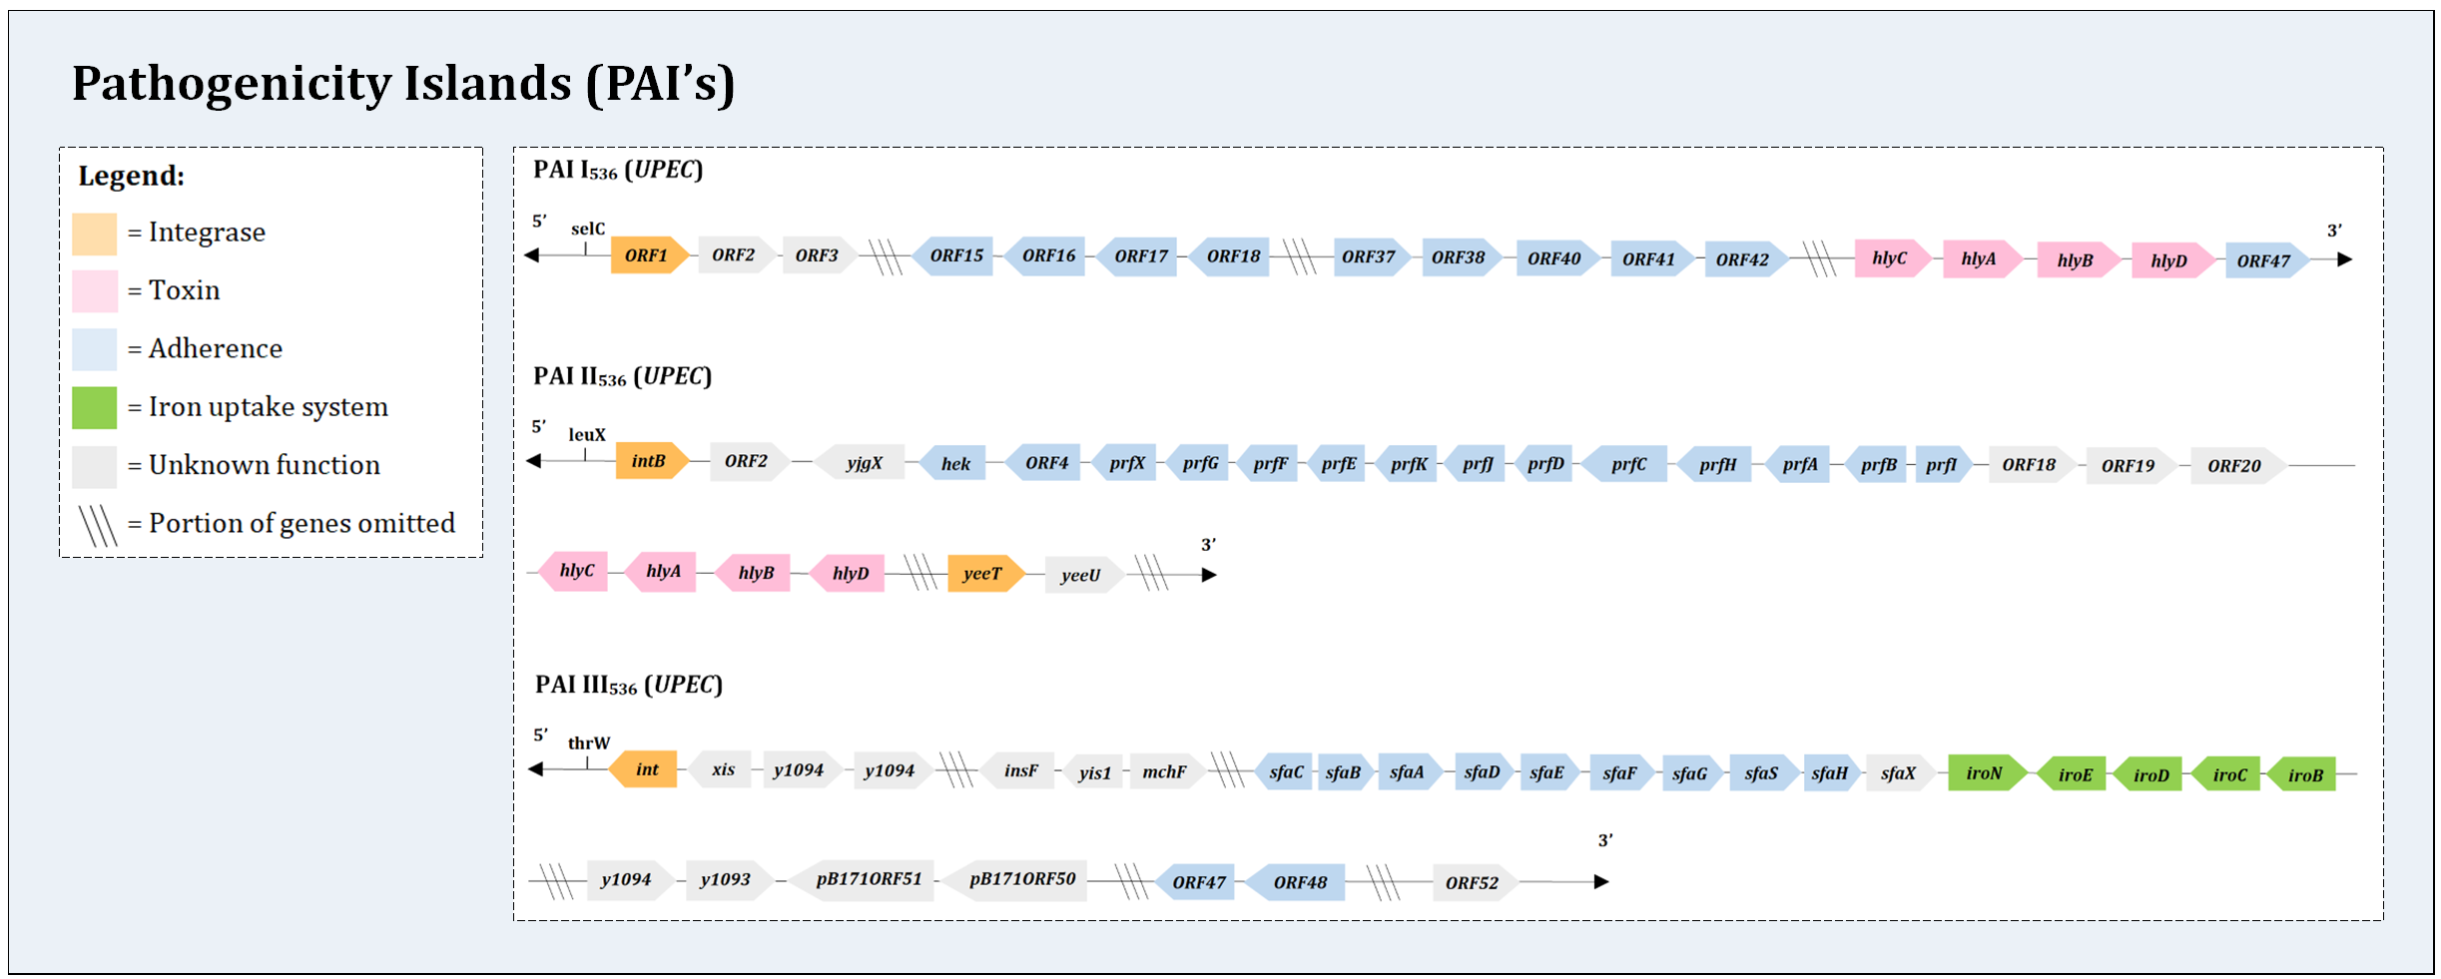
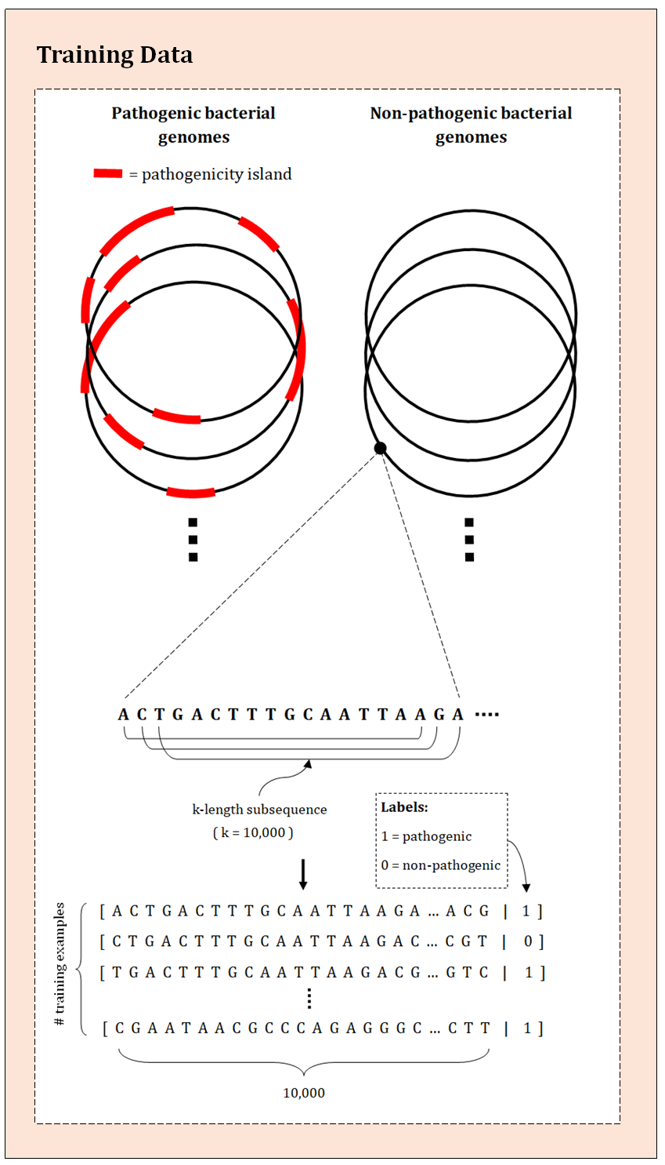
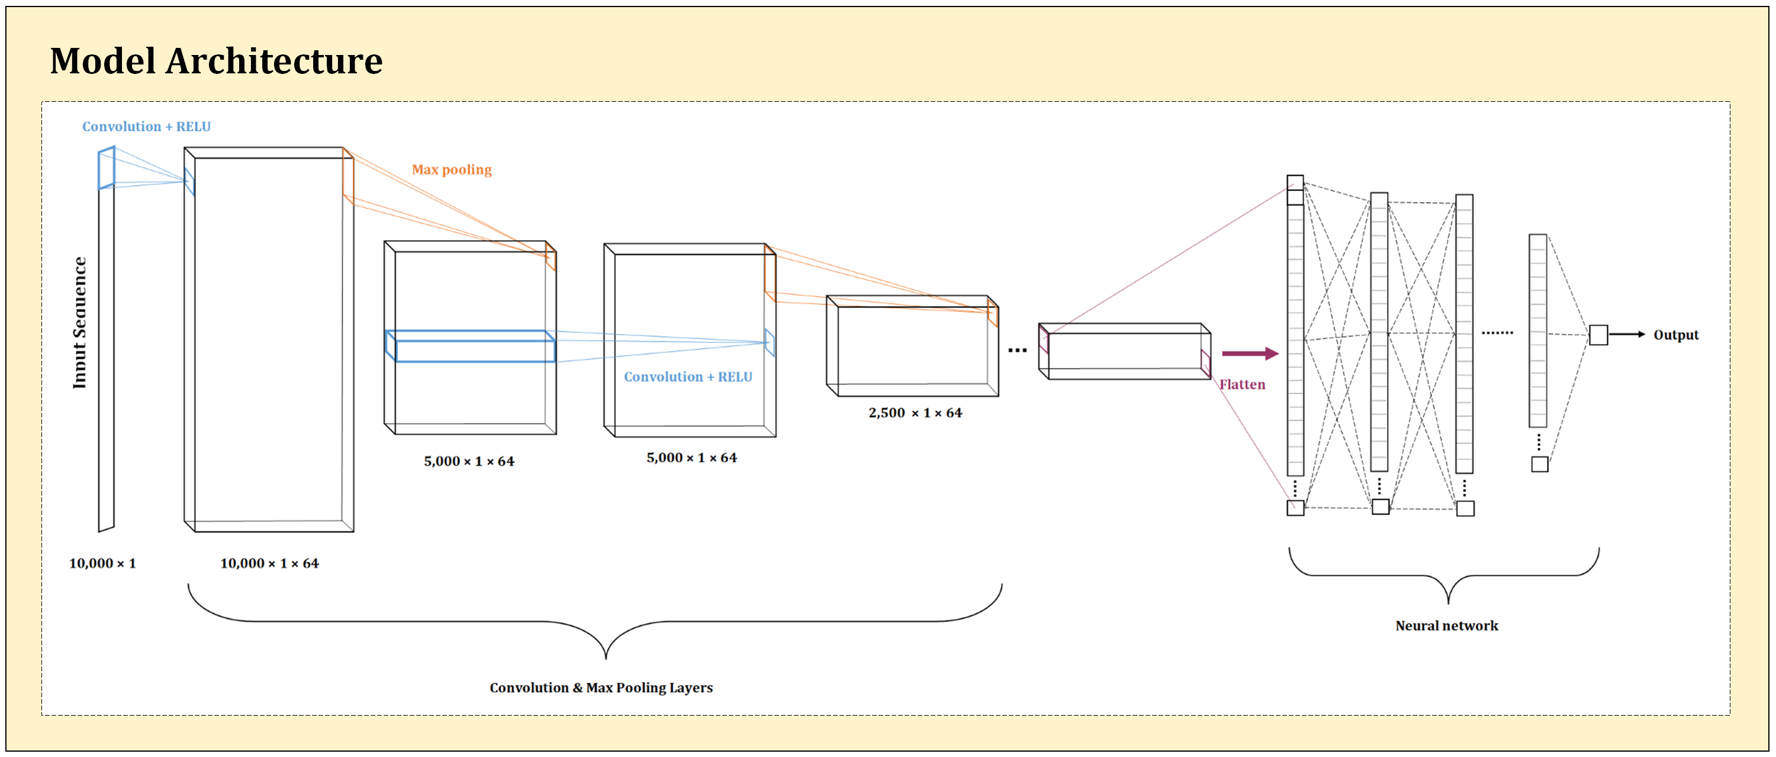
Predicting Pathogenicity using Genomic Sequence Data

Slide 2
Using Deep Learning to Extract Biomarkers from Whole Genome Sequencing Data in High-Scoring TA3 Targets
Ines Bilkic, Chemical Engineering, UCSB
inesbilkic@ucsb.edu

