Slide 1

Machine Learning Boosting
Oran Ofzer & Yevgeni Forost

Slide 2
Intro
A small Introduction to the presentation
The main topic of this presentation is Boosting.
We will cover some background subjects first, such as Classification and Ensemble Methods and then we will explain Boosting and AdaBoost.
We will provide an example of how AdaBoost works, and explain the algorithm step by step.
We will then show our code and some comparisons to other algorithms and shed some light on the main differences between them.
Notes:
תשתית, פלטפורמה,

Slide 3
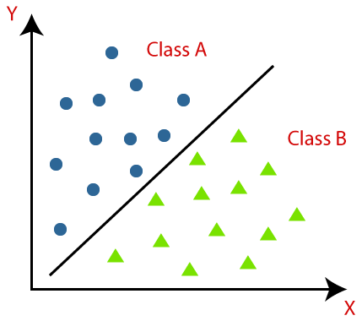
Classification
Classification is the process of predicting the class of given data points
Creating a function (f) from input variables (X) to [0 or 1] output variables (y).
While there are many classification algorithms out there, it’s not possible to say which one is superior to the other.
Notes:
תשתית, פלטפורמה,

Slide 4
Classification
Two main types of learners in classification:
Lazy Learners, that store the training data and when they perform the classification on the testing data, they run the algorithm on the stored data to predict. (Examples: KNN, Case-based reasoning)
Eager Learners, that construct a classification model based on the given training data before receiving actual test data for classification. (Examples: Decision Trees, Naïve Bayes)
We will discuss tree-based algorithms in the next slide
Notes:
תשתית, פלטפורמה,

Slide 5
Tree-Based Methods in Classification
Simple Decision trees are like the way people are thinking
A decision tree asks a question and based on the answer it makes a classification.
The answer can be:
- A simple Yes / No or True / False
- A numeric value / Boolean (Smaller/Larger than)
- Many other predefined answers.
A student has studied computer science for 3 years in Sapir Academic College
True False
Finished degree Haven’t finished
Notes:
תשתית, פלטפורמה,

Slide 6
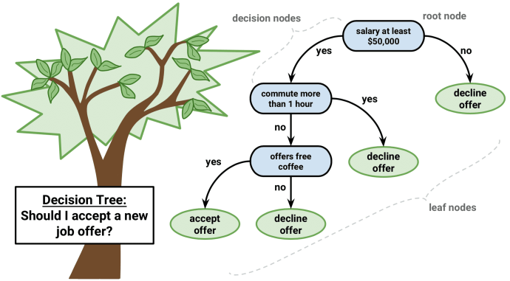
Tree-Based Methods in Classification
A Decision Tree can be a multi-leveled tree.
Might feature several classes.
More than 2 answers, a lot more.
Answers can lead to more questions being asked before making a prediction.
Advantages of decision trees?
Easier data preparation compared to other algorithms.
Doesn’t require normalization or scaling of data.
Intuitive & easy to explain and understand.
Disadvantages of decision trees?
Unstable, small changes in data can cause large changes in the tree.
Usually takes more time to train the model.
A fully grown decision tree that was designed to reduce training error might overfit and not be able to generalize.
Notes:
תשתית, פלטפורמה,

Slide 7
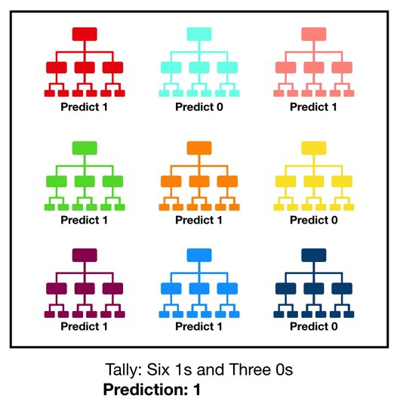
The Random Forest Classifier
Random forest is one way to avoid the disadvantages of decision trees.
An ensemble method (Based on bagging)
Consists of many individual decision trees.
The predictions made by the trees should have low correlation with each other (A key to the algorithm’s success).
Each decision tree in the forest makes a prediction.
The class with the most votes from all the trees becomes the final model’s prediction.
Notes:
תשתית, פלטפורמה,

Slide 8

Ensemble Methods in Machine Learning
Idea:
Don’t: Create one model and hope it is the best predictor / Classifier.
Do: Produce one optimal predictive model by using several base models.
Notes:
תשתית, פלטפורמה,

Slide 9
Ensemble Methods
Ensemble learning is a machine learning paradigm where multiple “weak learners” are trained to solve the same problem and combined to get better results.
Each weak classifier alone doesn’t perform so well, they usually have high bias.
Ensemble methods try reducing bias and/or variance of such weak learners by combining several of them together in order to create a strong learner that achieves better performances.
Notes:
תשתית, פלטפורמה,

Slide 10
Ensemble Methods
Bagging:
Learns the weak learners independently from each other in parallel and combines them following some kind of deterministic averaging process.
Stacking:
Learns the weak learners in parallel and combines them by training a meta-model to output a prediction based on the different weak models' predictions.
Boosting:
The main method discussed in this presentation. It learns the weak learners sequentially in a very adaptive way (a base model depends on the previous ones) and combines them following a deterministic strategy.
Notes:
תשתית, פלטפורמה,

Slide 11

Boosting
An ensemble method that sequentially trains a team of weak learners.
It is used for supervised learning.
Can be used both for classification and regression problems.
There are many boosting algorithms, which vary in:
Their method of weighting the training data points and hypotheses.
What problems they are solving.
Notes:
תשתית, פלטפורמה,

Slide 12
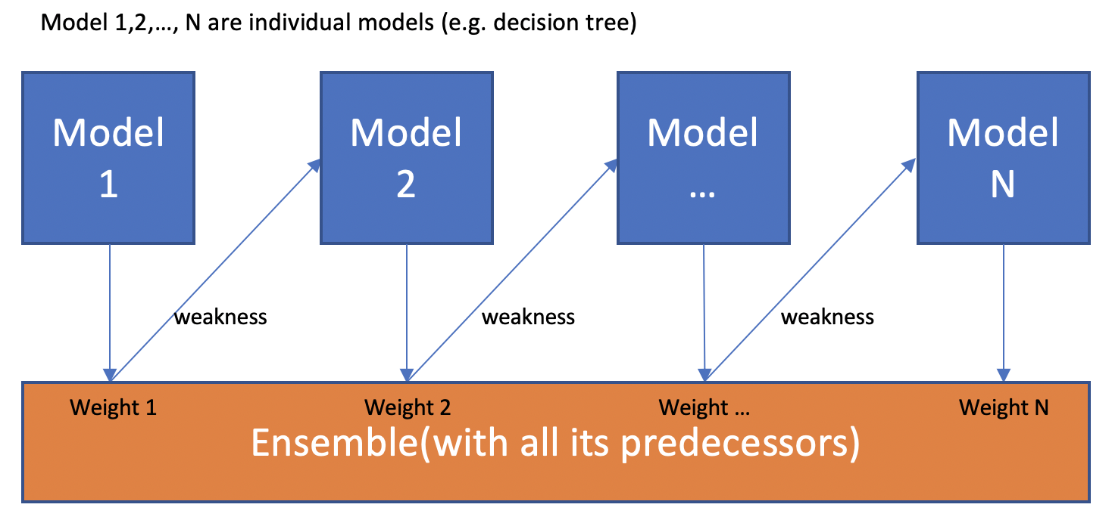
Boosting
Idea:
A generic algorithm that adapts to weak learners and use them to sequentially to create a strong learner.
Takes N models and gives each one of them a weight depending on how well each one performs.
Boosting learns from its past, so in each iteration, mistakes are written down so that in the next step the model will not repeat them.
The ensemble model makes up for each single model’s weakness and can outperform many strong models.
Notes:
תשתית, פלטפורמה,

Slide 13
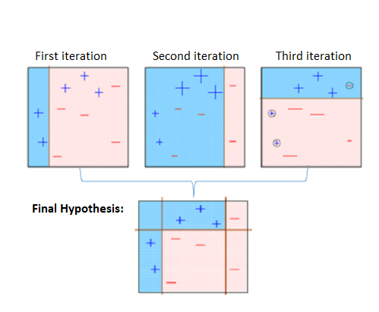
AdaBoost
Short for Adaptive Boosting
Israeli Pride
Algorithm presented by Yoav Freund and Robert Schapire.
First Boosting algorithm that could adapt to weak learners.
AdaBoost will work as long as the weak classifiers are slightly better than random.
Notes:
תשתית, פלטפורמה,

Slide 14
AdaBoost
Give an equal weight to all the points in the dataset.
Calculate total error for each stump/classifier.
Choose the stump with the minimum total error and calculate its weight.
Add chosen stump to the final classifier H(X).
Recalculate the weights for each data point in the dataset.
Check if the goal was achieved.
Repeat step 2 if needed.
Notes:
תשתית, פלטפורמה,

Slide 15
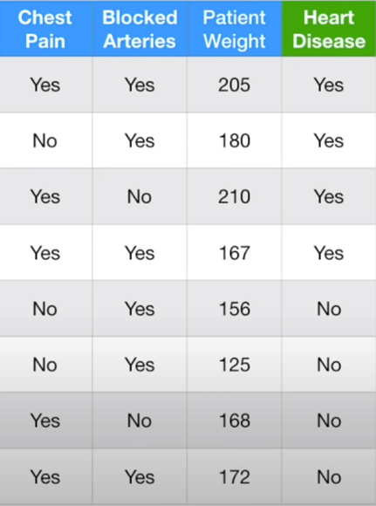
AdaBoost (illustration from StatQuest)
1. Give an equal weight to all the points in the dataset.
It begins by assigning the same weight to each sample in the dataset.
For each point Xi and for all N points in the dataset, assign weight Wi so that Wi = 1/N.
In the first iteration, the algorithm doesn’t pay attention to any specific point as it didn’t make any mistakes.
Notes:
תשתית, פלטפורמה,

Slide 16
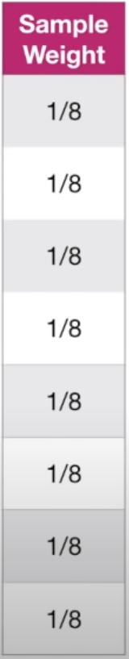
AdaBoost (illustration from StatQuest)
1. Give an equal weight to all the points in the dataset.
After we will create the first stump, the weights of the data will change.
Increase if the example was misclassified.
Decrease if the example was classified correctly.
In the next iterations, some data points will have more weight and will affect the choices of the next stumps.
Notes:
תשתית, פלטפורמה,

Slide 17
AdaBoost (illustration from StatQuest)
2. Calculate Total Error for each stump, choose a stump with minimum error
If this is the first iteration of Adaboost, then each data sample has a current weight of 1/N.
In the first iteration, Total Error for each stump is (num of misclassified)/N.
In General: Total Error = (sum of weights of misclassified)/N.
We will choose the stump that had the minimum total error.
Notes:
תשתית, פלטפורמה,

Slide 18
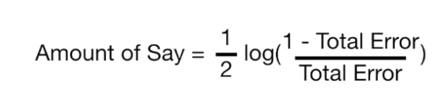
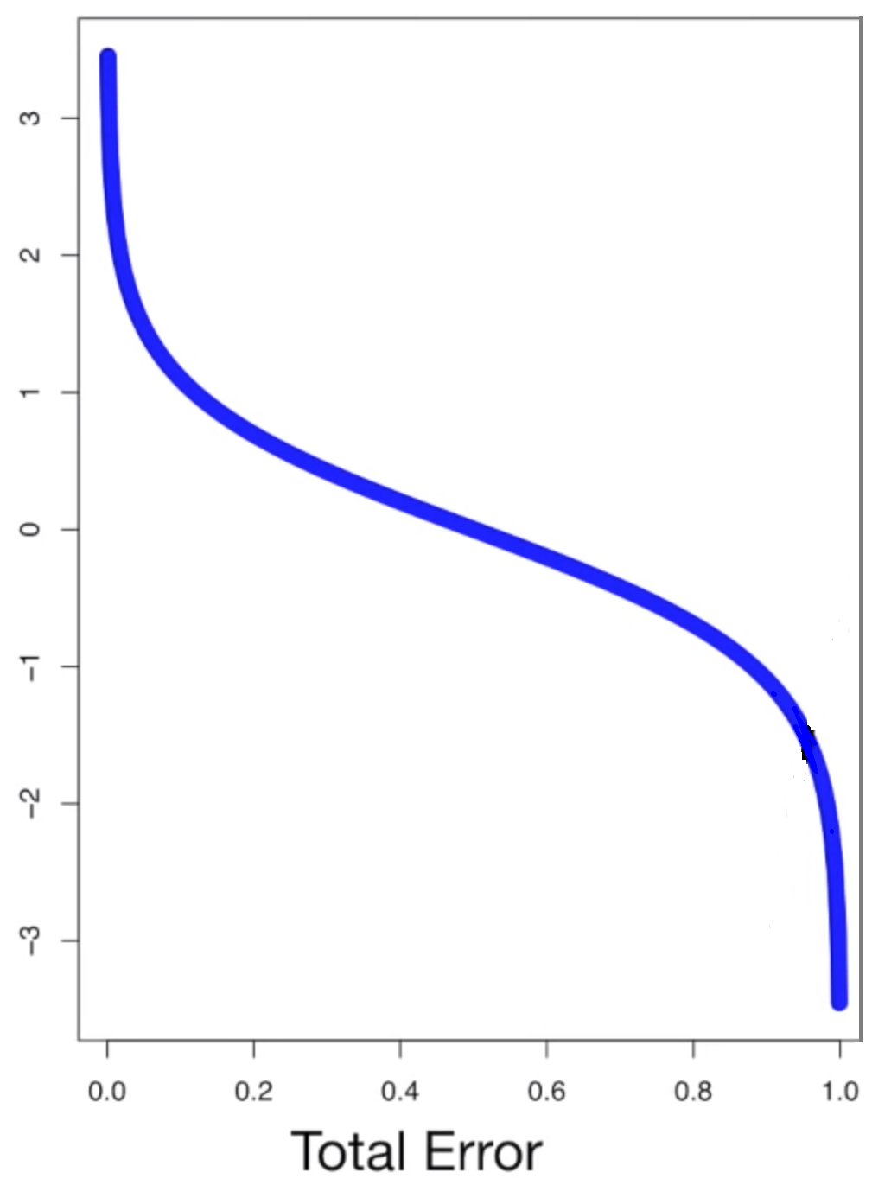


AdaBoost (illustration from StatQuest)
3. Choose the stump with the minimum Total Error and calculate its weight
$\text{α}$t =
This weight will be multiplied by the decision stump that will be added to the final classifier, indicating how much voting power it will have.
We can see that:
If the Total Error is less than 0.5, $\text{α}$t > 0.
If the Total Error is more than 0.5, $\text{α}$t < 0.
If the Total Error is 0.5, $\text{α}$t = 0.
$\text{α}$t
Notes:
תשתית, פלטפורמה,

Slide 19
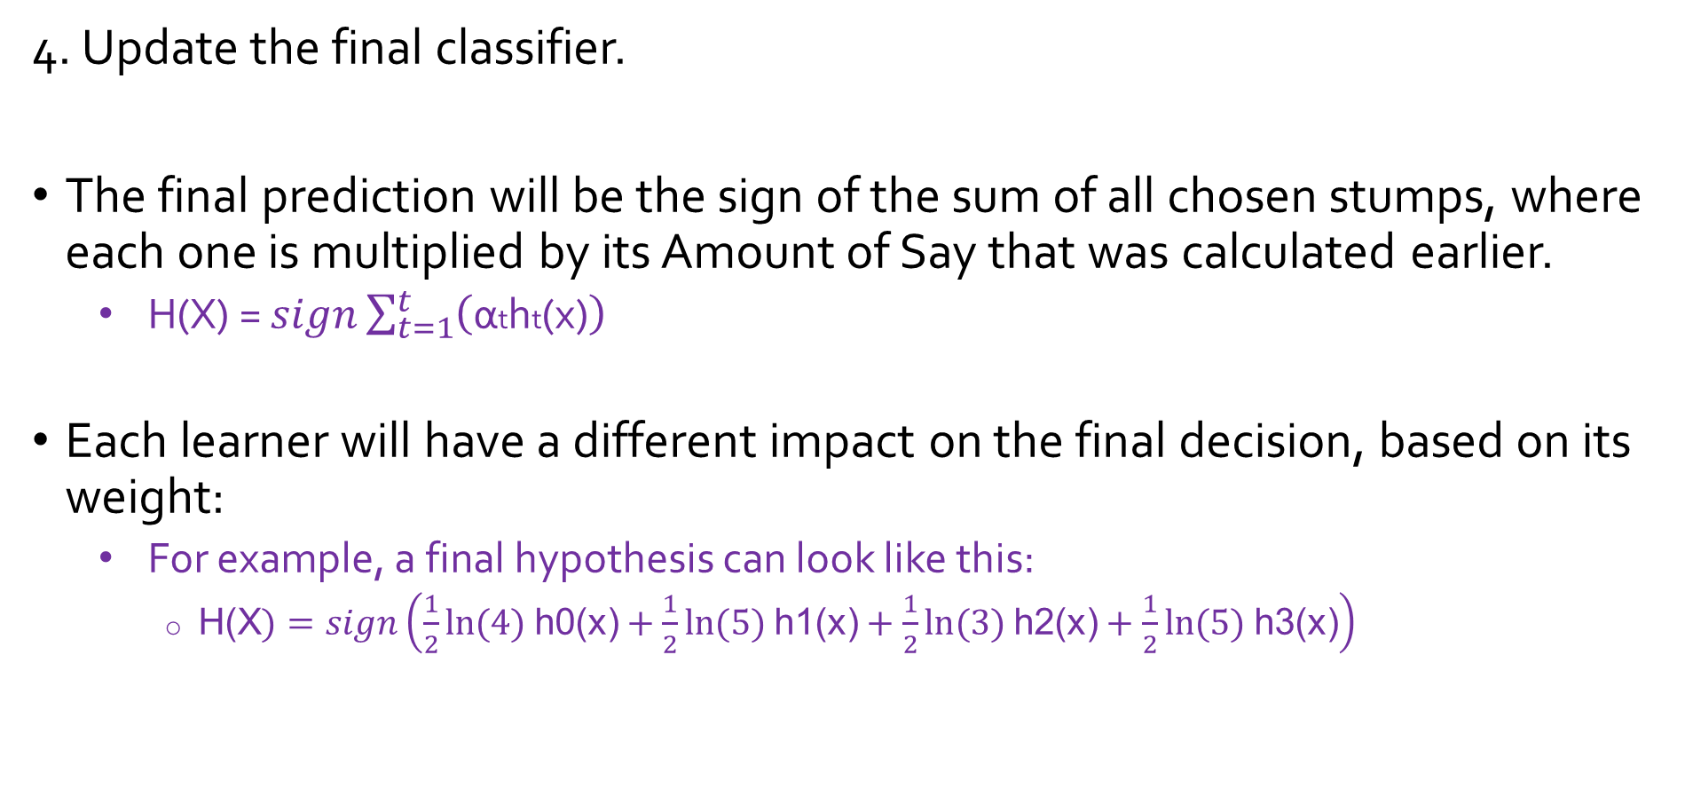
AdaBoost (illustration from StatQuest)
4. Update the final classifier.
The final prediction will be the sign of the sum of all chosen stumps, where each one is multiplied by its Amount of Say that was calculated earlier.
H(X) = $sign\sum_{t=1}^{t}{\left(\text{α}\text{t}\text{h}\text{t}\text{(}\text{x}\text{)}\right)}$
Each learner will have a different impact on the final decision, based on its weight:
For example, a final hypothesis can look like this:
H(X$)=sign\left(\frac{1}{2}ln⁡(4) \text{h}\text{0(}\text{x}\text{)}+\frac{1}{2}ln⁡(5) \text{h}\text{1(}\text{x}\text{)}+\frac{1}{2}ln⁡(3) \text{h}\text{2(}\text{x}\text{)}+\frac{1}{2}ln⁡(5) \text{h}\text{3(}\text{x}\text{)}\right)$
Notes:
תשתית, פלטפורמה,

Slide 20
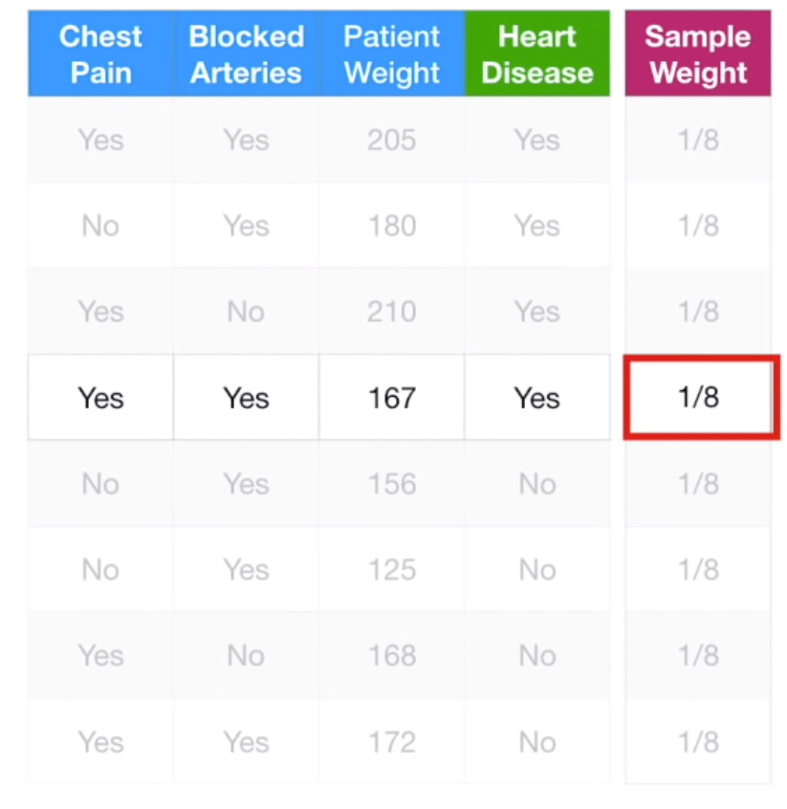
AdaBoost (illustration from StatQuest)
5. Recalculate the weights of each data point in the dataset
Using the Total Error of the chosen learner, calculate and update the new weights of all the points in the dataset:
For example, the marked example was misclassified, so we need to pay more attention to it in the next iteration.
We will do that by increasing its weight.
Notes:
תשתית, פלטפורמה,

Slide 21
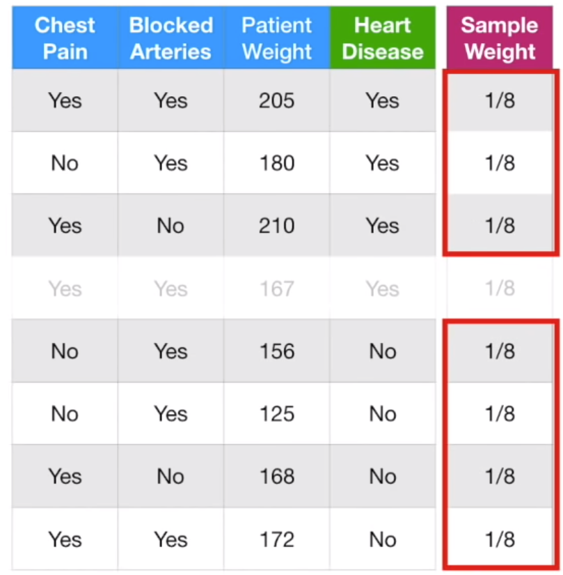

AdaBoost (illustration from StatQuest)
5. Recalculate the weights of each data point in the dataset
We will do the opposite for correctly classified points. Each correctly classified example from the dataset will have its weight decreased.
How to calculate?
If classified right: Wnew$=\frac{1}{2} \frac{Wold}{1−\text{Total}\text{_}\text{Error}\text{(}\text{ht}\text{)}}$
If classified wrong: Wnew$=\frac{1}{2} \frac{Wold}{\text{Total}\text{_}\text{Error}\text{(}\text{ht}\text{)}}$
Where ht is the stump with the minimum total error
If a point is classified right, its weight will decrease.
If a point is classified wrong, its weight will increase.
Notes:
תשתית, פלטפורמה,

Slide 22
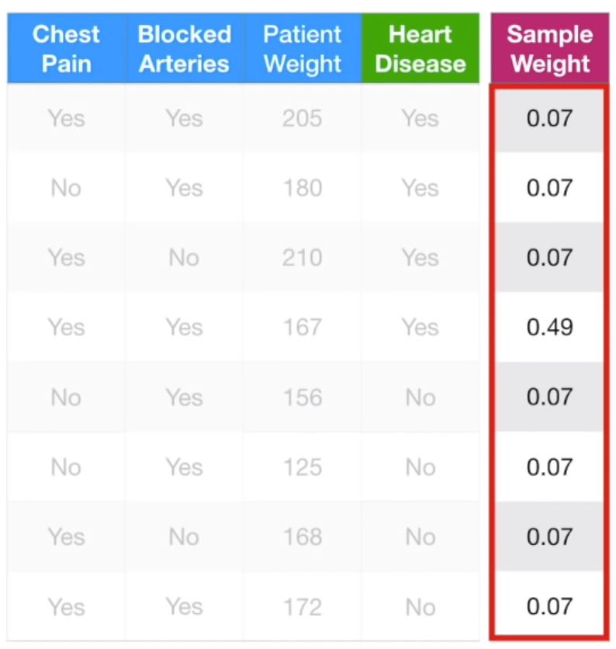
AdaBoost (illustration from StatQuest)
5. Recalculate the weights of each data point in the dataset
Now we will assign the new weights to each sample in the data set.
We can see how the misclassified point has a much larger weight than the rest.
The new weights assure us that the previous chosen classifier won’t have the minimum Total Error again.
Notes:
תשתית, פלטפורמה,

Slide 23
AdaBoost (illustration from StatQuest)
6. Check if achieved the goal.
In order to accomplish the calculation, we need to check:
Did we achieve a certain success rate?
Is the success rate not increasing anymore?
Are there any good weak learners left?
If we can answer yes to any of those questions, we can stop.
Final output is H(x) at the time the algorithm has stopped.
Notes:
תשתית, פלטפורמה,

Slide 24
AdaBoost (illustration from StatQuest)
7. Repeat if needed.
If the algorithm hasn’t stopped for any reason mentioned in step 6, we will repeat step 2.
Notes:
תשתית, פלטפורמה,

Slide 25
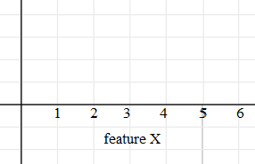
AdaBoost - Example
A toy example:
5 examples, 4 of them are labeled as positive, and 1 as negative.
Each example will be given weight 1/n, in this case w = 1/5.
We will start by iterating over all of the examples with each classifier.
Classifiers: (if truth, classified as +)
X < 2
X > 6
X < 6
X > 2
X < 4
X > 4
A B
C
D E

Slide 26
AdaBoost - Example
Point | W
A | 1/5
B | 1/5
C | 1/5
D | 1/5
E | 1/5
A B
C
D E
Classifier | Misclassified Points | Error Rate
X < 2 | B, E | 2/5
X > 6
X < 6
X > 2
X < 4
X > 4

Slide 27
AdaBoost - Example
Point | W
A | 1/5
B | 1/5
C | 1/5
D | 1/5
E | 1/5
A B
C
D E
Classifier | Misclassified Points | Error Rate
X < 2 | B, E | 2/5
X > 6 | A, B, D, E | 4/5
X < 6
X > 2
X < 4
X > 4

Slide 28
AdaBoost - Example
Point | W
A | 1/5
B | 1/5
C | 1/5
D | 1/5
E | 1/5
A B
C
D E
Classifier | Misclassified Points | Error Rate
X < 2 | B, E | 2/5
X > 6 | A, B, D, E | 4/5
X < 6 | C | 1/5
X > 2
X < 4
X > 4

Slide 29
AdaBoost - Example
Point | W
A | 1/5
B | 1/5
C | 1/5
D | 1/5
E | 1/5
A B
C
D E
Classifier | Misclassified Points | Error Rate
X < 2 | B, E | 2/5
X > 6 | A, B, D, E | 4/5
X < 6 | C | 1/5
X > 2 | A, D, C | 2/5
X < 4
X > 4

Slide 30
AdaBoost - Example
Point | W
A | 1/5
B | 1/5
C | 1/5
D | 1/5
E | 1/5
A B
C
D E
Classifier | Misclassified Points | Error Rate
X < 2 | B, E | 2/5
X > 6 | A, B, D, E | 4/5
X < 6 | C | 1/5
X > 2 | A, D, C | 2/5
X < 4 | C, B, E | 3/5
X > 4

Slide 31
AdaBoost - Example
Point | W
A | 1/5
B | 1/5
C | 1/5
D | 1/5
E | 1/5
A B
C
D E
Classifier | Misclassified Points | Error Rate
X < 2 | B, E | 2/5
X > 6 | A, B, D, E | 4/5
X < 6 | C | 1/5
X > 2 | A, D, C | 2/5
X < 4 | C, B, E | 3/5
X > 4 | A, D | 2/5

Slide 32

AdaBoost - Example
Pick classifier “X < 6” that had the lowest error rate in the first iteration and calculate the classifier’s voting power (α).
αx<6 = ½(loge $(\frac{1−1/5}{\text{1/5}}) \text{)}$ = ½(loge4)
Now we will add the classifier with its voting power to the final H(x).
H(x) = ½(loge4*h(x<6)) + … (to be added later on next iterations)
Classifier | Misclassified Points | Error Rate
X < 2 | B, E | 2/5
X > 6 | A, B, D, E | 4/5
X < 6 | C | 1/5
X > 2 | A, D, C | 2/5
X < 4 | B, C, E | 3/5
X > 4 | A, D | 2/5

Slide 33

AdaBoost - Example
Point | W
A | 1/5
B | 1/5
C | 1/5
D | 1/5
E | 1/5
The next step is assigning each sample with the new weight:
Wnew = If classified right: $\frac{1}{2} \frac{Wold}{1−\text{weighted}\text{_}\text{error}\text{(}\text{h}\text{t}\text{)}}$
If classified wrong: $\frac{1}{2} \frac{Wold}{\text{weighted}\text{_}\text{error}\text{(}\text{h}\text{t}\text{)}}$
New Weights:
A: $\frac{1}{2}∗\frac{1/5}{1\text{−}1/5}$ = $\frac{1}{2}∗ \frac{\frac{1}{5}}{\frac{4}{5}}$ = $\frac{1}{8}$
B: $\frac{1}{2}∗\frac{1/5}{1\text{−}1/5}$ = $\frac{1}{2}∗ \frac{\frac{1}{5}}{\frac{4}{5}}$ = $\frac{1}{8}$
C: $\frac{1}{2} \frac{1/5}{1/5}$ = $\frac{1}{2}$
D: $\frac{1}{2}∗\frac{1/5}{1\text{−}1/5}$ = $\frac{1}{2}∗ \frac{\frac{1}{5}}{\frac{4}{5}}$ = $\frac{1}{8}$
E: $\frac{1}{2}∗\frac{1/5}{1\text{−}1/5}$ = $\frac{1}{2}∗ \frac{\frac{1}{5}}{\frac{4}{5}}$ = $\frac{1}{8}$
Classifier | Misclassified Points | Error Rate
X < 2 | B, E | 2/5
X > 6 | A, B, D, E | 4/5
X < 6 | C | 1/5
X > 2 | A, D, C | 2/5
X < 4 | B, C, E | 3/5
X > 4 | A, D | 2/5

Slide 34
AdaBoost - Example
Now we will repeat step 2..
You can see how the weights of the correctly classified points decreased, and the weight of the misclassified point (C) increased.
Now the weights of the points will have a different impact than in the past iteration.
A B
C
D E

Slide 35
AdaBoost - Example
Point | W
A | 1/8
B | 1/8
C | 1/2
D | 1/8
E | 1/8
A B
C
D E
A B
C
D E
Classifier | Misclassified Points | Error Rate
X < 2 | B, E | 2/8
X > 6
X < 6
X > 2
X < 4
X > 4

Slide 36
AdaBoost - Example
Point | W
A | 1/8
B | 1/8
C | 1/2
D | 1/8
E | 1/8
A B
C
D E
Classifier | Misclassified Points | Error Rate
X < 2 | B, E | 2/8
X > 6 | A, B, D, E | 4/8
X < 6
X > 2
X < 4
X > 4

Slide 37
AdaBoost - Example
Point | W
A | 1/8
B | 1/8
C | 1/2
D | 1/8
E | 1/8
* Notice how the “X < 6” classifier is no longer the best one thanks to the increased weight of point C.
A B
C
D E
Classifier | Misclassified Points | Error Rate
X < 2 | B, E | 2/8
X > 6 | A, B, D, E | 4/8
X < 6 | C | 4/8
X > 2
X < 4
X > 4

Slide 38
AdaBoost - Example
Point | W
A | 1/8
B | 1/8
C | 1/2
D | 1/8
E | 1/8
A B
C
D E
Classifier | Misclassified Points | Error Rate
X < 2 | B, E | 2/8
X > 6 | A, B, D, E | 4/8
X < 6 | C | 4/8
X > 2 | A, D, C | 6/8
X < 4
X > 4

Slide 39
AdaBoost - Example
Point | W
A | 1/8
B | 1/8
C | 1/2
D | 1/8
E | 1/8
A B
C
D E
Classifier | Misclassified Points | Error Rate
X < 2 | B, E | 2/8
X > 6 | A, B, D, E | 4/8
X < 6 | C | 4/8
X > 2 | A, D, C | 6/8
X < 4 | C, B, E | 6/8
X > 4

Slide 40
AdaBoost - Example
Point | W
A | 1/8
B | 1/8
C | 1/2
D | 1/8
E | 1/8
A B
C
D E
Classifier | Misclassified Points | Error Rate
X < 2 | B, E | 2/8
X > 6 | A, B, D, E | 4/8
X < 6 | C | 4/8
X > 2 | A, D, C | 6/8
X < 4 | C, B, E | 6/8
X > 4 | A, D | 2/8

Slide 41

AdaBoost - Example
Point | W
A | 1/8
B | 1/8
C | 4/8
D | 1/8
E | 1/8
Pick classifier “X < 2” (Three with same minimal error rate, so we picked the first, and we will calculate the classifier’s voting power.
αx<2 = ½(loge $(\frac{1−2/8}{\text{2/8}})\text{ )}$ = ½(loge3)
H(x) = ½(loge4*h(x<6)) + ½(loge3*h(x<2)) + …
Calculate the new weight of the data points:
A: $\frac{1}{2}∗\frac{1/8}{1\text{−}2/8}$ = $\frac{1}{2}∗ \frac{\frac{1}{8}}{\frac{6}{8}}$ = $\frac{1}{12}$
B: $\frac{1}{2}∗ \frac{1/8}{2/8}$ = $\frac{1}{4}$
C: $\frac{1}{2}∗\frac{1/2}{1−2/8}$ = $\frac{1}{2}∗ \frac{\frac{1}{5}}{\frac{4}{5}}$ = $\frac{1}{3}$
D: $\frac{1}{2}∗\frac{1/8}{1\text{−}2/8}$ = $\frac{1}{2}∗ \frac{\frac{1}{8}}{\frac{6}{8}}$ = $\frac{1}{12}$
E: $\frac{1}{2} ∗\frac{1/8}{2/8}$ = $\frac{1}{4}$
Classifier | Misclassified Points | Error Rate
X < 2 | B, E | 2/8
X > 6 | A, B, D, E | 4/8
X < 6 | C | 4/8
X > 2 | A, D | 2/8
X < 4 | B, C, E | 6/8
X > 4 | A, D | 2/8

Slide 42
AdaBoost - Example
Point | W
A | 1/12
B | 1/4
C | 1/3
D | 1/12
E | 1/4
A B
C
D E
We will Quickly do the 3rd iteration and see the results..

Slide 43
AdaBoost - Example
Point | W
A | 1/12
B | 1/4
C | 1/3
D | 1/12
E | 1/4
A B
C
D E
Classifier | Misclassified Points | Error Rate
X < 2 | B, E | 3/6
X > 6 | A, B, D, E | 4/6
X < 6 | C | 2/6
X > 2 | A, D, C | 3/6
X < 4 | C, B, E | 5/6
X > 4 | A, D | 1/6

Slide 44

AdaBoost - Example
Point | W
A | 1/12
B | 1/4
C | 1/3
D | 1/12
E | 1/4
Pick classifier “X > 4” and calculate the classifier’s voting power:
αx>4 = ½(loge $(\frac{1−1/6}{\text{1/6}})\text{ )}$ = ½(loge5)
H(x) = ½(loge4*h(x<6)) + ½(loge3*h(x<2)) + ½(loge5*h(x>4))
We can notice that in each iteration the best classifier misclassified points that weren’t misclassified before.
For each classifier that misclassifies a point Pi, the 2 others classify that point correctly and outvotes it in the final prediction.
Classifier | Misclassified Points | Error Rate
X < 2 | B, E | 3/6
X > 6 | A, B, D, E | 4/6
X < 6 | C | 2/6
X > 2 | A, D, C | 3/6
X < 4 | C, B, E | 5/6
X > 4 | A, D | 1/6

Slide 45
AdaBoost - Example
Point | W
A | 1/12
B | 1/4
C | 1/3
D | 1/12
E | 1/4
H(x) = ½(loge4*h(x<6)) + ½(loge3*h(x<2)) + ½(loge5*h(x>4))
A B
C
D E
Classifier | Misclassified Points | Error Rate
X < 2 | B, E | 3/6
X > 6 | A, B, D, E | 4/6
X < 6 | C | 2/6
X > 2 | A, D, C | 3/6
X < 4 | C, B, E | 5/6
X > 4 | A, D | 1/6

Slide 46
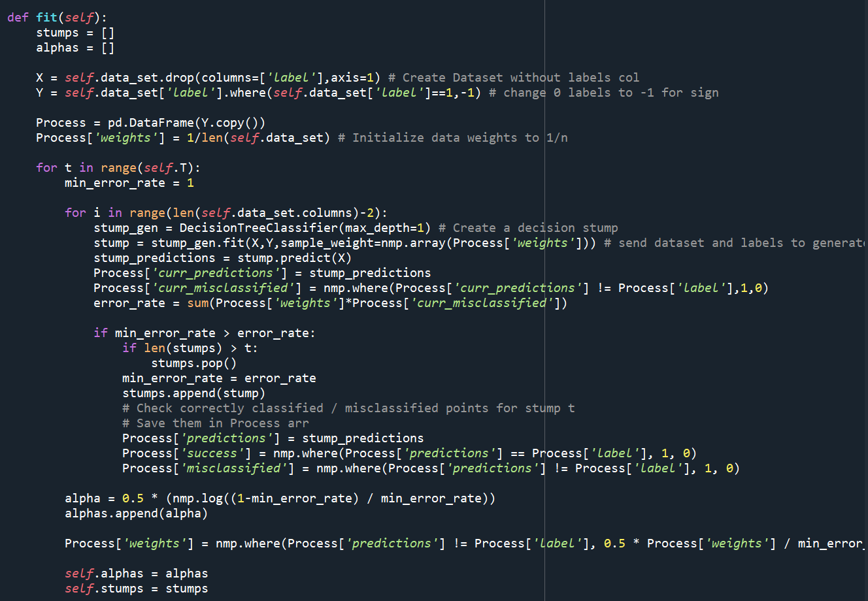
The Code
Fit function
AdaBoost Learning Stage
We used Decision Stumps on our training set.
We took each time the stump with the minimum total error and added it to the final classifier.
We used another database to hold each stump’s alpha (weight)
We maintained the predictions, correctly classified and misclassified data points in arrays for later calculations of data weight et cetera.
Notes:
תשתית, פלטפורמה,

Slide 47
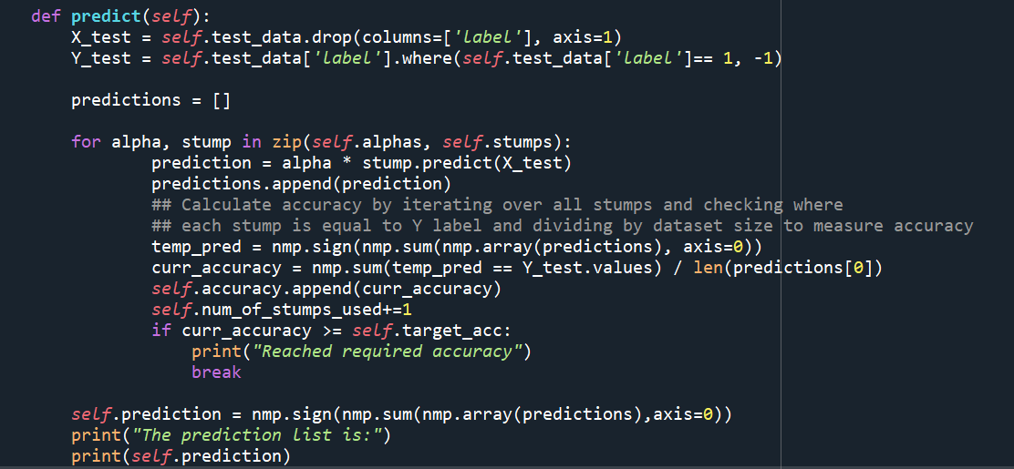
The Code
Predict function
We used the dataset for the test stage.
For each stump we made a prediction and then multiplied by its voting power and added it to the predictions array.
Predictions contains each stumps list of decisions for all data points in the dataset.
In each iteration we calculated the growing accuracy.
Notes:
תשתית, פלטפורמה,

Slide 48
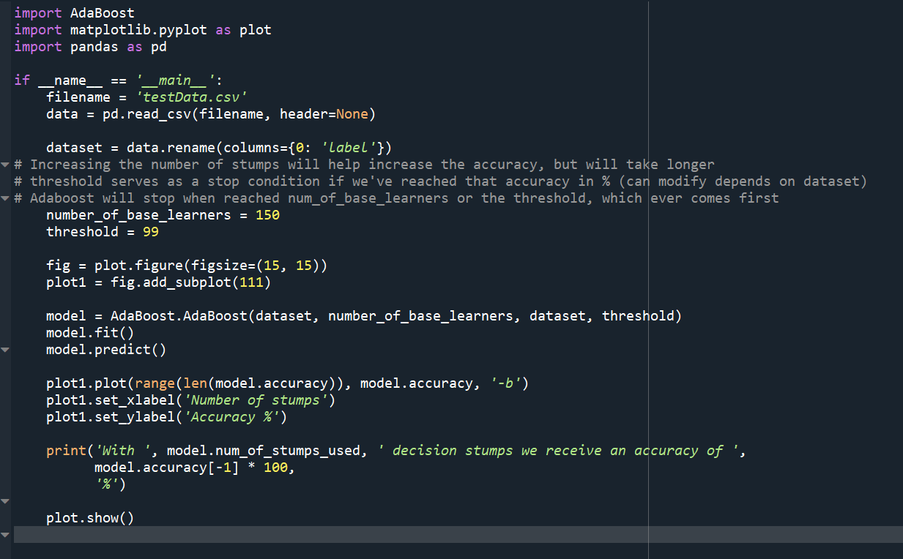
The Code
Main file
The main function takes the csv dataset
(should be in the same directory)
Two values can be changed:
number_of_base_learners (to increase accuracy)
Threshold (if reached required accuracy quickly)
Plot to show the increased accuracy in correlation with increased number of stumps
Notes:
תשתית, פלטפורמה,

Slide 49
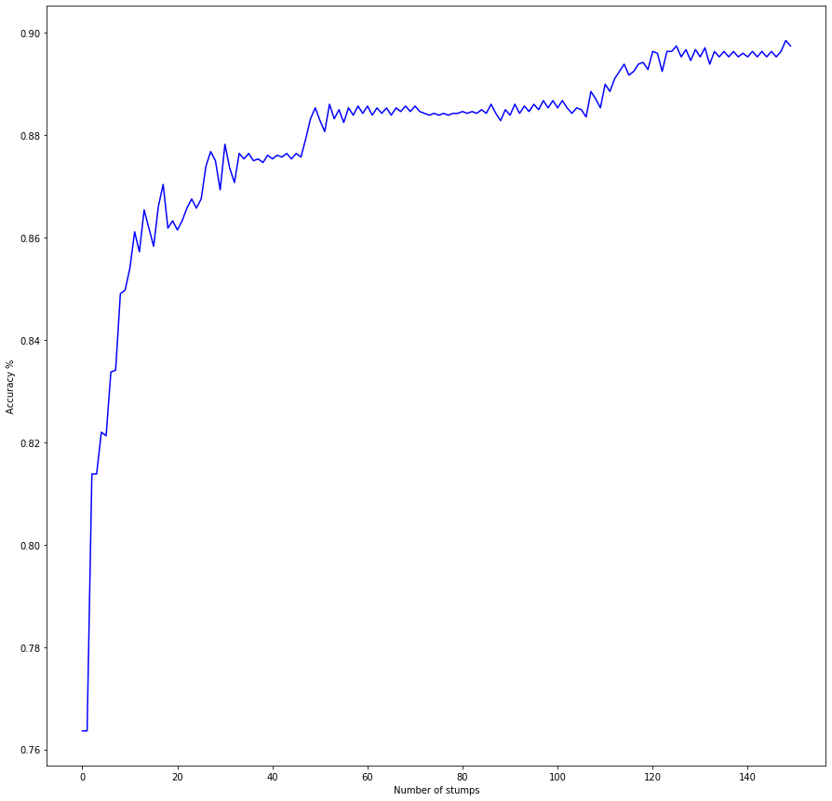
The Code - Results
Results on testData.csv
Dataset contains 2809 data points and 15 features.
Features contain float numbers and the labels are 0 or 1.
Using 150 stumps we were able to reach an accuracy of 89.747241%. For AdaBoost that isn’t considered very high.
On large datasets, AdaBoost might not achieve the desired accuracy in a reasonable amount of time as the amount of time it takes scanning through the datasets grows greatly.
Notes:
תשתית, פלטפורמה,

Slide 50
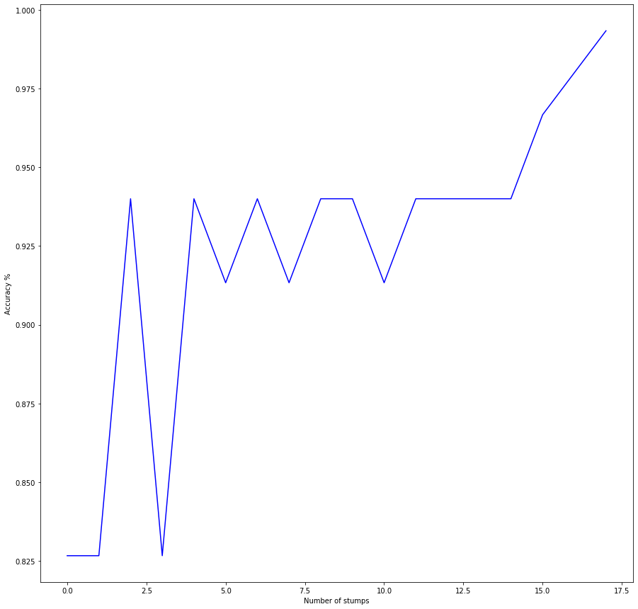
The Code - Results
Results on testData2.csv
A simpler derivative from testData.csv
Contains 150 data points and 10 features
Easily reaches the threshold of 99% after 18 stumps.
Reaches 100% accuracy after 41 stumps.
Shows the power of Boosting as a strong learner with by passing on important information such as misclassified points and the errors each classifier makes.
Notes:
תשתית, פלטפורמה,

Slide 51
What other algorithms are out there?
There are many other classification algorithms, we will discuss the main ideas behind some of them and compare them to Boosting.
SVM
Random Forest
Notes:
תשתית, פלטפורמה,

Slide 52
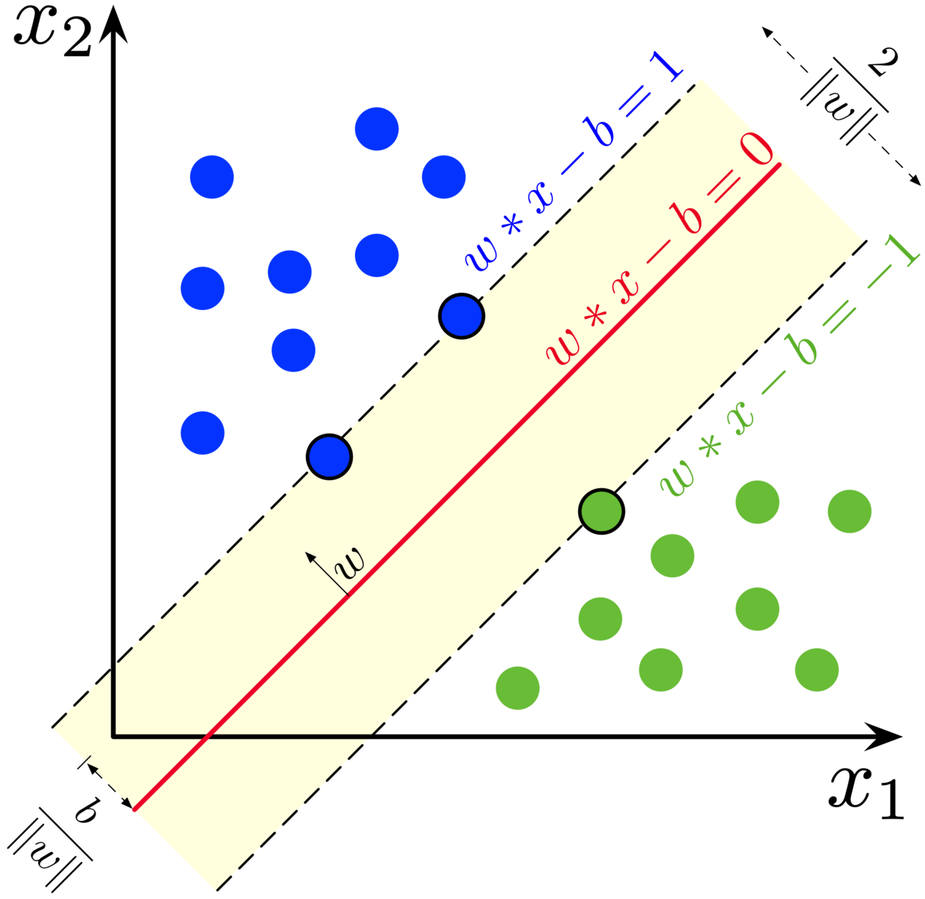
SVM vs Boosting
SVM seeks a hyperplane in the space of features and samples so that:
It will minimize the error of the training examples
It will maximize the margin between the points in the dataset.
Similar to Boosting in the way that it seeks to prevent from overfitting the data points, and yet reach a very high rate of accuracy.
Notes:
תשתית, פלטפורמה,

Slide 53
Random Forest vs Boosting
Random Forest is an ensemble method that is made to deal with the high variance created by decision trees.
They deal with more complex models where Boosting deals with weaker learners.
Creates a strong learner in parallel, where each tree in the forest works independently.
Variable selections and randomness that are added to the algorithm are making sure the trees have as little as possible in common, makes Random Forest an improvement over regular bagging and a strong learner.
Notes:
תשתית, פלטפורמה,

Slide 54
Random Forest vs Boosting
Boosting
Takes a set of weak learners with high bias and sequentially trains them to create one strong classifier.
General algorithm that fits and can work on many problems, whether it’s regression or classification.
Notes:
תשתית, פלטפורמה,

Slide 55
The End

