Slide 1
LLM-as-Multi-Robot-BT-Planner
Capability-Aware Generation of Synchronized Behavior Trees for Heterogeneous Robot Teams

Slide 2
0. ABOUT THE PRESENTER
Yevgeniy Dikun
Astana, Kazakhstan
Background: Finished 3rd-year Bachelor at Nazarbayev University
Major: Robotics Engineering
Research interests
• Robotics Control / Behavior Trees
• Scientific Machine Learning
• Computer Vision
Today: research proposal — LLM-as-Multi-Robot-BT-Planner.

Slide 3
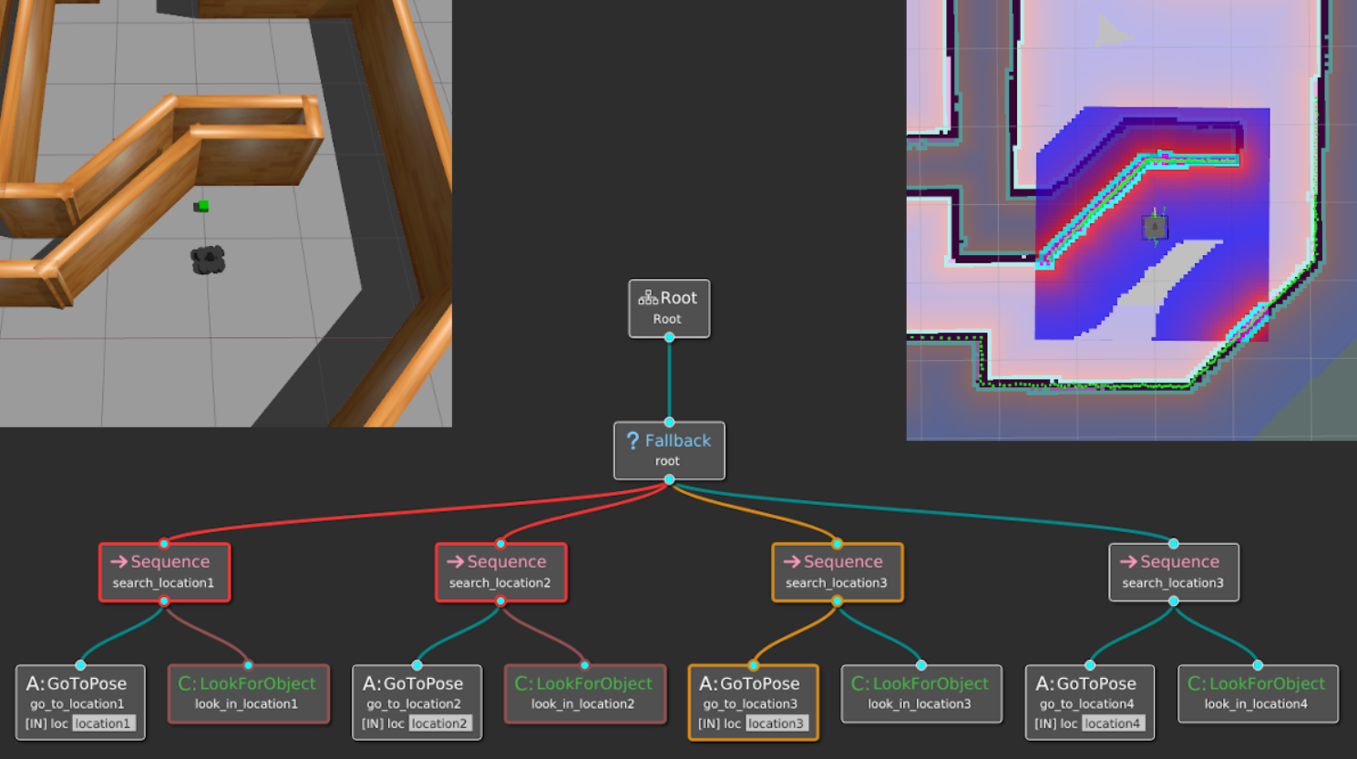
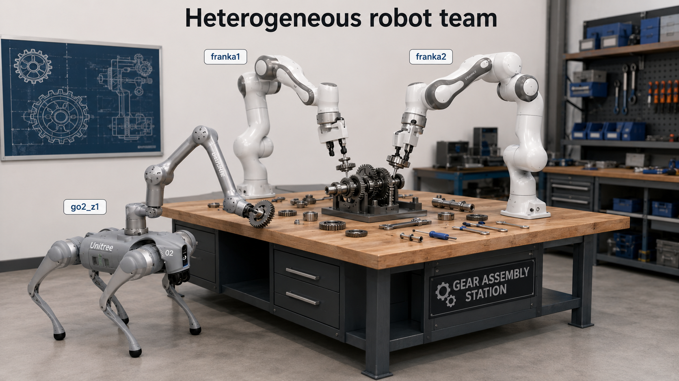
1. INTRODUCTION
The Problem: Programming Heterogeneous Robot Teams
Multi-robot teams improve efficiency and robustness by splitting subtasks across robots with different physical capabilities, BUT they are hard to program.
Behavior Trees is a way to structure the switching between different tasks in a robot.
Research question. Given only a natural-language instruction and the initial world state, can an LLM generate synchronized, executable Behavior Trees for a heterogeneous multi-robot team with no task-specific planning aid?
2

Slide 4
2. RELATED WORK
Where This Work Sits
Behavior Trees in robotics
We adopt the standard BT execution semantics and node types as our output representation (Colledanchise & Ögren, 2018).
SayCan (Ahn et al., 2022), ProgPrompt (Singh et al., 2023), PaLM-E (Driess et al., 2023): high-level decomposition and code generation. They generate flat action sequence for one robot (a list of skills to run in order). But we produce not just what actions, but which robot does each (capability-aware assignment), how they wait on each other (synchronization), and a full Behavior Tree per robot rather than a linear list.
LLMs for robot task planning
LLM-based BT generation
Papers such as LLM-as-BT-Planner (Ao et al., 2025). We build on its use of schema constraints and structured feedback but extend the setting from single-robot trees to capability-aware assignment and inter-robot synchronization.
Multi-robot BT planning
MRBTP (Cai et al., 2025): cross-tree expansion and intention sharing, using an LLM only as an optional subtree pre-planner. We share its problem setting but invert the roles, making the LLM the sole planner and treating the symbolic machinery purely as a verifier.
Our position. The LLM generates the synchronized multi-robot BTs directly from the instruction, code algorithms are used purely as a verifier and not as a planner.
3

Slide 5
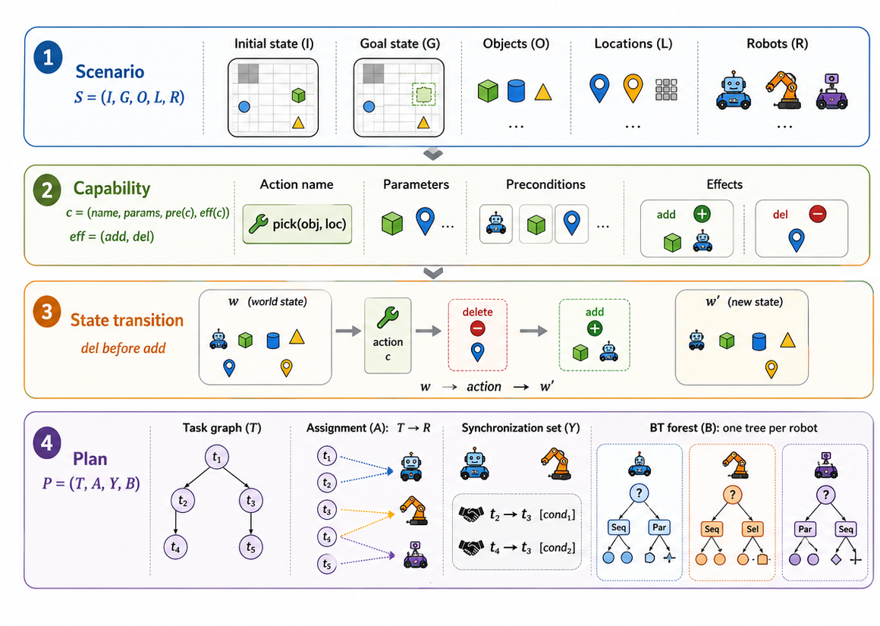
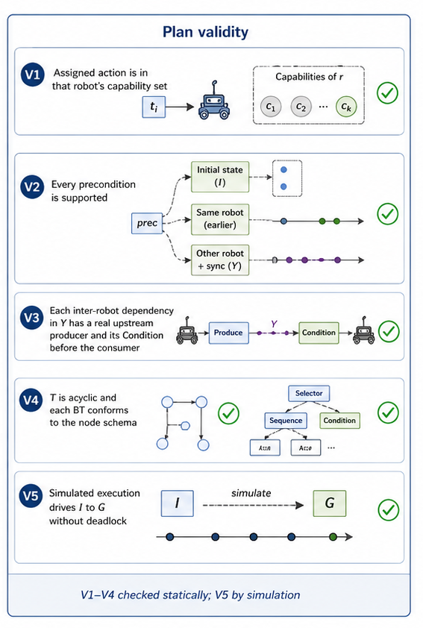
3. BACKGROUND & METHODOLOGY
Problem Formulation
4

Slide 6
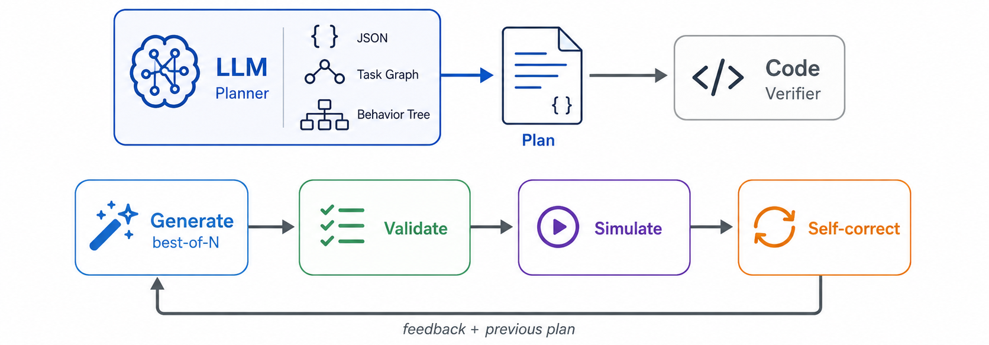
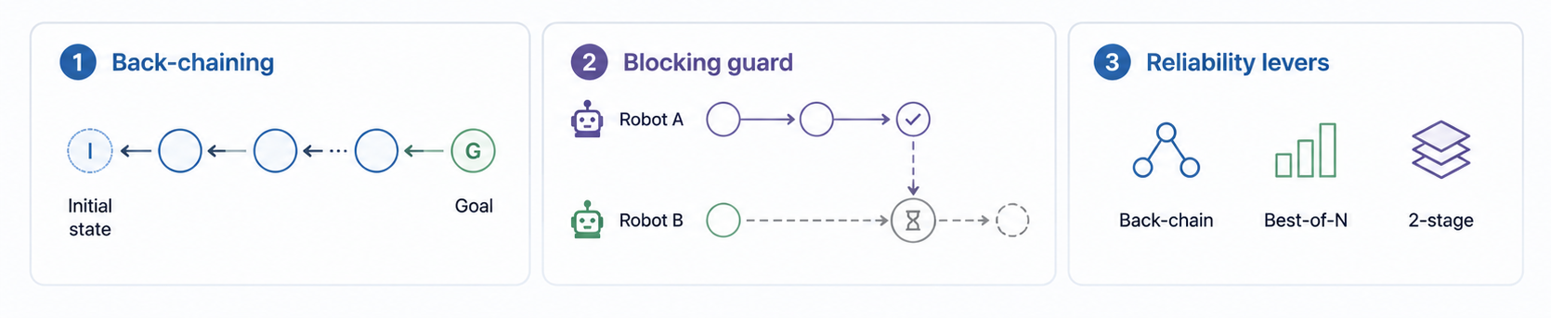
4. OUR METHOD
The LLM Is the Planner, Code Only Verifies
5

Slide 7
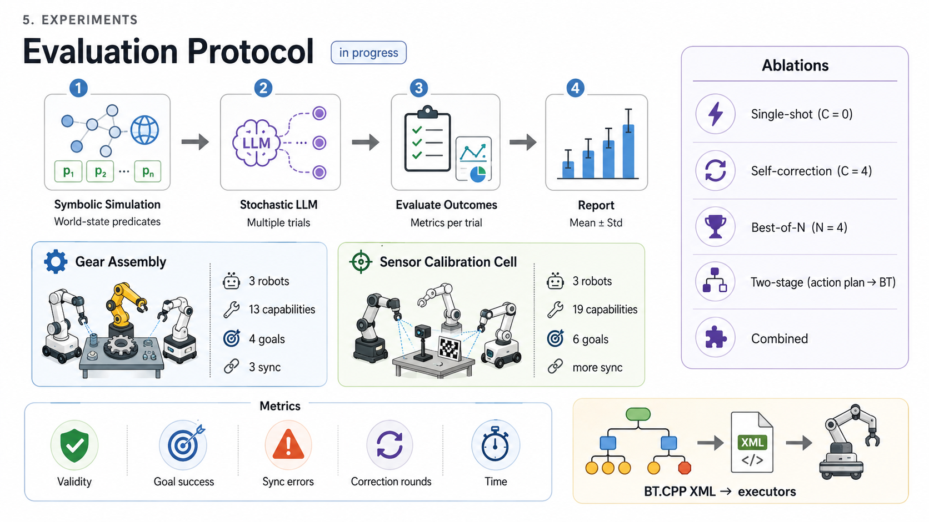
5. EXPERIMENTS
Evaluation Protocol (in progress)
6

Slide 8
6. RESULTS
Baseline Comparison
Manual BT design: expert-authored Behavior Trees; reliable but time-consuming and difficult to scale.
MRBTP (Cai et al., 2025): formal multi-robot BT planning with cross-tree coordination, but without direct LLM-based generation from language.
LLM-as-BT-Planner (Ao et al., 2025): LLM-generated executable BTs, mainly focused on single-robot assembly tasks.
LLM-MARS (Lykov et al., 2023): LLM-based BT generation for multi-agent robot systems, but with limited capability-aware synchronization.
Proposed method: LLM-generated synchronized BTs for heterogeneous multi-robot teams.
Method | Valid-BT ↑ | Goal succ. ↑ | Assign. acc. ↑ | Sync err. ↓ | Deadlock ↓ | Corr. rounds ↓ | BT size | Time (s) ↓
Manual (expert) | — | — | — | — | — | — | — | —
MRBTP | — | — | — | — | — | — | — | —
LLM-as-BT-Planner | — | — | — | — | — | — | — | —
LLM-MARS | — | — | — | — | — | — | — | —
Proposed (ours) | — | — | — | — | — | — | — | —
7

Slide 9
6. CONCLUSION
Conclusion & Next Steps
The proposed framework uses an LLM to generate the full multi-robot plan: task graph, capability-aware robot assignment, synchronization points, and one Behavior Tree per robot.
Deterministic modules do not plan, they verify. A task-agnostic validator and tick-based simulator detect errors and provide structured feedback for LLM self-correction.
Reliability is improved through three domain-independent strategies: back-chaining guidance, best-of-N sampling, and two-stage generation.
Next steps
Implement baseline methods for comparative evaluation.
Verify that generated BTs are compatible with ROS and real-robot execution constraints.
Add real-robot execution through the BehaviorTree.CPP / ROS interface.
8

