Slide 1
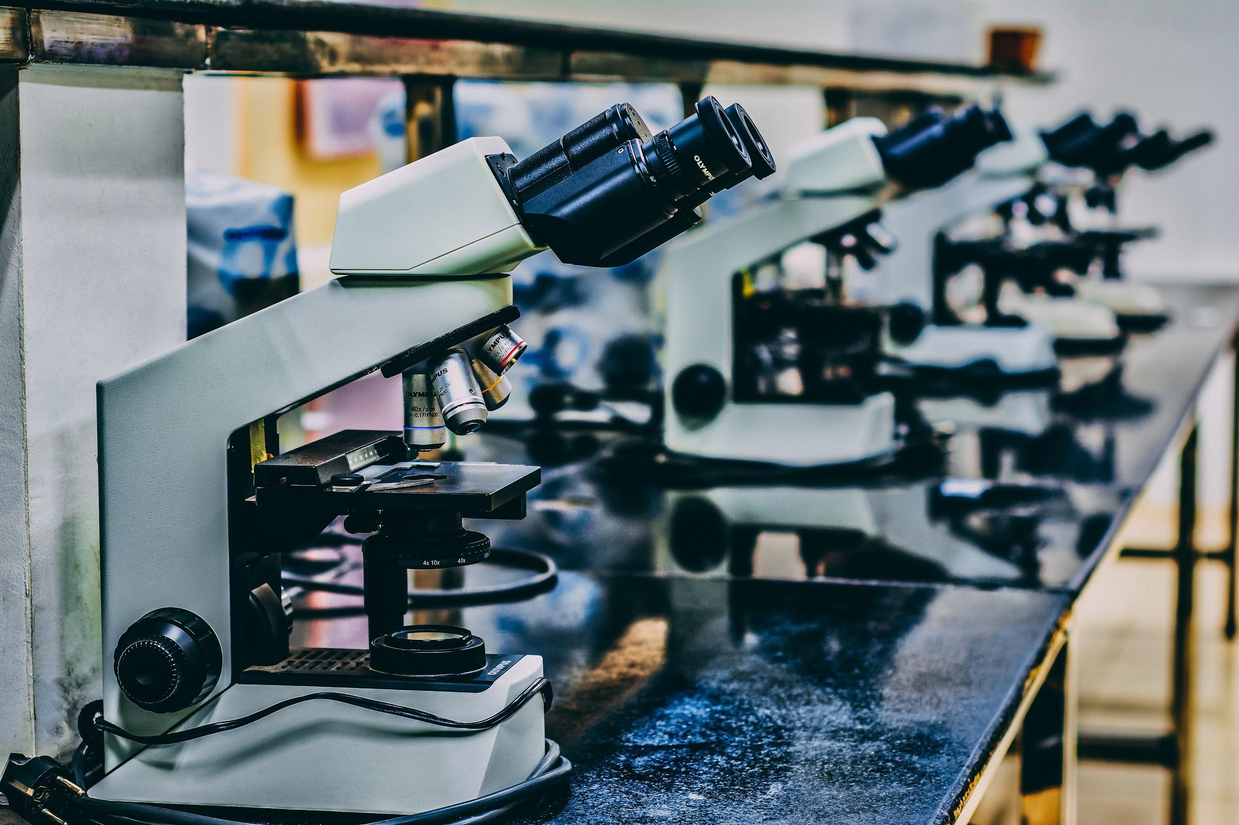
Kaggle Competition
Histopathologic Cancer Detection
Oleh Lukianykhin
Yevhen Pozdniakov

Slide 2
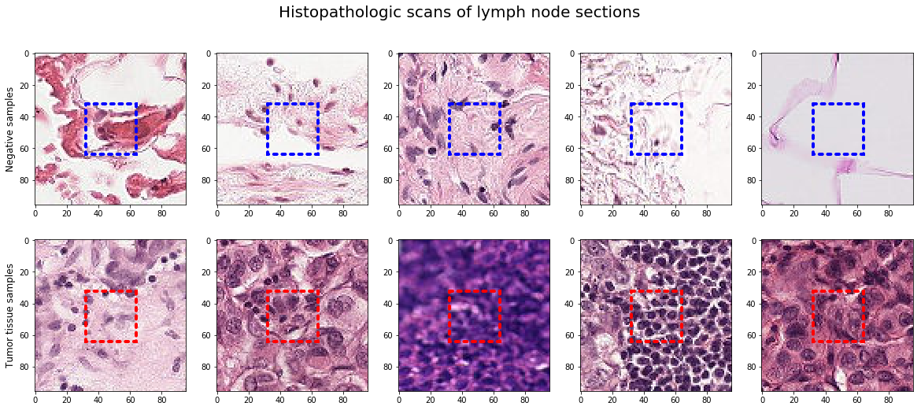
Problem
220k labeled histopathological images - 96*96px
Data is claimed to be preprocessed
Metastases (even single cancer cells) detection in the central region - 32*32px

Slide 3
Motivation
Early detection saves lives & money
Socially-important topic
Computer vision application

Slide 4
Related works
Models based on CNN and deep learning outperforms pathologists
Transfer learning conception is commonly used
Huge variety of models: AlexNet, VGG, ResNet, InceptionV3, MobileNet and DenseNet
Most of the transfer learning schemes use architectures or models trained on the ImageNet dataset

Slide 5
Thank you for attention!
Q&A

