Slide 1
Chapter 6:
Statistical Inference: n-gram Models over Sparse Data
TDM Seminar
Jonathan Henke
http://www.sims.berkeley.edu/~jhenke/Tdm/TDM-Ch6.ppt

Slide 2
Basic Idea:
Examine short sequences of words
How likely is each sequence?
“Markov Assumption” – word is affected only by its “prior local context” (last few words)

Slide 3
Possible Applications:
OCR / Voice recognition – resolve ambiguity
Spelling correction
Machine translation
Confirming the author of a newly discovered work
“Shannon game”

Slide 4
“Shannon Game”
Claude E. Shannon. “Prediction and Entropy of Printed English”, Bell System Technical Journal 30:50-64. 1951.
Predict the next word, given (n-1) previous words
Determine probability of different sequences by examining training corpus

Slide 5
Forming Equivalence Classes (Bins)
“n-gram” = sequence of n words
  bigram
  trigram
  four-gram

Slide 6
Reliability vs. Discrimination
“large green ___________”
tree? mountain? frog? car?
“swallowed the large green ________”
pill? broccoli?

Slide 7
Reliability vs. Discrimination
larger n: more information about the context of the specific instance (greater discrimination)
smaller n: more instances in training data, better statistical estimates (more reliability)

Slide 8
Selecting an n
Vocabulary (V) = 20,000 words
n | Number of bins
2 (bigrams) | 400,000,000
3 (trigrams) | 8,000,000,000,000
4 (4-grams) | 1.6 x 10¹⁷

Slide 9
Statistical Estimators
Given the observed training data …
How do you develop a model (probability distribution) to predict future events?

Slide 10
Statistical Estimators
Example:
  Corpus: five Jane Austen novels
  N = 617,091 words
  V = 14,585 unique words
  Task: predict the next word of the trigram “inferior to ________”
    from test data, Persuasion: “[In person, she was] inferior to both [sisters.]”

Slide 11
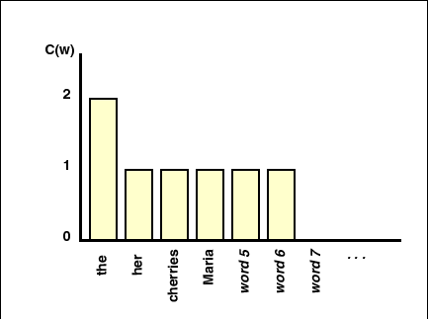
Instances in the Training Corpus:
“inferior to ________”

Slide 12
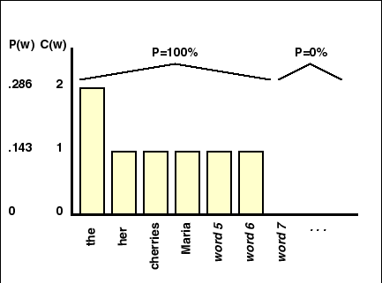
Maximum Likelihood Estimate:

Slide 13
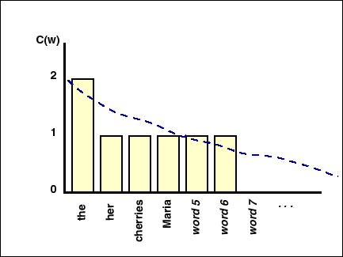
Actual Probability Distribution:

Slide 14
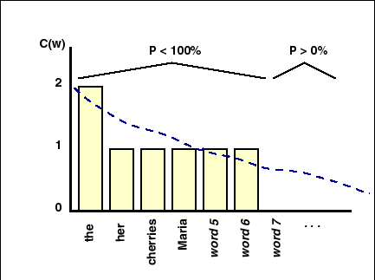
Actual Probability Distribution:

Slide 15
“Smoothing”
Develop a model which decreases probability of seen events and allows the occurrence of previously unseen n-grams
a.k.a. “Discounting methods”
“Validation” – Smoothing methods which utilize a second batch of test data.

Slide 16
LaPlace’s Law
(adding one)

Slide 17
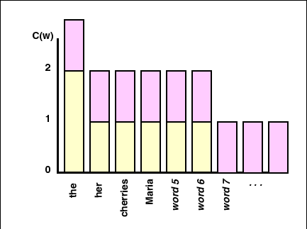
LaPlace’s Law
(adding one)

Slide 18
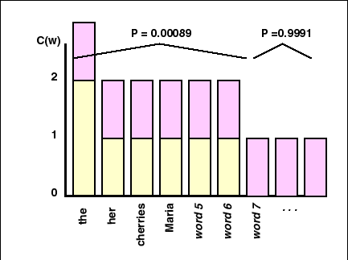
LaPlace’s Law

Slide 19
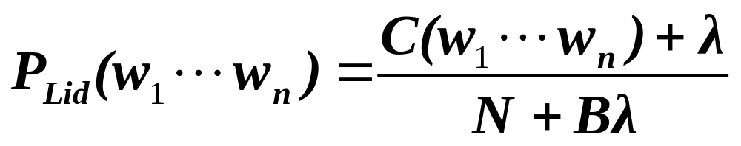
Lidstone’s Law
P = probability of specific n-gram
C = count of that n-gram in training data
N = total n-grams in training data
B = number of “bins” (possible n-grams)
λ = small positive number
    M.L.E: λ = 0
    LaPlace’s Law: λ = 1
    Jeffreys-Perks Law: λ = ½

Slide 20
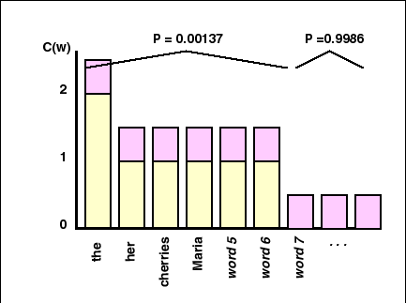
Jeffreys-Perks Law

Slide 21
Objections to Lidstone’s Law
Need an a priori way to determine λ.
Predicts all unseen events to be equally likely
Gives probability estimates linear in the M.L.E. frequency

Slide 22
Smoothing
Lidstone’s Law (incl. LaPlace’s Law and Jeffreys-Perks Law): modifies the observed counts
Other methods: modify probabilities.

Slide 23
Held-Out Estimator
How much of the probability distribution should be “held out” to allow for previously unseen events?
Validate by holding out part of the training data.
How often do events unseen in training data occur in validation data?
  (e.g., to choose λ for Lidstone model)

Slide 24
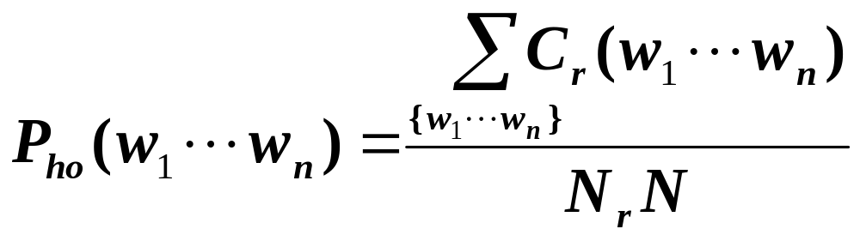
Held-Out Estimator
r = C(w₁… w_{n})

Slide 25
Testing Models
Hold out ~ 5 – 10% for testing
Hold out ~ 10% for validation (smoothing)
For testing: useful to test on multiple sets of data, report variance of results.
  Are results (good or bad) just the result of chance?

Slide 26
Cross-Validation
(a.k.a. deleted estimation)
Use data for both training and validation
Divide test data into 2 parts
Train on A, validate on B
Train on B, validate on A
Combine two models
A
B
train
validate
Model 1
validate
train
Model 2
Model 1
+
Model 2
Final Model

Slide 27
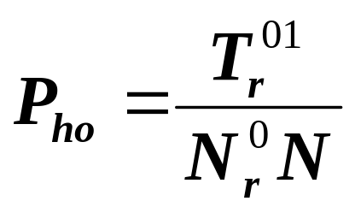
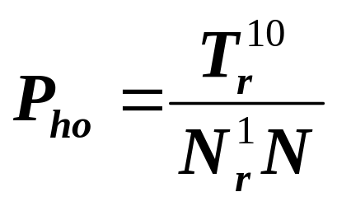
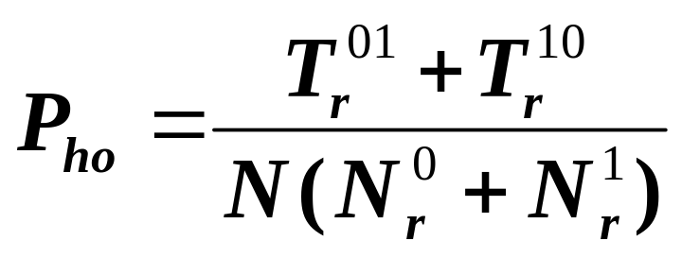
Cross-Validation
Two estimates:
N_{r}ª = number of n-grams occurring r times in a-th part of training set
T_{r}^{ab} = total number of those found in b-th part
Combined estimate:
(arithmetic mean)

Slide 28
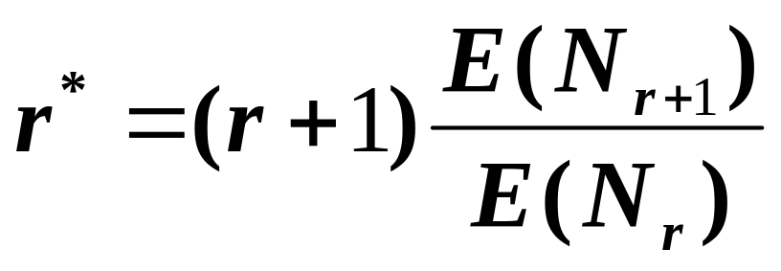
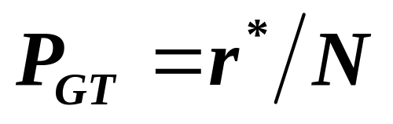
Good-Turing Estimator
r* = “adjusted frequency”
N_{r} = number of n-gram-types which occur r times
E(N_{r}) = “expected value”
E(N_{r+1}) < E(N_{r})

Slide 29
Discounting Methods
First, determine held-out probability
Absolute discounting: Decrease probability of each observed n-gram by subtracting a small constant
Linear discounting: Decrease probability of each observed n-gram by multiplying by the same proportion

Slide 30
Combining Estimators
(Sometimes a trigram model is best, sometimes a bigram model is best, and sometimes a unigram model is best.)
How can you develop a model to utilize different length n-grams as appropriate?

Slide 31
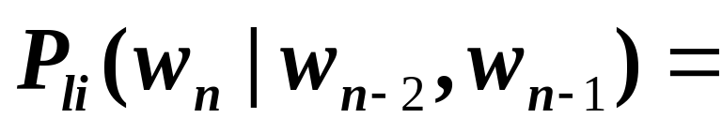
Simple Linear Interpolation
(a.k.a., finite mixture models; a.k.a., deleted interpolation)
weighted average of unigram, bigram, and trigram probabilities

Slide 32
Katz’s Backing-Off
Use n-gram probability when enough training data
  (when adjusted count > k; k usu. = 0 or 1)
If not, “back-off” to the (n-1)-gram probability
(Repeat as needed)

Slide 33
Problems with Backing-Off
If bigram w₁ w₂ is common
but trigram w₁ w₂ w₃ is unseen
may be a meaningful gap, rather than a gap due to chance and scarce data
  i.e., a “grammatical null”
May not want to back-off to lower-order probability

