Slide 1
CI/CD pipeline for deployment Intermine application on AWS
Yevhen Vieskov, DevOps_internal_Dnipro_2021Q3

Slide 2
Task. Part 1
1. Repository - https://github.com/intermine/intermine
2. Create 2 environments - dev and prod using terraform on any virtual platform (public cloud or local);
Use Terraform for provisioning infra in public cloud:
- Use modules - split all infra into 2 modules:
- first one
should deploy networking stuff - VPC, networks, routing tables, security groups and so on;
- second one
should deploy app layer - ASG, ALB and so on for:
- App Jenkins;
- Applications;
- State should be on remote backend;
- Install local Infra Jenkins
and develop Jenkins pipeline using Scripted or DSL pipelines to run Terraform code.
Pipeline must
do "plan", "apply", "destroy" for infrastructure. All secrets must be on Jenkins credentials;

Slide 3
Task. Part 2
3. Configure environment using ansible playbook; Install application dependencies and set application configuration;
Develop Ansible roles and use best practices developing ones;
- Ansible should be run locally on each instance using user-data for:
- App Jenkins (configure Jenkins for application, using Jenkins docker image);
- Applications
(install application dependencies and set application configuration);
4. Create/configure Jenkins, using Jenkins docker image;
5. Using Jenkins create pipeline to build/test/deploy warehouse application;
- the pipeline should be triggered
automatically after commit to repo;
- the deployment to dev should
occur automatically, manual to prod;
- you need to implement a solution
to track application versions;
- use groovy-libraries as much as possible;

Slide 4
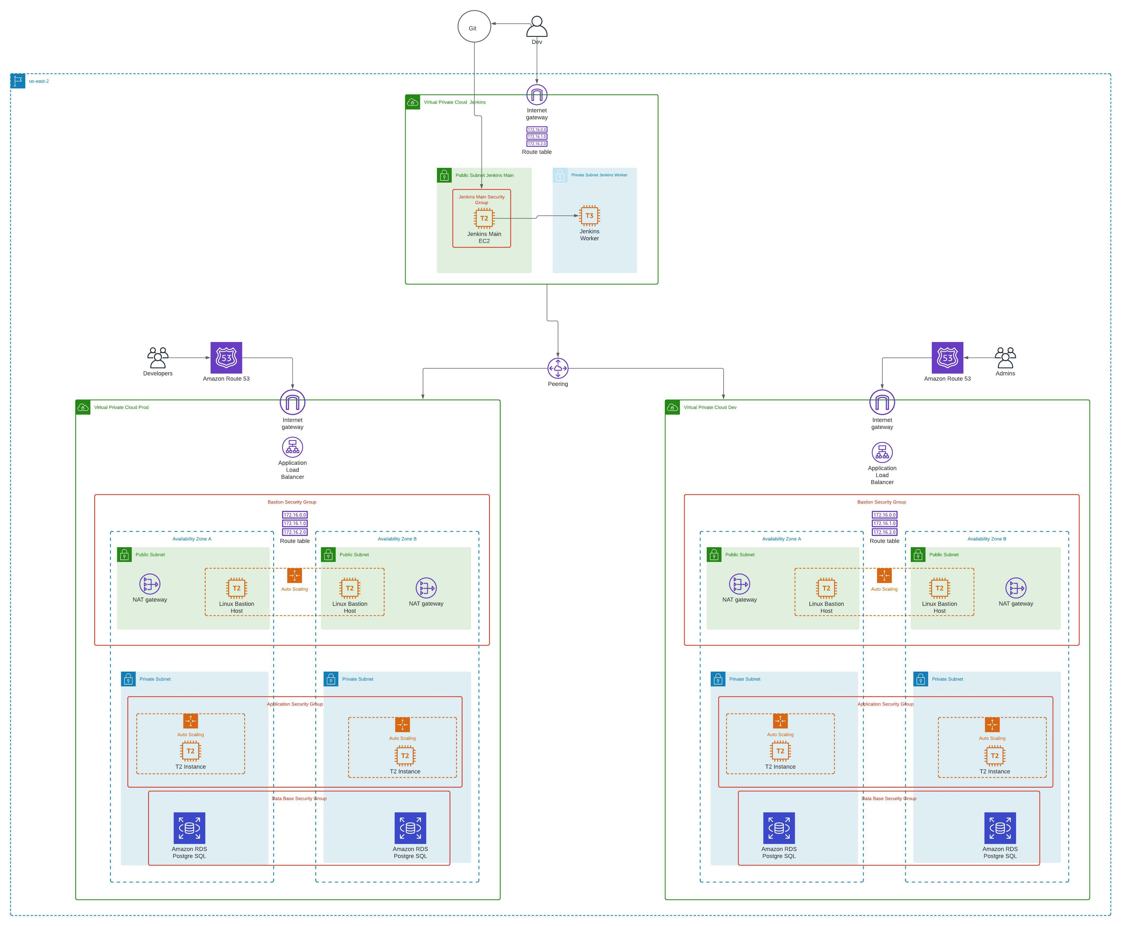
Infrastructure Scheme

Slide 5
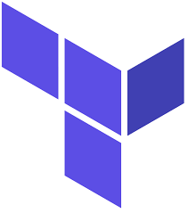
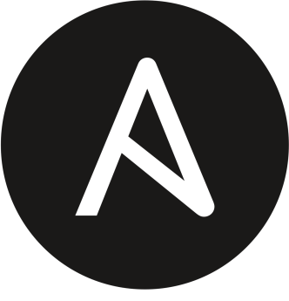
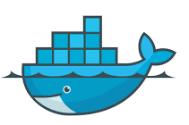

Software
Terraform is an open-source infrastructure as code software tool created by Hasi Corp. Users define and provide data center infrastructure using a declarative configuration language.
Ansible is an open-source software provisioning, configuration management, and application-deployment tool enabling infrastructure as code. It runs on many Unix-like systems, and can configure both Unix-like systems as well as Microsoft Windows. It includes its own declarative language to describe system configuration.
Docker is a set of platform as a service (PaaS) products that use OS-level virtualization to deliver software in packages called containers. Containers are isolated from one another and bundle their own software, libraries and configuration files; they can communicate with each other through well-defined channels. Because all of the containers share the services of a single operating system kernel, they use fewer resources than virtual machines.
Jenkins – an open source automation server which enables developers around the world to reliably build, test, and deploy their software.

Slide 6
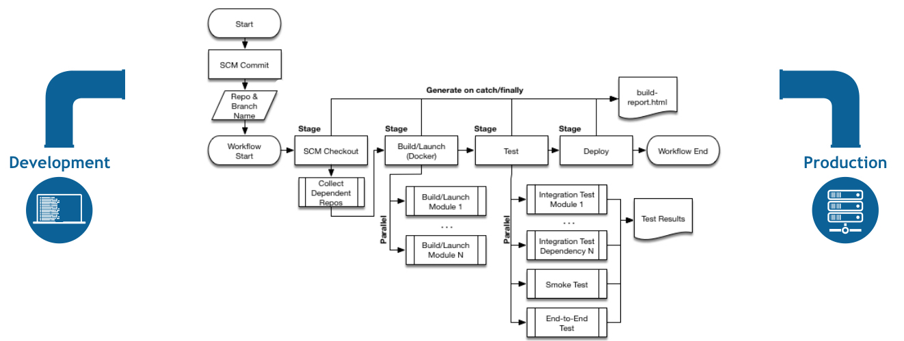
CI/CD Pipeline

Slide 7
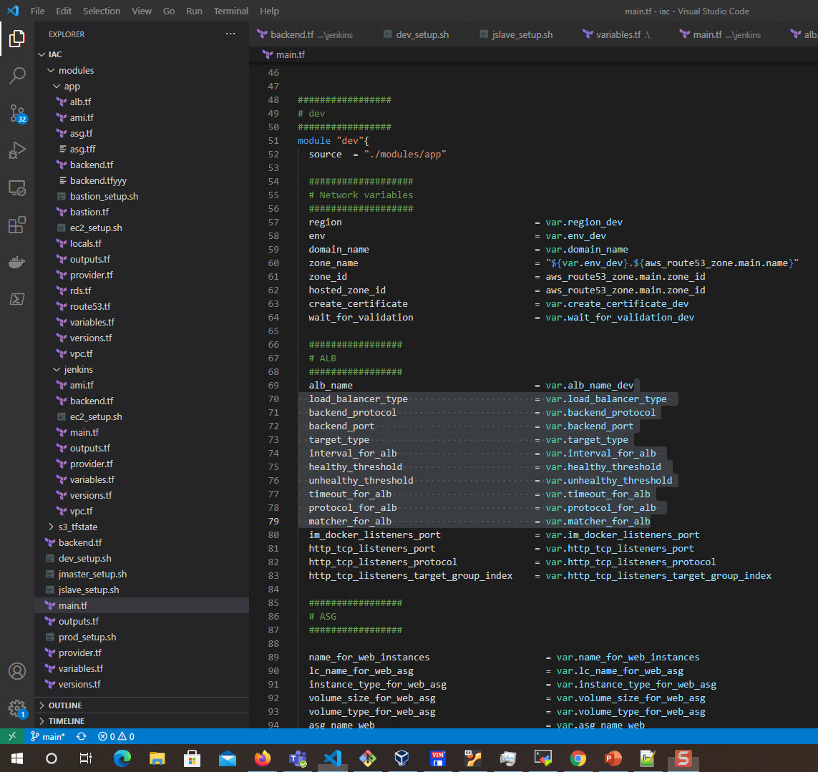
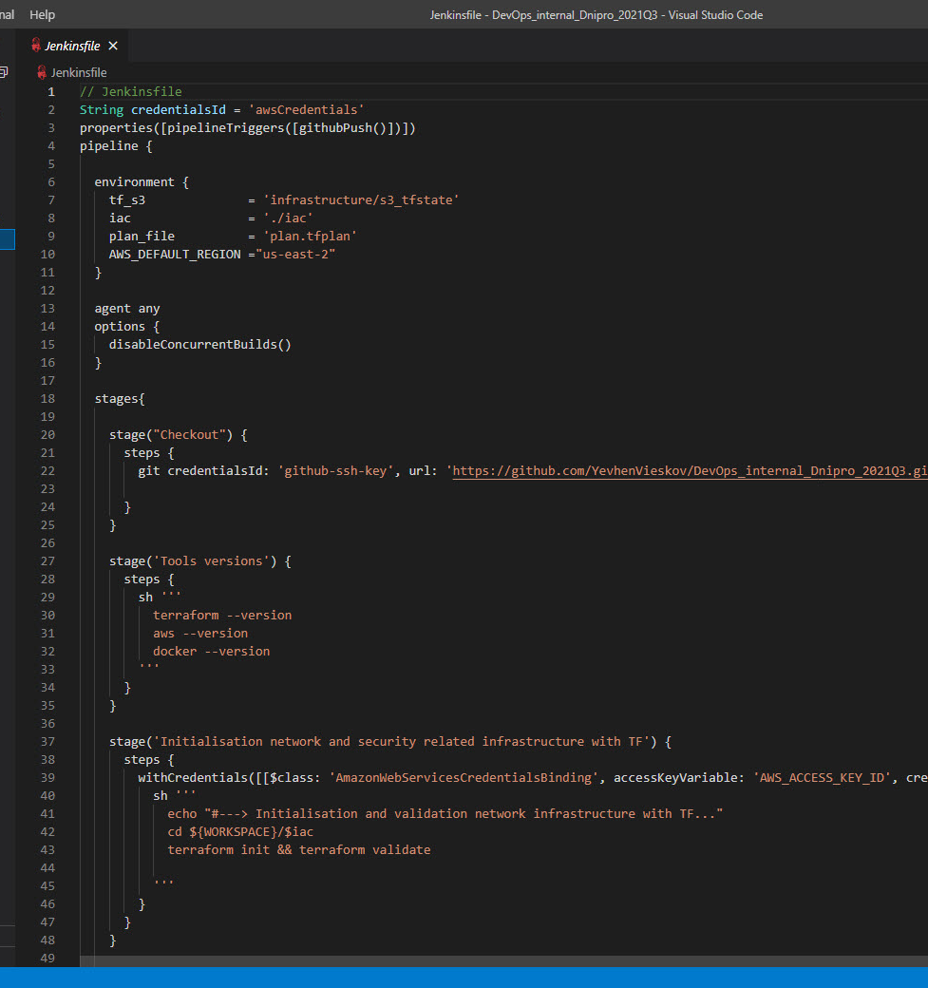
Code structure and Jenkins pipeline

Slide 8
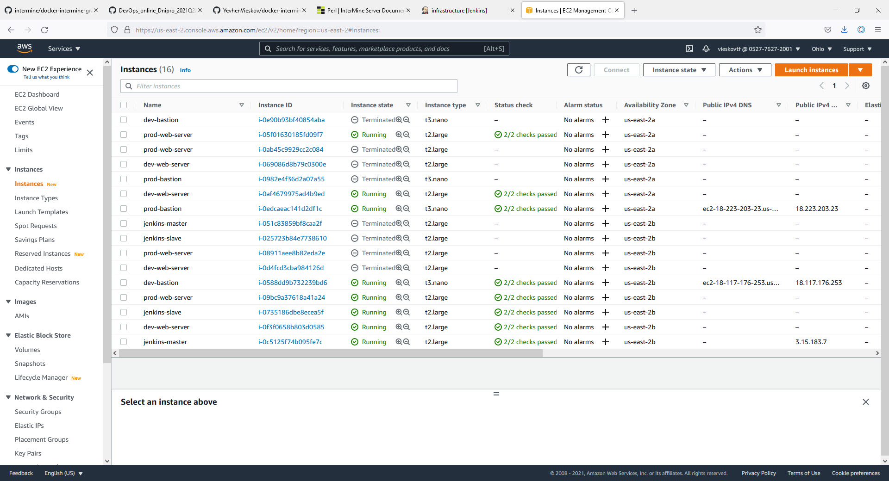
Results. AWS Infrastructure

Slide 9
Result. Application

Slide 10
Conclusion.
Three tier infrastructure for data warehouse application has been created with Terraform
Jenkins infrastructure with main and worker node has been created in Terraform
Application has been deployed to AWS in Docker Container
Jenkins infrastructure must be improved (load balanser, autoscaling group)
Database from warehouse application must be deployed on RDS. Web application may work in Docker

Slide 11
Reference.
https://github.com/YevhenVieskov/DevOps_internal_Dnipro_2021Q3.git
https://github.com/YevhenVieskov/docker-intermine-gradle.git

Slide 12
Thanks for your attention!

