Slide 1
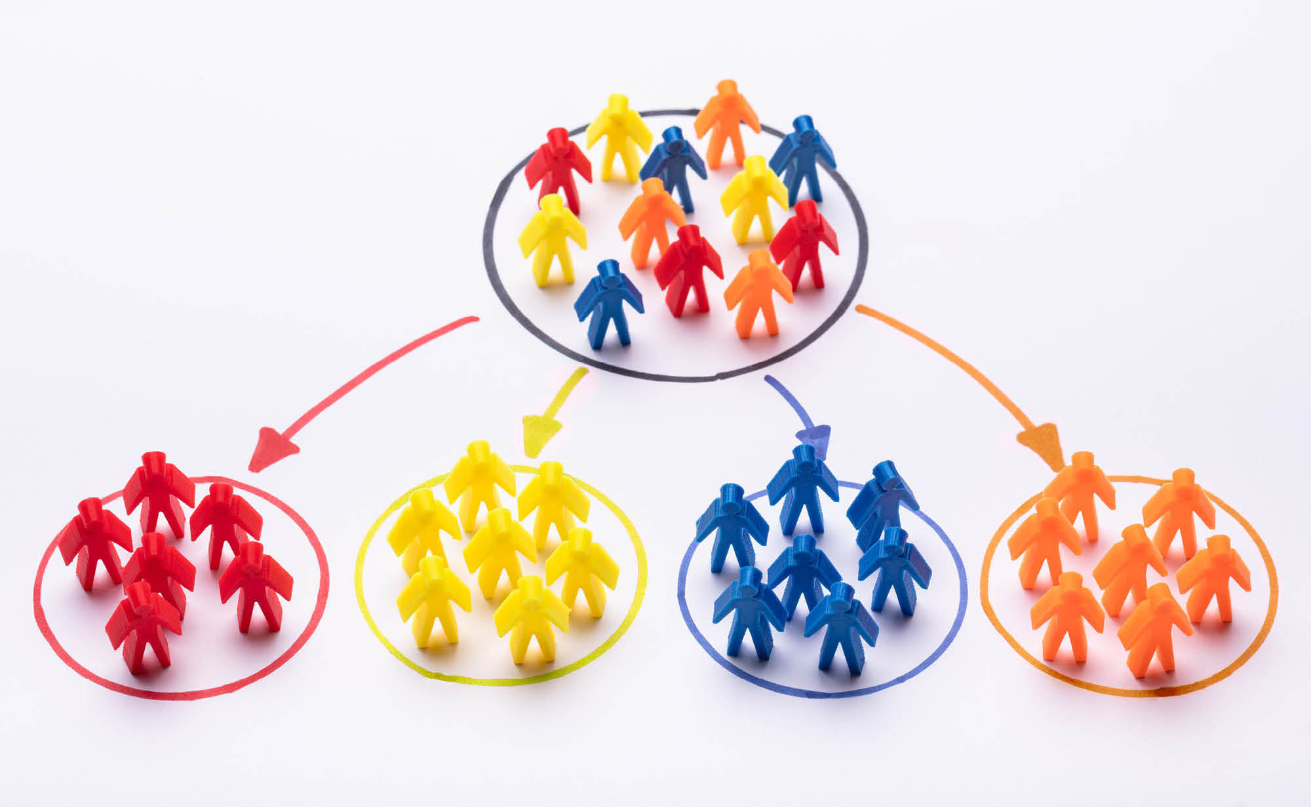
Applications of Data Clustering
Customer segmentation: Clustering
Overview:
Description of dataset
Methodology
9 sections
Different algorithms
Results
Interpret and compare the outputs
Name: Yew KaiShen

Slide 2
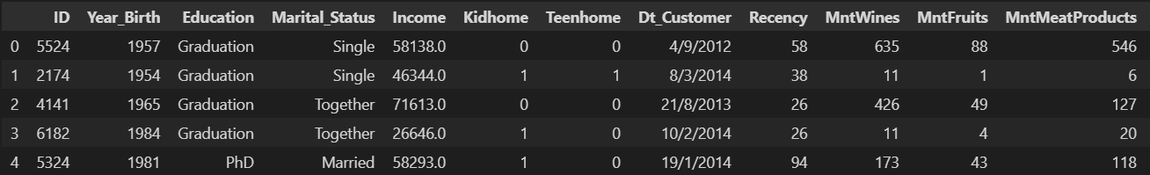
Description of dataset
From Kaggle source
2240 rows x 29 columns
Rows: data ; Columns: attributes
Customer information
Purchasing habits

Slide 3
Methodology
Data Preparation
Data Collection
Data Cleaning
Data Pre-processing
Data Standardization
Dimensionality Reduction
Find optimal number of cluster
Model Building
Model Evaluation
Profiling
Algorithms
Gaussian Mixture Model
Density-based Spatial Clustering of Applications with Noise (DBSCAN)
Agglomerative Hierarchical Clustering
K-Means Clustering

Slide 4
Result
Cluster 0 | Cluster 1 | Cluster 2 | Cluster 3
High income high spent | Low income low spent | Average income average spent | Low income low spent
Half of customer is younger | Most younger | Most younger | Most younger
Definitely no child | Most has 1 child and some 0 child | Most has 1 child and some has 2 children | Above average has 2 children, some has 1 child
Definitely not parent | Most is parent | Definitely is parent | Definitely is parent
Above average graduate, some postgraduate | Above average graduate, some postgraduate and undergraduate | Half graduate, half postgraduate | Half graduate, half postgraduate
Above average married | Above average married | Above average married | Above average married
Spent most on wines, second on meat | Spent most on wines | Spent most on wines | Spent most on wines
37% in store | 37% in store | 30% in web | 46% in store

