Slide 1



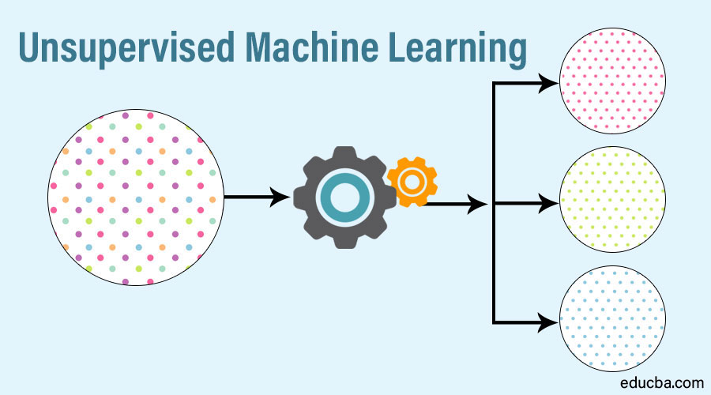

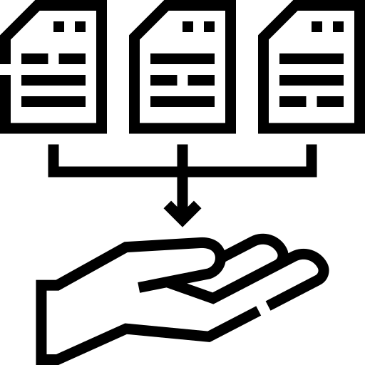


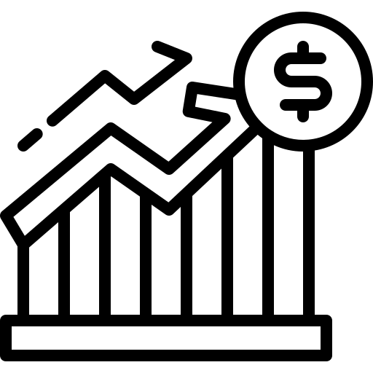
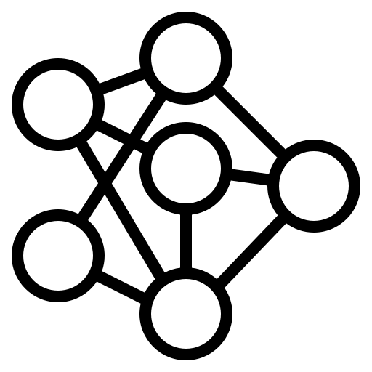
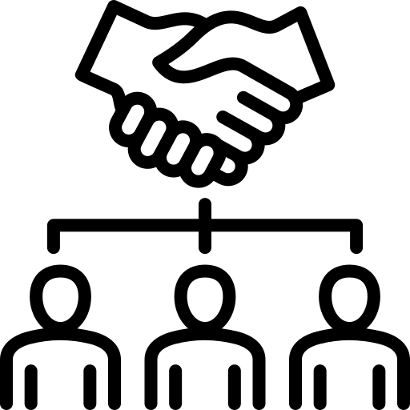


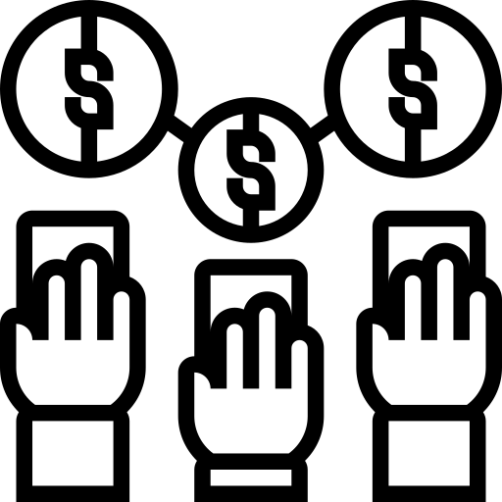
Applications in Data Clustering
Student: Yew KaiShen Supervisor: Panagiotis KANELLOPOULOS
BACKGROUND
PROCESS FLOW
ALGORITHM
K-means
DBSCAN
Gaussian Mixture
BIRCH
Affinity Propagation
Mean-shift
OPTICS
Agglomerative Hierarchy
Define the problem
Collect the data
Process data Analysis data
Interpret the results
Algorithm building and implement
Unsupervised learning uses machine learning algorithms to analyse and cluster unlabelled datasets by identifying groups of data with specific similar characteristics.
ADVANTAGES
APPLICATIONS
Market segmentation
Sport science
Health Insurance
Document analysis
Image segmentation
Customer loyalty
Economies of scale
Customer relationship
Channel of distribution
Enhance competitiveness

