Slide 1
DATA CLUSTERING
CUSTOMER SEGMENTATION : CLUSTERING
PRESENTED BY : YEW KAI SHEN

Slide 2
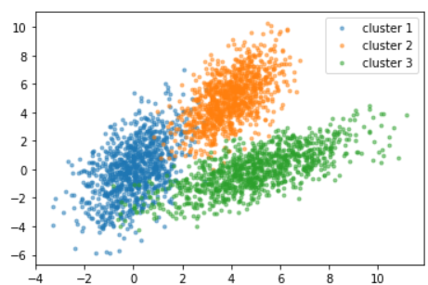
WHAT IS DATA CLUSTERING ??
Clustering algorithm
Classify similar customer into same groups
Helps to better understand customers in terms of demographics and behaviours
Business can benefit by creating a suitable marketing strategy

Slide 3
What is Customer Segmentation ?
Dividing a customer base into groups of individuals
Each group has their similar in specific ways such as age, gender, spending habits
Gain a deeper understand of their customers’ preferences and find the most valuable information in each group
Marketing effort would be better served if they can target specific group and lead them to buy something

Slide 4
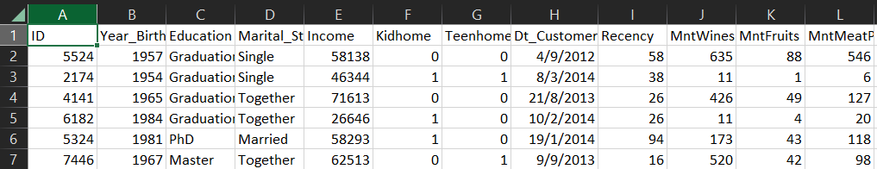
How is my dataset ?
Attributes
ID
Year_Birth
Education
Marital_Status
Income
Kidhome
Teenhome
Dt_Customer
Recency
Complain
MntWines
MntFruits
MntMeatProducts
MntFishProducts
MntSweetProducts
MntGoldProds
NumDealsPurchase
AcceptedCmp1
AcceptedCmp2
AcceptedCmp3
AcceptedCmp4
AcceptedCmp5
Response
NumWebPurchases
NumCatalogPurchases
NumStorePurchases
NumWebVisitsMonth
Z_CostContact
Z_Revenue
Shape : 2240 x 29

Slide 5
What is my Project Goal ?
I hope I can be a data analyst
Use a dataset which I am fully understand
Create more graphs so users can better understanding how is the dataset looks like
Implement more clustering algorithms to compare the accuracy between each algorithm
Use confusion matrix to calculate the accuracy of my project
Can help business company to discover something that will them to create a suitable marketing strategy

Slide 6
PROCESS FLOW
03
01
02
PREPARE DATA
CREATE SIMILARITY METRIC
IMPLEMENT AND INTERPRET
Cluster similar data points into the same cluster
Dissimilar points will be in different cluster
Clustering Algorithm
Improve result by modifying previous steps
Import packages/libraries
Clean the data

Slide 7
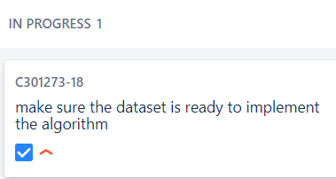
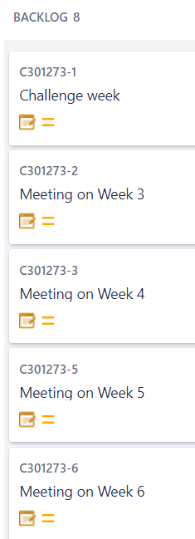
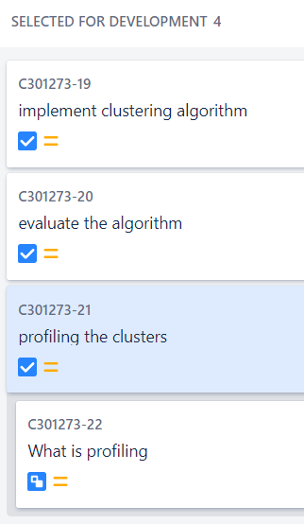
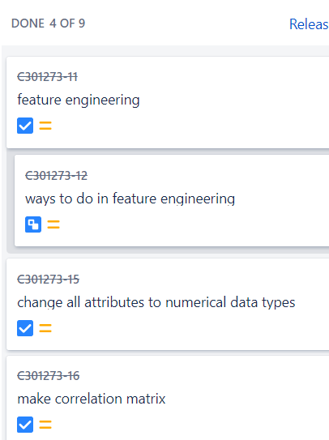
PROJECT MANAGEMENT TOOL (JIRA)

Slide 8
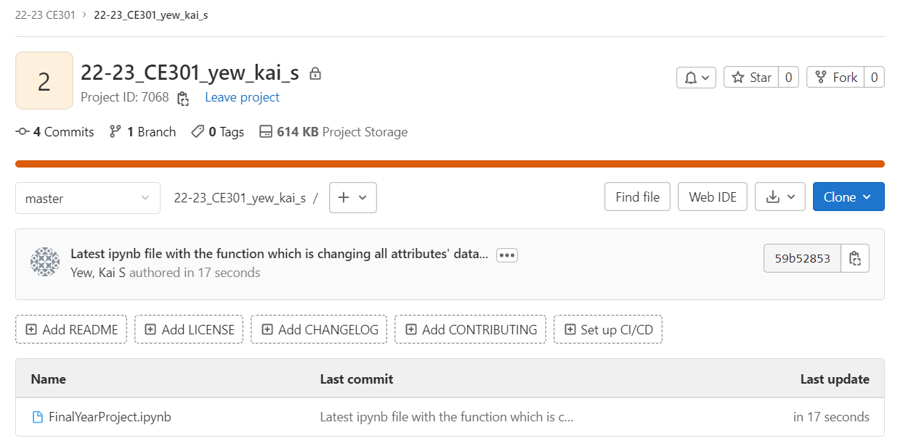
PROJECT MANAGEMENT TOOL (GITLAB)

Slide 9
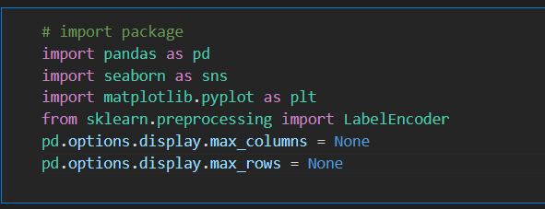
Progress on my project

Slide 10
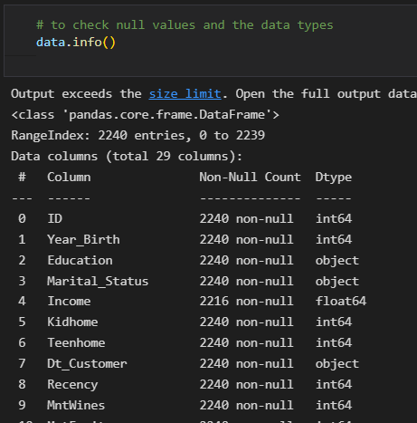
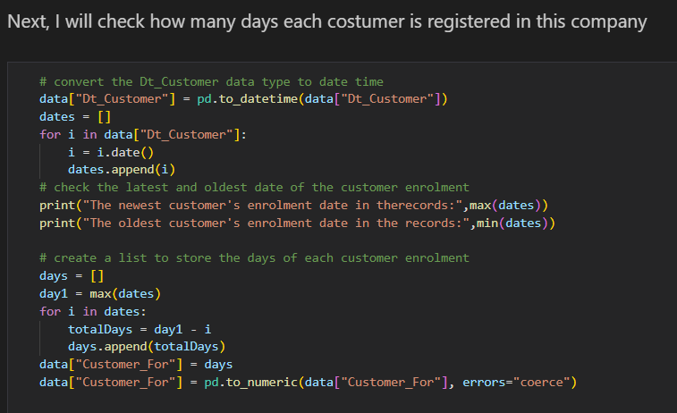
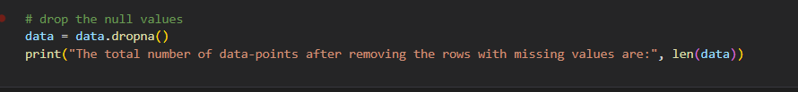

Slide 11
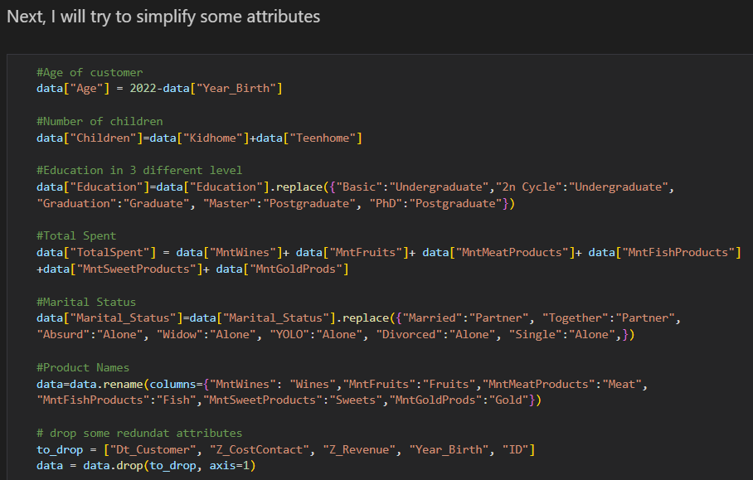
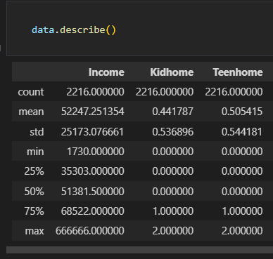

Slide 12
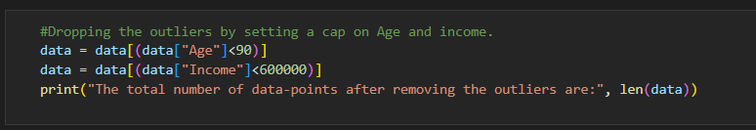
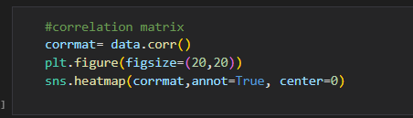
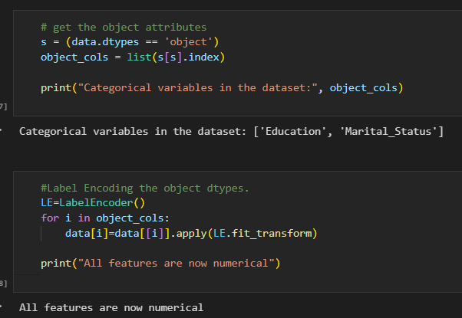

Slide 13
FUTURE PLAN
Instead of removing the data, fill in by mean, mode or median of the column
Create more graph so users can better understand how is the data structure of the dataset, for instance, relationship etc.
Probably will use other software to improve my clustering project. For instance, Tableau (Data Visualization) or R project (Statistical Computing)
Implement more clustering algorithm other than K-means
Improve the accuracy of the model by using the confusion matrix (TP,TN,FP,FN)

Slide 14
CHALLENGES FACED IN THIS PROJECT
Need to make sure the dataset is suitable for my project
Need to decide which programming language between R or Python that I will be using for my whole project
Since the process flow of data clustering is straightforward, it takes me some times to make it more unique

Slide 15
THANK YOU

