Slide 1


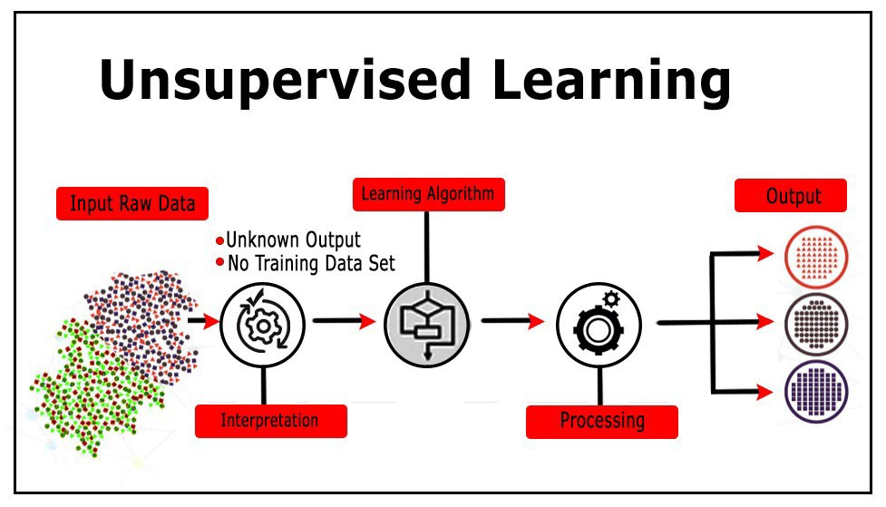
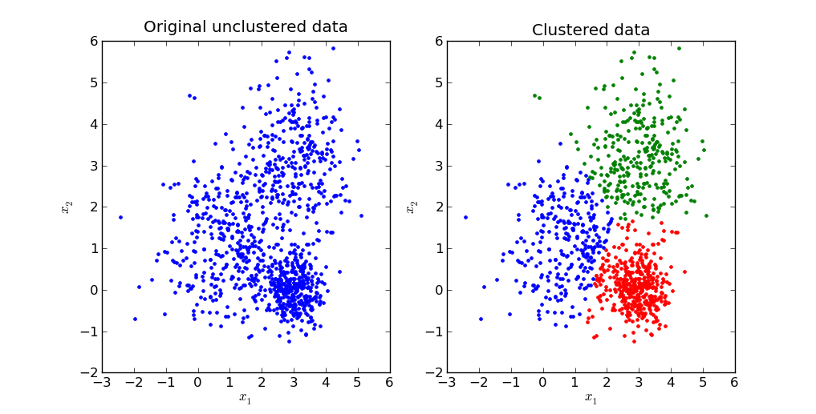



Applications in Data Clustering
Student: Yew KaiShen Supervisor: Panagiotis Kanellopoulos
WHAT
WHY
organizations can better understand their datasets by observing what are the similar characteristics in each cluster
to discover hidden patterns since it is unsupervised machine learning and there isn’t any defined output from the dataset
identify their customers and communicate with them through most effective ways
CUSTOMER SEGMENTATION
Import and read dataset
Clean the dataset
Run the algorithm
Interpret the result
IMPLEMENTATION
Visual Studio Code
Python
Jupyter

Slide 2



Applications in Data Clustering
Student: Yew KaiShen Supervisor: Panagiotis Kanellopoulos
WHAT
WHY
understand dataset
hidden information
better communication
marketing strategy
HOW
IMPLEMENTATION
Visual Studio Code
Python
Jupyter

Slide 3
Applications in Data Clustering
Student: Yew KaiShen Supervisor: Panagiotis Kanellopoulos
WHAT
WHY
organizations can better understand their datasets by observing what are the similar characteristics in each cluster
to discover hidden patterns since it is unsupervised machine learning and there isn’t any defined output from the dataset
identify their customers and communicate with them through most effective ways
Import and read dataset
Clean the dataset
Run the algorithm
Interpret the result
CUSTOMER SEGMENTATION
IMPLEMENTATION
Visual Studio Code
Python
Jupyter

