Slide 1
SmartClass
Smart classroom management for Universiti Malaya
AP2 progress · Yong Yew Sing · Modules 1, 3, 4, 8 · 14 November 2026
Notes:
Open with the one-line idea: students sign in with SPeCTRUM, a camera at the door takes attendance by face, attendance goes back to SPeCTRUM, and an AI assistant answers from the lecturer's own materials with citations. I cover my four modules; Shino presents hers.
Likely questions:
Q: What changed since AP1?
A: IoT environment control and desk projection were dropped (proposal revision, November 2026). Module 8 became an AI learning assistant over the course materials in a simulated SPeCTRUM (a local Moodle 4.5).
Q: Is this connected to the real SPeCTRUM?
A: No. A local Moodle 4.5 in Docker simulates it, with the same web-service API and the Attendance plugin. Real SPeCTRUM uses Microsoft 365 sign-in and would need UM IT approval.

Slide 2
Two students, eight modules
INTRODUCTION
Yong Yew Sing (this talk)
Chow Shino
M1
User Management
M2
Dashboard & Notifications
M3
Attendance Management
M5
Classroom Interaction
M4
Face Recognition Verification
M6
AI Quiz
M8
AI Learning Assistant
M7
Learning Analytics
Shared: one FastAPI backend and two apps. Where my modules meet Shino's, I build only the agreed interface (attendance read API for M7, material retrieval for M6).
Dropped since AP1: IoT environment control and desk projection.
Notes:
Each of us is graded on our own modules. I never build Shino's modules; where mine need hers I build only the interface described in the FR document, and requests between us are written down in docs/requests-for-shino.md.
Likely questions:
Q: How do the modules depend on each other?
A: M7 reads attendance through my read interface (FR-313). M6 retrieves course passages through my retrieval interface (FR-814). Five M8 features (FR-820 to FR-824) need M6 quiz results, so they wait.
Q: How do you avoid merge conflicts?
A: I work on a separate branch and merge to main only finished, checked work through a pull request.

Slide 3
All four modules built and tested
01 · OBJECTIVES PROGRESS
M1
User Management
M3
Attendance Management
Moodle sign-in, roles, PDPA consent, face self-enrolment checked against the matric card
Sessions from the timetable, four statuses, overrides, reports, sync to Moodle Attendance
Done · tried on real phones (T23)
Done · full class run with camera next (T48)
M4
Face Recognition
M8
AI Learning Assistant
Camera at the door detects faces; the server recognises them; students can flag a miss
Cited chat over Moodle materials, summaries, flashcards, practice, lecturer trends
Done with a webcam · Raspberry Pi run next (T47)
Done · quiz-based parts wait for M6
Notes:
Every module is built with automated tests. What is left is measuring on real hardware: the Pi run and a full class run with the camera. Module 8's quiz-based features depend on Shino's quiz module.
Likely questions:
Q: Why hasn't the Raspberry Pi been used yet?
A: The device client is the same Python code on a laptop webcam and on the Pi; only the camera differs. The Pi run (T47) measures frame rate (NFR-11) and recognition time (NFR-10).
Q: How does a student get their face enrolled without an admin?
A: They take three guided selfies and a photo of their matric card. The server compares the faces and reads the matric number by OCR; a clear pass is approved at once, anything else goes to the lecturer's verification queue.

Slide 4
62 of 71 functional requirements done
02 · REQUIREMENTS PROGRESS
62
Done
built with automated tests
2
Partly
FR-114 push notice waits for M2; FR-401 Pi field run
2
Not done
FR-314 PDF export, FR-411 offline buffer (both Could Have)
5
Deferred on M6
FR-820 to FR-824 need quiz results
Notes:
Every Must Have that does not depend on Shino's quiz module is built. The full table with the evidence (test name or screen) for each FR is in the report.
Likely questions:
Q: Why are FR-820 to FR-824 not done?
A: They use quiz results (weak topics, recommendations, blocking help during a graded quiz). The quiz is Shino's Module 6, so I built the retrieval interface she calls and will add these once quiz data exists.
Q: Why no PDF export?
A: FR-314 is Could Have; CSV covers the need and opens in Excel.
Q: What does 'Done' mean?
A: Built, with automated tests, the fast checks passing and a separate review; for screens, an end-to-end flow too.

Slide 5
Non-functional requirements
02 · REQUIREMENTS PROGRESS
Group | NFRs | Status | Evidence or next step
Security and privacy | NFR-01 to 09 | Met | Only embeddings kept; consent first; role checks; per-device keys; audit log
Reliability | NFR-20 to 24 | Met | Moodle outage retried; LLM outage gives a clear 503; no duplicate records
Maintainability | NFR-28 to 30 | Met | One LLM adapter (Gemini, DeepSeek); tests run without camera, Moodle or LLM
Accuracy | NFR-16 to 19 | Partly | Q&A evaluation harness built; set being finalised (T83); face accuracy at T48
Performance | NFR-10 to 15 | To measure | Pi run (T47), phone timing (T48), load during UAT
Usability | NFR-25 to 27 | To confirm | Class controls within 3 taps; guided enrolment; confirm in UAT (T107)
Notes:
Security, privacy and reliability are met in code and covered by tests. Performance and accuracy need real hardware and real users, which is the next phase.
Likely questions:
Q: How do you protect face data under PDPA?
A: Consent is recorded before any capture. Only face embeddings are stored; photos are deleted when the decision is made. Withdrawing consent deletes the embeddings at once and writes an audit entry.
Q: Is the API on HTTPS?
A: Locally no; NFR-07 applies to the UAT server (T99), which will run behind HTTPS.

Slide 6
Incremental: small tasks, each gated
03 · METHODOLOGY
1
2
3
4
5
6
Task
Build
Test
Check
Review
E2E
PLAN.md task cites its FRs and a "Done when" line
code for that task only
tests written with the code
lint, backend and app unit tests on every task
separate review for bugs and weakened tests
screens need their Maestro or Playwright flow
Human checkpoint after each module: I test on a real phone and in a browser before more is built (T23, T94, T48).
Stack
React Native + Expo SDK 54
Expo web (lecturer, admin)
FastAPI
PostgreSQL + pgvector
InsightFace buffalo_sc
Gemini / DeepSeek
Moodle 4.5 (Docker)
Notes:
Work is cut into small tasks of about a day. A task counts as done only when every gate passes. Decisions and results are logged in PROGRESS.md, so the history is traceable.
Likely questions:
Q: Is this Agile or Waterfall?
A: Incremental and iterative: short tasks with a review gate, and a checkpoint after each module that works like a sprint review with myself as the user.
Q: Did you use AI tools to write code?
A: Yes, an AI coding assistant under my plan. I write the requirements and the task list, every change must pass tests and a review, and I test each module on real devices at the checkpoints.
Q: Why FastAPI and React Native?
A: One Python backend for face recognition and the LLM pipeline; one React Native code base gives Android, iOS and, for the lecturer, the web.

Slide 7
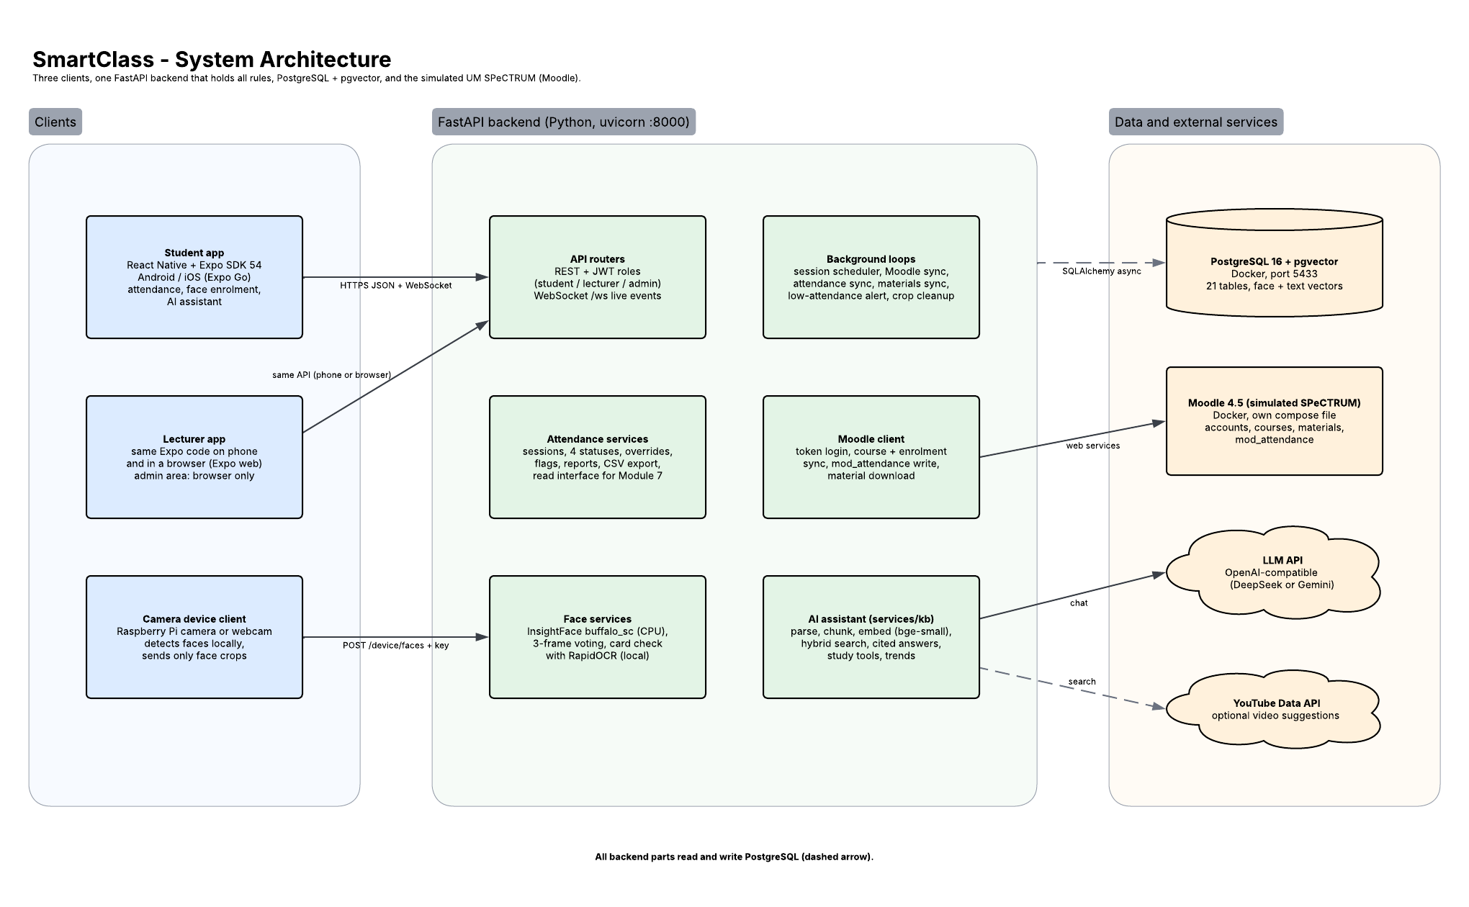
System architecture
04 · SYSTEM DEVELOPMENT
Two Expo apps; the lecturer app also runs in a browser and holds the admin area
Camera client detects faces; the server recognises them
Local Moodle 4.5 simulates SPeCTRUM, with the Attendance plugin
One LLM adapter: provider set by environment variables
Notes:
Walk left to right: apps and the camera device, the FastAPI backend in the middle, and the four things it depends on.
Likely questions:
Q: Why recognise on the server, not on the Pi?
A: The Pi only detects faces and sends crops; the face embeddings of enrolled students never leave the server, and the Pi stays cheap and fast.
Q: What happens if Moodle is down?
A: Attendance is kept in SmartClass and synced later with backoff; sign-in shows 'SPeCTRUM is not reachable right now' (503).

Slide 8
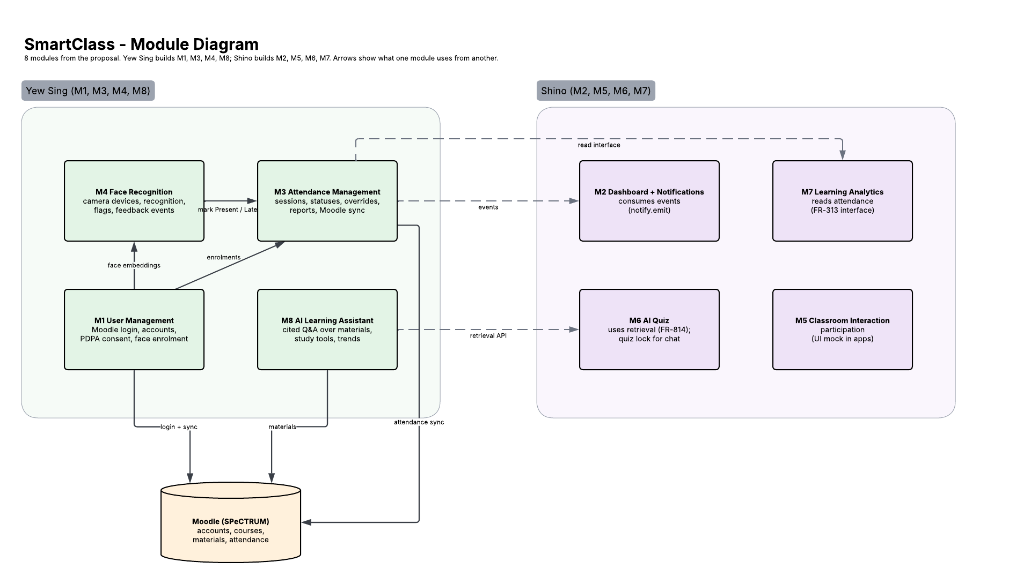
Module diagram
04 · SYSTEM DEVELOPMENT
My modules: M1, M3, M4, M8
M4 feeds recognitions into M3
M3 exposes a read interface to Shino's M7
M8 exposes retrieval to Shino's M6
Notes:
The arrows are real calls in the code. The two interfaces to Shino's modules are documented in docs/interfaces.md and checked by tests.
Likely questions:
Q: How is the interface to Shino tested?
A: tests/test_docs_interfaces.py checks the documented signatures and events against the code, so the document cannot drift.

Slide 9
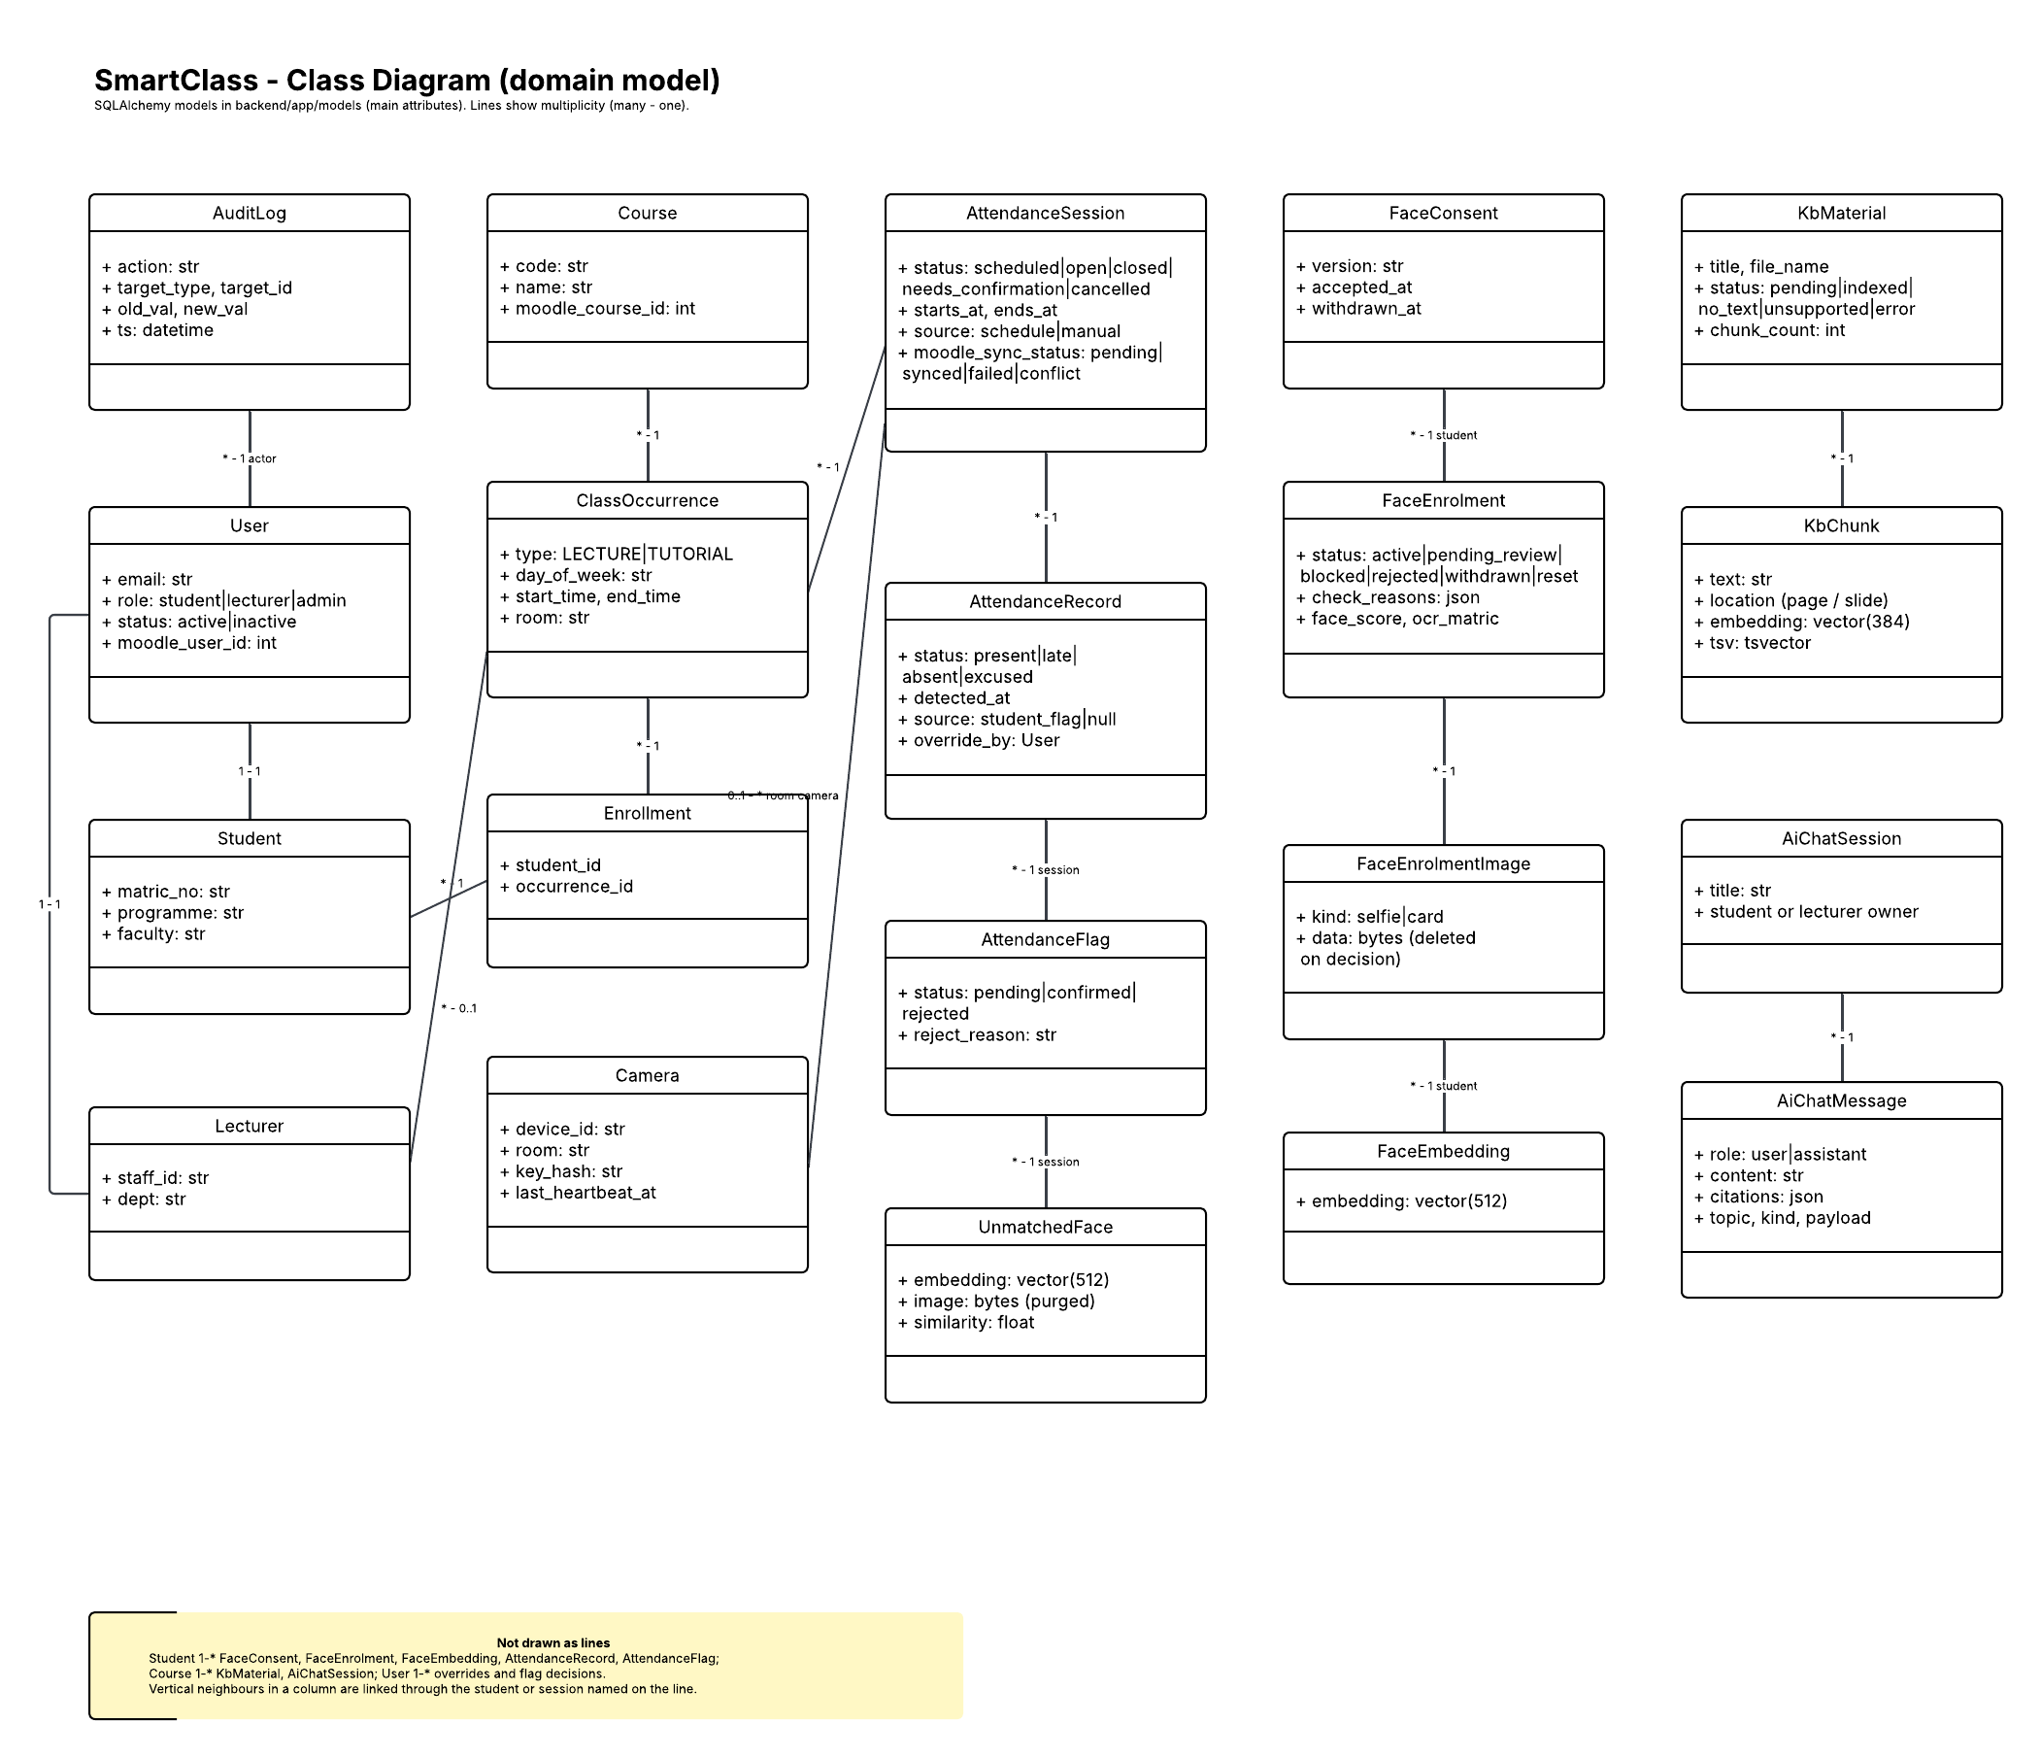
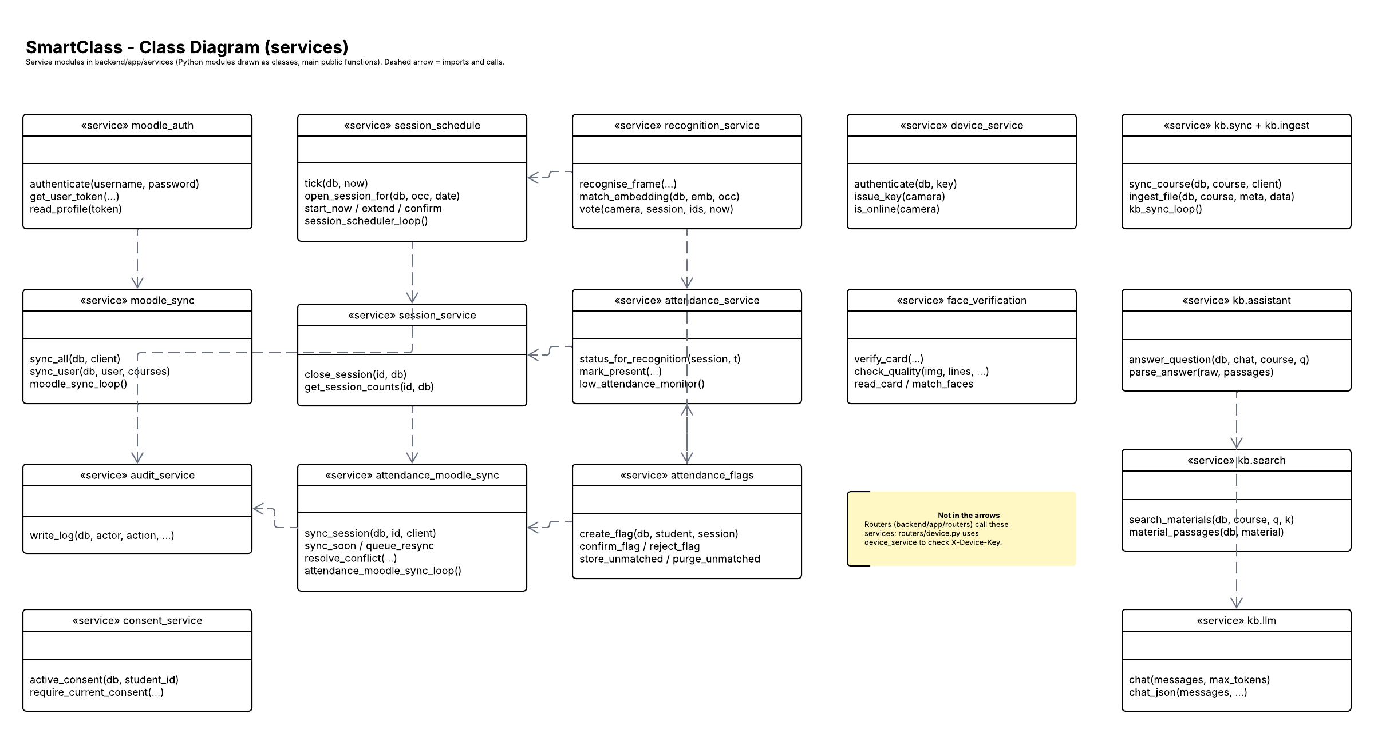
Class diagrams
04 · SYSTEM DEVELOPMENT
Domain models
Services (arrows = real imports)
Notes:
Both diagrams are generated from the code: the domain classes from the SQLAlchemy models and the service arrows from the real imports in app.services.
Likely questions:
Q: Are the diagrams up to date?
A: They are generated by docs/diagrams/build_lucid.py; a test fails if the committed diagram file differs from a fresh build.

Slide 10
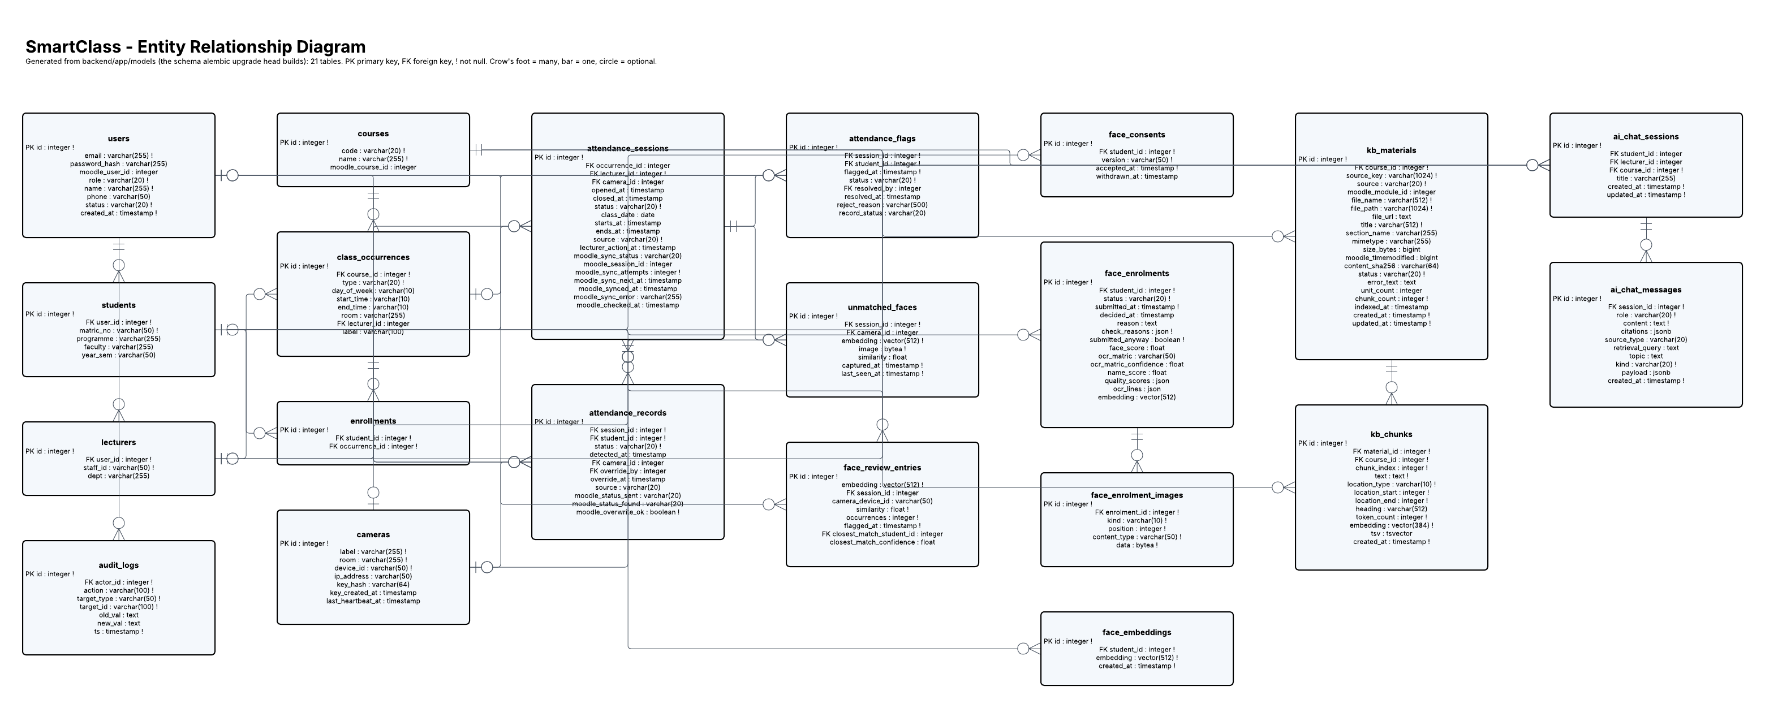
Entity relationship diagram
04 · SYSTEM DEVELOPMENT
21 tables, built from the SQLAlchemy models that the Alembic migrations create; a test checks every table and foreign key is drawn.
Notes:
Point at the four areas: accounts and consent, courses and sessions, attendance with flags and devices, and the knowledge base with chats.
Likely questions:
Q: Where are face embeddings stored?
A: In PostgreSQL with pgvector, linked to the student; photos are not kept after the enrolment decision.
Q: How do you change the schema safely?
A: Every change is an Alembic migration with a test that upgrades a fresh test database.

Slide 11
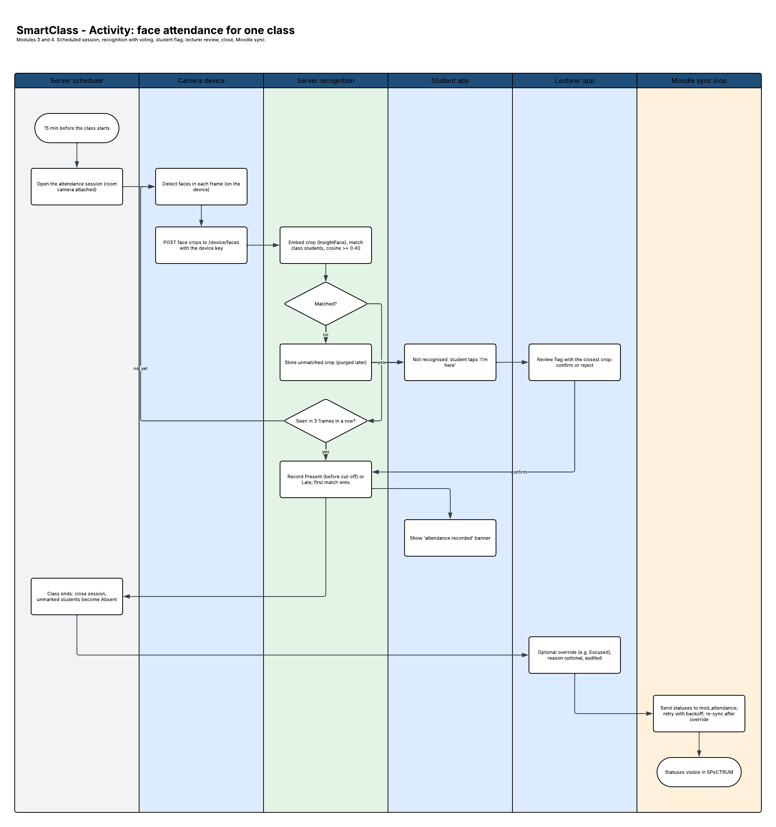
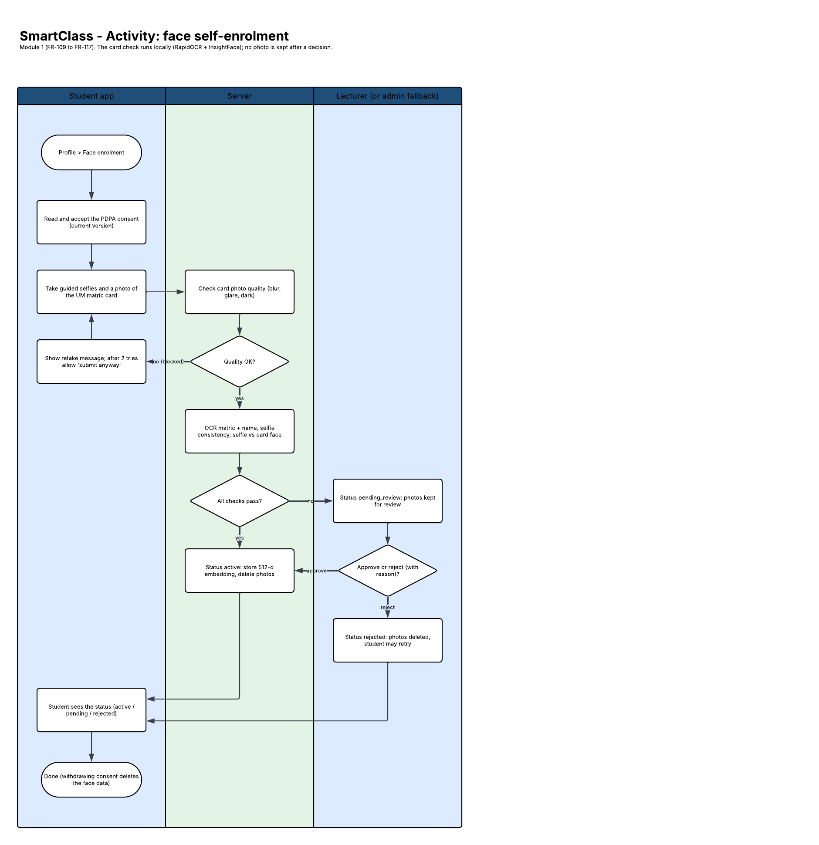
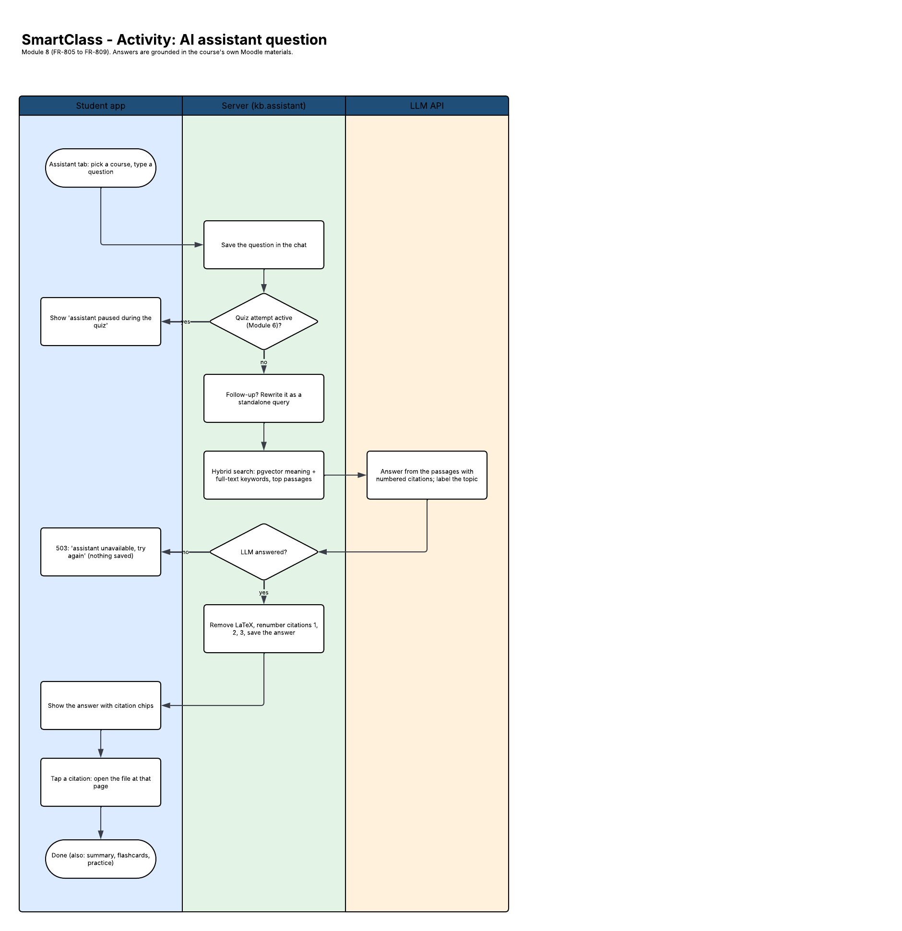
Activity diagrams
04 · SYSTEM DEVELOPMENT
Attendance by face
Face self-enrolment
AI chat with citations
Notes:
Attendance: the session opens from the timetable, the camera recognises a student over three frames, Present or Late, and close marks the rest Absent. Enrolment: consent, selfies, card, automatic check, or the lecturer's queue. Chat: retrieve passages, answer with citations, or label it general knowledge.
Likely questions:
Q: What if a student is not recognised?
A: They tap 'I'm here' in the app; the lecturer sees the flag with the closest unmatched face and confirms or rejects it.
Q: What if the AI answers outside the course?
A: The answer is labelled general knowledge, so the student knows it is not from the materials.

Slide 12
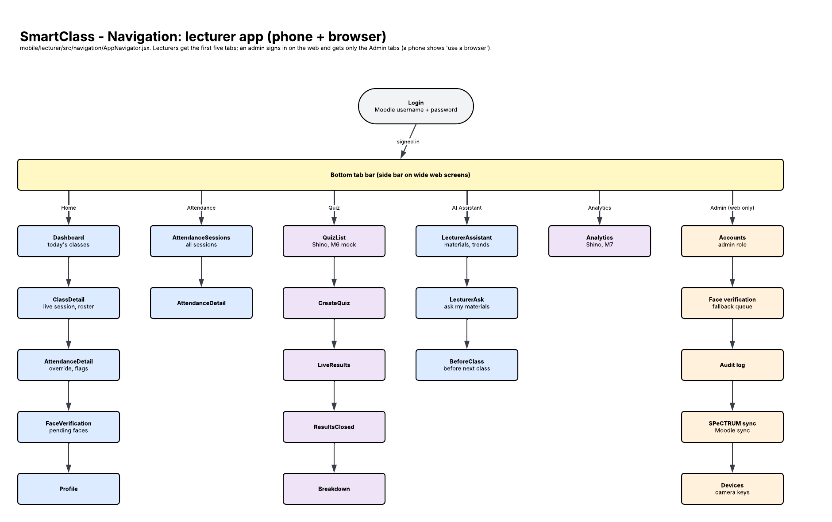
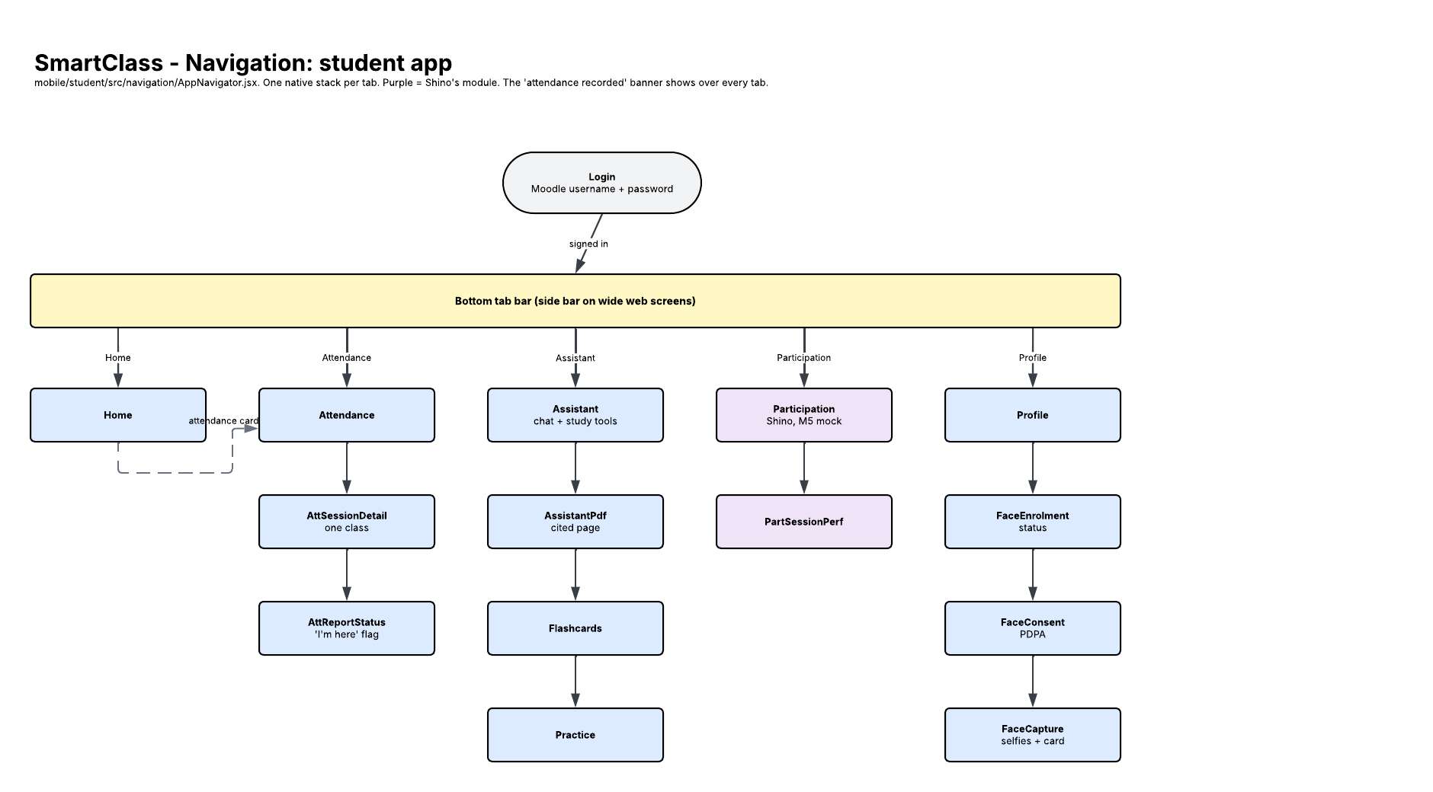
Navigation: student and lecturer apps
04 · SYSTEM DEVELOPMENT
Student app
Lecturer app (admin area in the browser)
Notes:
Both apps use bottom tabs with a stack per tab. Administrators sign in to the lecturer app in a browser and get four extra screens: accounts, Moodle sync, devices, audit log.
Likely questions:
Q: Why no separate admin website?
A: The old admin dashboard was retired; the admin needs only a few screens, so they live in the lecturer web app with one code base.

Slide 13
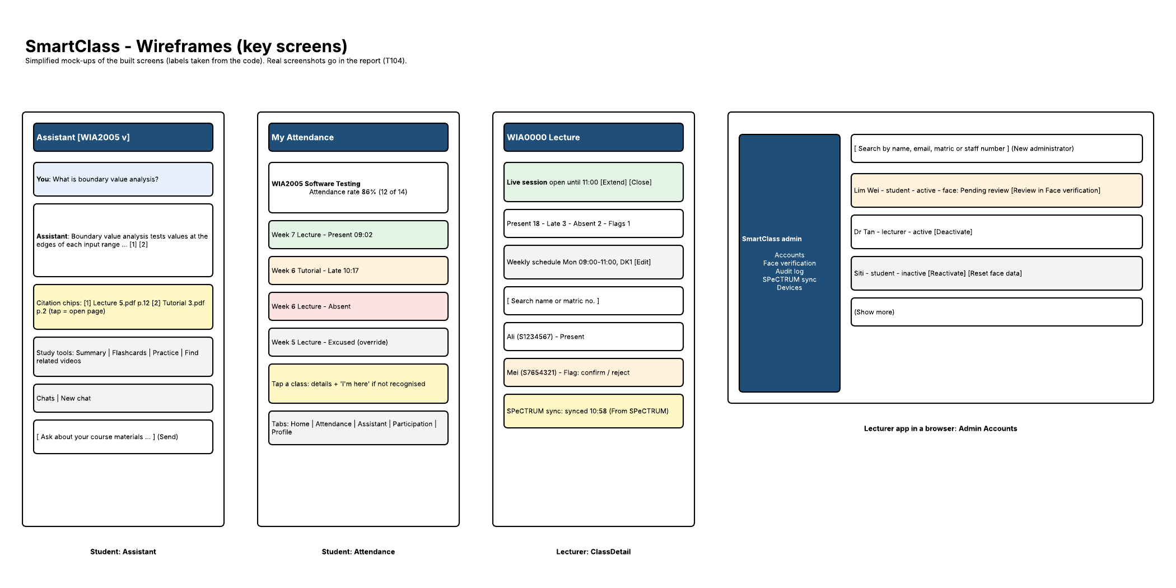
Wireframes
04 · SYSTEM DEVELOPMENT
Notes:
The wireframes show the main screens; the built screens follow them (next slide).
Likely questions:
Q: Did you test the design with users?
A: Not yet with other users; I check every module on a real phone at its checkpoint, and the UAT (T107) uses a task list.

Slide 14
What was built
04 · SYSTEM DEVELOPMENT
M1
M3
M4
M8
Moodle sign-in; consent, 3 selfies and card photo; admin accounts
Sessions from timetable; Present, Late, Excused, Absent; Moodle sync
Camera client; 3-frame match; "recorded" banner; "I'm here" flag
Cited chat; PDF at the page; flashcards, practice; trends
Screenshot
Student face enrolment status
Screenshot
Lecturer live session with counts and sync
Screenshot
Student flag and lecturer alert
Screenshot
Student assistant answer with citations
Notes:
Show one screen per module, then switch to the live demo if time allows. Screenshots use test accounts only: no real face, card, course material or key.
Likely questions:
Q: Can you show it working?
A: Yes: the lecturer web app in the browser and the student app on my phone through Expo Go, against the local Moodle.
Q: How fast is the 'attendance recorded' banner?
A: Target is 5 seconds (NFR-12); it will be timed on a phone in the full class run (T48).

Slide 15
Tests at every level
05 · TESTING AND EVALUATION
767
backend tests
unit, API + database, Moodle and live LLM
16
Maestro flows
phone end-to-end on an Android emulator (8 student, 8 lecturer)
11
Playwright specs
lecturer web app and admin area
Notes:
Normal tests never call Moodle or the LLM: they use fakes or recorded real model answers, so they are fast and repeatable. The live LLM suite runs against the real model on a synthetic course whenever the AI code or prompts change.
Likely questions:
Q: How do you test an AI whose answers change?
A: Live tests check structure and grounding (valid citations, cited passage contains the key term, off-topic labelled general), not exact wording, on a synthetic course we wrote ourselves.
Q: How do you test face recognition without real faces?
A: Generated images and InsightFace's bundled sample images; no student photo is ever committed (PDPA).
Q: What is the coverage?
A: Every FR in the report names its test or E2E flow.

Slide 16
Latest results and sample test cases
05 · TESTING AND EVALUATION
Run | Date | Result
Fast checks (lint, backend, app unit) | 14 Nov | 725 backend passed; apps 61 + 54
Live LLM suite | 14 Nov | 28 passed
Playwright (lecturer web) | 13 Nov | 29 passed
Requirement | Test case | Expected | Result
FR-101, NFR-24 | Sign in while Moodle is down | 503, no account created | Pass
FR-116, NFR-03 | Student withdraws face consent | Embeddings deleted, audited | Pass
FR-302 | Recognised after the late threshold | Status Late | Pass
FR-311, NFR-20 | Moodle down during attendance sync | Retried with backoff until synced | Pass
FR-403 | Real face of a student not in the course | Not recorded | Pass
FR-813, NFR-09 | Topic asked by only 2 students | Hidden from lecturer trends | Pass
Notes:
The report lists 15 test cases with the automated test that proves each one; these are six of them.
Likely questions:
Q: Were the Maestro flows re-run recently?
A: Each flow passed when its screen was built (9 to 13 November); I re-run all of them before the demo.
Q: What failed along the way?
A: For example the practice questions marked every pick wrong because the model answered with a letter; the server now maps letters to the option and a test covers it.

Slide 17
Error handling
05 · TESTING AND EVALUATION
Failure | What the user sees | What the system does
SPeCTRUM (Moodle) down at sign-in | "SPeCTRUM is not reachable right now" (503) | No account created or changed
Moodle down during attendance sync | Sync status failed, then synced | Attendance kept; retried with backoff
Poor enrolment photo | A specific retake message (blurry, no face) | Nothing stored; lecturer review after repeats
LLM down or slow | A clear error in the chat (503) | Nothing half-saved; other modules work
LLM daily quota used up | Same clear error | Not retried; per-minute limits are retried
Camera loses the server | Device shows offline | Client logs and retries
Notes:
Each row has an automated test named in the report (for example test_moodle_down_gives_503 and test_llm_unavailable_is_503_and_nothing_saved).
Likely questions:
Q: What if the face model fails to load?
A: Face endpoints answer 503 'Face recognition model not loaded'; sign-in, attendance viewing and the assistant keep working.
Q: What if one course's materials fail to sync?
A: That material shows 'error' to the lecturer; the other courses still sync.

Slide 18
Evaluation before the final demo
05 · TESTING AND EVALUATION
T47
T48
T83
T107
Raspberry Pi run
Full class run
AI answer quality
Small UAT
Frame rate (NFR-11) and recognition time (NFR-10) at the door
Timetable opens the class; Present, Late, flag, override, Moodle check
Q&A evaluation set: correctness and citation support (NFR-18/19)
Classmates and a lecturer try both apps with a task list
UAT runs on a server with installable Android apps (T99), so testers need no laptop.
Notes:
Honest status: the system is built; these runs produce the numbers for the evaluation chapter.
Likely questions:
Q: How will you measure face recognition accuracy?
A: In the class run (T48): students walk in, and I count correct, missed and wrong recognitions against who was there.
Q: How many UAT users?
A: A few classmates and a lecturer, each with a task list; results go into docs/testing/uat.md.

Slide 19
AP1 feedback and what was done
06 · AP1 FEEDBACK
Panel comment at AP1 | What was done | Where to see it
Rows are filled by Yew Sing from the AP1 panel comments (task T106).
Notes:
Go through each AP1 comment and what changed because of it. To be written by Yew Sing (T106) from the AP1 feedback and the panel rubric.
Likely questions:
Q: Did you act on every comment?
A: Answer per row; if one was not acted on, say why (for example a scope decision agreed with the supervisor).

Slide 20
Next steps
Raspberry Pi run and full class run (T47, T48)
Finalise the AI Q&A evaluation set (T83)
UAT server with installable apps, then a small UAT (T99, T107)
Quiz-based AI features once Shino's Module 6 is ready (FR-820 to FR-824)
Notes:
Close with what is left and ask for questions.
Likely questions:
Q: Will you finish on time?
A: All four modules are built; the remaining work is measurement and UAT, planned before the final demo.
Q: What is the biggest risk?
A: The Pi frame rate and recognition at the door in real light; the laptop webcam is the backup device (FR-409).

