Slide 1
Binary Classification Using Movie Revies
Ryo Tomiyama(5E)

Slide 2
Background
When looking at social media and similar platforms, we often see both positive and negative opinions mixed together about topics we like.
I thought it would be convenient if we could use machine learning to distinguish between positive and negative opinions.

Slide 3
Objective
Using machine learning to determine whether a text expresses a positive or negative opinion.

Slide 4

Deta
50,000 movie reviews provided by the Internet Movie Database. Positive and negative reviews are evenly split, with 50% each.
As preprocessing, only the 10,000 most frequently occurring words in the training data are retained, and words with low frequency are discarded.

Slide 5
Method
Assign numbers to words and convert reviews into lists of numbers.
Vectorize the reviews using multi-hot encoding.
Train the model on this data to perform binary classification of the reviews.

Slide 6
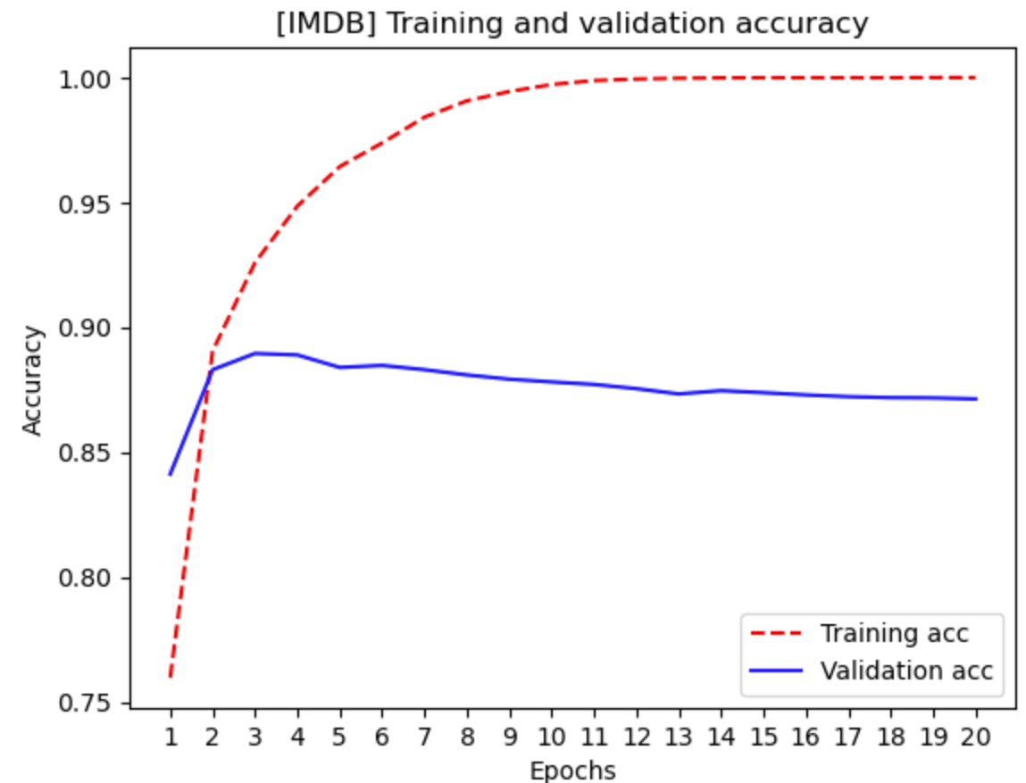
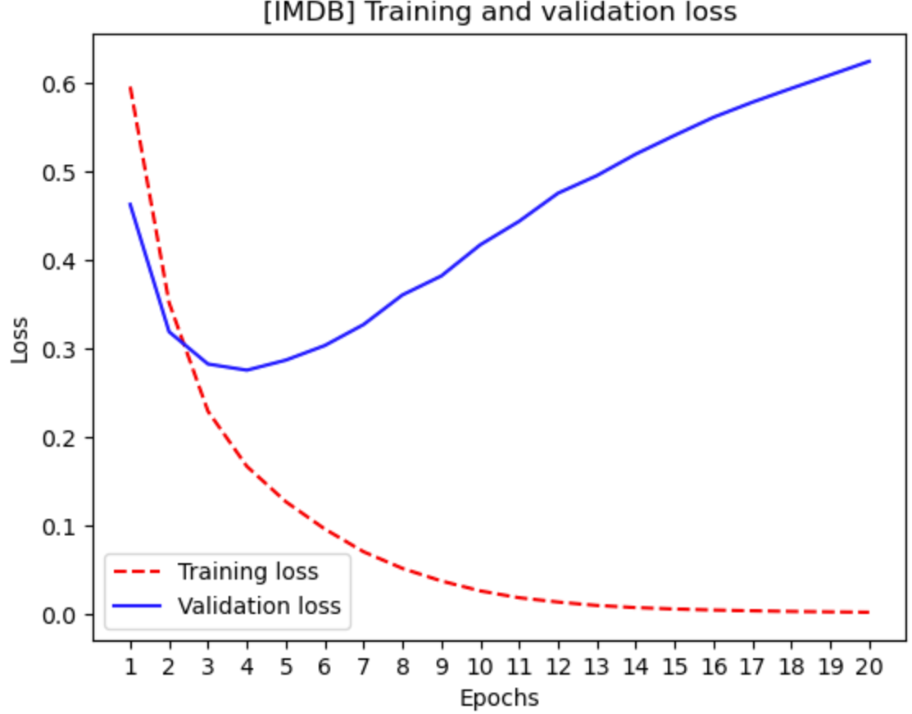
Result
正解率
損失関数

Slide 7
Consideration
Overfitting began after about 4 epochs, and the accuracy did not reach 90%.
I also thought that adjusting hyperparameters, using a larger dataset, or increasing the number of frequent words could improve the accuracy.
In the future, I would like to try classifying not just binary labels of negative and positive, but various other emotions as well.

