Slide 1
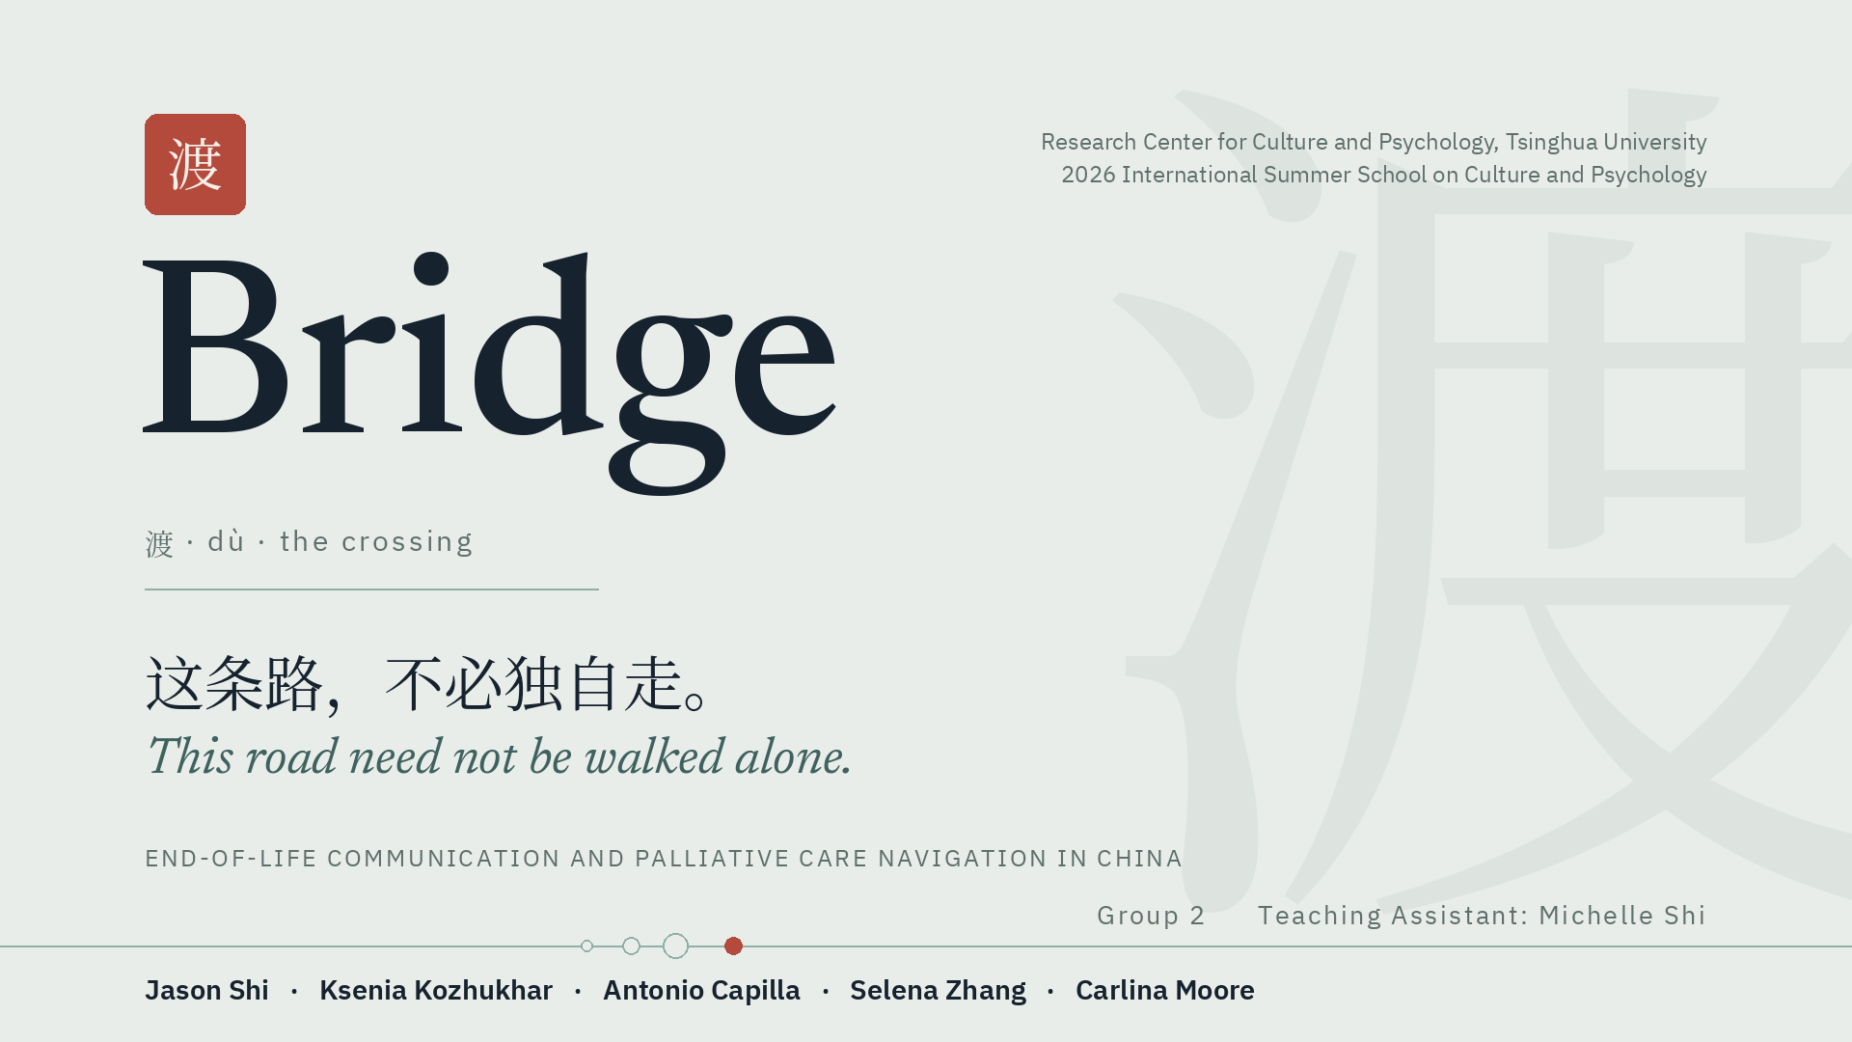

Slide 2
死 = ？
A universal experience. A local silence.
Bridge · Group 2
2

Slide 3

01
The problem
Three silences, and who pays for each

Slide 4
Bridge (渡)
Three Silences: Everyone Is Protecting Someone
The patient, family, and doctor may all avoid the same conversation
01. Patient Silence
Patients intuitively sense their prognosis but suppress questions to protect family members from emotional distress.
02. Family Silence
Families practice 'Protective Concealment' ( over 70% withhold terminal diagnosis) to shield patients from losing hope.
03. Clinical Silence
Physicians cautious of family conflict routinely defer disclosure decisions to primary caregivers.
The Filial Paradox (孝 · Xiao) in End-of-Life Decisions
• Protective Intent vs. Destructive Silence: Filial piety mandates protection and devotion, but manifests as demanding aggressive, non-beneficial ICU interventions to avoid appearing unfilial.
• Consequence: Strips dying patients of autonomy, legacy preparation, and dignified comfort while compounding family anticipatory grief.

Slide 5
Bridge (渡)
Background & Demographic Reality in China
Why this problem is growing in China
Demographic Pressure & Palliative Gap
• Rapidly Aging Population: Over 190M (>13.5%) aged 65+ in 2020.
• High Cancer Burden: China accounts for 24% of new cancer cases and 30% of cancer deaths globally.
• Quality of Death Index: Ranked 53rd out of 81 globally in 2021.
• Severe Resource Scarcity: <1% to 10% palliative coverage (vs >80% in developed systems), heavily concentrated in tier-1 cities.
Cultural Death Taboos & Silence
• Cultural Dictum: 'Enjoy life and detest death' (Confucian/Taoist longevity focus).
• Linguistic Taboo: Word 'death' (si) associated with bad luck, misfortune, and family disharmony.
• Default Response: Avoidance and protective denial, suppressing Advance Care Planning (ACP).
• Unspoken Burden: Caregivers bear care logistics and grief alone at home without professional navigation.

Slide 6
THE MECHANISM
Repairing the story instead of the room.
Older adults are found dead alone in their flats days after the fact often enough that a whole industry of responses now exists. It is worth asking what those responses are for.
WHAT THE CURRENT RESPONSES PROVIDE
WHAT THEY DO NOT PROVIDE
Earlier Detection
Human Connection
Notarised guardianship agreements, community check-in rounds, and in 2026 a mobile application whose entire function is to ask its users each day whether they are still alive. Every part addresses detection.
Death itself is public, ritualised and richly provisioned with custom. Under 孝, a parent's solitary death reads as the child's public failure — so the shame attaches to the circumstances, not to the fact.
When we improve the explanation but leave the real situation unchanged, we repair the story instead of the room.
Bridge · Group 2

Slide 7
WHO BEARS THE COST · 目标用户
Who Is Affected–And Who Can Begin the Change?
The silence is not distributed evenly, and neither is the ability to break it. That asymmetry decides who the product is for.
SECONDARY USER
PRIMARY USER
SECONDARY USER
The patient
The caregiver
The child
Isolated, with symptoms under-treated and a lack of agency and autonomy over the end of their life — denied the chance to prepare a goodbye or leave anything behind.
Aged roughly 30 to 60. Bears the information and responsibilities alone, is morally torn between honesty and filial protection, and enters bereavement as the only fully informed person in the family.
Told they are “too young to understand.” May become confused or anxious when adults provide no explanation.
The silence affects the patient, caregiver, and child differently. The patient loses information and control. The child is left confused. But the caregiver carries the diagnosis, decisions, and practical responsibilities, so the caregiver becomes our primary user and the person Bridge is designed to support first.
Bridge · Group 2

Slide 8
THE MECHANISM · 孝道悖论
The Filial Paradox: When Protection Creates Silence
THE INTENT
THE POSSIBLE RESULT
Protection
Unwanted Treatment
→
孝 obliges adult children to shield an ageing parent from harm. Over 70% of families withhold a terminal cancer diagnosis, and clinicians, wary of family conflict, defer disclosure to the caregiver.
The same duty is demonstrated to relatives through aggressive ICU intervention that no longer benefits the patient. To decline it would look unfilial.
The consequence. A dying person loses autonomy, legacy preparation and dignified comfort at once — and the family's anticipatory grief is compounded rather than shared. Both sides know. Neither can speak.
And it is measurable. 69.9% of the Chinese public would choose comfort-focused care for themselves — but only 57.2% would choose it for a relative (Tang et al., 2025).
Bridge · Group 2

Slide 9
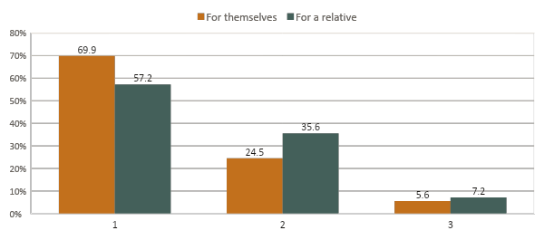
THE EVIDENCE · 实证
The same person gives two different answers.
Asked what care they would want if they were terminally ill — and then what they would want for a relative in exactly that position.
Read it twice
Preference for comfort falls 12.7 points the moment the decision is made on someone else's behalf.
Insistence on prolonging life first rises by 11.1 points over the same shift.
Nobody in this survey changed their mind about death. They changed their mind about whose death it was.
Tang et al., 2025 · n = 944
Bridge · Group 2

Slide 10
THE GAP
Services Are Expanding, but Families Still Can’t Find Them
National programs now cover 185 cities and districts.
Public awareness and service use remain low.
Services are still unevenly distributed.
Caregivers need clearer information and guidance.
41%
of respondents could explain what hospice and palliative care is, despite most of the people surveyed having access to higher education. The true figure is likely lower.
The bottleneck is not supply. It is that a caregiver in week one does not know the service has a name, or that it can be asked for.
Tang et al., 2025 · BMC Palliative Care 24:261 · n = 944
Bridge · Group 2

Slide 11
02
A Technical Solution

Slide 12
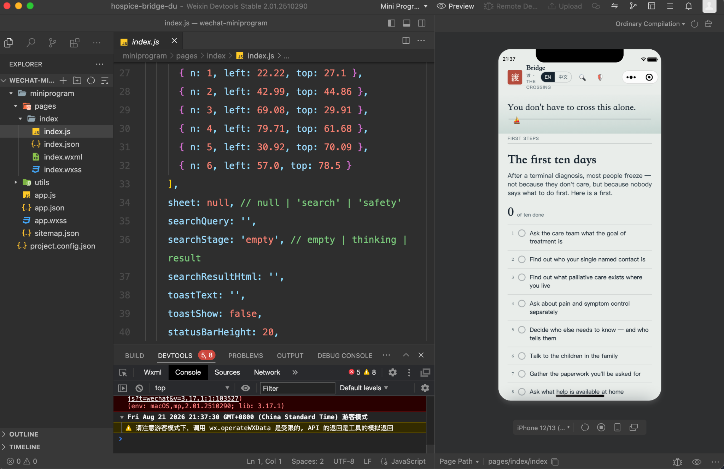
Core Design - WeChat Mini Program

Slide 13
AI Usage
渡 means to ferry across. It names a crossing and, in Buddhist usage, a passage made with help. The platform is the ferryman: its value is entirely in the crossing, and none of it is in being a place to stay.
The failure mode is not a platform that performs badly. It is a platform that performs well
enough that the difficult human conversation never happens
3

Slide 14




THE PLATFORM
Four surfaces. One rule: never make the user
name what they need.
A caregiver in the week after a diagnosis does not know that what they want is called hospice care, or that it can be asked for. Search exists; it is never the primary path.
Home
Words
Care Map
Forum
First Ten Days
The knowledge hub
Service directory
Peers and specialists
Ten ordered steps for the first fortnight, phrased as things to ask rather than things to know. Progress stays on the device; no account.
Age-graded guides for talking to a child, and a guide for talking to someone who is dying. Two euphemisms prohibited outright.
Wards, home-care teams, clinics, NGOs and offline groups — filtered, and each listing dated with when it was last confirmed.
Pseudonymous peer sections, time-boxed threads answered by verified clinicians, and a professionals-only room for peer supervision.

Slide 15

THE PROTOTYPE
Demo Time ：）
Four surfaces, and the two utilities that sit on every screen.
渡口
Home
The First Ten Days checklist — ten things to ask, not to know.
言语
Words
Age-graded child guides, and the guide for talking to someone dying.
寻路
Care Map
Filtered listings, each dated with when it was last confirmed.
同行
Forum
Pseudonymous peers, verified clinicians, professionals-only room.
Link Here
Ask sheet — retrieval only, and a refusal when the guides cannot answer. Safety sheet — the crisis routing, with the markers deliberately unwritten.
Bridge · Group 2

Slide 16
FOUNDATIONS · 理论基础与设计转化
Every feature is the translation of a construct.
Death anxiety and avoidance
Greenberg et al., 1986
Privacy boundaries as family rules
Petronio, 2002
→ Lantern Language: warm metaphor instead of clinical terms; the child track as a low-stigma entry
→ A script for renegotiating a rule, and the checklist step that assigns who tells whom
Filial obligation
Hsu et al., 2009
Components of the death concept
Speece & Brent, 1984
→ An explicit section naming mutual pretence and 孝, reframing speaking first as care
→ Age-graded guides for 3–6, 7–12 and 13+, with two phrases prohibited outright: “fell asleep,” “went away.” Irreversibility, non-functionality, universality
Dignity and being heard
Chochinov et al., 2005
Caregiver stress process
Pearlin et al., 1990
→ Script cards after 四道人生, inspired by dignity-oriented work rather than implementing it
→ Ten-step checklist, care map, peer community — appraisal and resources, not the illness
Self-efficacy
Bandura, 1997
Oscillation in grief
Stroebe & Schut, 1999
→ Verbatim openings rather than principles; Rehearse, deferred
→ No streaks, no notifications, no re-engagement mechanics of any kind
No feature is here because it was buildable. Each is here because a theory predicted it would help — which means each could turn out to be wrong.
Bridge · Group 2

Slide 17
03
Study

Slide 18
FORMATIVE STUDY · §6
First, We Let Older Adults Improve the Platform
Before testing whether Bridge works, we must make sure we designed the right thing.
WHO WE”LL HEAR FROM
WHAT PARTICIPANTS WILL DO
20–24 older adults At least half from rural communities
12–16 family caregivers The platform’s main intended users
8–10 bereaved relatives At least six months after their loss
6–8 professionals Clinicians, psychologists, and care specialists
Individual interview Tell us about their real experiences before seeing the app
Sort the features Label each one as necessary, useless, or harmful
Test the prototype Use it on their own phone while explaining their thoughts
Older-adult discussion groups Show us what feels comfortable to discuss with others
HOW THEIR FEEDBACK WILL CHANGE BRIDGE:
Their language preferences will rewrite our wording. Their views on disclosure will change the conversation guide. Their technology needs will change the interface. If three or more participants call a feature harmful, we will remove it.
If participants cannot change the product, their involvement is only decoration.
Bridge · Group 2

Slide 19
EVALUATION · 拟议的评估框架
Evaluation Framework - How We’ll Test Bridge, Step by Step
0
Expert Safety Review
Specialists review every guide and safety procedure.
If anything is unsigned or unsafe, we stop.
1
Can People Use It?
Around 15–25 participants test whether the platform is understandable and easy to navigate.
2a
Does The Language Help?
Around 300-500 people compare Bridge’s culturally adapted language with more direct wording
2b
Small, Real World Pilot
Around 40–60 caregivers use Bridge for four to six weeks. Researchers check participation, usability, and any unexpected problems. If the platform is not practical or safe, we do not continue.
3
Controlled trial
Bridge is tested across different healthcare sites to see whether it actually causes better outcomes.
4
Long Term Follow Up
Six to twelve months later, researchers examine family experiences, bereavement, and whether people actually contacted services.
No phase assumes the previous one succeeded. A qualitative strand runs through all six, because a farewell that became possible will not appear in a mean difference.
Bridge · Group 2

Slide 20
WHAT WE PREDICT · 预期成果
What We Expect to Change and How We’ll Measure It
MEASURABLE OUTCOMES
REAL WORLD OUTCOMES
DAP-R
Death Attitude Profile–Revised
01
Earlier Service Contact
Less death avoidance
Families receive available support sooner
ZBI-12
Zarit Burden Interview, short form
02
Caregiver Help Seeking
Lower caregiver role strain
Caregivers seek support for themselves
PHQ-4
Ultra-brief distress screen
03
A norm, not just an attitude
Lower emotional distress
Open communication becomes acceptable within the family
—
Communication self-efficacy
04
A third position for AI
More confidence starting conversations
AI successfully hands users off to people
And the primary question, which no instrument answers: did the conversation happen, and did it happen earlier than it would have?
Bridge · Group 2

Slide 21
DISCONFIRMATION · §7
Five results that would tell us we are wrong.
01
02
People feel better, but still do not talk
Family’s only use the children’s guide
Bridge reduced anxiety but did not lead to real conversations. We would need more practice and prompting, not more information.
If users do not continue to caregiver support or service navigation, the guide is only attracting users—not making the full platform effective.
03
04
Caregiver burden increases
Bridge mainly helps well served areas
Bridge may give an already overwhelmed caregiver more responsibility. We would treat this as a harmful outcome.
If Bridge only works where services are already strong, it may increase inequality instead of reducing it.
05 AND THE ONE WE MOST EXPECT
If users report the platform as a substitute — “we read it together, so we didn’t need to talk” — then we have built a faster way to repair the story, and the design premise is wrong. It is why “did the conversation happen” has to stay the primary question.
Bridge · Group 2

Slide 22
04
Limitations & Future Steps

Slide 23
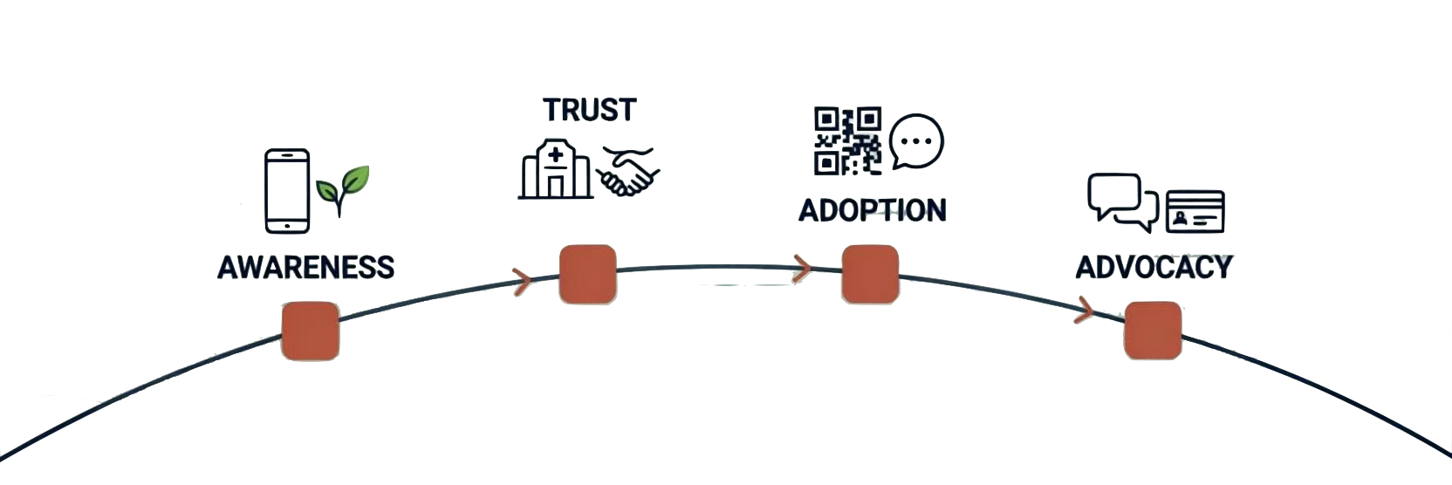
FUTURE WORK
How will people know?
Four routes, in the order they can be built — and one limit that governs all of them.
REACH
LEGITIMACY
ACCESS
CIRCULATION
Low-stigma doors, on the dates grief is already licensed
A nurse telling a family that something exists
A link in the family group chat; no install
Built to travel, not to hold people
Moderation capacity, not channel reach, is the ceiling: the forum may grow only as fast as the duty rota that keeps it safe.

Slide 24
FUTURE WORK
The next steps are not technical.
01
02
03
Clinical sign-off
The formative study
Partnerships
Every guide, and the crisis protocol, written and signed by clinicians against the 2025 national practice guideline.
Older adults, half of them rural, telling us which of our assumptions about their willingness to talk are wrong.
Hospices, oncology services and NGOs. Without them the care map cannot be verified and no trial can be recruited.
Then, as capacity allows
City-by-city expansion of the directory · Opening the forum as moderation capacity grows · Longitudinal follow-up into bereavement
The measure of success we would accept is narrow: more families having the conversation earlier.

Slide 25
LIMITATIONS
What we cannot claim.
01
Status
02
Our framing may be too tidy
A prototype and a proposal. No component clinically signed off, no study run, every effect above hypothesised.
The two opening cases are journalism, not data. Cultural heterogeneity within China is treated too simply throughout.
03
The outcomes we most want are unreachable
04
And most seriously: the intervention could become the thing it opposes. A family that reads a guide together, feels the matter has been handled, and never has the conversation has used the platform to repair the account rather than the situation. It is why “did the conversation happen” has to stay the primary question.
They belong to people we should not enroll, and the consent problem removes much of the patient-reported data an evaluator would want.

Slide 26
Thank you
QR here
Questions, and the prototype is live if you would like to try it.
Jason Shi · Ksenia Kozhukhar · Antonio Capilla · Selena Zhang · Carlina Moore
Group 2 Teaching Assistant: Michelle Shi

