Slide 1
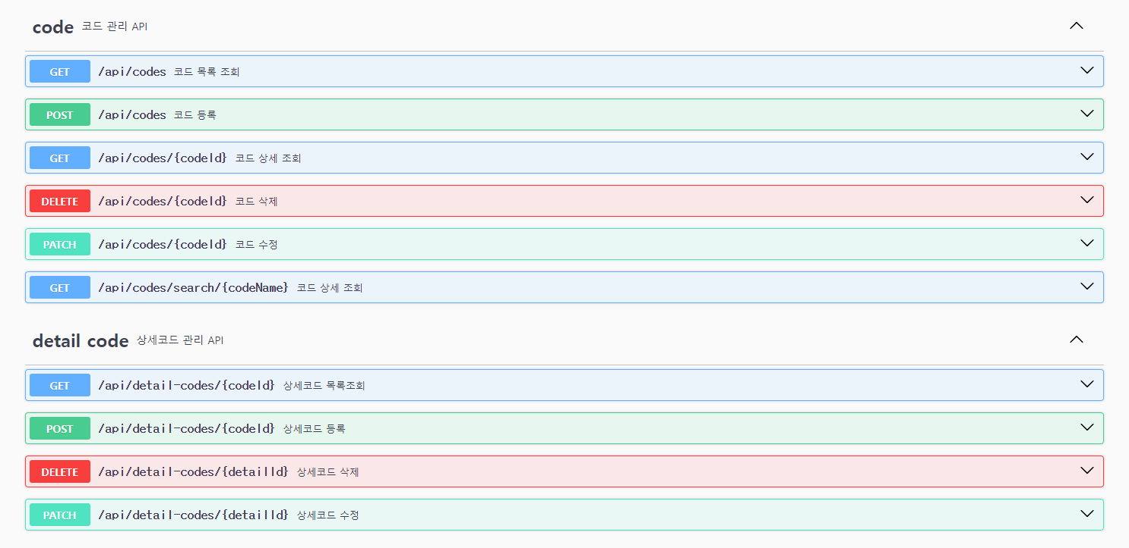
Code, Detail Code API 명세서

Slide 2
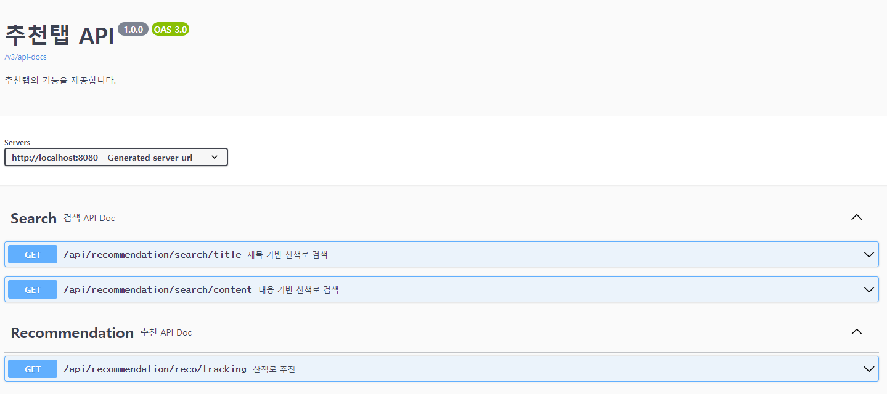
추천 탭 API

Slide 3
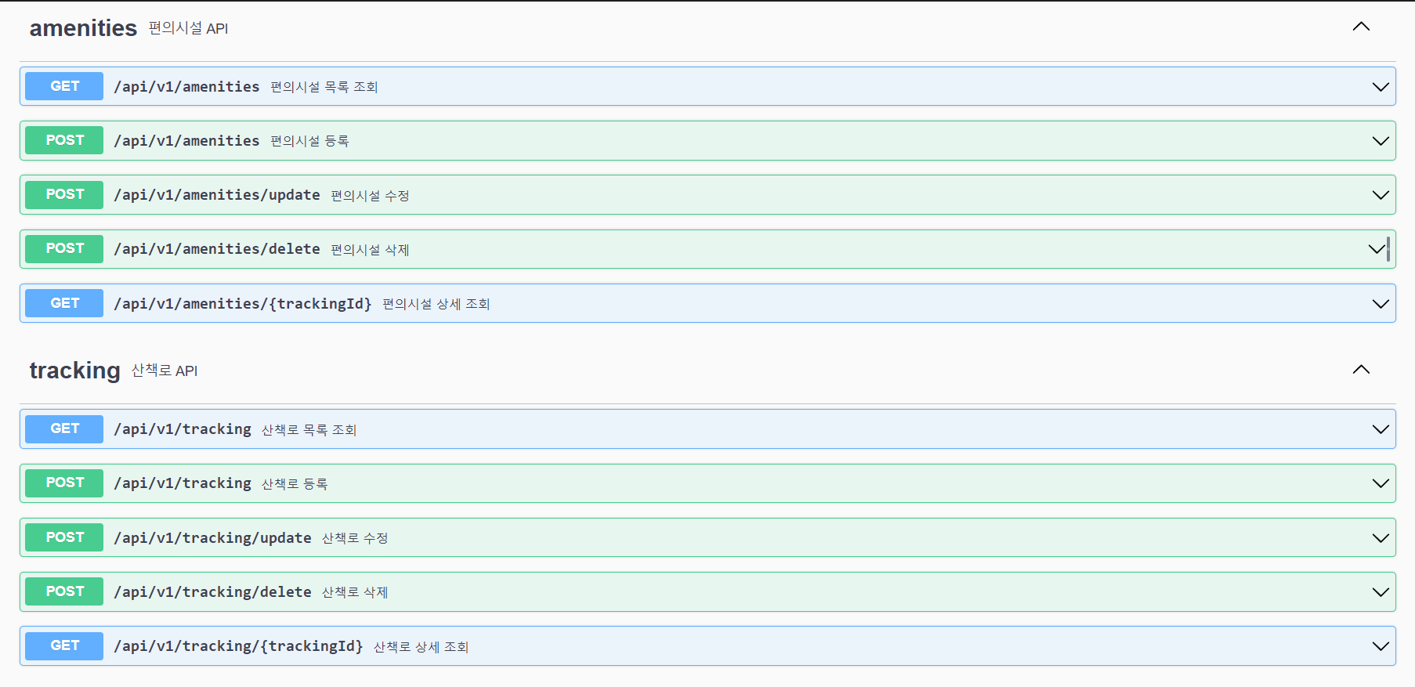
Amenities, tracking API

