Slide 1
AM Modulator (DSB-FC) on FPGA
RTL design project — full-cycle vs quarter-wave sine ROM
Artix-7 xc7a35tcpg236-1, 100 MHz

Slide 2
Problem and goal
• Build an amplitude modulator in fixed-point Verilog: s(t) = Ac [1 + μ m(t)] cos(2π fc t)
• Verify it bit for bit against an integer Python golden model
• Compare two sine-ROM architectures: full 2^AW words vs quarter-wave 2^(AW−2) words
• Measure LUT, FF, LUTRAM, BRAM, DSP, WNS, Fmax, power and SFDR for AW = 8, 10, 12

Slide 3
Signal model
• μ = amp_msg / amp_car; μ > 1 is overmodulation (envelope goes negative)
• Three spectral lines at fc − fm, fc, fc + fm = 980 / 1000 / 1020 kHz
• Bandwidth = 2 fm; sideband-to-carrier ratio = μ / 2
• amp_car = 0 gives DSB-SC with the same hardware

Slide 4
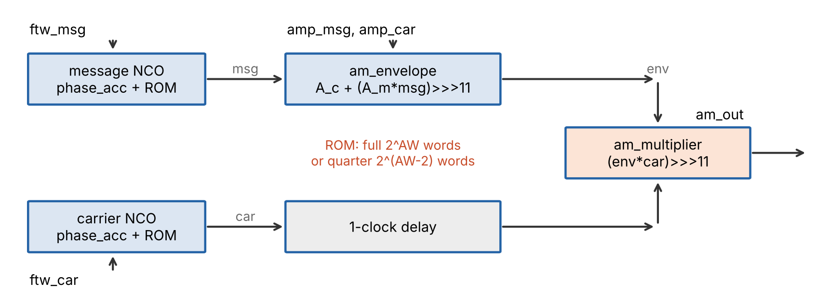
Architecture

Slide 5
Fixed-point contract
• Integer 2047 represents 1.0, so every product is shifted right by 11 bits
• msg_term = (amp_msg · msg) >>> 11 (25 b → 14 b)
• env = amp_car + msg_term (14 b signed)
• am_out = (env · car) >>> 11 (26 b → 16 b)
• Latency: 3 clocks (two ROM stages + one multiplier stage)

Slide 6
NCO and sine ROM
• 32-bit phase accumulator, f = FTW · fclk / 2^32 (0.023 Hz resolution)
• ftw_car = 42 949 673 (1 MHz), ftw_msg = 858 993 (20 kHz)
• Full ROM: 2^AW words. Quarter-wave ROM: 2^(AW−2) words, −75 % memory
• Phase truncation to AW bits limits SFDR to about 6 dB per address bit

Slide 7
Verification method
• Simulation of 10 000 samples per case; first 3 warm-up samples dropped
• Golden model uses the same integer arithmetic; comparison is sample by sample
• 13 cases: 7 functional (μ sweep, DSB-SC, fm = 100 kHz) and 6 ROM configurations
• Unit tests: 30 passing

Slide 8
Functional results
Case | Result | Mismatches | Envelope | am_out range | SFDR (dB)
functional_mu_0 | PASS | 0 | 2000…2000 | -2000…1999 | 48.2
functional_mu_0.25 | PASS | 0 | 1500…2499 | -2498…2497 | 48.1
functional_mu_0.5 | PASS | 0 | 1000…2999 | -2998…2997 | 48.1
functional_mu_1 | PASS | 0 | 0…3999 | -3997…3996 | 48.1
functional_mu_1.5 | PASS | 0 | -999…4998 | -4995…4994 | 48.1
functional_dsb_sc | PASS | 0 | -1000…999 | -1000…999 | 47.9
functional_fm_100k | PASS | 0 | 1000…2999 | -2985…2984 | 48.1

Slide 9
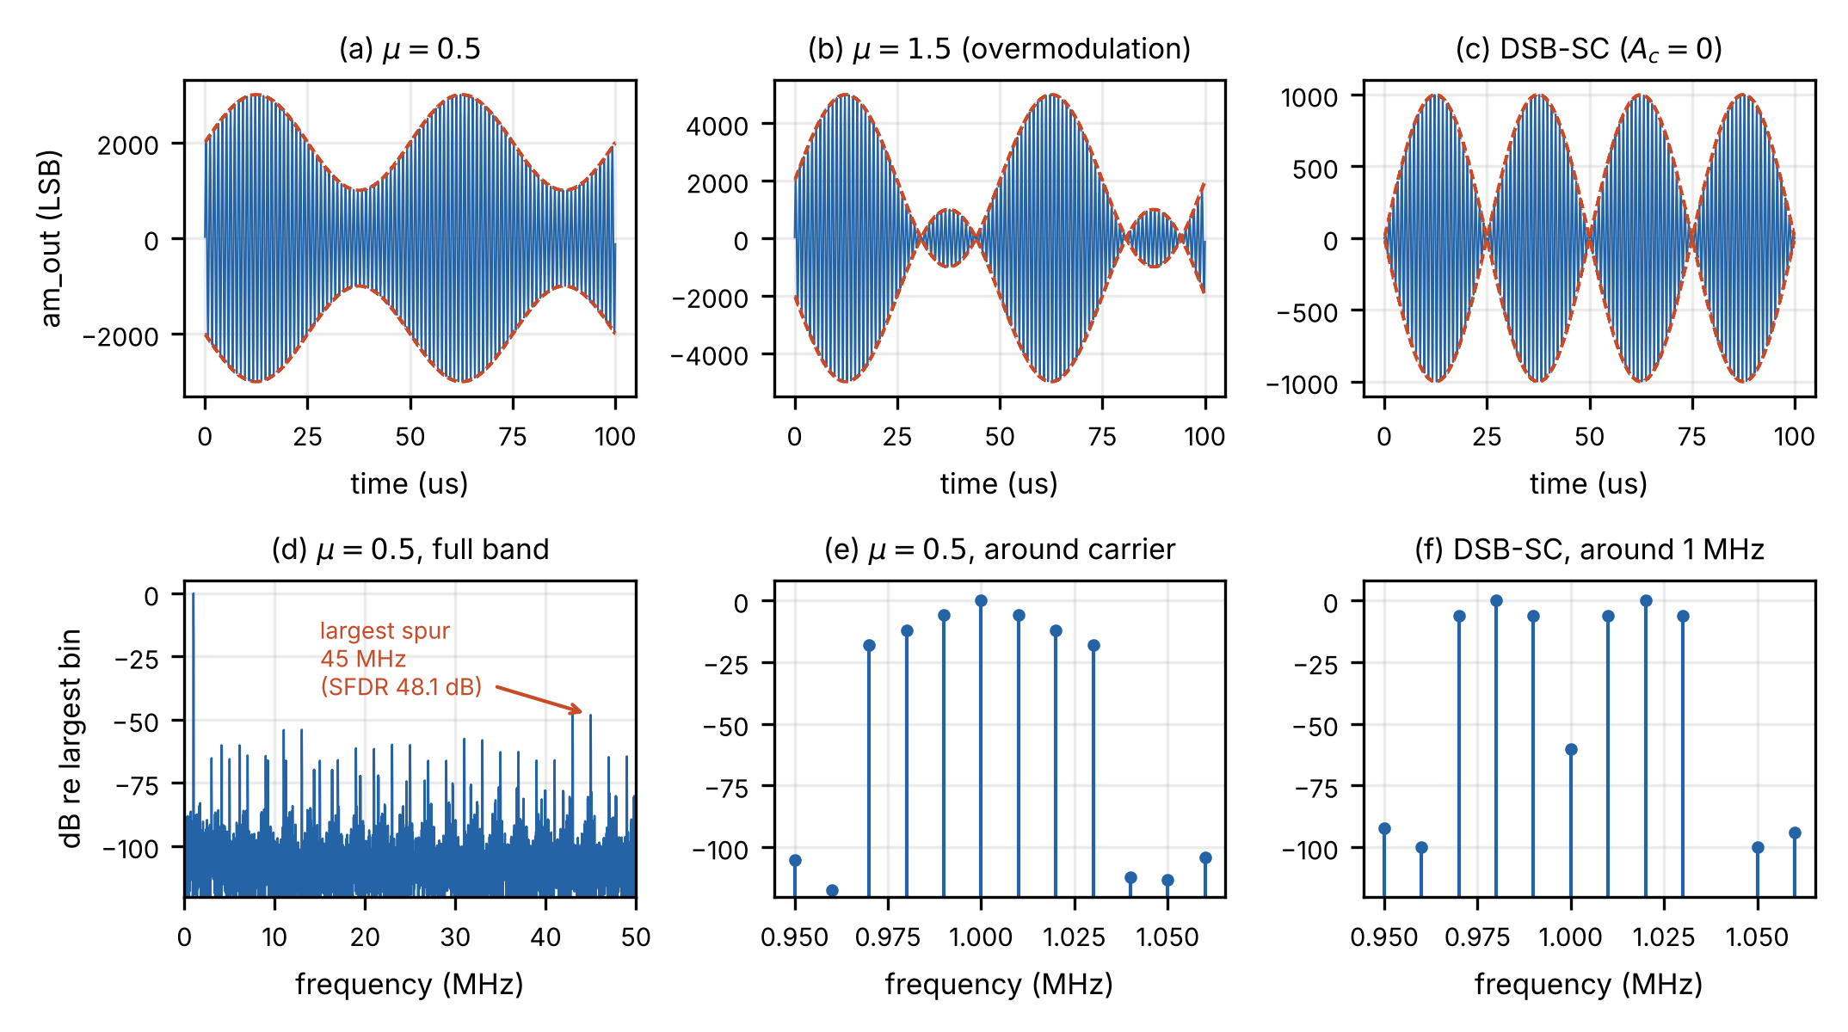
Waveforms and spectra

Slide 10
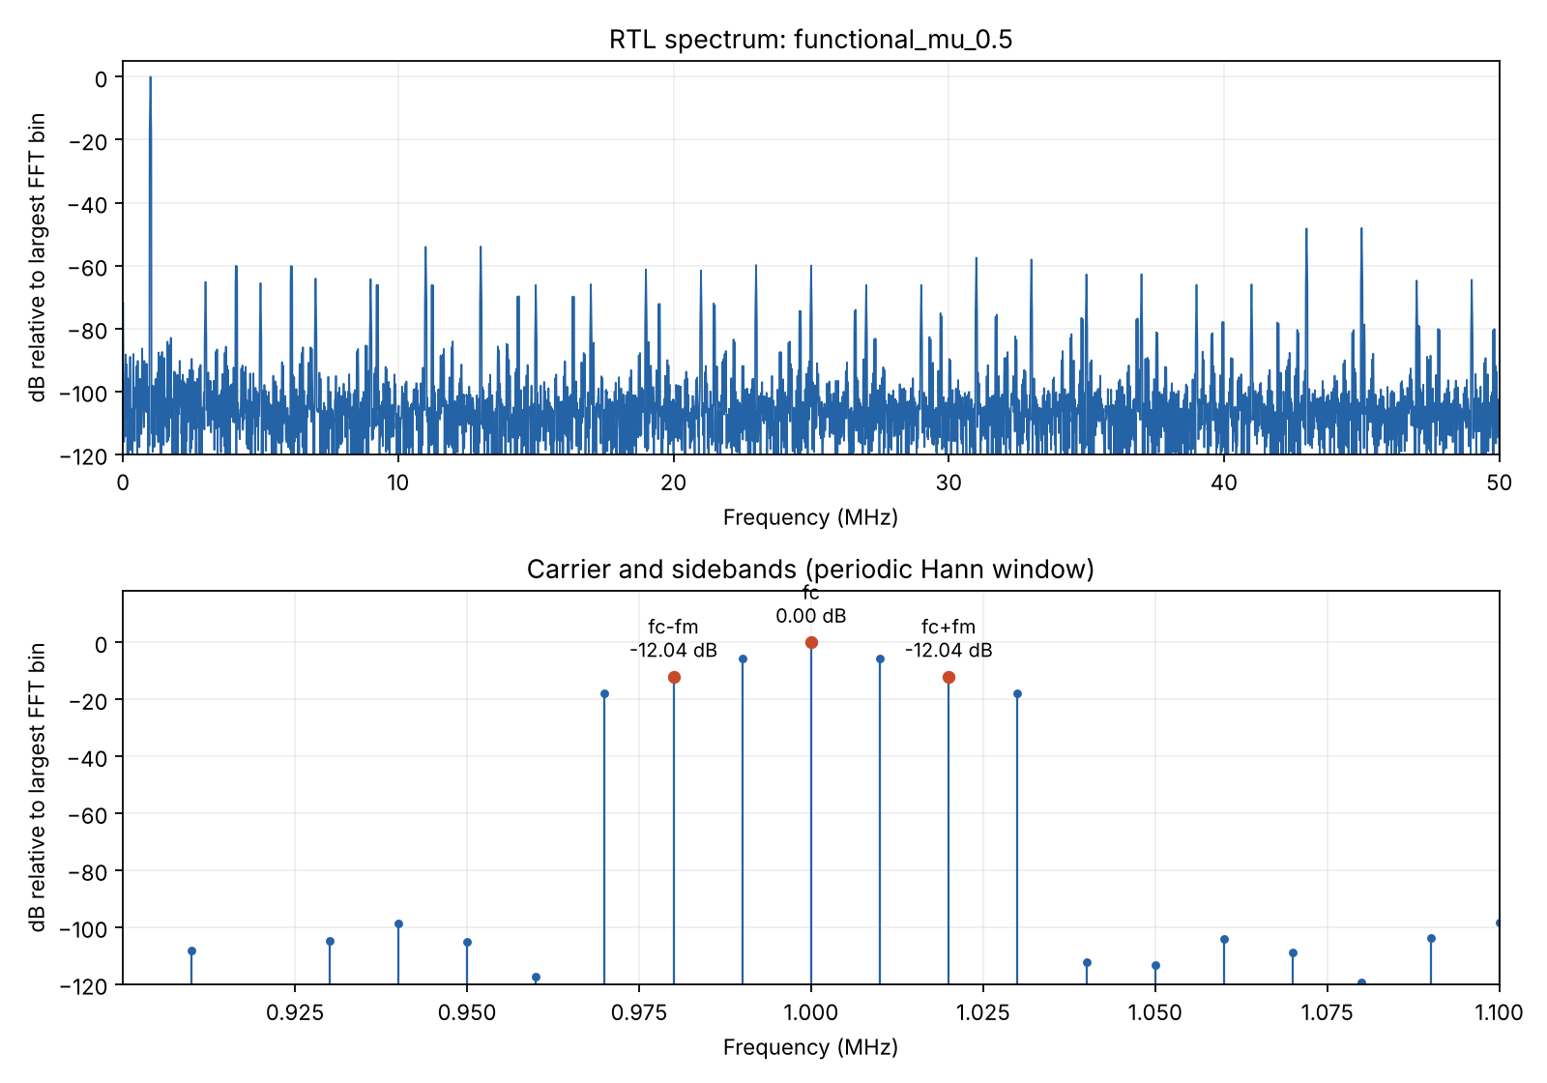
Spectrum check (μ = 0.5)
• Lines at 980, 1000, 1020 kHz with zero frequency error at the 10 kHz bin
• Sideband-to-carrier ratio matches μ/2 within 1.9·10⁻⁴
• Largest spurs lie at 45, 25 and 3 MHz (phase truncation images)

Slide 11
ROM comparison: results
Case | SFDR (dB) | Result | LUT | FF | LUTRAM | BRAM | WNS (ns) | Fmax (MHz)
rom_aw8_full | 48.1 | PASS | — | — | — | — | — | —
rom_aw8_quarter | 48.1 | PASS | — | — | — | — | — | —
rom_aw10_full | 60.7 | PASS | — | — | — | — | — | —
rom_aw10_quarter | 60.7 | PASS | — | — | — | — | — | —
rom_aw12_full | 71.9 | PASS | — | — | — | — | — | —
rom_aw12_quarter | 71.9 | PASS | — | — | — | — | — | —

Slide 12
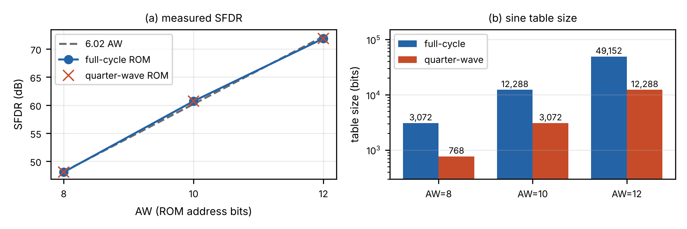
SFDR and memory

Slide 13
Hypotheses
• H1: full and quarter ROM give identical output — confirmed, 0 mismatches at AW = 8, 10, 12
• H2: quarter-wave cuts memory by 75 %; LUT count may not drop at small AW — see resource table
• H3: Fmax may drop slightly because of the address folding logic — see resource table

Slide 14
Conclusion
• All 13 configurations match the golden model bit for bit
• SFDR follows the address width: 48.1 / 60.7 / 71.9 dB for AW = 8 / 10 / 12
• Quarter-wave ROM keeps the output identical while storing a quarter of the words
• Future work: envelope detector, single-sideband, AXI-Stream wrapper

