Slide 1
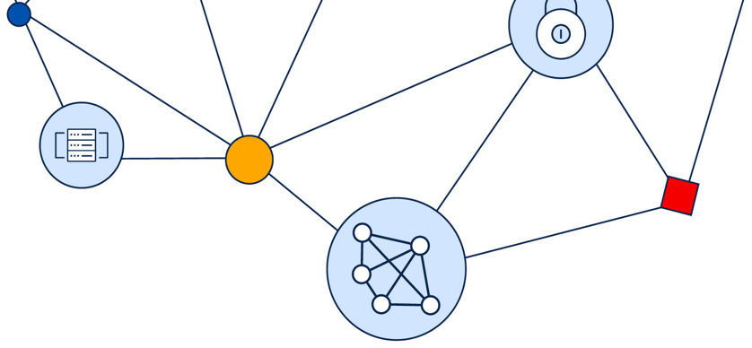
Cisco Certified Support Technician (CCST)
Entry-Level Certification Program
Cisco Networking Academy
June 2024

Slide 2
In this presentation
Benefits of certification
Cisco Certified Support Technician (CCST) certification program
ACE accreditation in the U.S.
CCST Networking
CCST Cybersecurity
CCST IT Support
How to become a Certiport Authorized Testing Center

Slide 3
Benefits of Cisco Certification
The benefits of certification are real:
99%
of organizations surveyed use technical certifications to make hiring decisions.
Build Your Technical Skills:
Develop a deep understanding of networking principles, protocols, and configurations.
Acquire the expertise to design, implement, and manage network infrastructures effectively.
91%
of employers believe IT certifications are a reliable predictor of a successful employee.
81%
Boost Your Professional Credibility:
of employers’ associate IT certification holders with increased quality and value of work contribution.
Earn respect from colleagues and employers by showcasing your commitment to networking excellence. Stay Current with Industry Trends: align with the latest industry trends, ensuring your skills remain relevant.
Cisco Certifications are time-honored proof you know what you’re doing. Plus, they’re ANSI and NIST certified, which means they’re industry certs with greater value in the marketplace.
¹ Pearson VUE 2023 Value of IT Certification

Slide 4
Cisco Certified Support Technician (CCST) Certifications
About the certification program:
Is ideal for entry-level job seekers, career changers, and college and high school students
Enables job seekers to show third-party verification of their skills in applications for internships, apprenticeships, and entry-level job roles
Validates entry-level skills in areas like cybersecurity and networking
Provides candidates with an early, achievable milestone, and creates a steppingstone to associate-level certifications like CCNA and CyberOps Associate
Free certification-aligned curriculum from Cisco Networking Academy, available instructor-led and self-paced

Slide 5
Cisco Certified Support Technician (CCST) Certifications
CCST Networking
CCST Cybersecurity
CCST IT Support
Validates candidate’s skills and knowledge of:
Entry-level networking concepts and topics
Foundational knowledge of network operations
Endpoints and media types
Network troubleshooting methodologies
Network support and security
CCST certification is for life
No recertification requirements
Validates candidate’s skills and knowledge of:
Cybersecurity principles
Network security and endpoint security concepts
Vulnerability assessment and risk management
Incident handling
CCST certification is for life
No recertification requirements
Validates candidate’s skills and knowledge of IT support tasks, including:
Queue and time management
Documentation
Troubleshooting
Assisting end users
Managing computer components
Identifying security threats
CCST certification is for life
No recertification requirements
CCST Cybersecurity

Slide 6
CCST certifications and related job roles
CCST Networking
CCST Cybersecurity
CCST IT Support
Network Support
Technician
Cybersecurity
Technician
IT End User Support
IT Support
Technician
Junior Cybersecurity Analyst
IT Help Desk Support
Help Desk
Technician
Help Desk
Support
Computer Support Specialist
IT Support
Specialist
Security Operations
Analyst
IT Help Desk Analyst
Notes:
Learners that earn the Cisco Certified Support Technician certifications are expected to have the required knowledge and work-ready skills necessary to launch a career in networking and cybersecurity, through at least 150 hours of instruction.

Slide 7


CCST certifications provide a step to CCNA and CyberOps Associate certifications
Cisco Certified Network Associate (CCNA)
CCNA certification proves you have what it takes to navigate the ever-changing landscape of IT. CCNA exam covers networking fundamentals, IP services, security fundamentals, automation and programmability.
Cisco Certified CyberOps Associate
Cisco Certified CyberOps Associate certification program validates the day-to-day, tactical knowledge and skills that Security Operations Center (SOC) teams need to detect and respond to cybersecurity threats.

Slide 8
CCST Certification Exam Details
50 minutes, 40-45 questions
Testing is offered through a Certiport Authorized Testing Center (CATC) or online testing through Certiport.
Academies can become a CATC and deliver exams.
Lifetime certification with no expiration
Language Availability:
CCST Cybersecurity exam is available in English, Arabic, Chinese Simplified, Spanish, French, and Portuguese-Brazilian.
CCST Networking exam is available in English, Arabic, Spanish, French, Japanese, and Portuguese-Brazilian.
CCST IT Support exam is available in English with additional languages to follow.

Slide 9
CCST certifications - now ACE accredited!
CCST Cybersecurity and CCST Networking certifications have received ACE accreditation for 3 credit hours each.
The American Council on Education (ACE) accreditation is used by higher education institutions in the U.S. to assess how many college credits to award an incoming/transfer student for courses or credentials already earned.
This is the highest number of credit hours recommended by this body for a certification.
ACE is the major coordinating body for all the nation’s higher education institutions, representing more than 1,600 college and university presidents and more than 200 related associations nationwide.

Slide 10
Steps to attain college credit
Step 1: Verify with the university/college admissions office that they grant credit for the specific certification.
Step 2: Send your transcript.
The ACE Transcript, powered by Credly, provides a seamless way to share your transcript with prospective learning institutions and organizations. Learners must have a Credly account to access official transcripts and digital badges. Visit the Credly sign-in page to request an official transcript.
For more information:
American Council on Education Student Resource Center
Credly Help Center

Slide 11
Cisco Certified Support Technician (CCST) Networking

Slide 12
Why an entry-level networking certification?
Job demand growth in U.S. between 2021-2022
The demand for entry-level networking skills has increased across a wide range of jobs. These skills are no longer required only for networking IT job roles.
Pre-associate, entry-level junior support IT job roles have long sought a Cisco entry-level certification to validate the candidate’s competencies.
The Cisco Certified Network Associate (CCNA) certification has become an industry standard for associate network administrator-like job roles.
Non-Networking IT Jobs
476,114
+11.4%
Networking IT Jobs
140,948
+3%
Source: Pearson VUE. 2022.

Slide 13
Network Support Technician
Description:
Entry-level network support personnel have the foundational knowledge and skills necessary to demonstrate how networks operate, including the devices, media, and protocols that enable network communication.
Not yet ready to take lead roles but have a broad range of knowledge and skills to participate in and assist with tasks performed by seasoned networking professionals.
Other job titles:
Entry-level IT Support Technician
Entry-level Help Desk Technician
IT Support Specialist
Tier 1 Help Desk Support
Skills:
Explain basic network fundamentals.
Identify common network devices, components, and accessories; end point devices, routers, switches, access points.
Perform basic troubleshooting and demonstrate effective methodologies and help desk best practices.
Explain foundational security concepts.
Experience level: 0-1 years
Desired Certification: Cisco Certified Support Technician - Networking

Slide 14

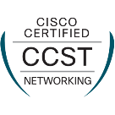
Networking Essentials
Version 3.0, Instructor-Led only (65 hours)
Entry-level Networking Offerings
Networking Basics (22 hours)
Networking Devices and Initial Configuration (22 hours)
Network Addressing and Basic Troubleshooting (14 hours)
Network Support and Security (12 hours)
Network Technician Career Path
or
Apply for entry-level jobs, internships, and apprenticeships
Network Support Technician
Entry-level Help Desk Technician
IT Support Specialist
Progress to additional certifications
Continue on
CCNA
CyberOps Associate
Notes:
For learners looking to move from awareness to careers, the Cisco Networking Academy networking curriculum provides easy starting points. Our courses are bundled into a Network Technician Career Path learning experience, designed to take learners from zero to entry-level job- ready and prepared to earn an entry-level networking certification.
Learners can also choose to continue to additional courses to advance their skills and prepare for Associate-level certifications and jobs

Slide 15
Cisco Certified Support Technician (CCST) Cybersecurity

Slide 16
The skills gap
3.5 Million
undersupply of cybersecurity professionals worldwide
Continued lack of cybersecurity professionals threatens economic growth.
It is vital to have professionals who can provide cybersecurity leadership, test and secure systems, and train people in digital hygiene.
Cybersecurity Jobs Report 2021, Cybersecurity Ventures
Notes:
Cybersecurity Ventures estimates a global demand of 3.5 million cybersecurity roles by 2025.
Cyber threats are in abundance, but cyber professionals equipped with the skillset needed to handle them are not.
The World Economic Forum estimates by 2025, 50% of all employees will need to be reskilled.
Moreover, 59% of businesses report experiencing significant difficulty responding to cybersecurity threats, as a result of the skills gap.
Continued lack of cybersecurity professionals threatens economic growth

Slide 17
Job opportunities are everywhere!
Cybersecurity jobs are not limited to tech companies only. All organizations need protection from cybersecurity threats.
There is growing demand across industries, such as:
Healthcare
Transportation
Energy
Food
Water
Smart cities
89%
65%
In 2018, 89% of all online IT job openings were in non-tech companies
IT job growth outside the tech sector jumped up to 65% from 2013-2018
Beyond Tech: The Rising Demand for IT Skills in Non-Tech Industries, Burning Glass, 2019
Notes:
And it’s also important to realize.
Cybersecurity job roles are not limited to tech companies only. Every company is a digital company and therefore they need to be cybersecurity resilient. Job opportunities are everywhere!
In fact, in 2018, 89% of all online IT job openings were in non-tech companies .

Slide 18

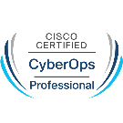
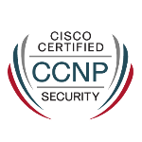


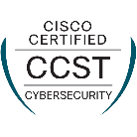
Cybersecurity Career Progressions
Offensive security
Defensive security
Cisco Learning & Certifications or Partners
Vulnerability Assessment and Penetration Testing Manager
Security Operations Center (SOC) Analyst Level 2
Network Security Architect
Professional
Cisco Networking Academy
Ethical Hacker
Security Operations Center (SOC) Analyst Level 1
Network Firewall Security Engineer
Associate
Entry
Junior Cybersecurity Analyst
Notes:
Let’s take a look at the job roles and career progression opportunities for the Red and Blue cybersecurity teams.
At the entry-level, a Cybersecurity Analyst supports and participates in both offensive and defensive cybersecurity-related activities across the Red and Blue Teams.
A career progression into the Red Team can lead to an associate-level Ethical Hacker role and then a professional-level Vulnerability Assessment and Penetration Manager role.
A career progression into the Blue Team can lead to a Security Operations Center (SOC) Analyst Level 1 and then Level 2. Or an associate-level Network Firewall Security Engineer role and then a professional-level Network Security Architect role

Slide 19

Junior Cybersecurity Analyst
Description:
Security operations personnel that supports and participates in cybersecurity-related activities, including vulnerability assessment, incident handling, and security reporting and documentation.
Not yet ready to take lead roles but have a broad range of knowledge and skills to participate in and assist with tasks performed by seasoned cybersecurity professionals.
Aliases:
Junior Cybersecurity Technician
Cybersecurity Support
Cybersecurity Specialist
IT Technician with Security Focus
Tier 1 Help Desk Support
Skills:
Understand core security concepts
Assist with network security and data analysis
Assist with systems and software security, including malware, cloud & endpoint security, and identity management
Assist in applying risk management principles and processes
Assist in incident response and disaster recovery
Experience level: 0-1 years
Desired Certification: Cisco Certified Support Technician (CCST) Cybersecurity certification
Notes:
The Cybersecurity Analyst is a security operations personnel that supports and participates in cybersecurity-related activities, including vulnerability assessment, incident handling, and security reporting and documentation.
With 0 to 1 years’ worth of experience, a Cybersecurity Analyst has skills to understand and assist in daily operations. While not yet ready to take lead roles, they have a broad range of knowledge and skills to participate in and assist with tasks performed by seasoned cybersecurity professionals.
Job tasks:
Security Core
* Understand important cybersecurity concepts.
* Understand the types of data and the security challenges posed by each.
* Understand the types of security controls and their functions.
* Interpret and contribute to cybersecurity reports.
* Understand the importance of organizational compliance with relevant legal and regulatory requirements.
* Adhere to the ethical and legal codes of the cybersecurity professional.
* Verify conformance to organizational security policies.
Network Security
* Understand network protocols, network architectures, and network communication processes.
* Assist with gathering and analyzing network monitoring data including packet captures and various log file entries in order to identify security incidents.
* Assist in operating and managing security devices and platforms.
* Understand common and emerging network security threats and associated mitigation measures.
* Understand enterprise-level wireless network security mechanisms.
* Understand data protection mechanisms, such as encryption algorithms, and the recommendations for their use.
* Understand the value and usage of the public key infrastructure (PKI).
Systems and Software Security
* Assist in identifying, obtaining, and analyzing malware files.
* Assist in configuring, monitoring, and verifying endpoint security for hosts, servers, and mobile and embedded systems
* Understand cloud security measures and models.
* Assist with implementing, operating, and maintaining virtual environments.
* Assist with administering and hardening networking devices and Linux and Windows workstations and servers.
* Assist with performing all phases of the identity lifecycle management.
Risk Management and Vulnerability Assessment
* Assist in applying risk management principles and processes.
* Assist in performing and interpreting vulnerability assessments of the network and systems including penetration testing, asset management, and threat monitoring.
* Understand security assessment of IT systems such as system and information security, system development and change management, computer operations, and information assurance.
* Participate in cybersecurity intelligence-gathering activities to understand emergent security threats that are relevant to the organization and report on these threats to stakeholders.
Incident Response
* Assist in performing forensic investigation of cybersecurity incidents.
* Participate in incident response and recovery planning activities.
* Support post-incident disaster-recovery activities such as containing, removing, and recovering compromised systems and data.

Slide 20

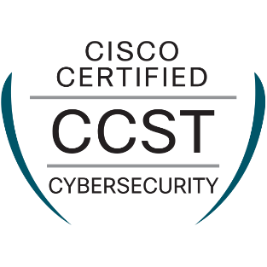
Cybersecurity Essentials
Version 3.0, Instructor-Led only (70 hours)
Junior Cybersecurity Analyst Career Path
Self-paced only (120 hours)
Entry-level Cybersecurity Offerings
Networking Prerequisites
Cyber Threat Management
Instructor-led or Self-paced (16 hours)
Endpoint Security
Instructor-led or Self-paced (27 hours)
Network Defense
Instructor-led or Self-paced (27 hours)
Networking Prerequisites
or
or
Apply for entry-level jobs, internships, and apprenticeships
Junior Cybersecurity Analyst
Cybersecurity Technician
Cybersecurity Specialist
Tier 1 Help Desk Support
Progress to additional learning
Continue to
&
CyberOps Associate
Network Security
IoT Security
Cloud Security

Slide 21
Cisco Certified Support Technician (CCST) IT Support

Slide 22
Cisco Certified Support Technician (CCST)
IT Support
In June 2024, Cisco and Certiport, a Pearson VUE business, added a third CCST certification focused on IT Support.
The CCST IT Support certification provides a validation of work-ready skills and knowledge necessary to help start careers in roles such as IT End User Support, IT Help Desk Support, Computer Support Specialist, and IT Help Desk Analyst.
Cisco Networking Academy plans to provide learning content for candidates to prepare for the new CCST IT Support certification. Watch for more information to come!

Slide 23
Cisco Certified Support Technician (CCST)
IT Support – Exam Objectives
Interpersonal skills such as communication, active listening and expressing technical concepts.
Troubleshooting hardware issues that involve ports and cables as well as connectivity and resource access issues.
Troubleshooting operation systems and application issues, such as display settings and updates on Windows and MacOS operating systems and mobile devices.
Dealing with common threats to the end user, such as malware, phishing, and Personally identifiable information (PII) data.
Leveraging a broad set of tools, including Artificial Intelligence (AI).

Slide 24
How to become a Certiport Authorized Testing Center
Notes:
Version 2.9.2022
24

Slide 25

Certiport
A Pearson Vue Business
Principal provider of the following official industry-recognized certifications:
Founded in 1997, and later acquired by Pearson VUE in 2012, Certiport delivers more than
3 million global exams annually through a network of 15,000+ Certiport Authorized Testing Centers (CATCs).

Slide 26
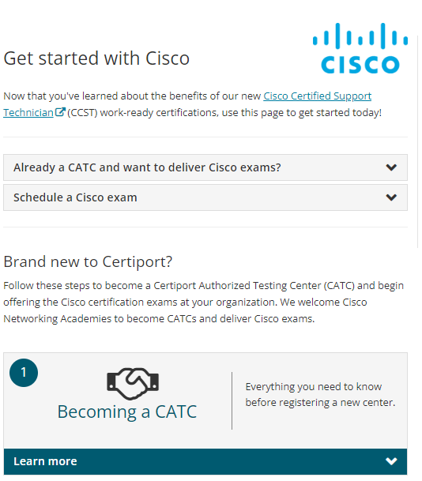
Get Started with Cisco
Already a CATC?
Do you want to get certified?
Brand new to Certiport and Cisco?
www.certiport.pearsonvue.com/
CATCs/Cisco-get-started

Slide 27

WHY BECOME A CATC?
Easily deliver the Cisco Certified Support Technician certification exams and additional Certiport certifications
Grow the offerings of your academy through certification delivery and resources
Provide test candidates with a pathway to certification and career success
Access to additional professional development materials and an exclusive CERTIFIED community
And more

Slide 28

How to become a CATC?
Verify that your organization meets Certiport’s policies and requirements
Create a new user account at Certiport.com (needed to register as a new testing center)
Register to become a CATC through your user account using the “Register a CATC” form
Once submitted, a representative will reach out to you with the status of registration
View the full instructions and policies/requirements on the webpage here.

Slide 29
Technical Requirements*
Minimum Operating System: Windows 8.1 or Mac OS X Big Sur 11
Minimum Processor Speed: 1.3 GHz
Minimum RAM: 4 GB for Live-in-the-Application exams 2 GB for all other exams
Minimum Resolution: 1024 x 768 (Standard 4:3)
Minimum Internet Connection Speed: 256 Kbps
Complete technical requirements
*Please note that some requirements may vary depending on the certification exams you deliver.

Slide 30
Exam Policies for Administrator*
Proctoring: Proctoring must be arranged to deliver exams and proctors are responsible to ensure a candidate’s information matches their ID.
Identity: A CATC is responsible to confirm a candidate's identity.
Devices: Recording and electronic devices are not allowed in testing area, including writing utensils, bags or packs. These should be stored outside the testing environment.
Breaks: A Candidate may take a break during testing if requested, however, the testing clock cannot be stopped during this time.
Complete administration exam policies
*Please note that some policies may vary depending on the certification exams you deliver.

Slide 31
Exam Policies for Candidates*
Identity: Candidates must present approved identification.
Devices: Recording and electronic devices are not allowed in testing area, including writing utensils, bags or packs. These should be stored outside the testing environment.
Communication: A Candidate may speak to other candidates or administrators during the exam, except to request an authorized break.
NDA: All candidates must agree to the terms of an NDA and may not remove exam content from the testing area.
Complete candidate exam policies
*Please note that some policies may vary depending on the certification exams you deliver.

Slide 32
Retake Policies for Candidates*
Waiting Period: Cisco Certified Support Technician exams require a 24-hour break before a candidate can retake after failing the first time. Additional retakes after the second attempt increase to 48 hours.
Retake Vouchers: Retake vouchers must be used within 60 days of the initial failed exam. If a retake was purchased, the retake voucher is sent by email after a failed exam.
Violations: Test results found to be in violation of any exam policy will result in the candidate not being awarded the attempted credential, regardless of score.
Complete exam retake policies
*Please note that some retake policies may vary depending on the certification exam.

Slide 33
Accommodations
Accommodations can be requested online using the Reasonable Adjustments Request System (RARS).
RARS guides are available to help inform teachers, proctors, parents, and test candidates.
Please allow up to 10 business days for accommodation requests to be reviewed.
Accommodations for minors will need to have a parent or guardian complete a consent form.
Complete accommodation information

Slide 34

NEXT STEPS
After becoming an active CATC, you will be assigned the role of Organization Administrator and can start the process of administering and delivering exams.
PURCHASE EXAMS
REVIEW TRAINING
INSTALL EXAM SOFTWARE
You can purchase directly from a Certiport sales consultant or purchase inventory through your “organization administrator” account.
Review all resources, training sessions, and user guides on how to manage your CATC account and how to administer an exam.
Download and install our exam delivery software, Compass. Delivery systems vary by certification program and supported operating systems.

Slide 35
View the full step-by-step process of becoming a CATC and delivering Certiport exams at:
certiport.pearsonvue.com/CATCs/Cisco-get-started

