Slide 1




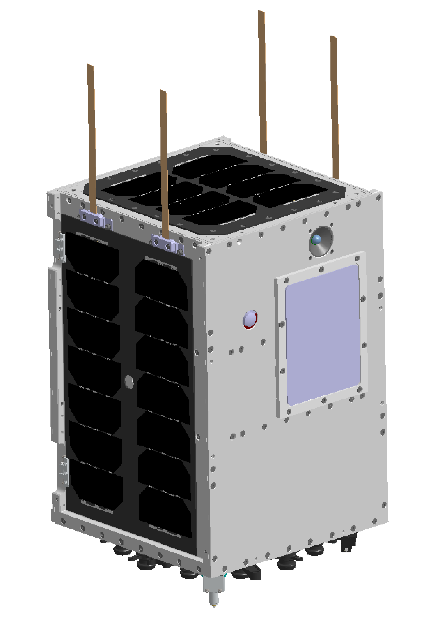
Thermal analysis & Tests UPMSat-3
De Ávila Cabral, Sergio
22/04/2024

Slide 2
Table of content
Introduction & Objectives
GMM & TMM
Instruments temperatures
Thermal Hardware
Conclusions

Slide 3
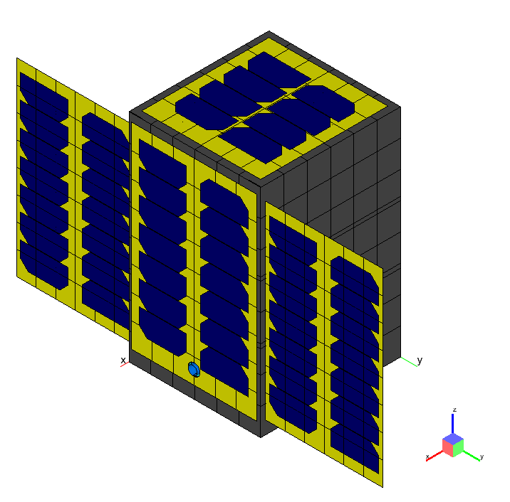
1. Introduction & Objectives
UPMSat-3 Mission
Thermal Analysis
Operational Requirements
Survival Requirements
Thermal Hardware Design
Thermal vacuum testing
Figure 1: ESTAN-TMS model.
Notes:
Dentro de marco de la mission UPMSat

Slide 4
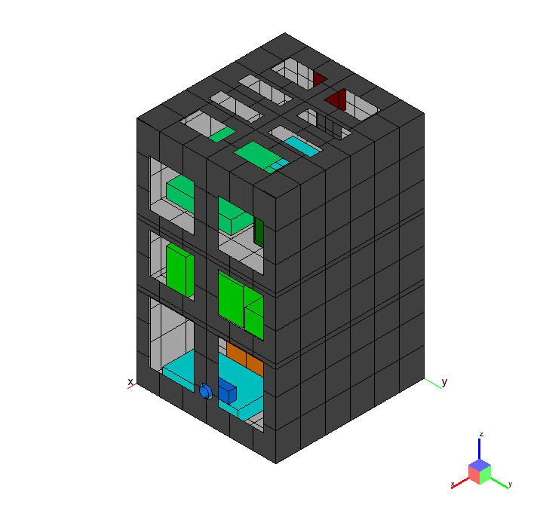
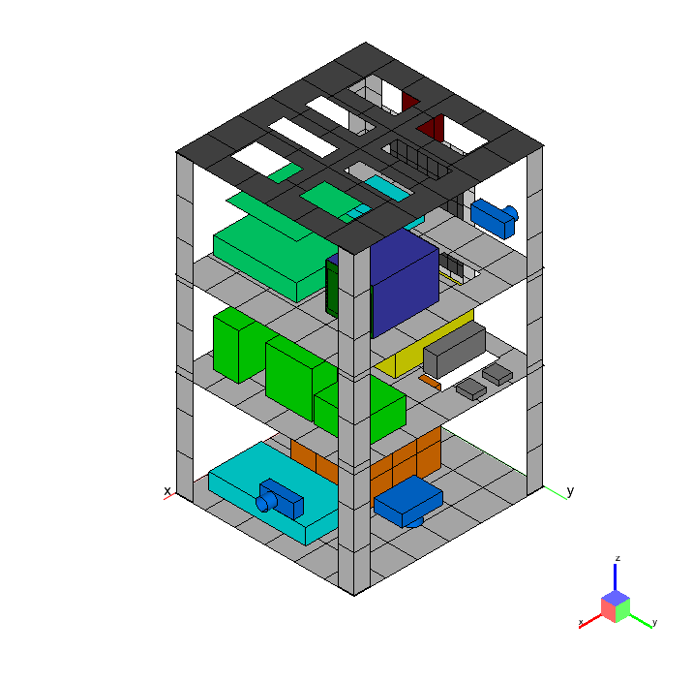
2. GMM & TMM
Figure 2: Materials applied in the model.
Notes:
Str + SP => Modelado más detallado.

Slide 5
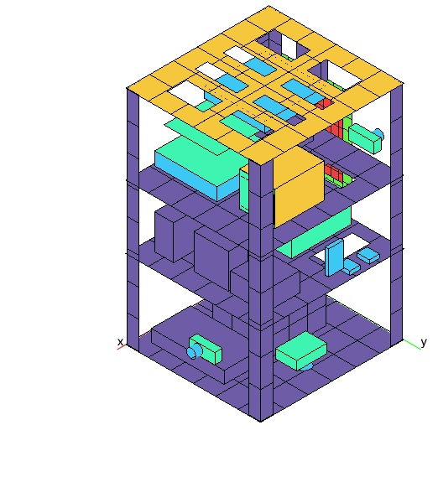
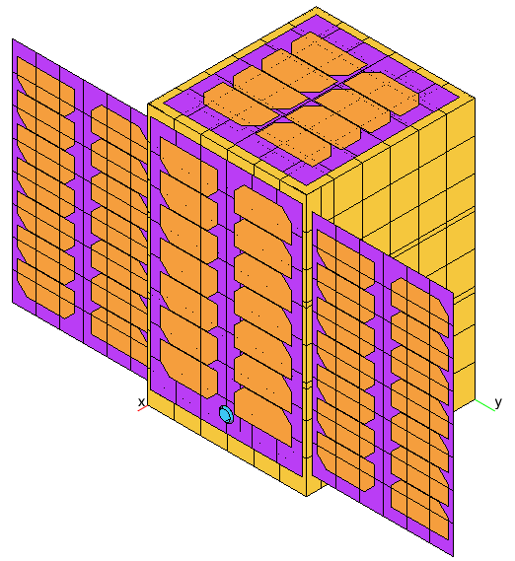

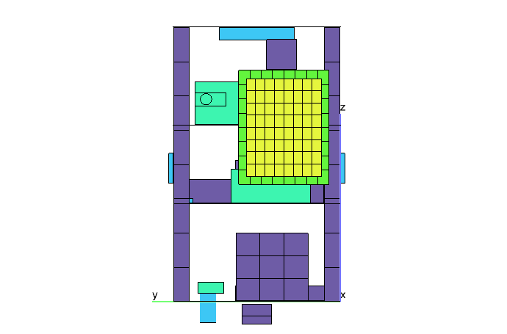
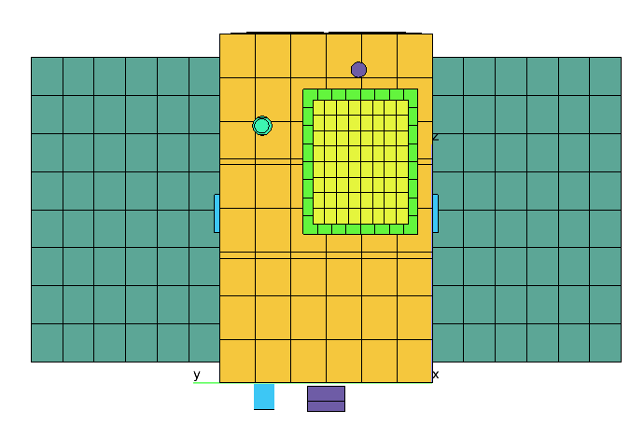
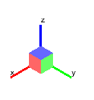
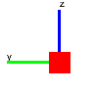
2. GMM & TMM: Thermo-optical properties
Silvered FEP
Surtec 650
Kapton + CFRP
CFRP
Solar cell.
PCB
DELRIN
Black Anodize
Aluminium
Aluminised Kapton
Figure 3: Thermo-optical properties applied in the model.
Notes:
Absortividad corregida de las células solares.

Slide 6
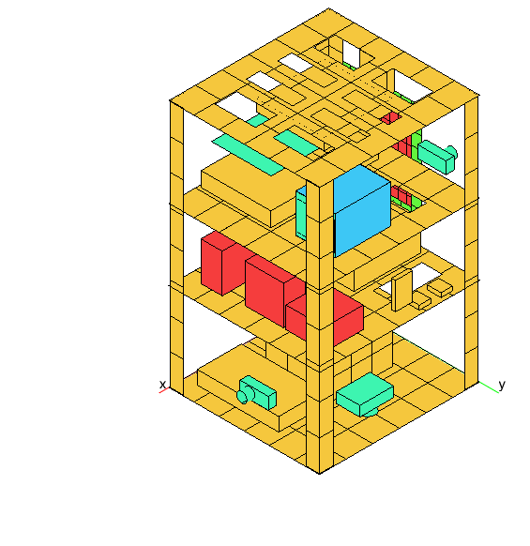
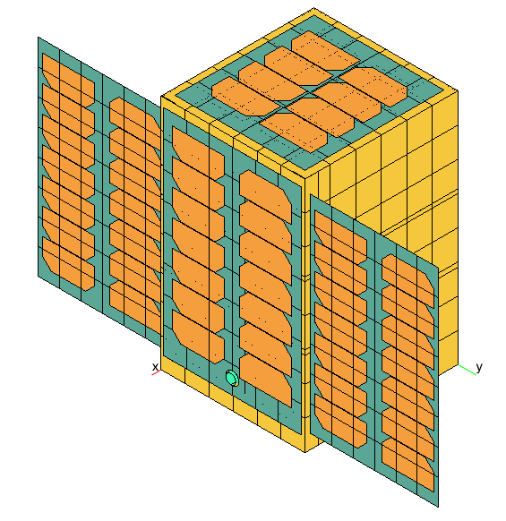
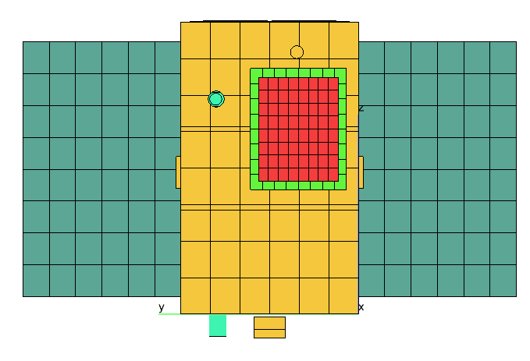
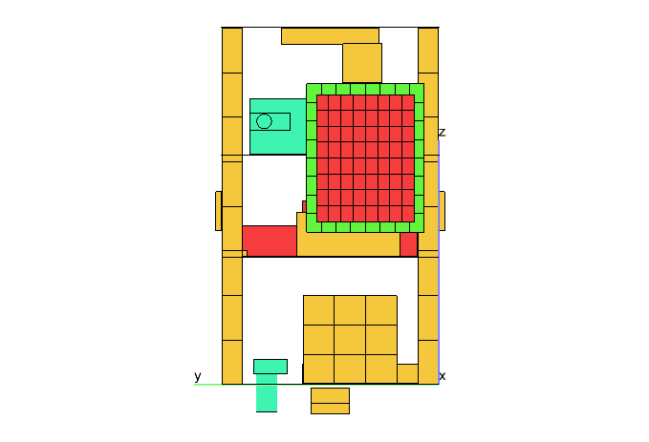

2. GMM & TMM: Materials
Solar Panels eq¹.
GaAsGe
PCB eq¹.
DELRIN
Al-7075-T651
Al-6082
Al-6061
Figure 4: Materials applied in the model.
1: Equivalent properties.

Slide 7
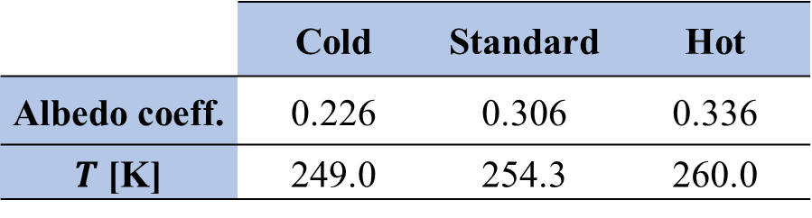
2. GMM & TMM: Analysis Cases
Table 1: STEM results.
Table 2: Analysis cases.
 | Cold | Standard | Hot
Albedo coeff. | 0.226 | 0.306 | 0.336
$T$ [K] | 249.0 | 254.3 | 260.0
Analysis case | Radiative Case | Dissipation [W]
Latency Cold | Cold | 1.00
Latency | Standard | 1.00
Nominal | Standard | 7.65
PL1 Cold | Cold | 15.65
PL1 | Standard
PL1 Hot | Hot
PL2 | Standard | 9.65
Safe | Standard | 7.65

Slide 8
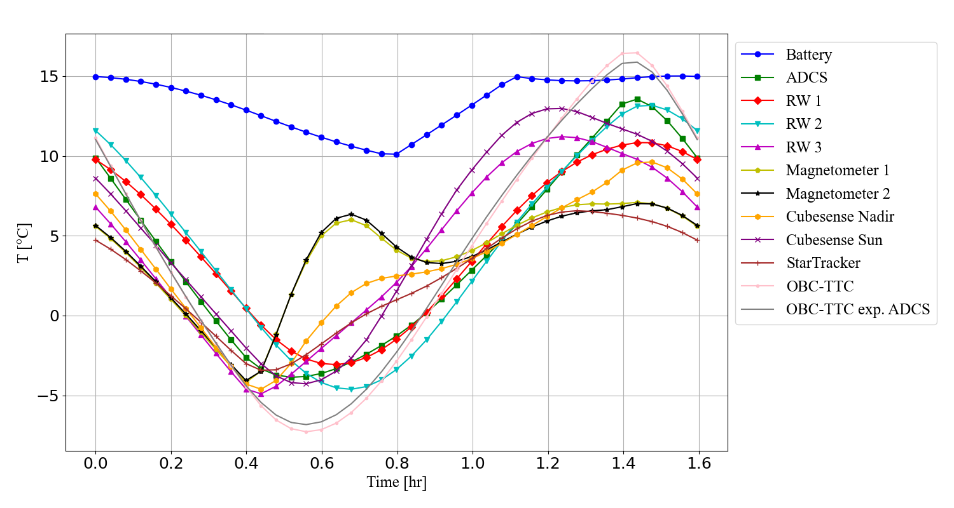
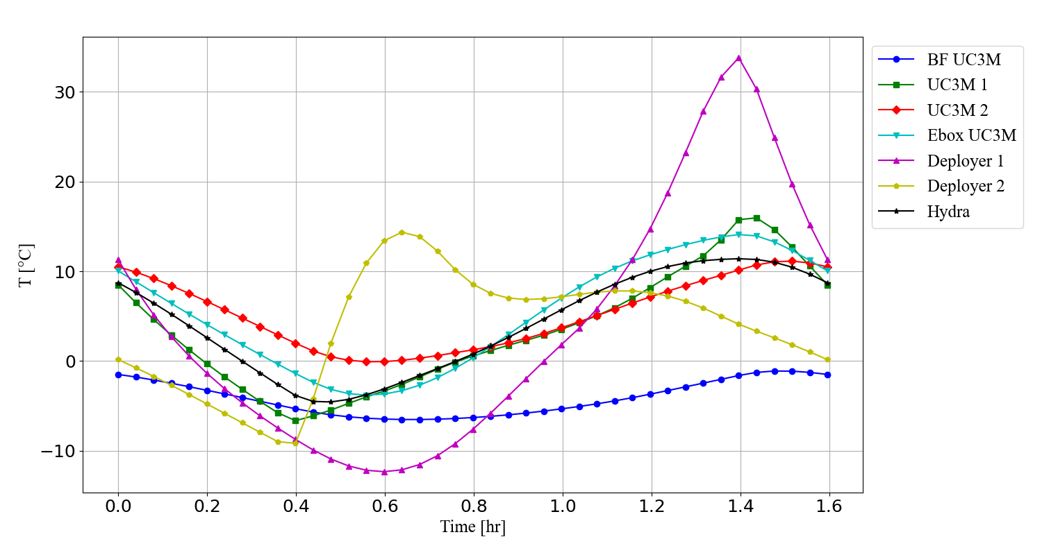
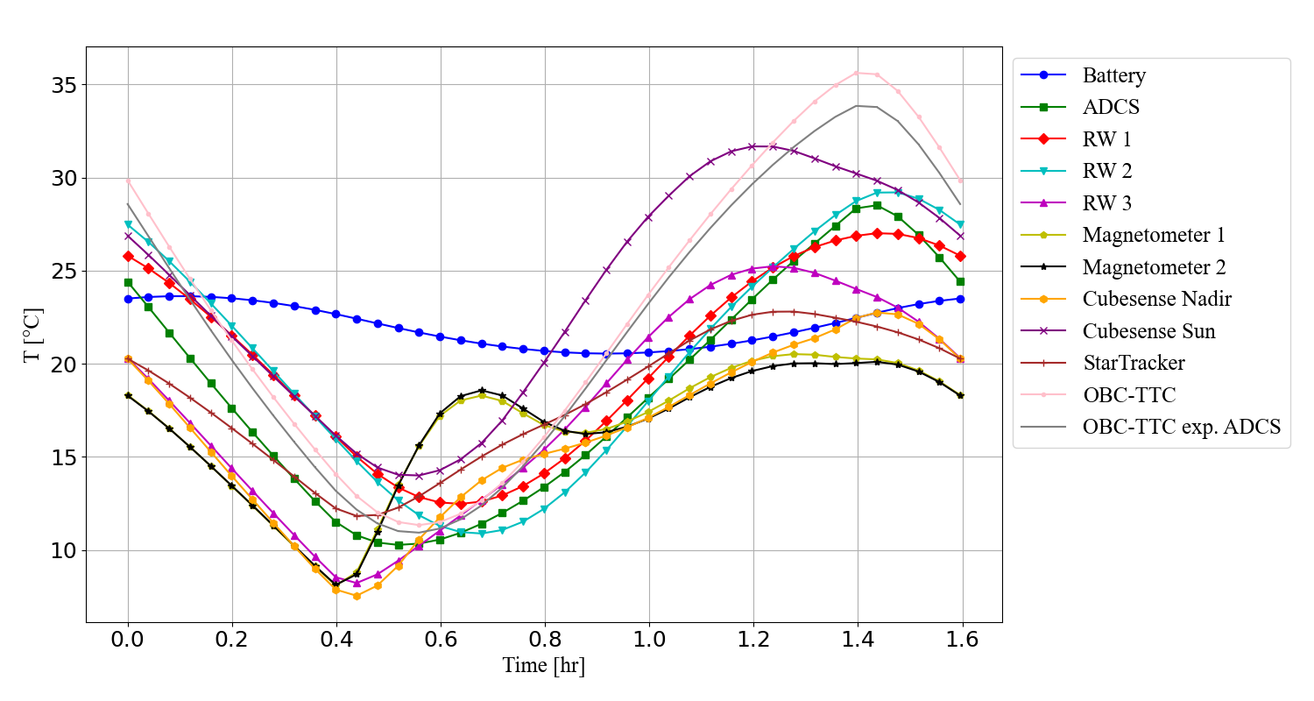
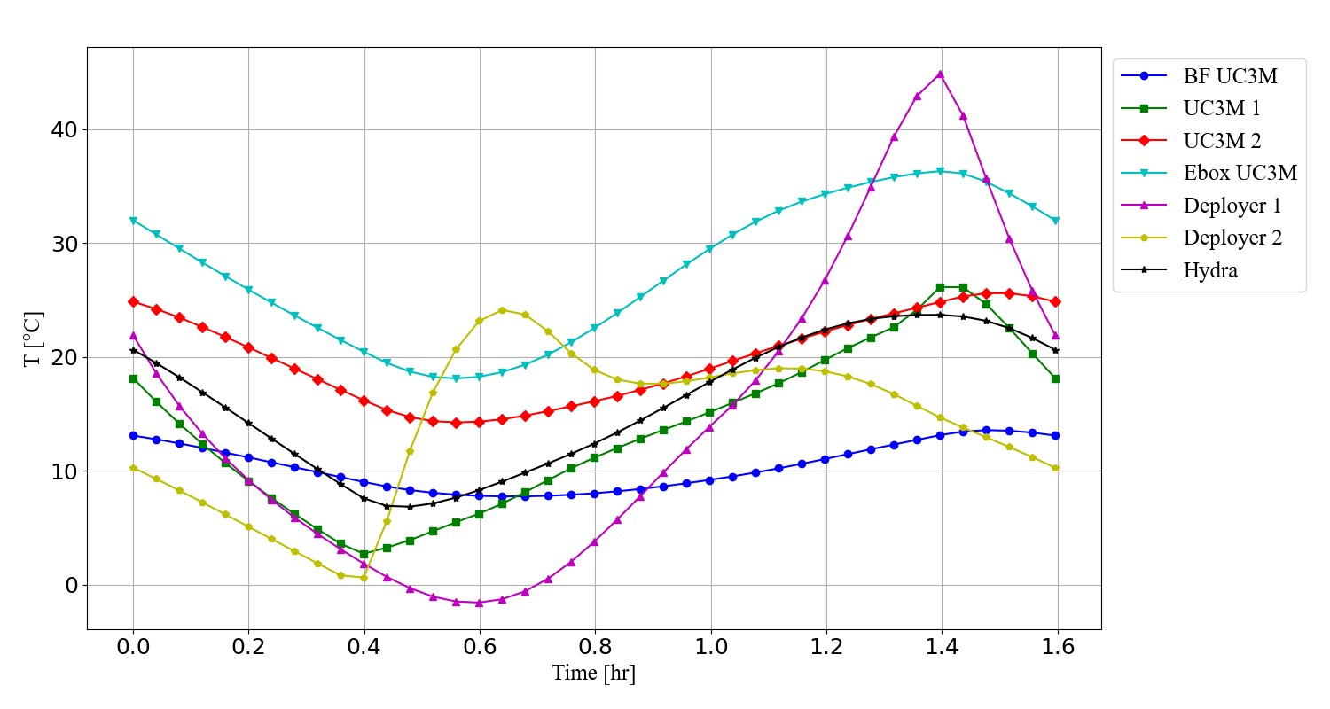
3. Instruments temperatures
Latency Cold: Instruments
Latency Cold: Payload
PL1: Instruments
PL1: Payload
Temperature ranges
$T_{ops}=[−10 °\text{C}$ to 60$°$C$]$
𝑇_𝑜𝑝𝑠=[−10 °"C" to 60°C]
$T_{suv}=[−10 °\text{C}$ to 7$0°$C$]$
𝑇_𝑠𝑢𝑣=[−10 °"C" to 70°C]
$T_{bat}>10 °$C
𝑇_𝑏𝑎𝑡>10 °C
Figure 5: Instruments temperature in Latency Cold.
Figure 6: Payload temperature in Latency Cold.
Figure 7: Instruments temperature in PL1.
Figure 8: Payload temperature in PL1.

Slide 9
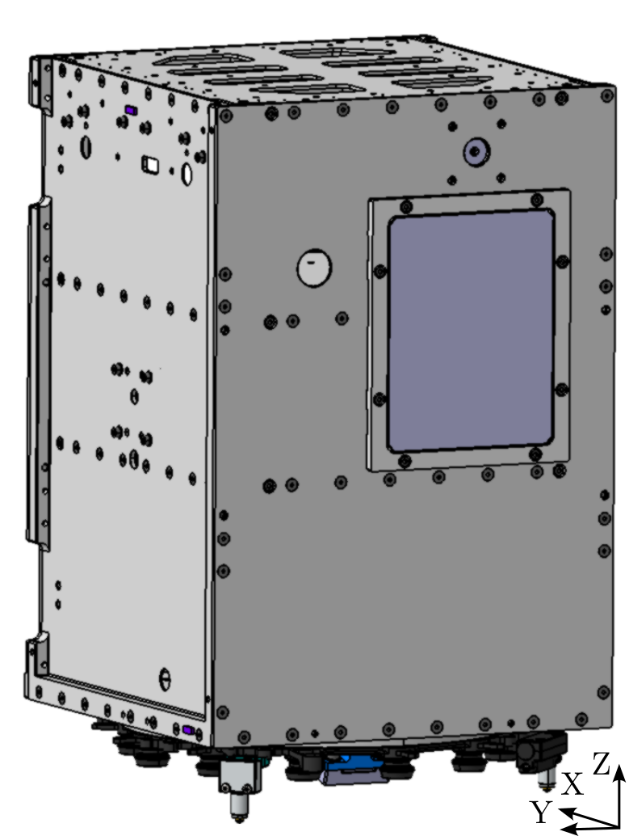
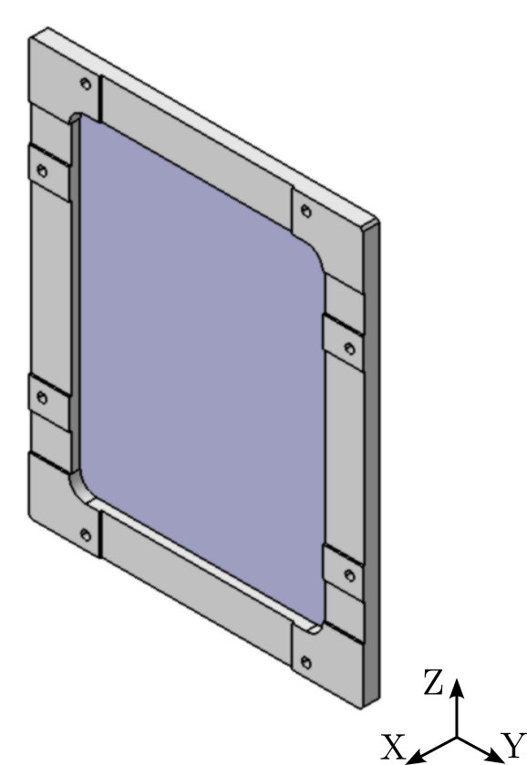
4. Thermal Hardware: Radiator
Radiator
Dim: 100 x 130 mm
Mat: Al-6061
Front: Silvered FEP
Back: Alum. Kapton
Frame
Mat: DELRIN
Eight contact points
Dim: 121.2 x 151.2 mm
Figure 9: Radiator 3D model.

Slide 10
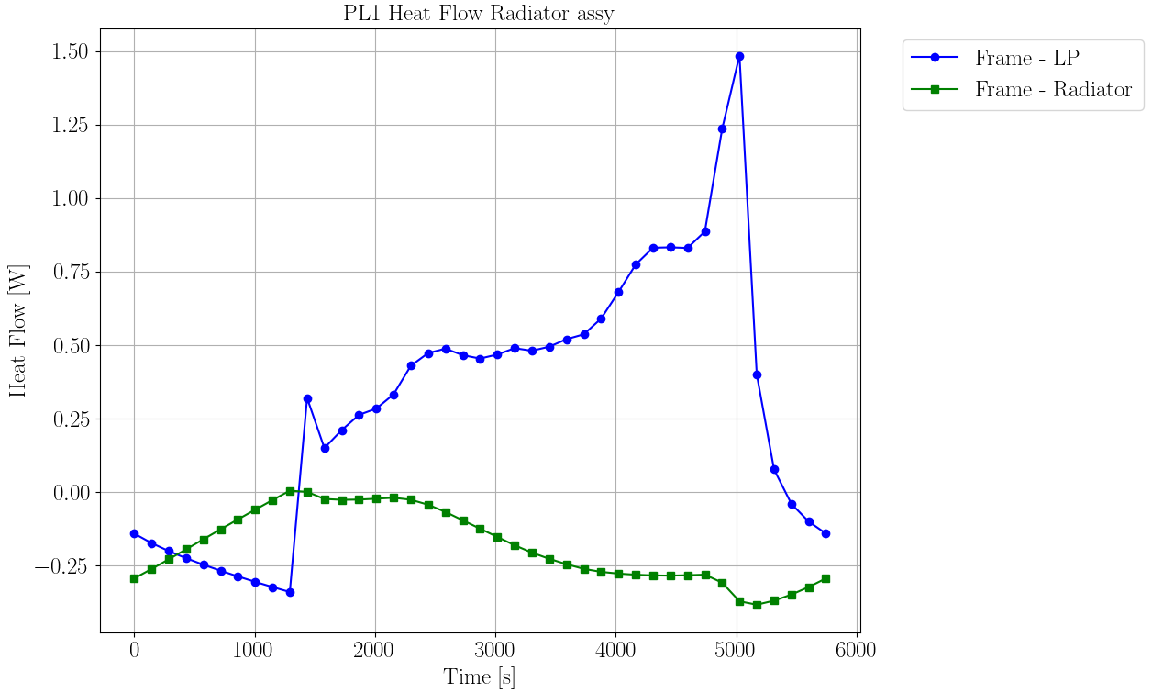
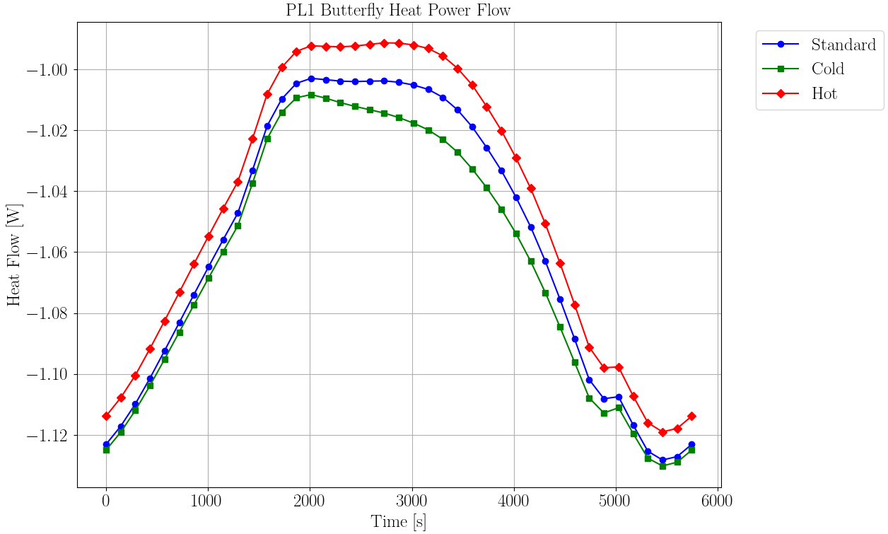
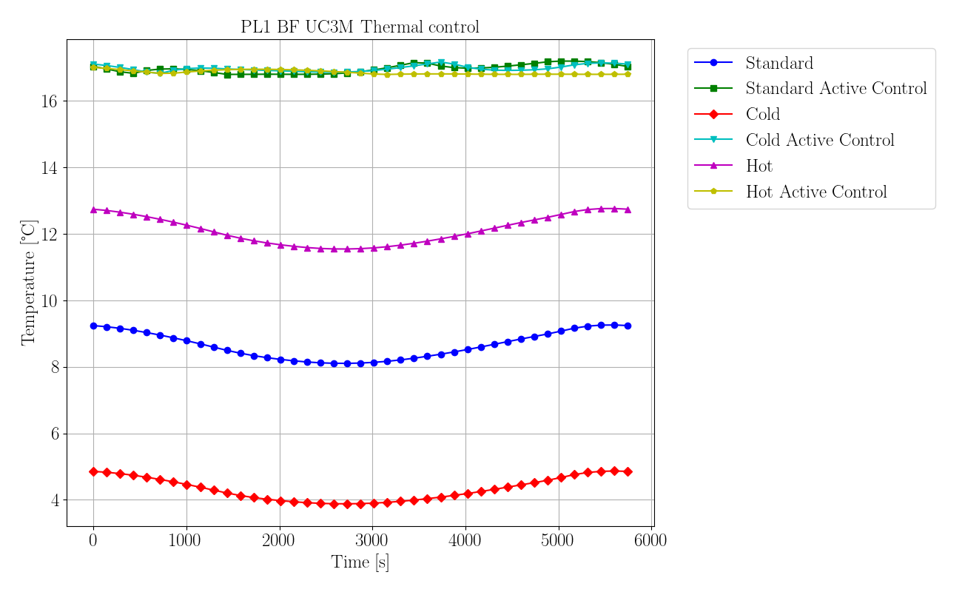
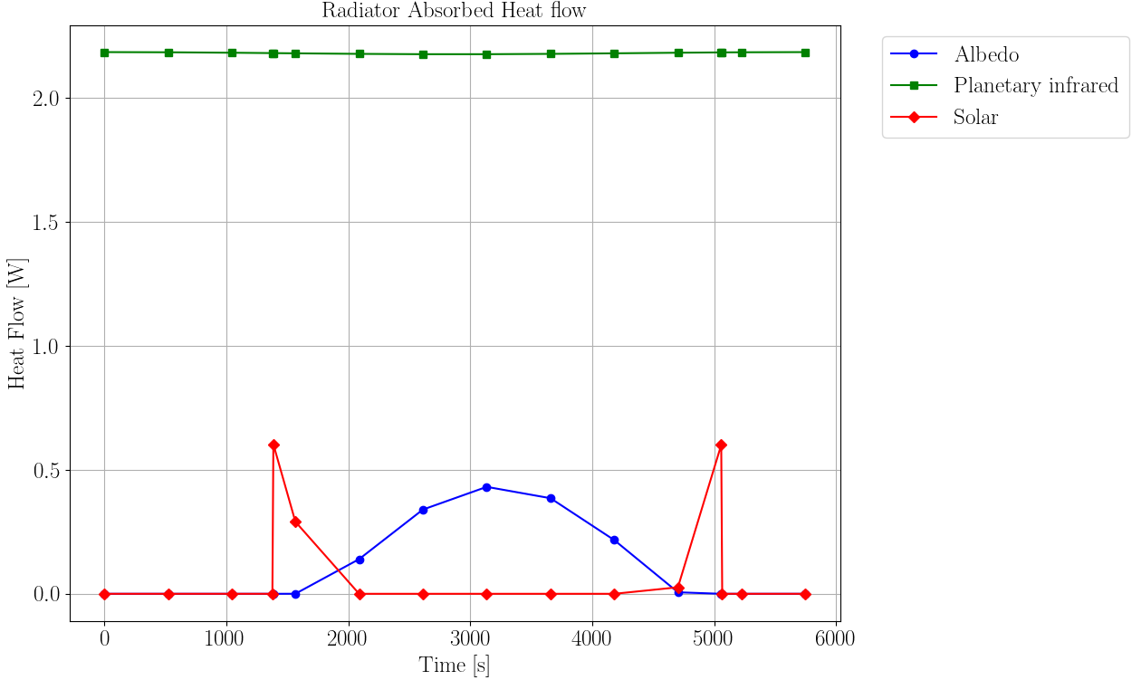
4. Thermal Hardware: Radiator
Figure 10: Radiator Absorbed Heat flow.
Figure 11: Heat flow between Frame - LP and Frame - Radiator.
Figure 12: Heat Flow between BF- Radiator.
Figure 13: BF temperatures.

Slide 11
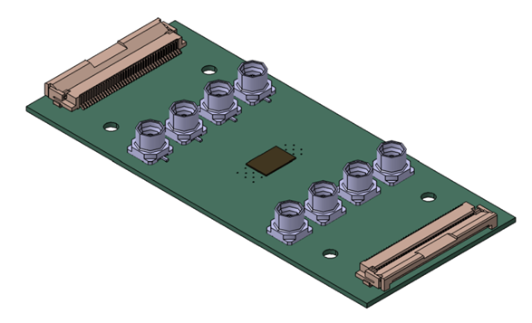

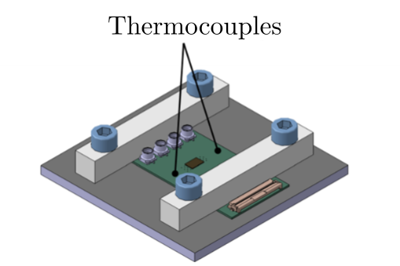
5. PCB-UC3M Test
Passive PCB Dim: 68.6 x 30.0 x 0.8 mm
Temperature range
$T_{max}=50 °$C
𝑇_𝑚𝑎𝑥=50 °C
$T_{min}=−40 °$C
𝑇_𝑚𝑖𝑛=−40 °C
Allowed tolerance : $T_{error}=±3 °$C
Allowed tolerance : 𝑇_𝑒𝑟𝑟𝑜𝑟=±3 °C
Stay time: 30 min
Minimum cycles: 8
Figure 12: PCB-UC3M 3D model.
Figure 13: Setup
Thermal test.

Slide 12
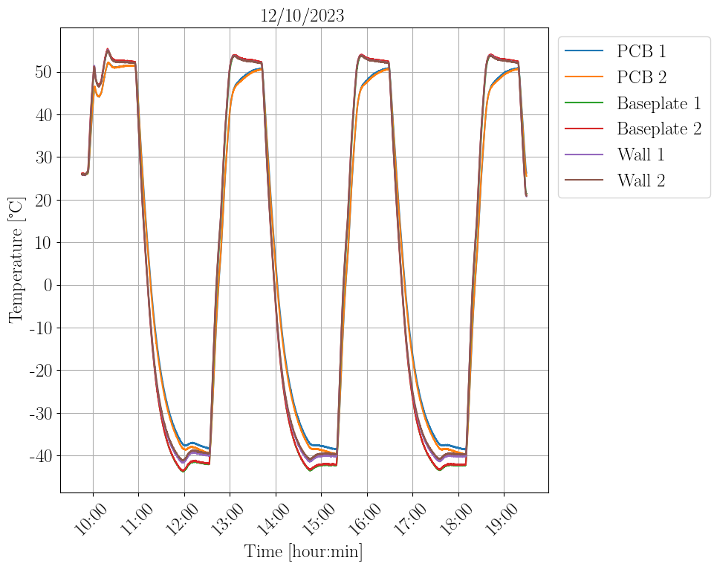
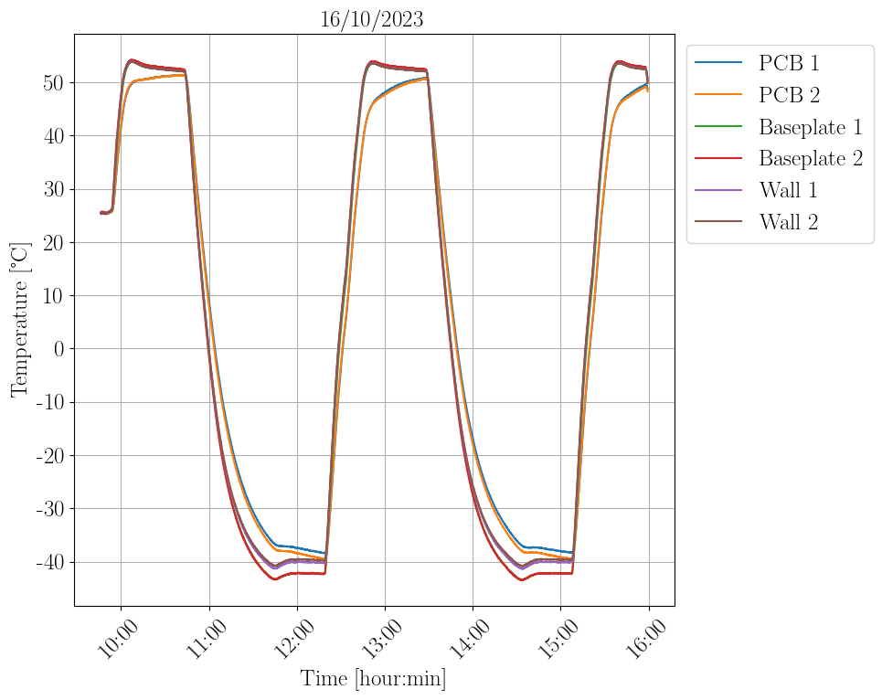
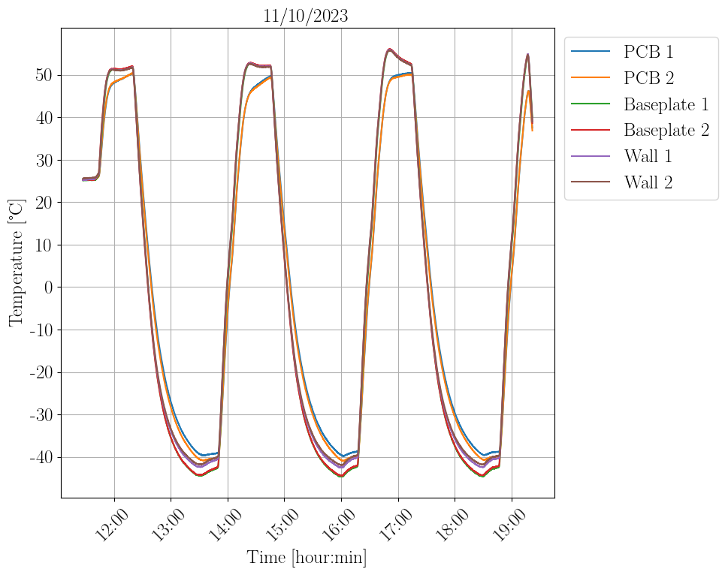
5. PCB-UC3M Test
Passive PCB Dim: 68.6 x 30.0 x 0.8 mm
Temperature range
$T_{max}=50 °$C
𝑇_𝑚𝑎𝑥=50 °C
$T_{min}=−40 °$C
𝑇_𝑚𝑖𝑛=−40 °C
Allowed tolerance : $T_{error}=±3 °$C
Allowed tolerance : 𝑇_𝑒𝑟𝑟𝑜𝑟=±3 °C
Stay time: 30 min
Minimum cycles: 8
Total time: approx. 26 hours.
Time per cycle: 2.5 hours approx.
Figure 14: Thermal test results.

Slide 13
6. Conclusions
Survival and operating requirements are met in all modes of operation.
Thermal Hardware required:
Insulating supports.
Radiator and frame.
Active Thermal Control.
Radiator sized for non-optimum conditions.
Need of model refinement to obtain more accurate data and reduce the level of uncertainty.
Perform thermal vacuum test.

Slide 14

Thanks for your attention Questions?

Slide 15
Referencias
[1] | Et al. Ignacio Torralbo. «Thermal Analysis of the Solar Orbiter PHI Electronics Unit». En: (2020).
[2] | David G. Gilmore. Spacecraft Thermal Control Handbook. The Aerospace Press, 2002. isbn: 1-884989-11-X.
[3] | Sergio De Ávila Ahmad Khalaf. Test Report / Test Result. Thermo-Optical Properties of Surtec 650. Instituto de Migrogravedad Ignacio Da Riva (IDR), 2023.
[4] | Mechanical and Electrical ICD Radiometer Payload. Inf. téc. Universidad Carlos III de Madrid, 2023.

Slide 16
Referencias
[5] | Et al. Ignacio Torralbo. «Thermal Analysis of the Solar Orbiter PHI Electronics Unit». En: (2020).
[6] | AzurSpace: 30% Triple Junction GaAs Solar Cell Type: TJ Solar Cell 3G30C Advanced.
[7] | EESEM. Properties of Si, Ge, and GaAs at 300K. url: eesemi.com/sigegaas.htm.
[8] | ASM Aerospace Specificacions Metas Inc. MatWeb. url: https://www.matweb.com/

Slide 17
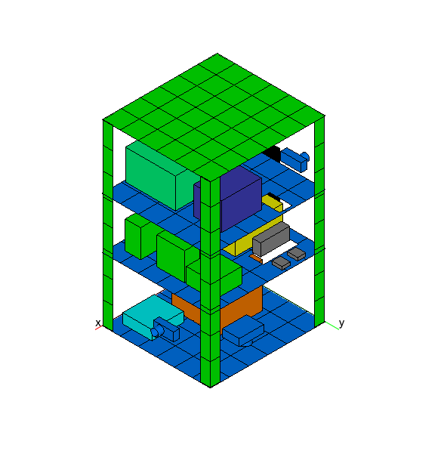
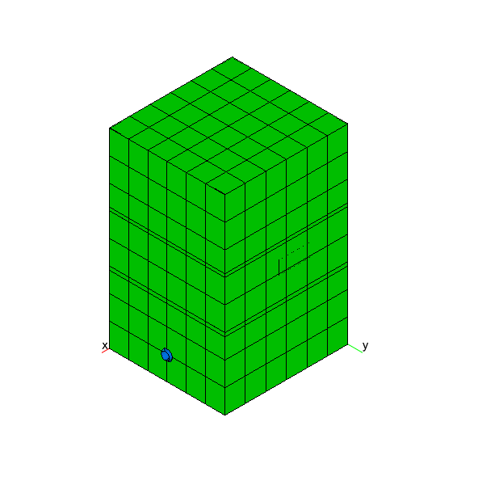
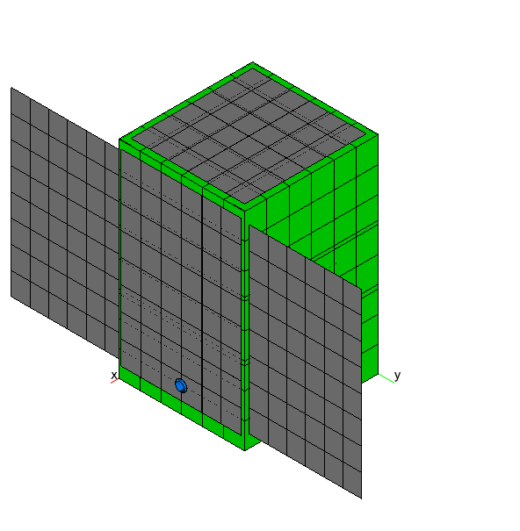
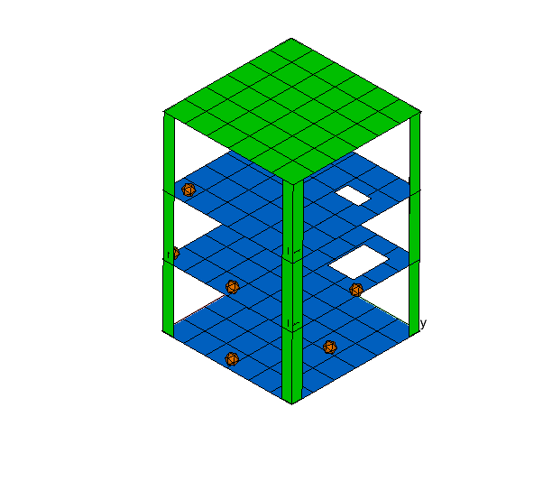
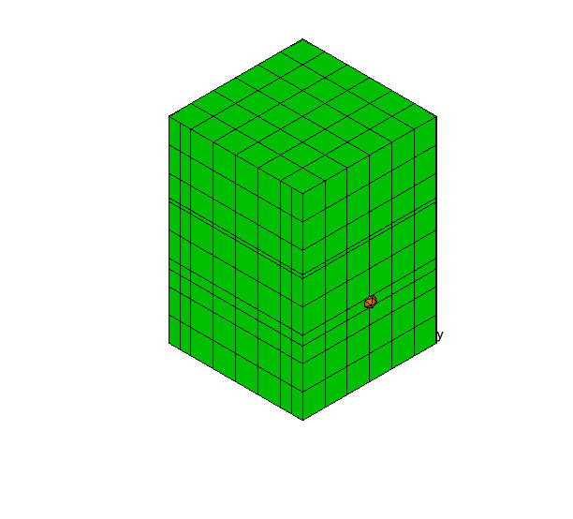
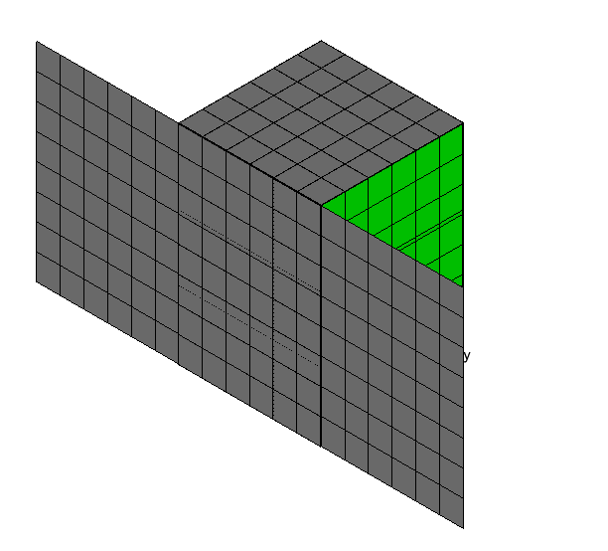
Model evolution

Slide 18
Model evolution

Slide 19
Model evolution

