Slide 1
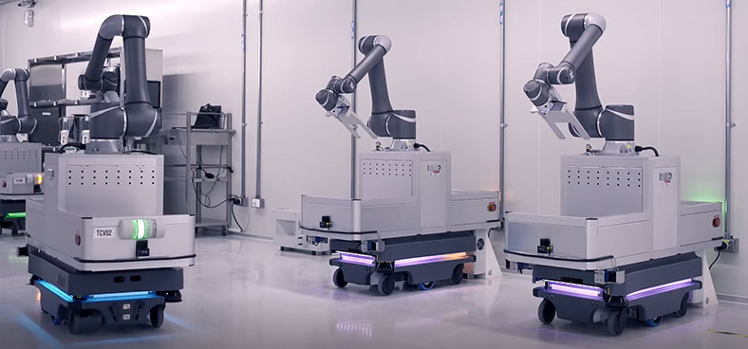
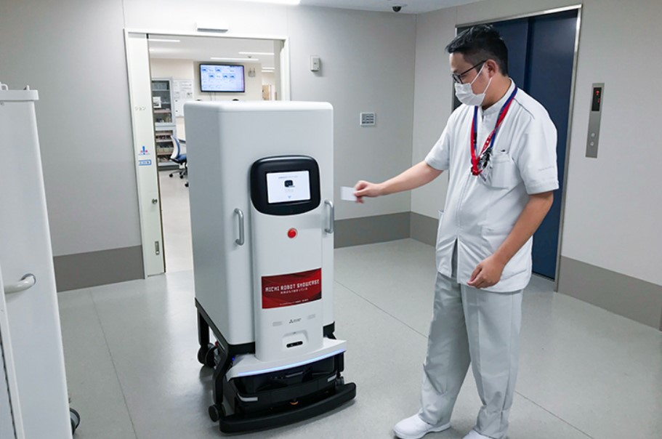
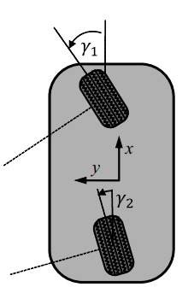
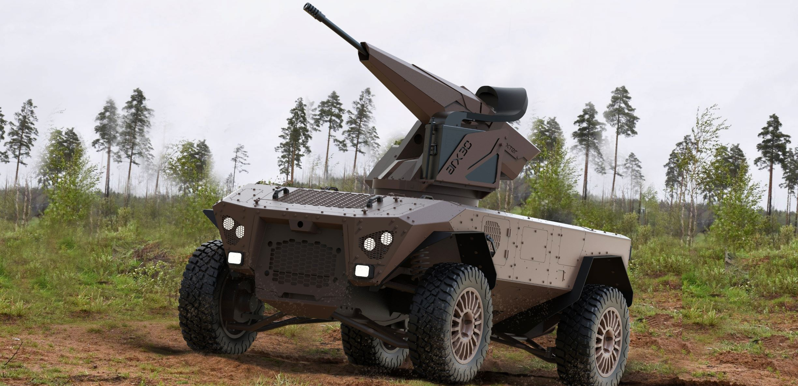
[2]
“special awareness” ability
[3]
Autonomous Mobile Robot (AMR)
General Bicycle Model (GBM)
[1]
[1]：Kelly, Alonzo. Mobile robotics: mathematics, models, and methods. Cambridge University Press, 2013.
[2]：” AMR智慧整合 移動商機起飛” , 模具與成形智慧工廠雜誌, 2022
[3]：台日科技資訊網

