Slide 1
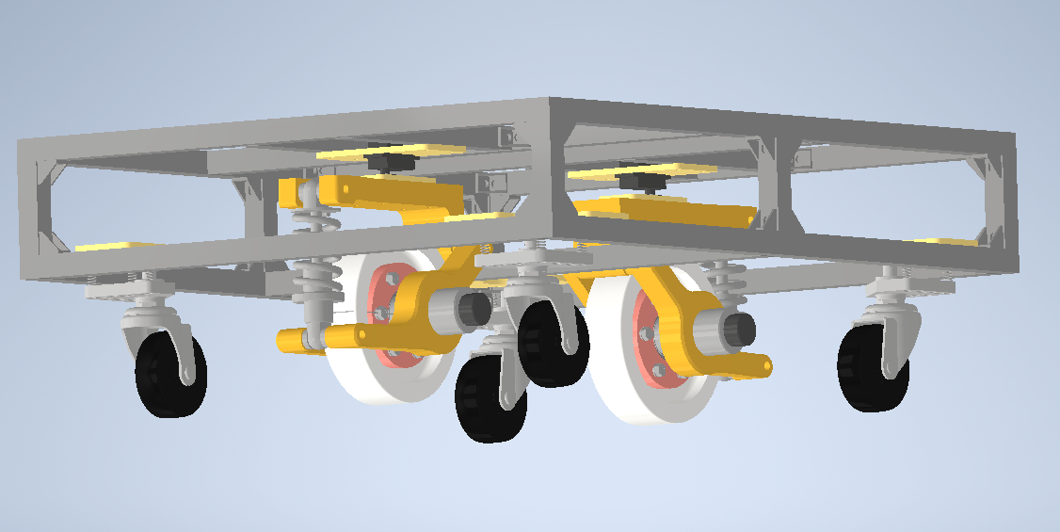
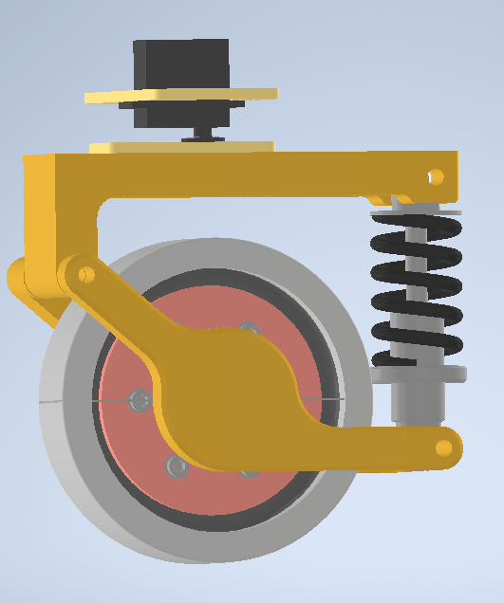
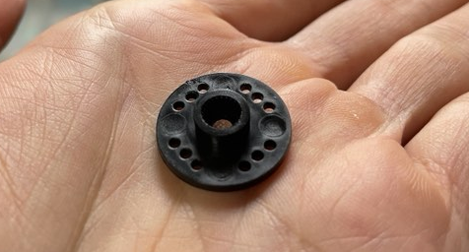
8.5mm

Slide 2




$$\hat{B}$$
}
$$v_{AB}$$
$$A$$
$$δt$$

Slide 3
$$\hat{B}$$
$$v_{AB}$$
$$A$$

