Slide 1





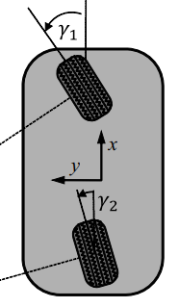



Obstacle-avoidance Algorithm
General Bicycle Model (GBM)
Observe obstacles in dynamic environment
Give decision
Prediction &
Risk evaluation
Adjust future path

