Slide 1
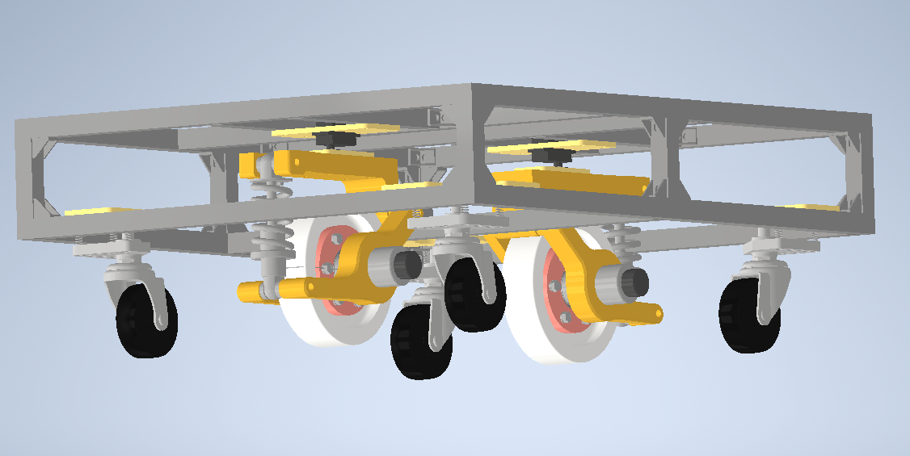
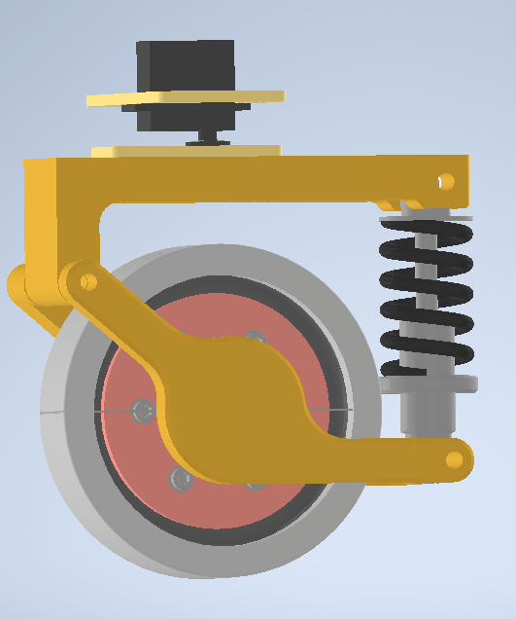
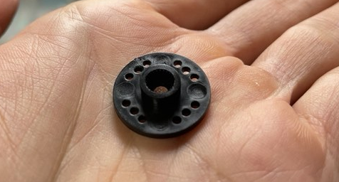
8.5mm

Slide 2




$$\hat{B}$$
}
$$v_{AB}$$
$$A$$
$$δt$$

Slide 3
$$\hat{B}$$
$$v_{AB}$$
$$A$$

Slide 4


$$r_{A}+r_{B}$$
B
$$v_{AB}$$
X
O
O
A

