Slide 1

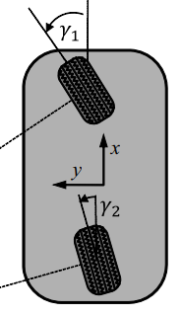


Obstacle-avoidance Algorithm
General Bicycle Model (GBM)
Evaluate Risks in dynamic Environmests
Give decision
Dynamic Environment

